Slide 1


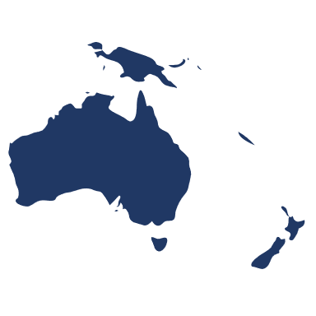









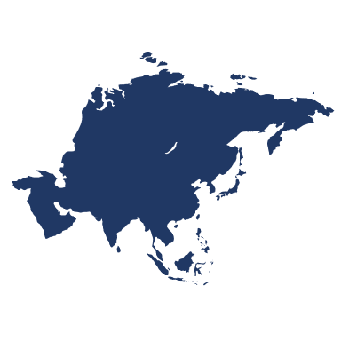



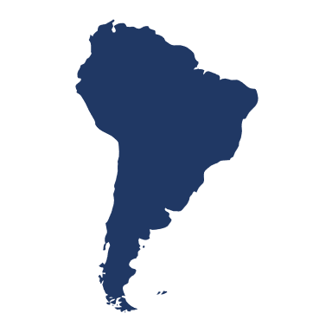
Countries
Resorts

Slide 2
Ski Resorts
Resort Options
North America
Fun For All
Asia
One Day Skill Pass
Best Time To Go
Oceania
Beginner
Europe
Favorite Resorts
South America
Slopes Length (km)

