Slide 1
6.1 Working with Text
Owen Lockwood

Slide 2
Text → words
Segment by word
Segment by character
N-gram

Slide 3
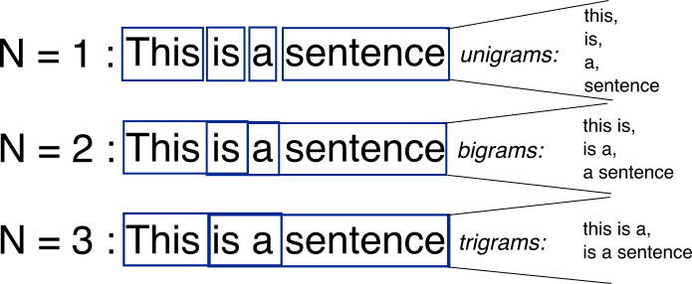
N-gram
Group N or fewer word together in set
Shallow, loses order/meaning

Slide 4
One hot encoding
Similar to vectorization in conversion
One hot hashing for large vectors

Slide 5
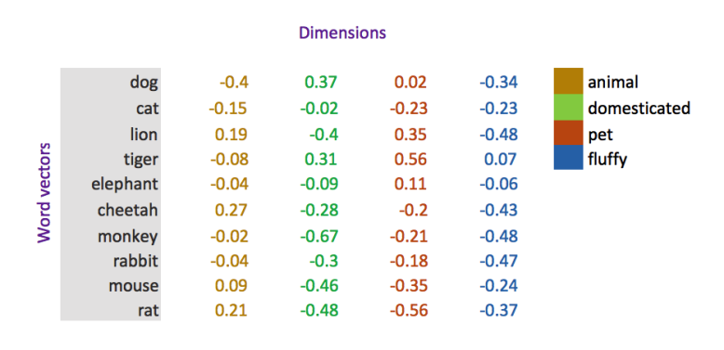
Word Embeddings
More useful to convey meaning
Dense, low dimensional and must be learned
Keras embedding layer
Flatten
Dense

Slide 6
Pretrained
Much like convents
Basic meaning, some is universal

