Slide 1
Chapter 2.3
Owen Lockwood

Slide 2
Layers
keras.layers.Dense(512, activation=‘relu’)
Each layer:
Output = relu(dot(W, input) + b)
W and Input are 2D tensors and b is a 1D vector

Slide 3
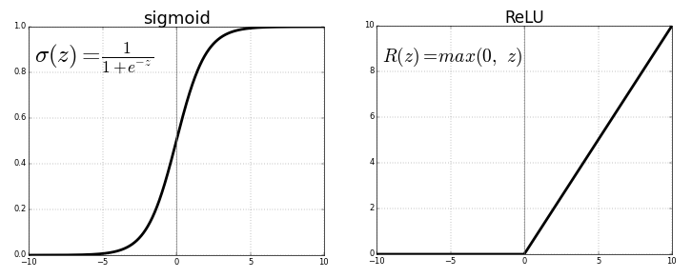

relu
relu = rectified linear unit
Activation function, replacing sigmoid
Element-wise operation (checks every element)
Simple function: $f\left(x\right)=\max\left(0,x\right)$
Sharma, S. (2017, September 6). ReLU v/s Logistic Sigmoid [Digital image]. Retrieved January 16, 2019, from https://towardsdatascience.com/activation-functions-neural-networks-1cbd9f8d91d6

Slide 4
Addition
Addition, multiplication etc. can also be element-wise operations
Adding 2, 2D tensors results in adding each element

Slide 5
Broadcasting
Operations on different size tensors
E.g. the b in the relu is 1D but the others are 2D
Can be thought of as reshaping the lower dimension to a higher (not computationally done)
In the 2D + 1D example, the vector is the same size as each row, and is added to each row

Slide 6
Tensor dot
Dot product between vectors → scalar sum of their multiplied elements
2D . 1D = 1D vector of the sum of each row multiplied by the vector
2D . 2D = 2D
As long as in x . y x.shape[1] == y.shape[0], it results in matrix x.shape[0], y.shape[1]
Each row of x is dotted as a vector with each column of y

Slide 7
Tensor reshaping
Usually same number of elements, but organized differently
Train_images is reshaped from a 3D tensor to 2D (60000, 28*28) which is the same number of elements but organized differently
Transposition of matrices is a special form of reshaping where the rows and columns are swapped

Slide 8
Geometric tensors
1D tensors can easily be represented geometrically
Crumpling and flattening paper as an analogy for different data represenations

