Slide 1
8.2 and 8.3
By: Owen Lockwood

Slide 2
8.2 Deep Dream
Used to visualize representations of CNN
Famous for making very unique images, with lots of eyes and feathers (as ImageNet was trained on birds and dogs)
Similar to visualization techniques previously, gradient ascent to maximize certain features to see what its learning
Maximize entire layer rather than a specific filter, lots of features visualized at once
Start from an existing image, and the effects ‘latch’ onto certain things in the image

Slide 3
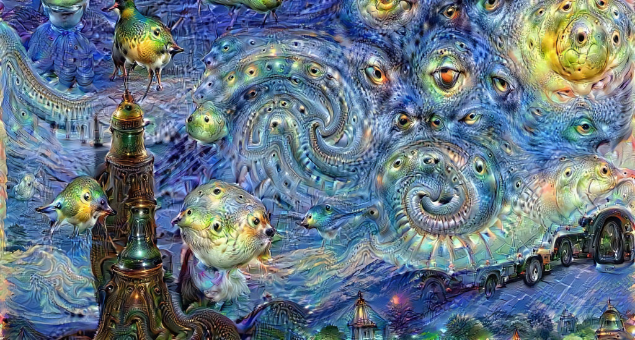
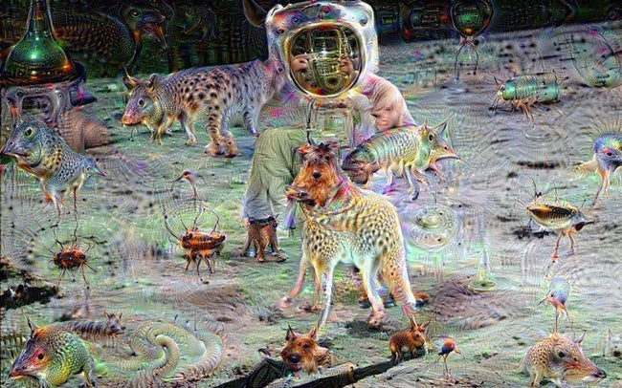
Implementation
Can theoretically be done on any CNN, but we use Inception V3 (built in)
Define list of octaves at which to process image, each time the size of image grows by 40%

Slide 4
8.3 Neural Style Transfer
Apply style of one image to content of another (texture, color, visual patterns)
Define a loss function specific to what you want to achieve, and you minimize this
Loss = distance(style(ref_image) – style(generated_image)) + distance(content(original_image) – content(generated_image))

Slide 5
Losses
Content: high level of CNN represent global content, L2 norm (sqrt(sum(v^2))) between activations between upper layer in target and generated
Style: Gram matrix of layers activations: representing a map of the correlations between the layer’s features of the feature maps of a given layer

Slide 6
Implementation
Use any CNN, we use VGG19
Similar implementation to the Deep Dream
Put in 3 images (2 given, 1 that can be changed)
Minimize the loss

Slide 7
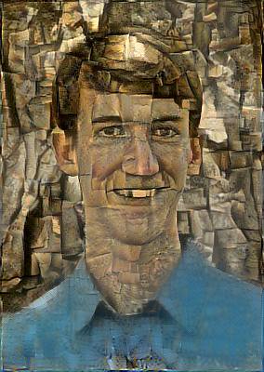
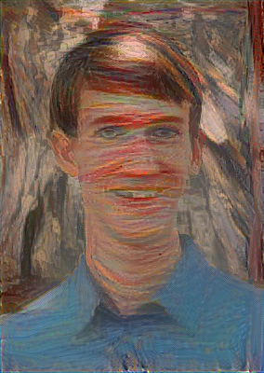
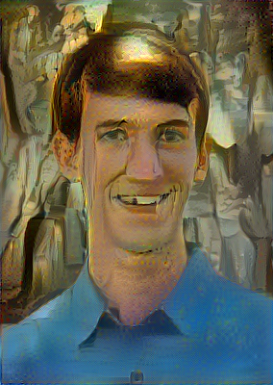
Examples
Cubist
Expressionist
Surrealist
Pollock

