Slide 1
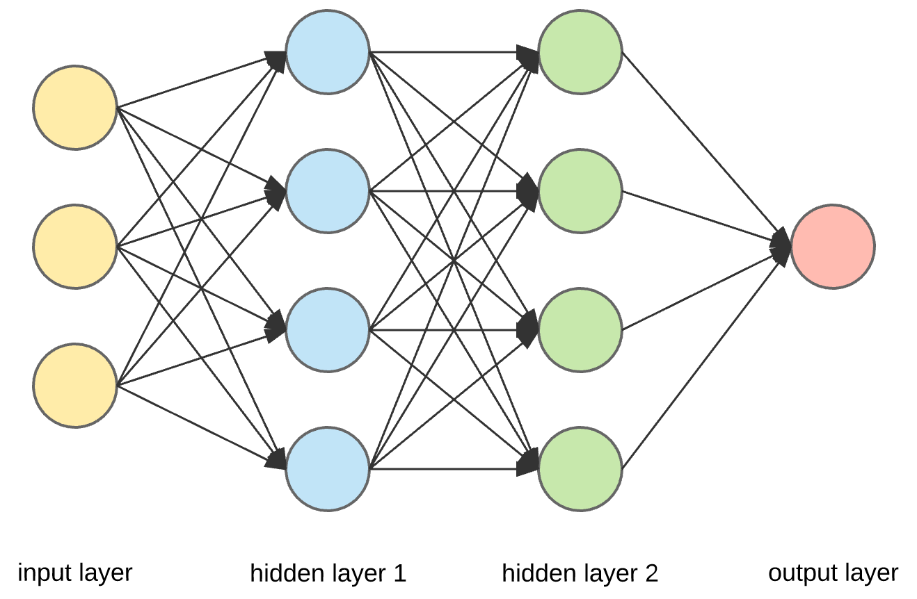
3.1 Anatomy of a Neural Network

Slide 2
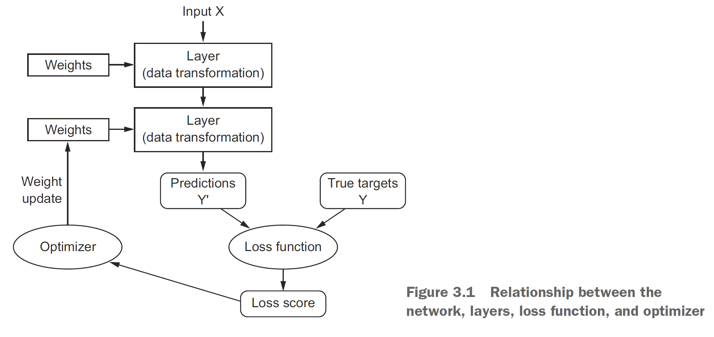

Slide 3
Layers
Layers have weights which contain the networks knowledge
Layers can be connected in different ways
Densely or fully-connected layers
Recurrent layers
Convolution layers
Layers can be different shapes
This will affect the shape of the weight matrix
Keras automatically shapes the weight matrix
vs.
Example Code:
from keras import models
from keras import layers
model = models.Sequential()
model.add(layers.Dense(32, input_shape=(784,)))
model.add(layers.Dense(32))
No shape argument needed because keras knows the previous layer is 32

Slide 4
Models: Networks of Layers
Many different network topologies
Two-branch networks
Multihead networks
Inception blocks
Network topology defines the hypothesis space

Slide 5
Loss Functions and Optimizers
Loss function- the quantity that is minimized for training
These are well optimized for standard problems
Classification
Regression
Sequence learning
It is important that this represent standard for success
Optimizer- determines how the network will be updated

