Slide 1
CNN 5.2.4 – 5.3 and Updates
Owen Lockwood

Slide 2
5.2.4 Data Preprocessing
Process image data:
Read in JPEG
Decode JPEG into RGB pixel grids
Convert into tensors
Rescale the tensors
Keras has ImageDataGenerator
Since data sets are large enough (especially images), they cannot be loaded directly into memory
Generators!

Slide 3
Generators
Enable you to iterate through the input
Keras ImageDataGenerator makes a generator from input images
Must use fit_generator to fit it and specify a number of steps per epoch
Include steps_per_epoch, the number of gradient descent steps to do before concluding the epoch (sample size / batch size)

Slide 4
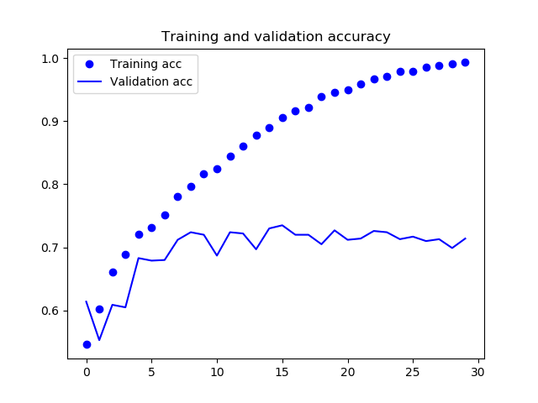
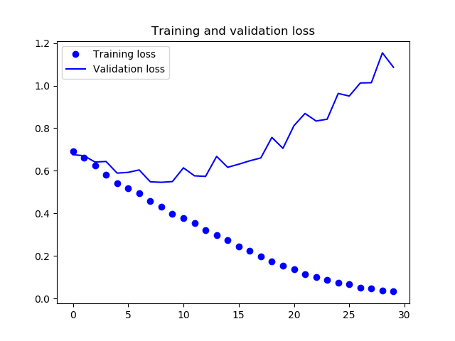

Slide 5
5.2.5 Data Augmentation
Overfitting is a problem on small data sets
Generate more training data from existing data
A number of techniques (can be put into ImageDataGenerator):
Rotation Range: rotates the picture by a certain degree
Width/height shift: fractions of total which the images is randomly translated
Shear/zoom
Horizontal flip
Fill: fill in new pixels (after width height shift) with nearest
CNN never sees the same input twice

Slide 6
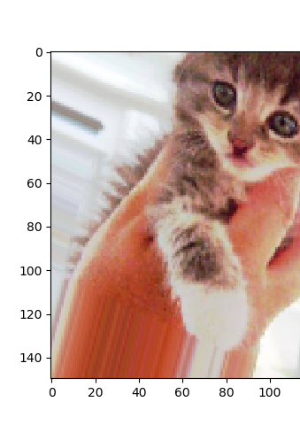
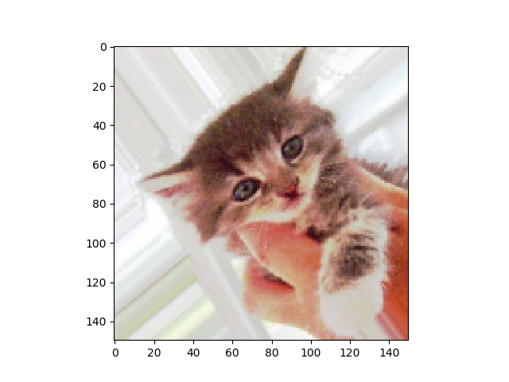
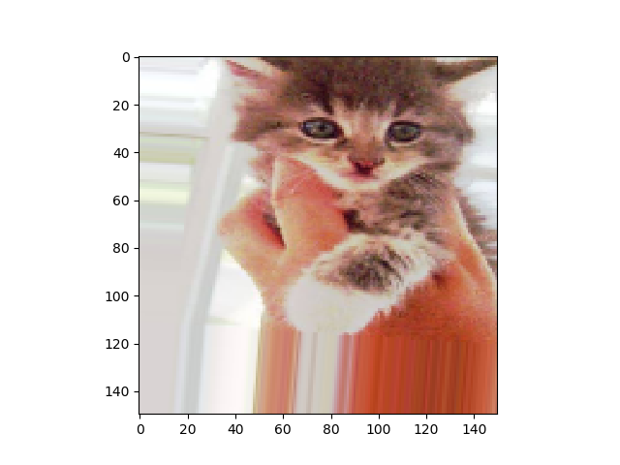
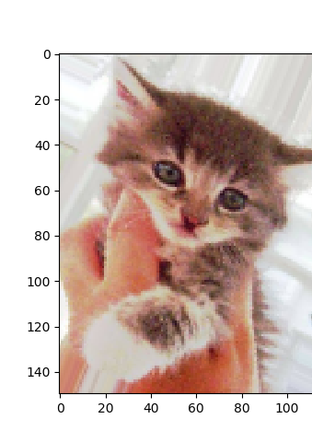
Data Augmentation

Slide 7
5.3 Using a Pretrained Convnet
A CNN that has already been trained
Import the model/weights and use it
Feature extraction
Fine-tuning

Slide 8
5.3.1 Feature Extraction
Image identification = CNN + Dense
Use the pretrained CNN (that has learned general patterns) and train the Dense
Fast feature extraction without data augmentation: CNN predict training data, then train the Dense layers (very quick)
Get output from convolutional base → separate dense layers
With data augmentation: freeze the convbase, attach the dense and use data augmentation (every picture must go through CNN, previously only went through once, hence significantly more computationally expensive)

Slide 9
5.3.2 Fine Tuning
Add custom network on top of pretrained
Freeze base
Train added layers
Unfreeze a couple of top CNN layers
Train both
This enables the CNN to be slightly more customized toward your specific needs
Train Dense first to avoid large unintended changes from random initial values

Slide 10
Fine tuning (cont.)
Since each layer contains more abstract information, you don’t want to retrain whole CNN
If you’re looking for different kinds of dogs, instead of dog vs cat
Photo -> animal -> animal ear -> dog ear -> output
All the previous steps are fine as recognition
Also don’t want to overfit, example base has > 15,000,000 parameters

