Slide 1
3.5: Multiclass Classification Example
Owen Lockwood

Slide 2
Problem
Reuters dataset used for single-label, multiclass classification
Given some words can you tell what topic it is
Using the 10,000 most common words from the data set (like IMDB)
Similar representation, each word = number (from dictionary)

Slide 3
Vectorization
2D list must become 2D tensor
Each row in new vector is 10,000 long to represent the 10,000 words
If that word is in the given list, the 2D tensor index is assigned a 1
This is how the input data is formated

Slide 4
Labels
Two ways to make labels:
Either as array of numbers
Or similar to the 2D tensor and assign them 46 length vectors (instead of 10,000) which again have 0 or 1
This is called one-hot encoding or categorical encoding

Slide 5
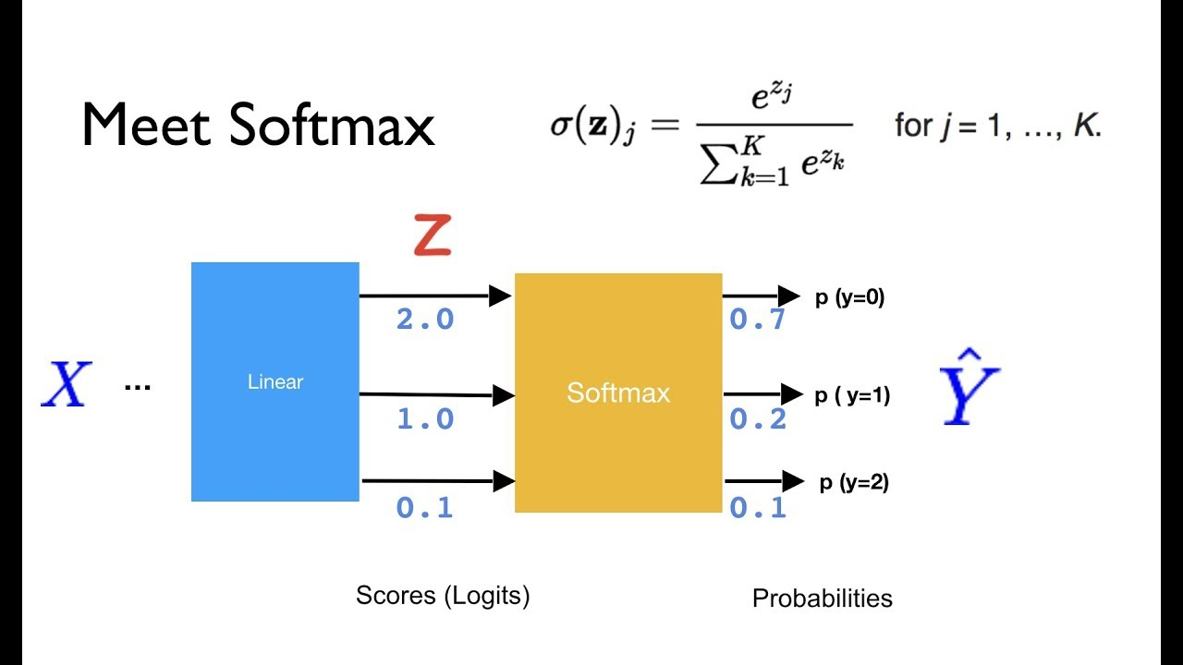
Layers
It is important to have big enough layers
The last layer must have the same number of nodes as the expected size of output (46)
Uses softmax to normalize to a probability summing to 1
This output is a
probability
distribution

Slide 6
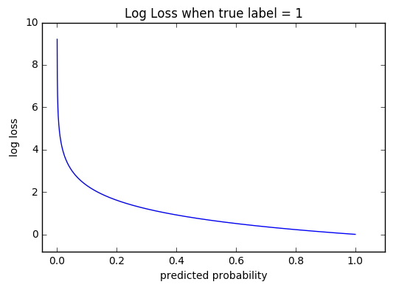

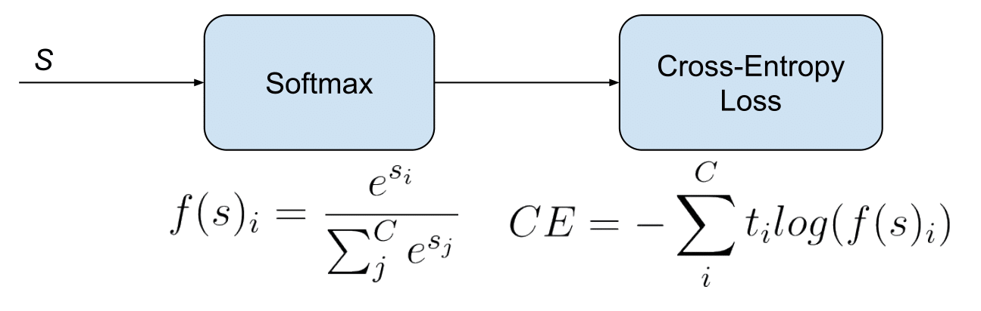
Loss function
https://gombru.github.io/2018/05/23/cross_entropy_loss/
If categorical encoded: categorical cross entropy
If array: sparse categorical crossentropy

