Slide 1
Cavity Formation Determination
By: Owen Lockwood

Slide 2
Logistical Preface
https://github.com/garde-group/ML-Waterbox/tree/master/source-code
All code available (uncommented)

Slide 3
Simulation Data
5ns simulation of SPC/E water producing 5000 frames
~4x4nm box

Slide 4
Problem
Given coordinates, can a deep learning neural network predict cavity formation?
Binary classification (either this is a cavity or there isn’t)
Straight forward problem, good for proof of concept

Slide 5
Processing data
3 main programs each have important aspects of preparing data for the neural network
Pre.py could easily be incorporated to FORTRAN
Cavity.f90
Pre.py
Coord.py

Slide 6
.xtc processing
FORTRAN program to read in xtc and write to .dat file
Each line has the grid coordinate, the 20 nearest point coordinates, and a 0 or 1 for cavity
Even just 10 frames produces > 2Gb file
Lots of data

Slide 7
Pre.py
However, many of the data points are zeroes
If you train on mostly zeroes (as I first did) it will be very accurate but not actually work as intended (if 99% 0s then 99% accuracy is easy)
This outputs the number of 0s and 1s
This data can then be plugged into the coord.py

Slide 8
Coord.py
In this data, there are 24,103 1s so to get equal representation we want 48206 total points (SIZE)
Reads in all of the 1s and 24103 0s into the data array and the labels (0 or 1) into a labels array of the same size
Shuffle the data (especially important with the way I read the data in)
Split into different data sets, simple hold out validation

Slide 9
Distances
Prior to coordinates I did work with distances (which is basically just an if statement) and it worker very well
So simple didn’t upload the code

Slide 10
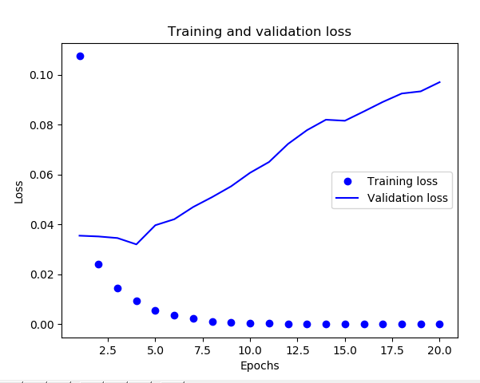
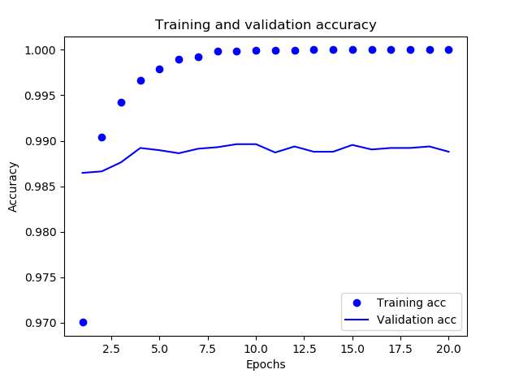
Results
3 layers
64/32/1 Nodes
Relu, relu, sigmoid
Epochs: 20
Test accuracy: 99.02%

Slide 11
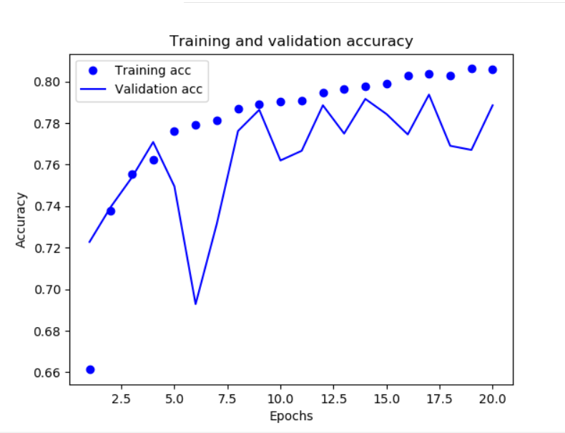
Vectorization
An important step in preprocessing data
Example: Same architecture and input as before but not vectorized
Test accuracy: 78.87%

Slide 12
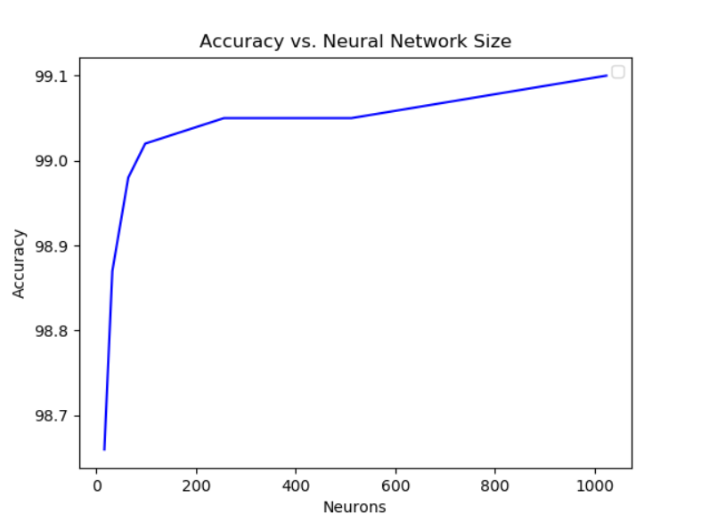
The Effect of Network Size on Accuracy

Slide 13
Future Directions
Comment Code
Change Various Specifications of input data (i.e. different number of points, etc.)
Too slow! Use the IBM Power 9, with NVIDIA Tesla V100 GPUs (much faster than GTX 1080)

