Slide 1
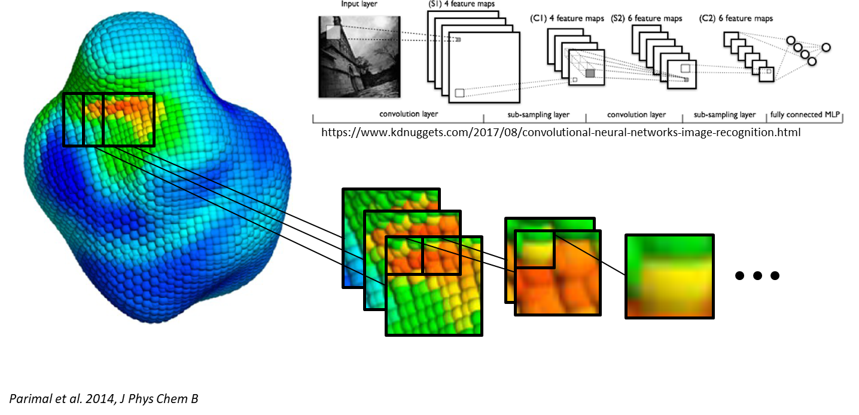
Data Type: Voxel Representation
One Surface Patch: 4D Tensor
Z Dim
Y Dim
X Dim
Atom Type 1 Occupancy*
Atom Type 2 Occupancy*
Atom Type 3 Occupancy*
*Each atom in PDB affects the nearest grid points based on a Gaussian density approximation

Slide 2
Autoencoder concept:
Create folder containing a large number of PDBs (need at least 100 to get a similar size dataset to MNIST)
Convert each PDB to an "occupancy map"- a 3D x n tensor containing the occupancy of a given atom type at a given 3D point (n is the number of atom types, can be thought of as the number of channels)
Divide each occupancy map into a set of surface patches of side length r- a r x r x r x n tensor (4 axes) centered on the center of geometry of each surface exposed residue
For each residue:
If residue is surface exposed above threshold alpha:
Calculate surface patch and add to list of surface patches
Else
Do nothing
Train autoencoder based on m samples of r x r x r x n tensor "surface patches"

Slide 3
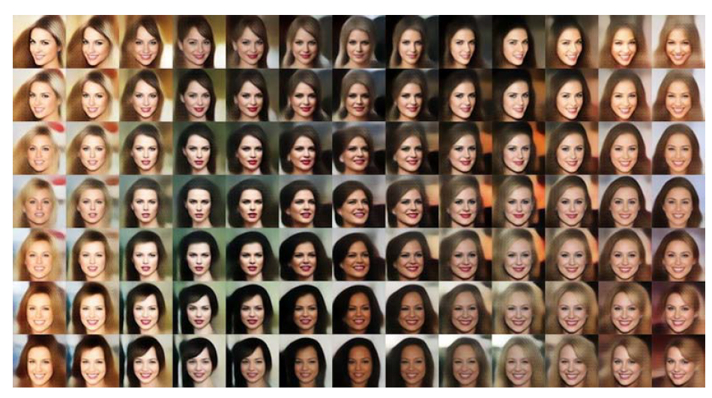
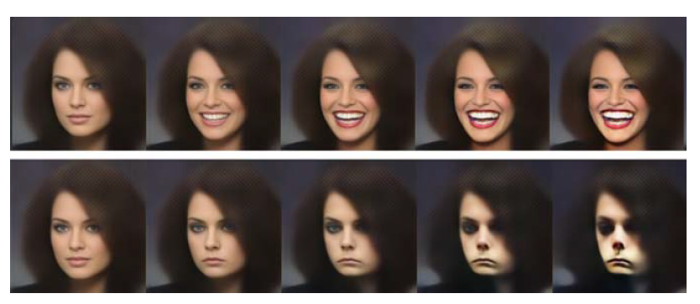
Clustering in Latent Space:
Do protein patches fall naturally into clusters? How many?
Do closely related proteins have consistently similar protein surface patches? (Sanity check)
Can we use similar patches on different proteins to predict protein surface properties for some small number of patches?
We can gather high resolution (simulation) data on a few key proteins whose surface patches span most of protein surface property space
We can then “cut” these proteins into patches and “paste” those patches onto any new molecule of interest
We can extend any high resolution data (for example, a hydration map or a ligand interaction map), based on this cut and paste approach, to new, related proteins
We can identify concept vectors in latent space which are linked to protein surface interaction behaviors
A neural network can learn protein surface properties in the way that it learns a human face:

