Slide 1
DISTRIBUTED ENTITY RESOLUTION ON MULTI-TYPED GRAPHS
A GRAPH BASED APPROACH
Muhammad Sadiq
Dept. of Computer Engineering
Kyung Hee University Global Campus
South Korea
sadiq@oslab.khu.ac.kr
Jan 16 2018

Slide 2
CONTENTS
Introduction
Motivation
Problem Statement
Existing approaches
Proposed Solution
Algorithms

Slide 3
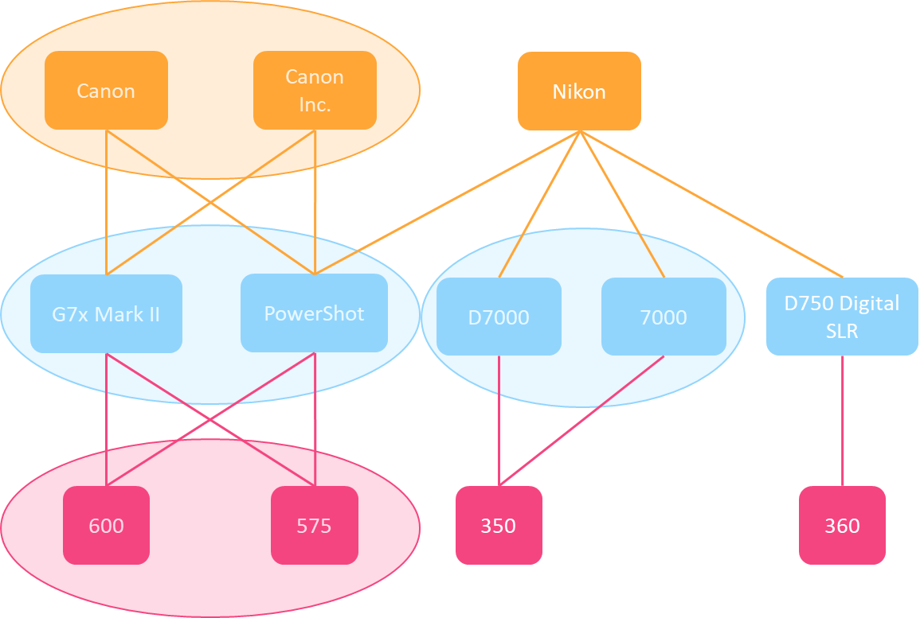
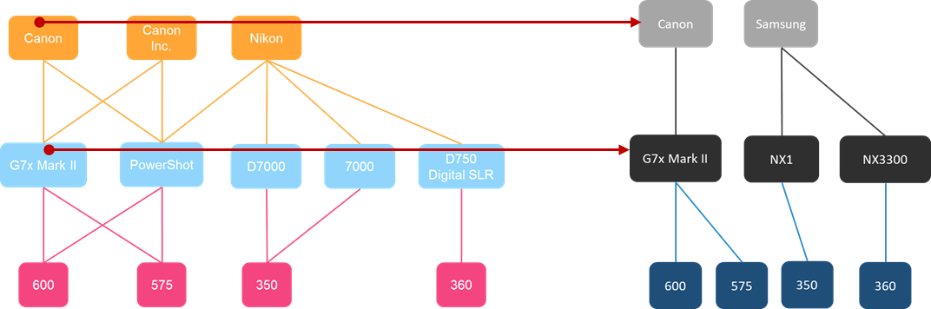
INTRODUCTION
Entity Resolution
Entity resolution is the task of identifying all mentions that represent the same real-world entity within knowledge base, across multiple knowledge bases
A very well known problem
Examples of entity resolution (disambiguation)
Different ways of addressing
Names, emails, Facebook accounts etc.
Multiple mentions of
Same product with different descriptions
in an ecommerce site
Same author with different names in publications
Entity resolution within knowledge base
Entity resolution across multiple knowledge bases

Slide 4
INTRODUCTION
Products on ebay
Canon
Canon Inc.
Nikon
Sony
Manufacturers
Products
Prices
Multi-type graph
G7x Mark II
PowerShot
D7000
7000
D750 Digital SLR
Alpha a6000
600
575
350
360
599

Slide 5
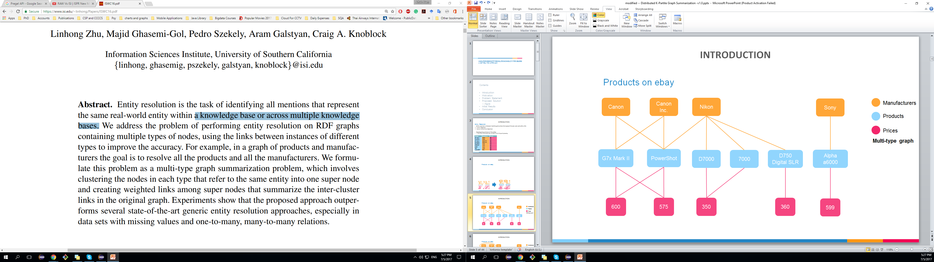
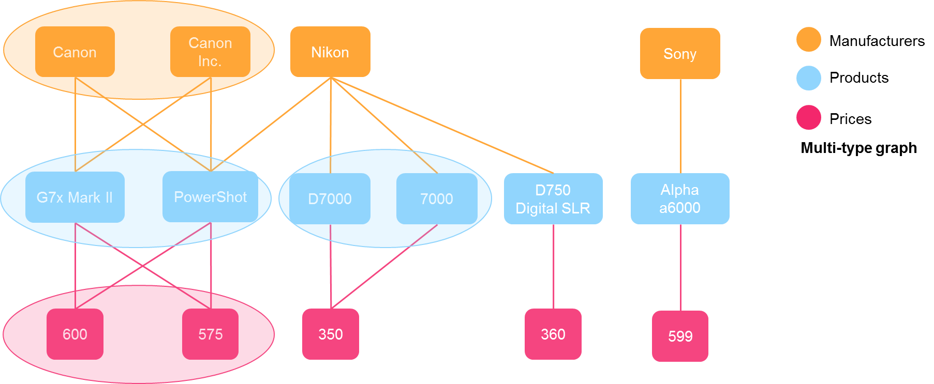
INTRODUCTION
2
Products on ebay
1
Product | Manufacturer | Price $
G7x Mark II | Canon | 600
PowerShot | Canon | 575
G7x Mark II | Canon Inc. | 600
PowerShot | Canon Inc. | 575
PowerShot | Nikon | 575
D750 SLR | Nikon | 360
D7000 | Nikon | 360
7000 | Nikon | 350
Alpha a6000 | Sony | 599
3

Slide 6
Motivation
Entity resolution needs to be addressed with scalability and resource utilization in perspective
Entity resolution has become computationally intensive task
Because of the growing size of knowledge bases, computational complexity of matching.
In research explicit performance efficiency of entity resolutions has been addressed
Getoor, Lise, and Ashwin Machanavajjhala. "Entity resolution for big data." Proceedings of the 19th ACM SIGKDD international conference on Knowledge discovery and data mining. ACM, 2013.

Slide 7
Problem Statement
Entity resolution is a computationally intensive task.
A lot of efforts have been made so far to improve accuracy of the matching techniques, but performance is still an issue.
There is a need to boost performance while preserving the accuracy of the matching techniques.
Therefore entity resolution requires scalability and efficient utilization of available resources.

Slide 8
RELATED WORK
Approaches to entity resolution
Pairwise comparison
Linguistic based approaches
Textual similarity
Vector document
Graph summarization
Content similarity
Structural similarity

Slide 9
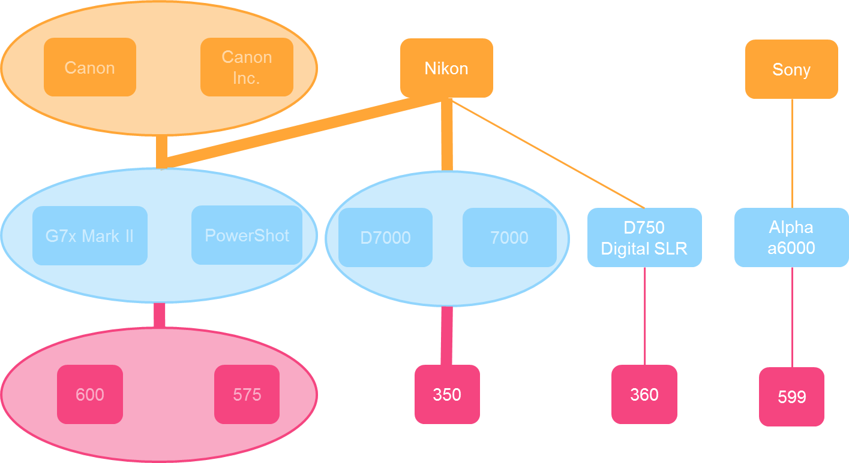
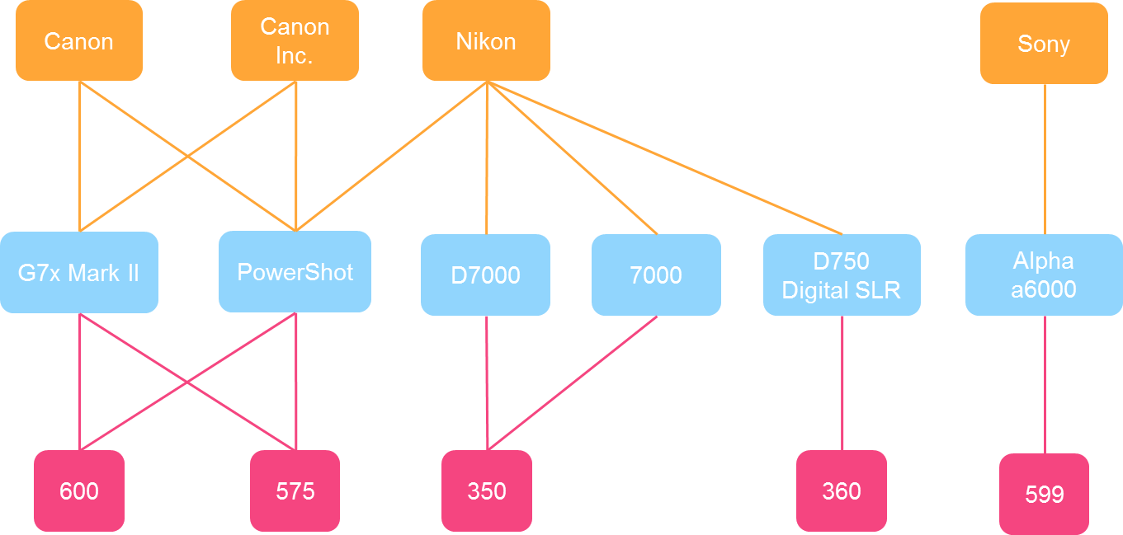
Graph summarization
Find a concise but meaningful representation of a given graph
Supernode
Set of similar nodes in the original graph
Super Edges
Link to/from supernode
Supernode
Superedge
Original Graph
Summarized Graph

Slide 10
Existing graph summarization approach
Methodology
Unsupervised entity resolution on multi-type graphs
Formulated entity resolution problem as a multi-type graph summarization problem
Cluster the nodes in each type that refer to the same entity into one supernode
Create weighted links among supernodes
Content base similarity
Structural similarity
Benefits of the recent approach
Graph summarization for entity resolution provides
Easy support for many-to-many relations and missing values
Multi-directional flow of information in the graph
Outperforms existing approaches in both
Quality
Efficiency
Zhu, Linhong, et al. "Unsupervised Entity Resolution on Multi-type Graphs." International Semantic Web Conference. Springer International Publishing, 2016.

Slide 11
LIMITATION
Non-Scalable for dense graphs
I/O time is dominant for small data
Requires more I/O time on dense graphs
Performance degradation on large-scale graphs
Running time rise rapidly with increasing graph size

Slide 12
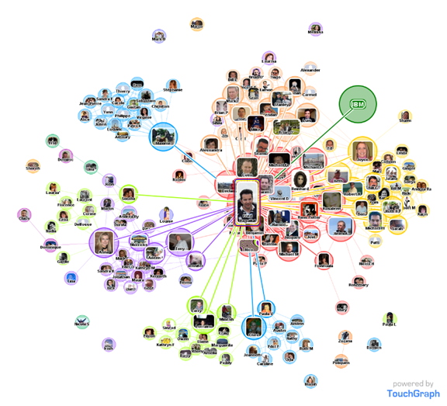

SOLUTION
Distributed approach
Partition graph into smaller chunks
Process all chunks parallel in distributed environment
Aggregate to generate final summarized graph
Data dependency problem!!!
P1
P2
P3
P3

Slide 13
DISTRIBUTED GRAPH PROCESSING
Utilize message passing technique to enable communication between nodes
Vertex centric approach
Vertex centric approach
Message passing to out edges
Apache Giraph
Open source implementation of Pregel (Google)
Supports
Iterative algorithms
Vertex-to-vertex communication in distributed environment
Vertex centric model
Each vertex as an independent computing unit
Each vertex send messages on its out edges

Slide 14
PROBLEM
Distributed multi-type (K-Partite) graph summarization
Demo K-partite graph
Will use it throughout the presentation
Here k = 3
manufacturer
products
prices
0
1
2
3
4
Giraph
2012
Pregel
2010
BSP
1990
5
6
7
8
9
10
We write our algorithms on top of Giraph.
Giraph is an open source implementation of Pregel (Google).
Pregel is a C++ implementation of the BSP Model
11
12
13
14
15
16

Slide 15
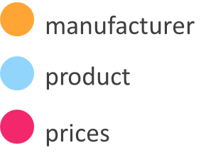
DISTRIBUTED K-PARTITE GRAPH SUMMARIZATION
Visible Challenges
No direct edge between same type of vertices
0
1
2
3
4
5
6
7
8
9
10
11
12
13
14
15
16

Slide 16

EMPOWER DISTRIBUTED K-PARTITE GRAPH SUMMARIZATION
Visible Challenges
No direct edge between same type of vertices
Expensive communication between same type vertices
M
0
1
2
3
4
5
6
7
8
9
10
11
12
13
14
15
16

Slide 17
EMPOWER DISTRIBUTED K-PARTITE GRAPH SUMMARIZATION
Visible Challenges
No direct edge between same type of vertices
Expensive communication between same type vertices
Computation of structural similarity (too expensive)
0
1
2
3
4
5
6
7
8
9
10
11
12
13
14
15
16

Slide 18
EMPOWER DISTRIBUTED K-PARTITE GRAPH SUMMARIZATION
Visible Challenges
No direct edge between same type of vertices
Expensive communication between same type vertices
Computation of structural similarity (too expensive)
Path selection for communication
0
1
2
3
4
5
6
7
8
9
10
11
12
13
14
15
16

Slide 19

EMPOWER DISTRIBUTED K-PARTITE GRAPH SUMMARIZATION
Visible Challenges
No direct edge between same type of vertices
Expensive communication between same type vertices
Computation of structural similarity (too expensive)
Path selection for communication
Only same type of vertices should merge
0
1
2
3
4
5
6
7
8
9
10
11
12
13
14
15
16

Slide 20

EMPOWER DISTRIBUTED K-PARTITE GRAPH SUMMARIZATION
Visible Challenges
No direct edge between same type of vertices
Expensive communication between same type vertices
Computation of structural similarity (too expensive)
Path selection for communication
Only same type of vertices should merge
0
1
2
3
4
5
6
7
8
9
10
11
12
13
14
15
16

Slide 21
EMPOWER DISTRIBUTED K-PARTITE GRAPH SUMMARIZATION
Visible Challenges
No direct edge between same type of vertices
Expensive communication between same type vertices
Computation of structural similarity (too expensive)
Path selection for communication
Only same type of vertices should merge
Merge conflict
0
1
2
3
4
5
6
7
8
9
10
11
12
13
14
15
16

Slide 22
METHODOLOGY CONSISTS OF FOUR ALGORITHMS
MESSAGE SHUFLING #1
Enables efficient communication between same type of vertices
Helps CCN phase in computing structural similarity
COMPUTE COMMON NEIGHBORS (CCN) #2
Computes structure similarity
Makes merging decision (request)
CONFLICT RESOLUTION #3
Grant, and or deny merge requests
Update edges after merge
MERGE RESOLUTION #4
Validate graph state
Resolve merge conflicts

Slide 23
K-Partite Graph Summarization
Message Shuffling Phase [ Super step 0 ]
0
1
2
3
4
Each vertex want to match with its type
But same type of vertices do not know each other they are
hidden from each other!
How to match?
How to enable matching (communication) between hidden type vertices?
Each vertex knows about their neighbour
5
6
7
8
9
10
11
12
13
14
15
16

Slide 24
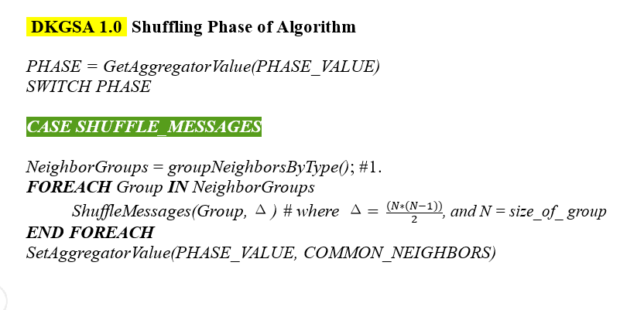
K-Partite Graph Summarization
Message Shuffling Phase [ Algorithm ]
0
1
2
3
4
5
6
7
8
9
10
11
12
13
14
15
16

Slide 25
K-Partite Graph Summarization
Message Shuffling Phase [ Super step 0 ]
0
1
2
3
4
5
6
5
7
6
7
5
6
7
8
9
10
11
12
13
14
15
16

Slide 26
K-Partite Graph Summarization
Message Shuffling Phase [ Super step 0 ]
0
1
2
3
4
5
6
5
7
5
7
6
7
5
6
7
8
9
10
11
12
13
14
15
16

Slide 27
K-Partite Graph Summarization
Message Shuffling Phase [ Super step 0 ]
0
1
2
3
4
5
6
5
7
7
8
5
7
7
9
6
7
8
9
5
6
7
8
9
10
11
12
13
14
15
16

Slide 28
K-Partite Graph Summarization
Message Shuffling Phase [ Super step 0 ]
0
1
2
3
4
5
6
5
7
7
8
8
9
5
7
7
9
8
10
6
7
8
9
9
10
5
6
7
8
9
10
11
12
13
14
15
16

Slide 29
K-Partite Graph Summarization
Message Shuffling Phase [ Super step 0 ]
0
1
2
3
4
5
6
5
7
7
8
8
9
5
7
7
9
8
10
6
7
8
9
9
10
5
6
7
8
9
10
11
12
13
14
15
16

Slide 30
K-Partite Graph Summarization
Message Shuffling Phase [ Super step 0 ]
0
1
2
3
4
5
6
5
7
7
8
8
9
0
1
5
7
7
9
8
10
11
12
6
7
8
9
9
10
5
6
7
8
9
10
11
12
13
14
15
16

Slide 31
K-Partite Graph Summarization
Message Shuffling Phase [ Super step 0 ]
0
1
2
3
4
5
6
5
7
7
8
8
9
0
1
5
7
7
9
8
10
11
12
6
7
8
9
9
10
5
6
7
8
9
10
11
12
11
12
13
14
15
16

Slide 32
K-Partite Graph Summarization
Message Shuffling Phase [ Super step 0 ]
0
1
2
3
4
5
6
5
7
7
8
8
9
0
1
5
7
7
9
8
10
11
12
6
7
8
9
9
10
5
6
7
8
9
10
11
12
0
1
0
2
1
2
11
12
13
14
15
16

Slide 33
K-Partite Graph Summarization
Message Shuffling Phase [ Super step 0 ]
0
1
2
3
4
5
6
5
7
7
8
8
9
0
1
5
7
7
9
8
10
11
12
6
7
8
9
9
10
5
6
7
8
9
10
11
12
0
1
2
3
0
2
13
14
1
2
11
12
13
14
15
16

Slide 34
K-Partite Graph Summarization
Message Shuffling Phase [ Super step 0 ]
0
1
2
3
4
5
6
5
7
7
8
8
9
0
1
5
7
7
9
8
10
11
12
6
7
8
9
9
10
5
6
7
8
9
10
11
12
0
1
2
3
3
2
0
2
13
14
14
15
1
2
11
12
13
14
15
16

Slide 35
K-Partite Graph Summarization
Message Shuffling Phase [ Super step 0 ]
0
1
2
3
4
5
6
5
7
7
8
8
9
0
1
5
7
7
9
8
10
11
12
6
7
8
9
9
10
5
6
7
8
9
10
11
12
0
1
2
3
3
3
4
2
0
2
13
14
14
15
14
15
1
2
14
16
11
12
13
14
15
16
15
16

Slide 36
K-Partite Graph Summarization
Message Shuffling Phase [ Super step 0 ]
0
1
2
3
4
5
6
5
7
7
8
8
9
0
1
5
7
7
9
8
10
11
12
6
7
8
9
9
10
5
6
7
8
9
10
11
12
0
1
2
3
3
3
4
2
0
2
13
14
14
15
14
15
1
2
14
16
11
12
13
14
15
16
15
16
5
6

Slide 37
K-Partite Graph Summarization
Message Shuffling Phase [ Super step 0 ]
0
1
2
3
4
5
6
5
7
7
8
8
9
0
1
5
7
7
9
8
10
11
12
6
7
8
9
9
10
5
6
7
8
9
10
11
12
0
1
2
3
3
3
4
2
0
2
13
14
14
15
14
15
1
2
14
16
11
12
13
14
15
16
15
16
5
6
5
6
5
7
6
7

Slide 38
K-Partite Graph Summarization
Message Shuffling Phase [ Super step 0 ]
0
1
2
3
4
5
6
5
7
7
8
8
9
0
1
5
7
7
9
8
10
11
12
6
7
8
9
9
10
5
6
7
8
9
10
11
12
0
1
2
3
3
3
4
2
0
2
13
14
14
15
14
15
1
2
14
16
11
12
13
14
15
16
15
16
5
6
5
6
5
7
6
7

Slide 39
K-Partite Graph Summarization
Message Shuffling Phase [ Super step 0 ]
0
1
2
3
4
5
6
5
7
7
8
8
9
0
1
5
7
7
9
8
10
11
12
6
7
8
9
9
10
5
6
7
8
9
10
11
12
0
1
2
3
3
3
4
2
0
2
13
14
14
15
14
15
1
2
14
16
11
12
13
14
15
16
15
16
5
6
5
6
10
9
5
7
6
7

Slide 40
K-Partite Graph Summarization
Message Shuffling Phase [ Super step 0 ]
0
1
2
3
4
5
6
5
7
7
8
8
9
0
1
5
7
7
9
8
10
11
12
6
7
8
9
9
10
5
6
7
8
9
10
11
12
0
1
2
3
3
3
4
2
0
2
13
14
14
15
14
15
1
2
14
16
11
12
13
14
15
16
15
16
5
6
5
6
10
10
9
9
5
7
6
7

Slide 41
K-Partite Graph Summarization
Message Shuffling Phase [ Super step 0 ]
0
1
2
3
4
5
6
5
7
7
8
8
9
0
1
5
7
7
9
8
10
11
12
6
7
8
9
9
10
5
6
7
8
9
10
11
12
0
1
2
3
3
3
4
2
0
2
13
14
14
15
14
15
1
2
14
16
11
12
13
14
15
16
15
16
5
6
5
6
10
10
9
9
5
7
6
7

Slide 42
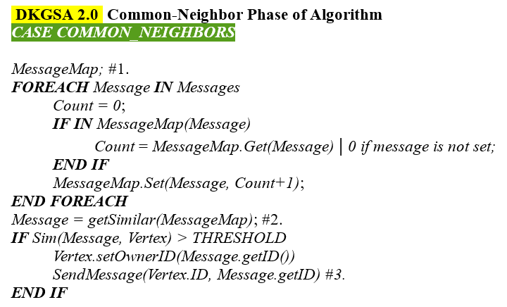
K-Partite Graph Summarization
Compute Common Neighbors [ Algorithm ]
0
1
2
3
4
5
6
7
8
9
10
11
12
13
14
15
16

Slide 43
K-Partite Graph Summarization
Compute Common Neighbors [ Super step 1 ]
0
1
2
3
4
5
6
7
8
9
10
11
12
13
14
15
16

Slide 44
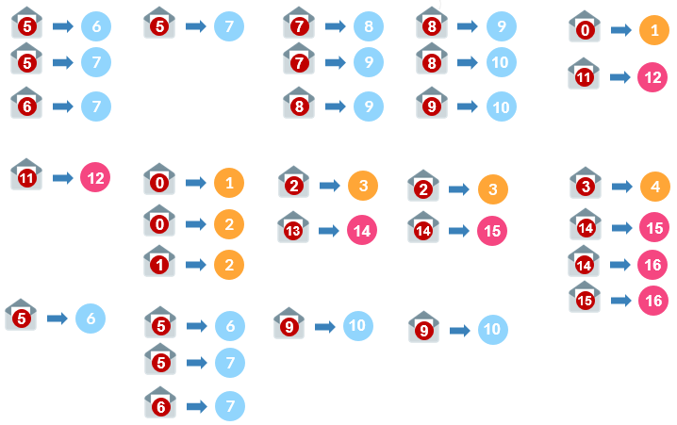
Note:
Threshold = 2
K-Partite Graph Summarization
R
= send merge request to
each merging vertex updates its owner ID
Default OwnerID = vertex.ID
Compute Common Neighbors [ Super step 1 ]
0
1
2
3
4
0
[] = {}
1
[0, 0] = {0:2}
R
0
2
[0,1] = {0:1, 1:1}
Previous Phase
3
[2,2] = {2:2}
R
2
5
6
7
8
9
10
[3] = {3:1}
4
5
[] = {}
11
[] = {}
6
[5,5,5] = {5:3}
R
5
12
[11,11] = {11:2}
R
11
7
[5,5,5,6,6] = {5:3, 6:2}
R
5
13
[] = {}
11
12
13
14
15
16
[13] = {13:1}
8
[7] = {7:1}
14
9
[7,8,8] = {7:1, 8:2}
R
8
15
[14,14] = {14:2}
R
14
10
[8,9,9] = {8:1, 9:2}
9
16
[14,15] = {14:1, 15:1}
R

Slide 45
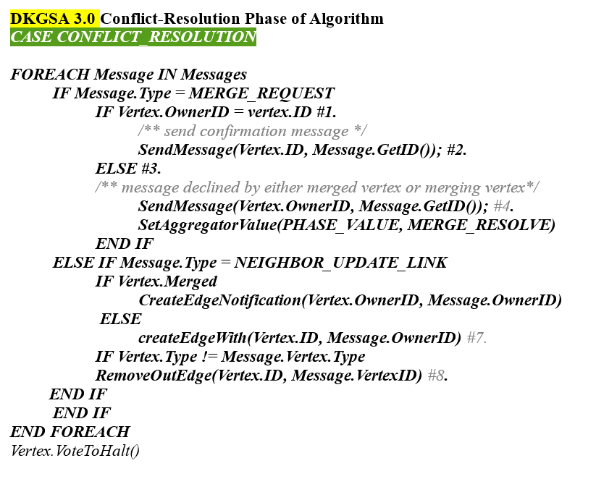
K-Partite Graph Summarization
Conflict Resolution Phase [ Algorithm ]
0
1
2
3
4
5
6
7
8
9
10
11
12
13
14
15
16

Slide 46
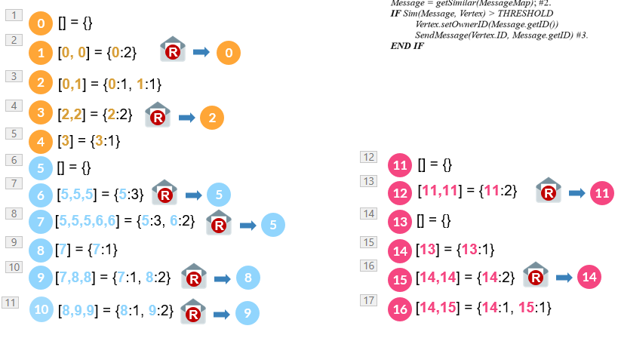
K-Partite Graph Summarization
Conflict Resolution Phase [ Super step 2 ]
0
1
2
3
4
0
C
1
1
2
C
3
Previous Phase
3
5
6
7
8
9
10
4
5
C
6
7
11
C
12
6
12
11
12
13
14
15
16
7
13
8
C
9
14
15
C
9
D
10
8
15
10
16

Slide 47
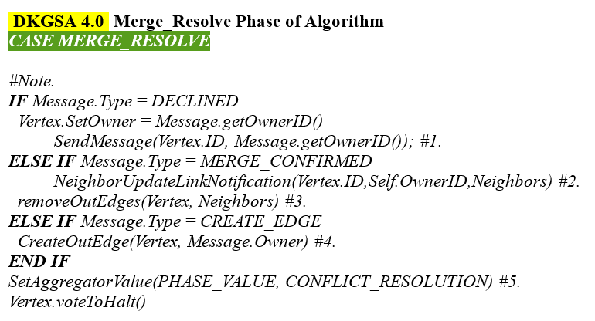
K-Partite Graph Summarization
Merge Resolution Phase [ Algorithm ]
0
1
2
3
4
5
6
7
8
9
10
11
12
13
14
15
16

Slide 48
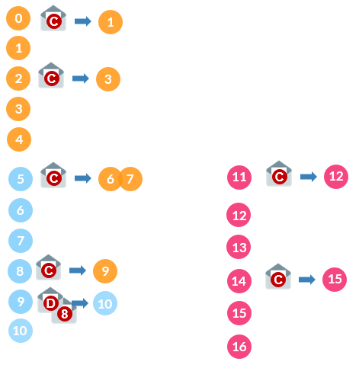
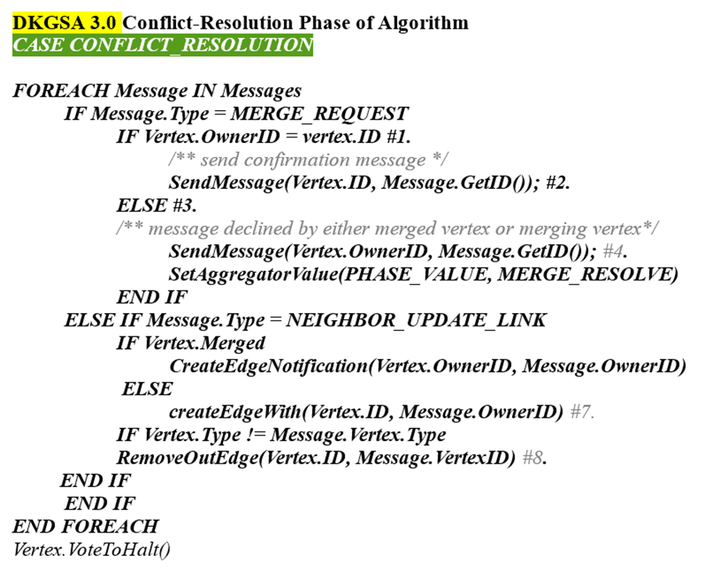
K-Partite Graph Summarization
Merge Resolution Phase [ Super step 3 ]
0
1
2
3
4
6
U
0
11
12
Update Edge From –to-
5
6
7
U
0
1
2
12
Update Edge From –to-
5
7
Previous Phase
5
6
7
8
9
10
10
D
8
0
1
2
R
0
1
2
11
12
13
14
15
16
5
6
7
5
6
7
11
12
11
12

Slide 49
K-Partite Graph Summarization
diseases
K = 3.
genes
protein complexes
0
1
2
3
4
0,1
2,3
4
0
2
4
5
6
7
8
9
10
5,6,7
8,9,10
5
8
11
12
13
14
15
16
11,12
13
14,15
16
11
13
14
16
Final Summarized Graph

Slide 50
FUTURE WORK
On going Research
Attributed multi-type graph summarization
Reduce Communication overhead (message passing)
Future Direction
Graph Recreation (error minimization)
Entity resolution on multiple sources
Graph summarization on disconnected graph

Slide 51
References
[1]. Zhu, Linhong, et al. "Unsupervised Entity Resolution on Multi-type Graphs." International Semantic Web Conference. Springer International Publishing, 2016.
[2]. Malewicz, Grzegorz, et al. "Pregel: a system for large-scale graph processing." Proceedings of the 2010 ACM SIGMOD International Conference on Management of data. ACM, 2010.
[3]. Liu, Yike, et al. "A Graph Summarization: A Survey." arXiv preprint arXiv:1612.04883 (2016).
[4]. Getoor, Lise, and Ashwin Machanavajjhala. "Entity resolution for big data." Proceedings of the 19th ACM SIGKDD international conference on Knowledge discovery and data mining. ACM, 2013.
[5]. Valiant, Leslie G. "A bridging model for parallel computation." Communications of the ACM 33.8 (1990): 103-111.

Slide 52
THANK YOU!

