Slide 1

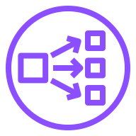









AWS Cloud
Network Load Balancer
AWS Certificate Manager (ACM)
Amazon Elastic Container Registry (Amazon ECR)
Virtual private cloud (VPC)
Availability Zone
Public subnet
Public subnet
Registry
NAT gateway
NAT gateway
Private subnet
Private subnet
EKS managed node group
Kubernetes nodes
Kubernetes nodes
Amazon Elastic Kubernetes Service (Amazon EKS)

