Slide 1
MEDI
Melodic Encoder of Data Inputs
Notes:
My project is a program I’ve written that I call MEDI, for Melodic Encoder of Data Inputs. MEDI is written in Python, and converts raw data from either standard in or a file into a musical melody outputted in MIDI format. This wasn’t the original intention for the project, but instead the result of research into the field of algorithmic composition.

Slide 2
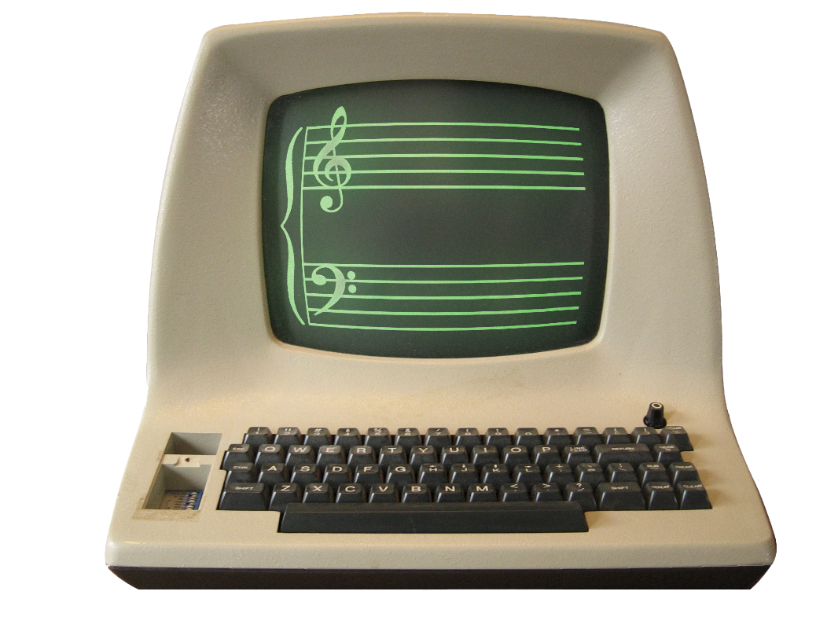
Algorithmic Composition
Notes:
Algorithmic composition is defined as “the process of using some formal process to make music with minimal human intervention”. Algorithmic composition has been around for a while – composers including Mozart and John Cage have been known to use games of chance to compose music, which could be considered an algorithm. Compositional algorithmic composition has been a topic of research for almost as long as computers themselves have been around, as evidenced by this quote from Ada Lovelace.

Slide 3
“Supposing, for instance, that the fundamental relations of pitched sound in the signs of harmony and of musical composition were susceptible of such expression and adaptations, the engine might compose elaborate and scientific pieces of music of any degree of complexity or extent.”
Ada Lovelace
Source: Alpern, A.: Techniques for algorithmic composition of music. Hampshire College (1995)

Slide 4
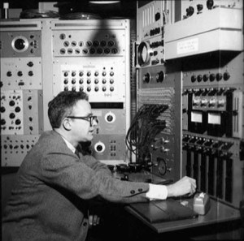
Illiac Suite
Notes:
The first computational algorithmic compositions to be developed was the Illiac Suite, composed by Hiller and Isaacson in 1957 at the University of Illinois on an ILLIAC I computer. Since then, a variety of different techniques have been developed.

Slide 5
Markov Chains
B
A
C
Notes:
Markov chains are one technique used for algorithmic composition. Markov chains have a finite number of states, which could in music be notes, rhythms, sections or melodic fragments, and map the probability of transitioning between each state (or staying in the same state) at a given point. They were used in the Illiac Suite.

Slide 6

L-Systems
Notes:
L-systems and fractals can also be used in algorithmic composition to generate complex patterns using a simple set of rules.

Slide 7
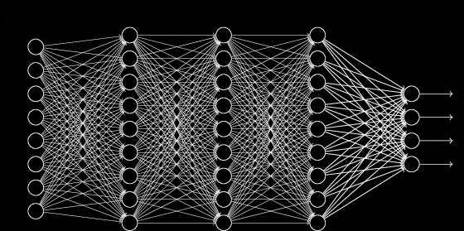
Neural Networks
Notes:
Neural networks have gotten a lot of popular attention lately with project’s like Google’s deep dream. Researchers have experimented with using neural networks, both pre-definined and self-organizing, to create music. That’s only three techniques to give you an idea of the field, but there’s a huge variety of techniques, including cellular automata, generative grammars, and machine learning.

Slide 8


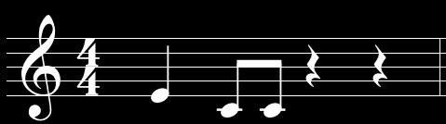
Notes:
One thing I noticed during my research was that a lot of techniques used in algorithmic composition were the same as those used in natural language processing, which inspired my original project specification. I planned to mine tweets and perform some basic natural language processing, and use the outputs of that to compose music. The idea was that this could run indefinitely, as a stream over the internet.

Slide 9
ChucK
athenaCL
isobar
Notes:
With that in mind, I began looking at different tools that would help. ChucK is a pretty neat language that allows for real-time audio programming, developed in collaboration between researchers at Stanford and Princeton. I also found athenaCL, a higher-level tool coded in Python for composition. I liked the idea of using Python, but Athena felt bloated with features, and I worried I wouldn’t be able to learn it in time. I finally settled on using Isobar, a light-weight Python library that makes composing MIDI melodies incredibly simple. However, in researching isobar I found somebody had already used it in a project that was exactly my project specifications.

Slide 10
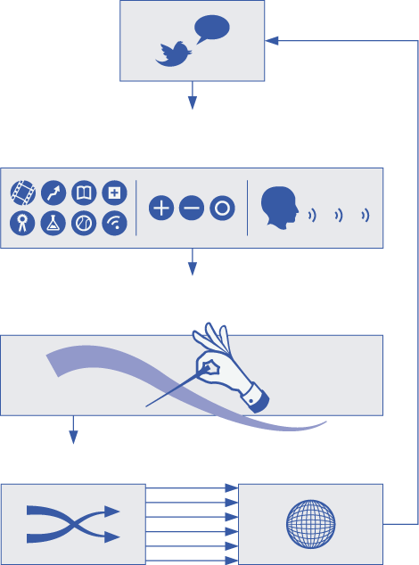
The Listening Machine
source: https://www.thelisteningmachine.org
Notes:
The Listening Machine followed the tweets of about 500 twitter users for a year, performing natural languages analyses like sentiment analysis and generating music based off that. Not that there’s anything wrong with following footsteps of a previous project, but I did lose some enthusiasm when I learned that my idea wasn’t so original.

Slide 11
Data, not language
Notes:
This was when I had the idea to approach the project from a different angle. Rather than focus on imitating a human in reading text and composing music, the program would read data at the lowest level – 1’s and 0’s – and compose music based on a pre-defined set of rules. Here’s the specification for the project:

Slide 12
It should:
Sound natural
Encode losslessly
Handle any input
Notes:
First of all, it should sound “natural”, as in not stilted and not immediately recognizable as machine-composed. That’s a subjective specification, so I would have to decide for myself whether or the final project fulfills that requirement. It should also encode losslessly, meaning that any melody generated by the program should be deterministic and could theoretically be decoded back into the source data. It should also be able to handle any range of input and still fulfill those requirements. In effect, it treats input as completely random bytes with no expectations.

Slide 13
MEDI
isobar
composer
bit feeder
MIDI device
interface
command line
Notes:
The architecture of the project consists of three parts: a feeder, which is essentially a queue that takes bytes as input and feeds out bits one at a time, a composer, which uses the output of the feeder to generate notes one at a time, and a command line interface modelled after GNU utilities. The composer is defined to interface with isobar in order to output real-time MIDI events.

Slide 14
Bit Feeder
“hello”
0110100001100101…
Notes:
The bit feeder is responsible for turning the input into individual bits. This is done by creating a queue that stores input using Python’s built in bytearray object, and converts bytes in into bits using Pythons built in converter, and feeds those bits in one at a time.

Slide 15
Bit Feeder
0110100001100101…
get_bit() = 0
Notes:
The bit feeder is responsible for turning the input into individual bits. This is done by creating a queue that stores input using Python’s built in bytearray object, and converts bytes in into bits using Pythons built in converter, and feeds those bits in one at a time.

Slide 16
Bit Feeder
110100001100101…
get_bit() = 1
Notes:
The bit feeder is responsible for turning the input into individual bits. This is done by creating a queue that stores input using Python’s built in bytearray object, and converts bytes in into bits using Pythons built in converter, and feeds those bits out one at a time, popping each one off the end as it goes.

Slide 17
Bit Feeder
10100001100101…
get_bit() = 1
Notes:
The bit feeder is responsible for turning the input into individual bits. This is done by creating a queue that stores input using Python’s built in bytearray object, and converts bytes in into bits using Pythons built in converter, and feeds those bits out one at a time, popping each one off the end as it goes.

Slide 18
Composer
0110100001100101…
tonic
Notes:
The composer is responsible for taking those its one at a time and generating melodies from them. It first selects a key and tonic by reading small 3- and 4-bit integers from the first bits it’s given.

Slide 19
Composer
0100001100101…
scale
Notes:
The composer is responsible for taking those its one at a time and generating melodies from them. It first selects a key and tonic by reading small 3- and 4-bit integers from the first bits it’s given.

Slide 20
0110100001100101…

Slide 21
Interface

Slide 22
Example

Slide 23
Why?

Slide 24
The Future

