Slide 1
Summer Internship
18th May, 2026 – 17th July,2026
Team Members : Abhishek Sinha, Kali Nangia, M. Akshay Kumar
Reporting Manager : Karan Choudhary

Slide 2
PROJECT FOUNDATIONS
Project Context & Key Actors
Akshay (Developer)
• Operator of the end-to-end engineering pipeline.
• Runs yt_dlp streams & raw audio ingestion.
• Tuned Whisper Turbo & evaluated Whisper Large.
• Configured Gemma LLM reference-free scoring.
Abhishek (Senior Advisor)
• Provides initial base codebase & scripts.
• Guides Whisper Turbo fine-tuning setups.
• Consults on translation prompt templates.
Karan Sir (Project Lead)
• Provides raw group discussion audio datasets.

Slide 3
FUNCTIONAL REQUIREMENTS
System Boundary & Key Use Cases
UC-1: Process Ingestion
Ingests streams via yt_dlp & raw local group discussion audio recordings.
UC-4: Evaluate Output Quality
Executes reference-free Gemma 9B LLM Judge semantic & grammar scoring.
UC-2: Execute ASR Processing
Deploys Whisper Large-v3 pipelines & fine-tunes Whisper Turbo variant.
UC-5: Execute Translation
Translates transcripts to Hindi Diagnostic reports via optimized prompts.
UC-3: Apply Noise Suppression
Applies 4th-order Butterworth (80-7500Hz) & Adaptive Wiener (mysize=19).

Slide 4
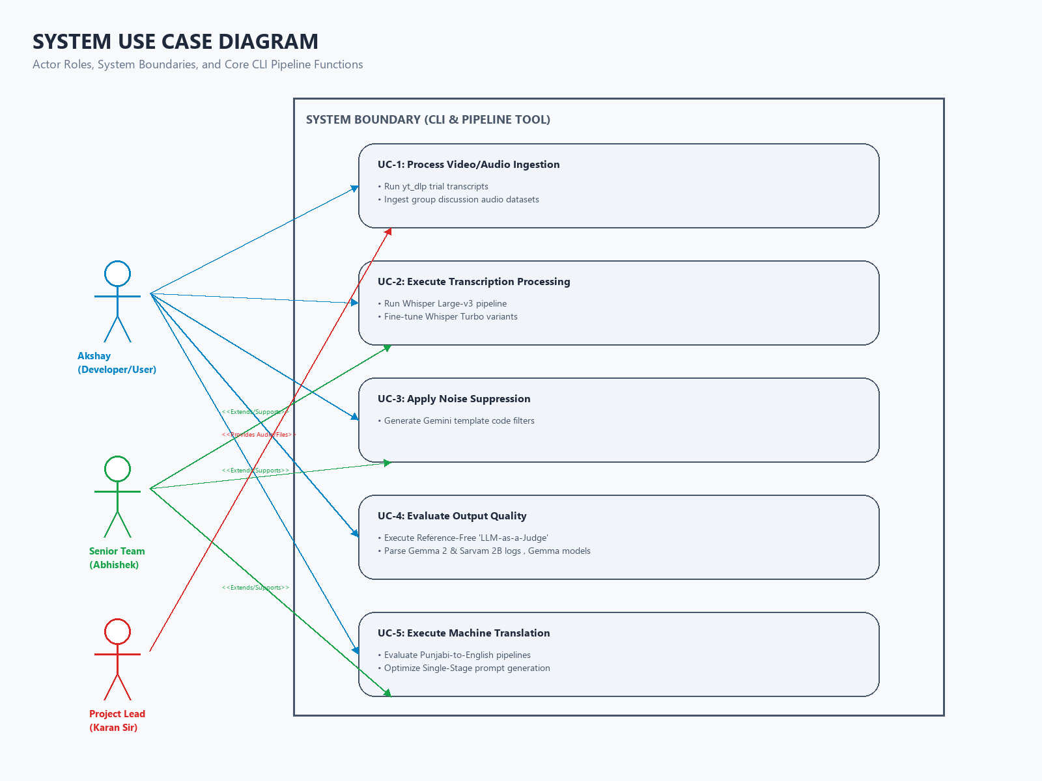
FUNCTIONAL REQUIREMENTS
Use Case Diagram

Slide 5
SYSTEM ARCHITECTURE
Pipeline Architecture & Data Flow
1. Ingestion Nodes
• Audio captured at mic node or YouTube parsed via yt_dlp.
• Output: Raw Punjabi Audio.
2. Processing & ASR
• Standardizes to 16000Hz mono.
• Whisper transcribes clean audio to Punjabi Text.
3. Storage & Judge
• Saved to database (no ground truth).
• Gemma 9B evaluates semantic/grammar quality.
• Output: Quality Metrics.
4. Optimization
• Method B: Single-Stage Direct Flow (WINNER).
• Outputs direct Hindi Diagnostic report.

Slide 6
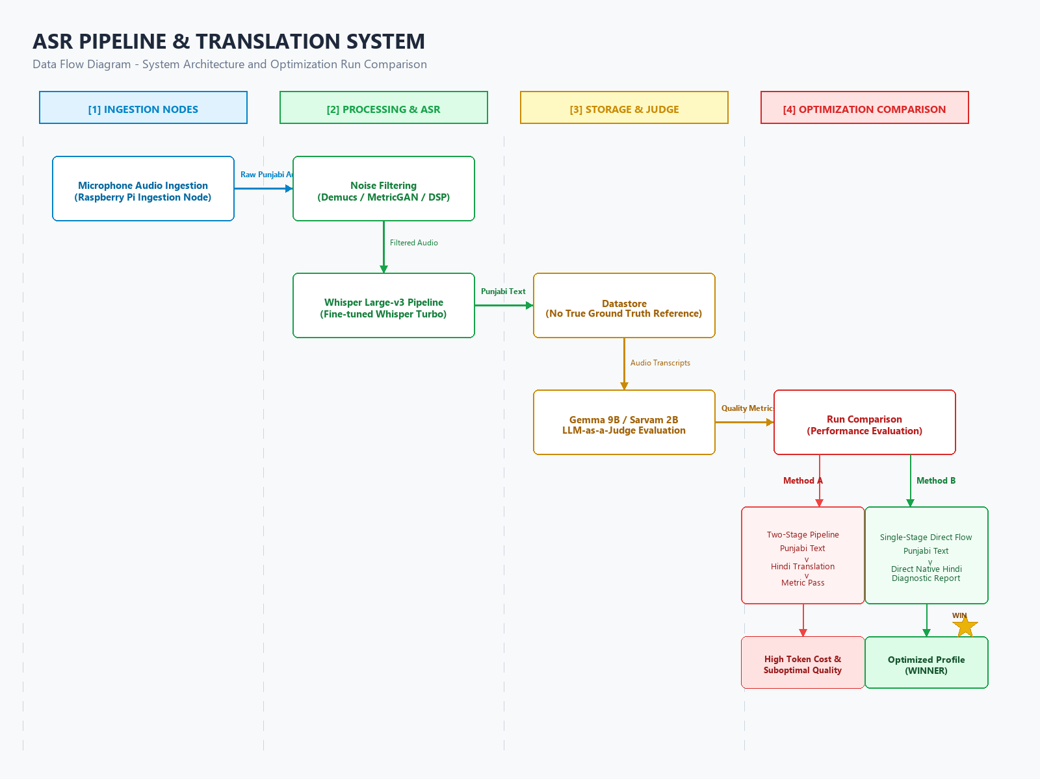
SYSTEM ARCHITECTURE
System Data Flow Diagram

Slide 7
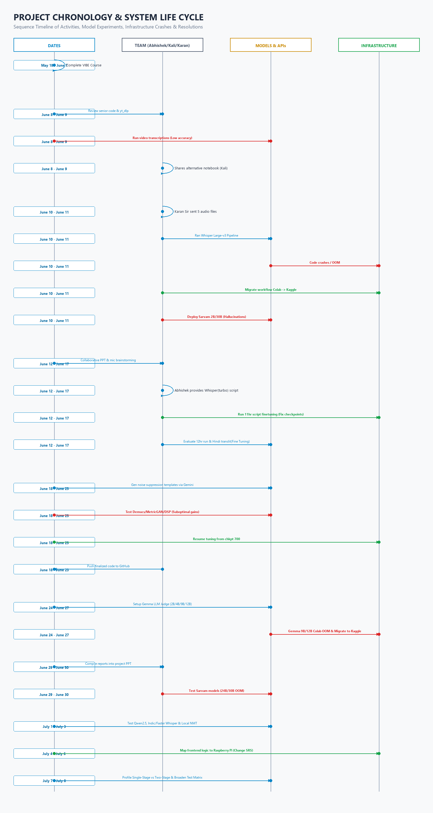
SYSTEM ARCHITECTURE
System Sequence Diagram

Slide 8
As Previously mentioned,
Discussed about Krishi Darshan for audio transcription.
1. Did transcription using colab.
Outreach session:
1. Checked transcript using whisper models(large v3, small), Sarvam models(2B,30B,API: Saaras v3)
Also did Noise Suppression

Slide 9
Whisper Fine Tuning
Did finetuning for model whisper-large-v3-turbo.
Did finetuning for datasets
1. abhi8799/Punjabi-STT-Processed-mozilla
2. abhi8799/Punjabi-STT-Turbo-40H
3. KaliNangia/Punjabi-STT_Combined_Preprocessed
The reason for doing finetuning:
1. Helps to get accurate transcript.

Slide 10
Encoder-Decoder Model
Whisper utilizes a Transformer-based architecture to process audio spectrograms and generate text autoregressively.
8-bit Quantization: Reduces memory footprint for deployment on resource-constrained GPUs.
PEFT (LoRA): Fine-tunes only a subset of parameters, making training faster and preventing catastrophic forgetting.

Slide 11



Implementation Workflow
Data Preparation
Model Config
Evaluation
Loading the common-voice dataset, resampling audio to 16kHz, and computing Mel-spectrogram features for model input.
Integrating BitsAndBytes for 8-bit loading and setting up LoRA Config with specific rank and target modules.
Training with HuggingFace Seq2SeqTrainer and calculating Word Error Rate (WER) to ensure domain adaptation success.

Slide 12
Introduction & Core Challenge
The Reference Scarcity Problem
Proposed Methodology
Standard Automatic Speech Recognition (ASR) benchmarking relies deeply on human-annotated ground-truth transcripts to compute Word Error Rate (WER).
For regional dialects or highly customized vocabularies (e.g., Punjabi Gurmukhi script), verified datasets are exceptionally scarce, rendering traditional evaluation techniques impossible to execute.
This project introduces a dual-pronged alternative validation stack in Code.ipynb:
Token Consensus Engine: Merges transcripts from multiple fine-tuned models to synthesize a high-integrity Pseudo-Ground Truth.
Autonomous LLM Judges: Evaluates transcription quality zero-shot using cloud-based Gemini & local Gemma models.

Slide 13
System Ecosystem & Parameter Pools
LoRA Fine-Tuned Whisper Array
Cloud-Based LLM Judge
Local GPU-Accelerated Judges
Using 5 distinct fine-tuned architectures optimized with LoRA adapters for Gurmukhi Punjabi speech patterns: Whisper Turbo, Medium, and Small classes.
Google Gemini 2.5 Flash accessed through the modern cloud GenAI API to deliver scalable, zero-shot comparative linguistic auditing.
Google Gemma-2-2b-it and Gemma-3-4b-it models deployed locally on a T4 GPU under strict memory optimization profiles (bnb 4-bit config).
ASR Processing Engine
API Consensus Evaluator
Local Evaluation Judges

Slide 14
Code Block 1 & 2 - Setup and Dependencies
1. Core ML Validation Libs
2. Hardware Optimization & Audio Libs
First execution line downloads packages for model hosting, validation, and adapter arrays:
Second code block loads specialized quantization frameworks and audio backends:
!pip install transformers datasets evaluate jiwer peft accelerate
!pip install --upgrade torchao
!pip install librosa soundfile
Installs torchao for tensor mathematical layouts and quantization profiles, along with librosa to process and dynamically resample raw audio signals directly.
This facilitates hosting the Whisper model structures, configuring LoRA target arrays, calculating baseline Levenshtein distance metrics (via jiwer), and accelerating standard weights.

Slide 15
ASR Inference Execution (Whisper LoRA)
Inference Execution Block
Key Engineering Features
Librosa Resampling: Force-resamples raw input telemetry stream down to 16,000 Hz, matching Whisper's native expected frequency rate.
FP16 Half-Precision: Enforces half-precision execution (torch.float16) to dramatically increase execution speed on the T4 GPU.
30-Second Sliding Windows: Uses chunking layouts to process long files step-by-step and protect GPU capacity.
The system loads local audio telemetry data (Full Narration_MarauliKhurad.m4a) and executes pipeline-based translation:
# Sourced from Code.ipynb
audio_array, sr = librosa.load(path, sr=16000)
asr_pipeline = pipeline(
"automatic-speech-recognition",
model=model_id,
device=0,
torch_dtype=torch.float16
)

Slide 16
Constructing "Pseudo-Ground Truth" Baseline
Token-Level Majority Voting
Consensus WER (cWER) Calculation
Since no human-annotated ground truth transcript is available, the code dynamically constructs a reference script using cross-model consensus voting.
For every sequential word slot ($i$) in the transcription array, the tokens emitted by all 5 active models are pooled together. A statistical frequency evaluation determines the winning word token to be written to the master reference string.
Once the dynamic pseudo-ground truth reference is generated, each individual model's output is evaluated against it using standard Levenshtein distance calculations:
cWER = (Substitutions + Deletions + Insertions) / Total Consensus Words
A lower cWER indicates higher structural alignment with the collective majority framework, marking stable, hallucination-resistant architectures.

Slide 17
ASR Evaluation Pipeline Flow
1. Input Audio
Loads local M4A file & resamples to 16,000 Hz
2. Whisper LoRA
5 models generate raw Punjabi streams
3. Token Voting
Positional frequency mapping builds reference
4. Evaluation
Calculates cWER + fires LLM Judge API
Cloud Evaluation Judge
Gemini 2.5 Flash comparative evaluation via GenAI SDK API
Local Evaluation Judges
Gemma local execution directly on memory-quantized budget GPUs

Slide 18
ASR Benchmark Outputs (Consensus Matrix)
Model Parameter Pool Target | Consensus WER (cWER) | Status / Key Behavior
Garden2006/whisper-large-v3-turbo-gurmukhi-lora | 0.0688 | Winner: Close alignment with majority framework
abhi8799/whisper-large-v3-turbo-gurmukhi-lora | 0.5888 | Moderate error; displaying minor phrasing variations
KaliNangia/whisper-large-v3-turbo-gurmukhi-lora | 0.6757 | Elevated variance; contains alternative spellings
KaliNangia/whisper-medium-gurmukhi-lora | 0.7346 | Significant word insertions and structural drift
abhi8799/whisper-small-gurmukhi-lora | 0.8659 | High error outlier; severe repetition loop errors

Slide 19
Introduction & Core Challenge

Slide 20
Why Introduce LLM as a Judge?
Determines if sentence transitions are grammatically fluent in natural Punjabi.
Detects context retention, ASR repetition loops, and structural hallucinations that traditional formulas miss.
Synonyms: Correct alternative word choices are graded as harsh errors.
Gurmukhi Dialects: Dialectical spelling updates cause metric drift despite clean audio match.
Context Blindness: Scrambled, meaningless outputs with matching tokens receive falsely positive scores.
Syntactic Metrics Fall Short
Linguistic Fluency Auditing

Slide 21
The LLM Judge Prompt Template
"You are an expert linguistic judge specializing in Punjabi (Gurmukhi script) Automatic Speech Recognition (ASR). Comparative evaluation rules: judge transcripts on linguistic fluency, grammatical accuracy, absence of ASR loops/spam, and context cohesion... Output format must strictly be a formatted Markdown table."

Slide 22
Google GenAI SDK Integration (API Code)
Gemini Flash Execution
Execution Advantages
Native Client Initializer: Direct class-based execution bypasses redundant networking codes.
Gemini 2.5 Flash: Extremely high-speed, cost-effective multimodal model with highly trained Gurmukhi language parsing.
High Context Window: Effortlessly ingests multiple long transcript streams simultaneously in a single prompt.
import os
from google.genai import client
os.environ["GEMINI_API_KEY"] = userdata.get('GOOGLE_API_KEY')
ai = client.Client()
response = ai.models.generate_content(
model='gemini-2.5-flash',
contents=judge_prompt
)

Slide 23
Cloud Judge Context Assembly & Output
1. Ingest Assembly
2. Schema Enforcement
3. File Dispatch
The system loops over all output variables in raw_transcripts, appending structured delimiters (e.g. ### Model: Name) to organize the input block.
The prompt strictly instructs Gemini to return evaluations in a structured Markdown matrix, guaranteeing parsable results containing Model Name | Score | Reason.
The returned text stream is parsed and written directly to a local workspace file: LLM_Judge_ASR_Evaluation.md for immediate deployment.

Slide 24
Local Judge Evaluation (Gemma Models)
To eliminate cloud API dependencies, the code deploys Gemma-2-2b-it and Gemma-3-4b-it locally in Google Colab.
Since these models run on shared T4 GPUs with strict hardware limits, the pipeline implements advanced quantization to prevent Out-Of-Memory (OOM) errors.
Local GPU Deployment Strategy
BitsAndBytes 4-bit Quantization
quantization_config = BitsAndBytesConfig(
load_in_4bit=True,
bnb_4bit_compute_dtype=torch.bfloat16
)
This process compresses the 16-bit weight parameters into a highly optimized 4-bit space, **saving over 8GB of active VRAM memory** on the T4 GPU without degrading linguistic analysis performance.

Slide 25
Local CUDA Memory Lifecycle Flowchart
1. VRAM Flush
Deletes stale variables (Whisper, old outputs)
3. Quantized Load
Loads Gemma models locally in 4-bit space
4. Zero-Shot Inference
Emits markdown metrics locally to disk
2. CUDA Clear
Runs torch.cuda.empty_cache() & Garbage Collection
"Crucial Step: Deep memory purging must occur between loading Gemma-2-2B and Gemma-3-4B models to avoid CUDA OOM errors on standard Google Colab T4 runtimes."

Slide 26
Local Judge Analysis: Gemma 2B & 4B
Gemma 2 2B Audit Characteristics
Gemma 3 4B Audit Characteristics
Loaded inside a standard quantized container to establish a low-parameter processing baseline:
Upgraded parameter weight profile processed inside Google Colab environment:
Winner Selected: Garden2006/whisper-large-v3-turbo
Assigned Score: 8.5 / 10
Model Observation: Noticeably higher contextual accuracy. Demonstrates sharper parsing of continuous text blocks and successfully identifies minor syntactic variations.
Winner Selected: Garden2006/whisper-large-v3-turbo
Assigned Score: 8.0 / 10
Model Observation: Effectively isolates grammatical structure. Captures core semantic definitions accurately, though it experiences minor drift during dense dialect switches.

Slide 27
High-Tier Local Judge: Gemma 9B Execution
Model Parameter Pool Target | Score (1-10) | Key Strength / Linguistic Evaluation | Loops
Garden2006/whisper-large-v3-turbo-gurmukhi-lora | 6 | Good overall grammar and structure. Captures content gist. | No
abhi8799/whisper-large-v3-turbo-gurmukhi-lora | 4 | Lacks fluency, many repetition and grammatical errors. | Yes
abhi8799/whisper-small-gurmukhi-lora | 3 | Very poor transcription with spelling and grammatical errors. | Yes
KaliNangia/whisper-large-v3-turbo-gurmukhi-lora | 7 | Winner: Good vocabulary and captures the nuances of the transcript. | No
KaliNangia/whisper-medium-gurmukhi-lora | 5 | Shows improvement over smaller model, but retains loops. | Yes

Slide 28
Gemma High-Tier Model Scaling Workflow
Gemma 2B
Gemma 3 4B
Gemma 9B (12B Class)
Low memory footprint; sets structural validation limits.
Balanced runtime efficiency; detects context gaps cleanly.
Deep context layer processing; flags fine repetition loops.
Critical Benchmarking Shift: While Gemma 2B and 4B identified Garden2006 as the most stable baseline, the high-capacity **Gemma 9B** runtime exposed hidden loop anomalies, declaring **KaliNangia/whisper-large-v3-turbo** the actual winner due to nuance tracking.

Slide 29
Preventing T4 OOM Errors During Scaling
Memory Allocation Mechanics
Loading the unified class Gemma 9B layer directly after processing 2B/4B models causes instant memory collision errors on free Google Colab nodes.
The notebook resolves this by executing a structured teardown pipeline between inference blocks to keep active VRAM allocation under **5.8 GB**.
Garbage Collection & Cache Purge
import gc
import torch
# Delete variables and break links
del model, tokenizer, trainer
gc.collect()
# Hard purge unallocated VRAM segments
torch.cuda.empty_cache()

Slide 30
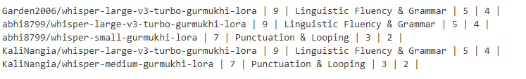
Using Sarvam Models
Used Sarvam models 2B,24B(Sarvam-M), Sarvam 30B.
The models Sarvam 24B, Sarvam 30B took large amount of storage and showed OOM so the two models failed.
Only Sarvam 2B showed an output and gave a report.
The report did not show what it represent.

Slide 31
Sarvam 30B and Sarvam 24B :
These models were a failure because it showed CUDA Out of Memory.
The storage already reached its limit by downloading the files and the models required more memory.
So tried to run it in 4bit quantization but we couldn’t do because quantization of 30B is not possible so used pre quantized model and tried to run it but couldn’t solve the issue.
For Sarvam 24b tried with 4 bit quantization but still it couldn’t run the complete code.

Slide 32
Next made transcription using Indic whisper and Faster whisper.
Then used LLM as judge using model Qwen2.5-7B-Instruct and checked the final report.
This is done by using a 5 seconds audio sample file.
judge_pipeline = pipeline(
"text-generation",
model="Qwen/Qwen2.5-7B-Instruct",
model_kwargs={ "quantization_config": quantization_config }

Slide 33
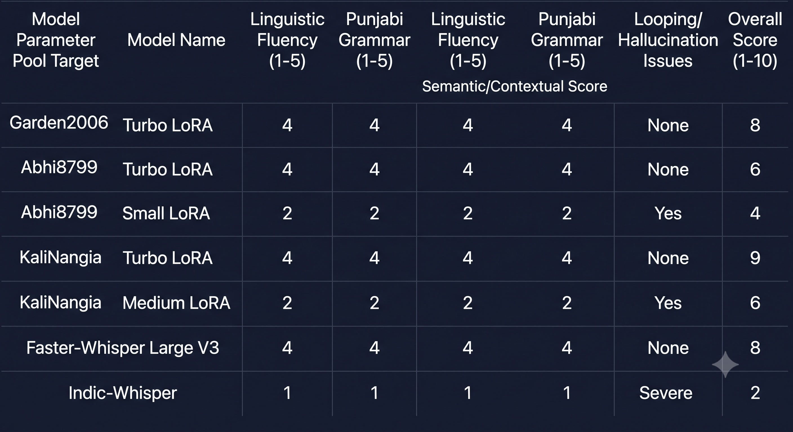
Report

Slide 34
TECHNICAL DEEP DIVE
Machine Translation & Transliteration
Transliteration Layer
• Utilized Indic NLP Library.
• Mapped Punjabi Gurmukhi script to Devanagari (Hindi) unicode characters.
• Enabled phonetic consistency across models.
Sarvam AI Models
• Tested Sarvam 2B and 30B models.
• Experienced high hallucination rates on raw audio API passes.
• Scale testing: Sarvam 24B/30B hit OOM errors on standard configurations.
LLM APIs vs. Local NMT
• Tested Qwen 2.5 local model and local Punjabi NMT.
• Addressed API traffic locks by adding exponential backoff in pipeline code.

Slide 35
Translation API
Checked few models for translations using API because locally the output was very bad.
Models selected for testing:
1. Gemini 2.5 Flash Lite.
2. Gemini 2.5 Flash.
3. Llama 3.1 70B instruct.
4. GPT 4o mini.
5. Qwen 3 8B.
6. Deepseek V4 Flash.
Mostly Llama gave better output, but Gemini 2.5 Flash Lite models is very good but couldn’t create transcript every time.

Slide 36
PIPELINE EFFICIENCY
Architecture Optimization: Two-Stage vs. Single-Stage
Method A: Two-Stage Pipeline
• Workflow: Punjabi Audio -> Whisper ASR -> Punjabi Text -> Translation LLM -> Hindi Translit -> Quality Check.
• Token Footprint: Extremely high (multiple model prompts).
• Latency Profile: High (serialization overhead between models).
• Error Propagation: Failures in Whisper transcribe directly corrupted translation stages.
Method B: Single-Stage Direct Flow (WINNER)
• Workflow: Punjabi Audio -> Whisper ASR -> Punjabi Text -> Direct Native Hindi Diagnostic Report (Single Pass).
• Token Footprint: Optimized (consolidated context prompts).
• Latency Profile: Low (single LLM inference hop).
• Robustness: Direct evaluation reduces cascading failures.
• Cost Profile: Highly economical, minimizing LLM API traffic.

Slide 37
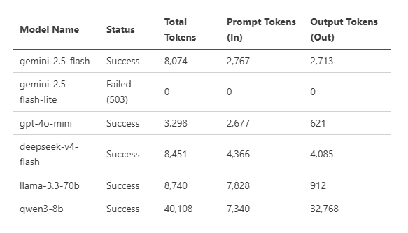
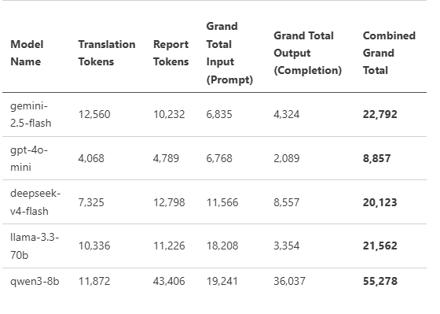
Translation API Token Report

Slide 38
CONCLUSIONS
Project Summary & Deliverables
Key Accomplishments
• Built end-to-end audio ingestion, transcription, and translation pipeline.
• Resolved Colab GPU OOM constraints by migrating to Kaggle T4 GPUs.
• Fine-tuned Whisper Turbo and compared its performance against Whisper Large.
• Designed reference-free 'LLM-as-a-Judge' quality framework using Gemma 9B.
Edge Deployment & Next Steps
• Mapped frontend microphone capture directly to Raspberry Pi.
• Updated SRS specifications to cover edge-node offline capture.
• Future Roadmap: Deploy Faster Whisper natively on Raspberry Pi.
• Implement automated rate-limiting checks for translation APIs.

