Slide 1
Constructive Solid Geometry on Neural Signed Distance Fields
Pierrick Bournez
Antoine Vialle

Slide 2
Idées de l’article :
Loss pour CSG + reg
Loss pour SV + reg
Eikonal + leur reg = sdf
Fig 8 du papier -> pseudo sdf très claqué au sol après dilatation et erosion (ce qui peut être très utile pour de la modélisation 3D quand même).

Slide 3
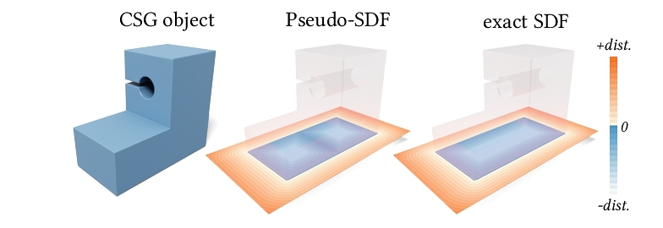
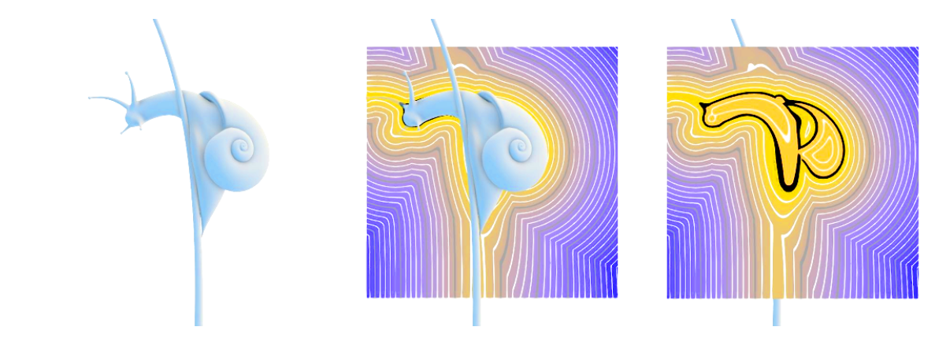
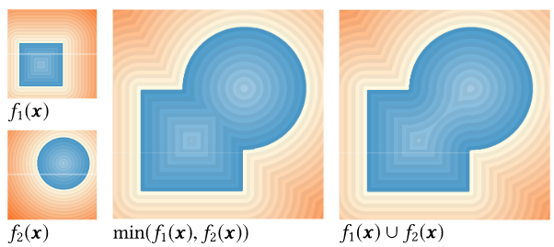




Introduction: Implicit function
$$f_{θ}\left(x\right)=\left\{\begin{aligned} d\left(x,Σ\right) if x outside of Σ \\ −d\left(x,Σ\right) \end{aligned}\right.$$
$${min⁡(f}_{1}(x),f_{2}(x))$$
$$Σ=f^{−1}(\{0\})$$
A canonical representation: the signed distance functions ( SDF)
Complex Boolean operations can be done easily
$$f_{1}(x)∪ f_{2}(x)$$
Notes:
iso-contour of a function
Encoder les surfaces
Plot de gauche à remplacer par signed distance function/ et une fonction random avec 0 level set !
Pierrick
Union of two basic shape
Can represent every mesh with any level of details .

Slide 4
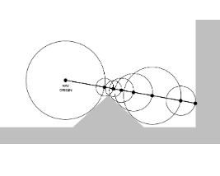

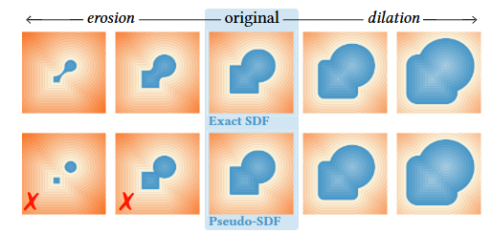
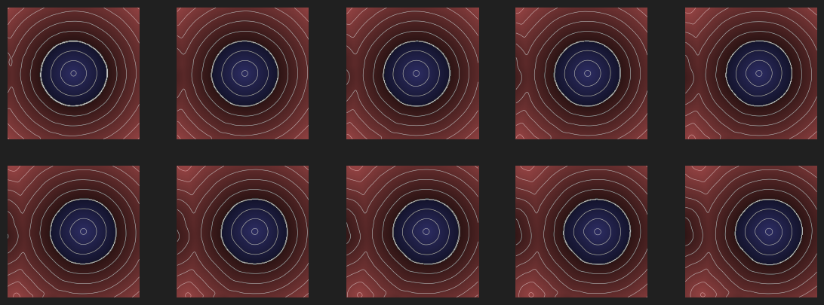
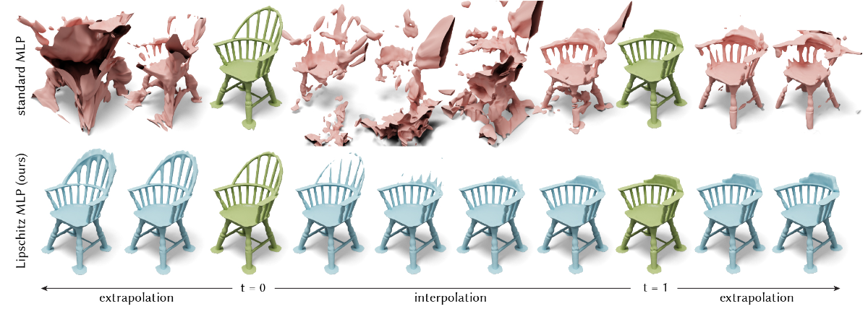
Context: Shape editing with SDF
But:
With “any” implicit function, rendering
( ray marching) can be hard
SDF are not stable under shape editing operation (Boolean operations)
Erosion / dilatation
=> How to transform back into a signed distance function?
Notes:
pierrick

Slide 5
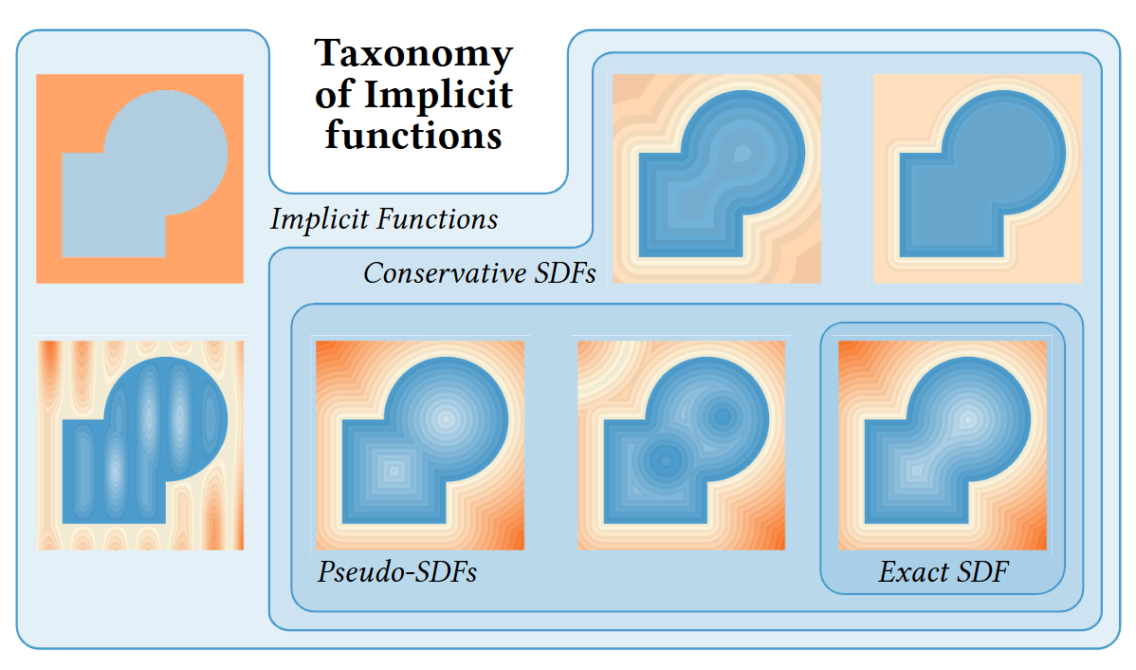
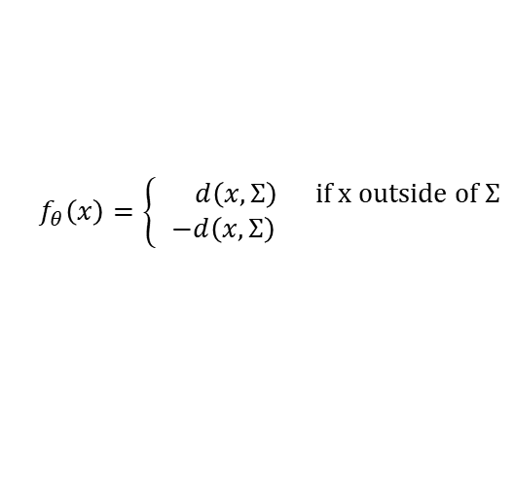


Context: Taxonomy of implicit functions
Conservative distance function
$$\left|f_{θ}\left(x\right)\right|≤|d\left(x,Σ\right)|$$
Eikonal
$$||∇f_{θ}\left(x\right)|| =1$$
Signed distance function
$$f_{θ}\left(x\right)=\left\{\begin{aligned} d\left(x,Σ\right) if x outside of Σ \\ −d\left(x,Σ\right) \end{aligned}\right.$$
Notes:
Schéma ! Pour les 3 trucs !
antoine

Slide 6
Context: Taxonomy of implicit functions
Conservative distance function
Stable under union,inter, complement
Eikonal
Stable (ae) under union, inter, complement
Signed distance function
Not stable
Notes:
Schéma ! Pour les 3 trucs !
antoine

Slide 7
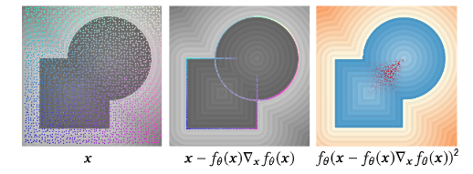
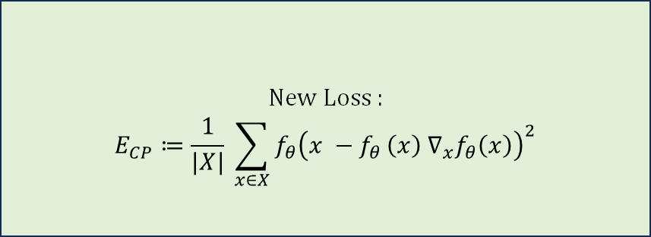
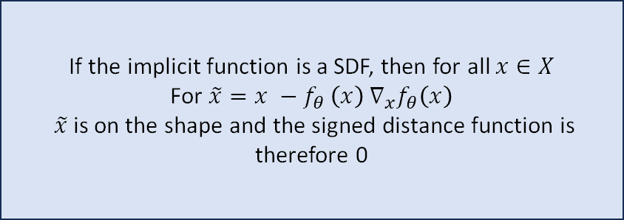
Idea : Concieve a new loss
Ideas
Solution
If the implicit function is a SDF, then for all $x∈X$
For $\tilde{x}=x −f_{θ }\left(x\right) ∇_{x}f_{θ}\left(x\right)$
$\tilde{x}$is on the shape and the signed distance function is therefore 0
New Loss :
$$E_{CP}≔\frac{1}{|X|} \sum_{x∈X}{f_{θ}{\left(x −f_{θ }\left(x\right) ∇_{x}f_{θ}\left(x\right)\right)}^{2}}$$
Notes:
Antoine
Rajouter sampling et le Xf(x) est plus moche que la maman dePunPun
Maths explanation

Slide 8
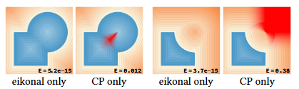
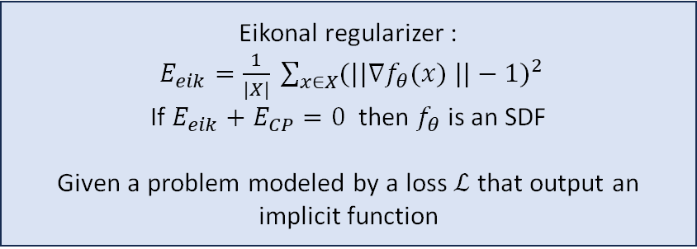
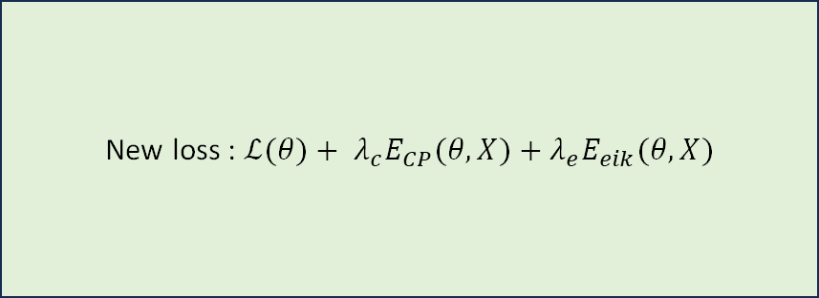
Idea : Concieve a new loss
Ideas
Solution
Eikonal regularizer :
$E_{eik}=\frac{1}{|X|} \sum_{x∈X}{{(||∇f_{θ}(x) ||−1)}^{2}}$
If $E_{eik}+E_{CP}=0$then $f_{θ}$ is an SDF
Given a problem modeled by a loss $ℒ$ that output an implicit function
New loss : $ℒ(θ)+ λ_{c}E_{CP}(θ,X)+λ_{e}E_{eik}(θ, X)$
Notes:
Antoine
Rajouter sampling et le Xf(x) est plus moche que la maman dePunPun
Maths explanation

Slide 9

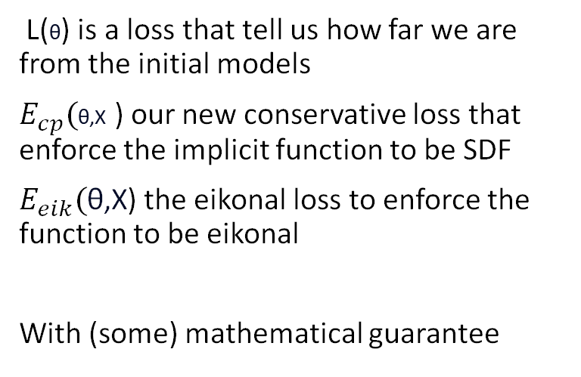
Idea : Concieve a new loss
L(θ) is a loss that tell us how far we are from the initial models
$E_{cp}($θ,X ) our new conservative loss that enforce the implicit function to be SDF
$E_{eik}(\text{θ}\text{,}\text{X}$) the eikonal loss to enforce the function to be eikonal
With (some) mathematical guarantee
Highlights of the different loss
Notes:
Antoinou
Expliquer les maths/faire une preuve

Slide 10
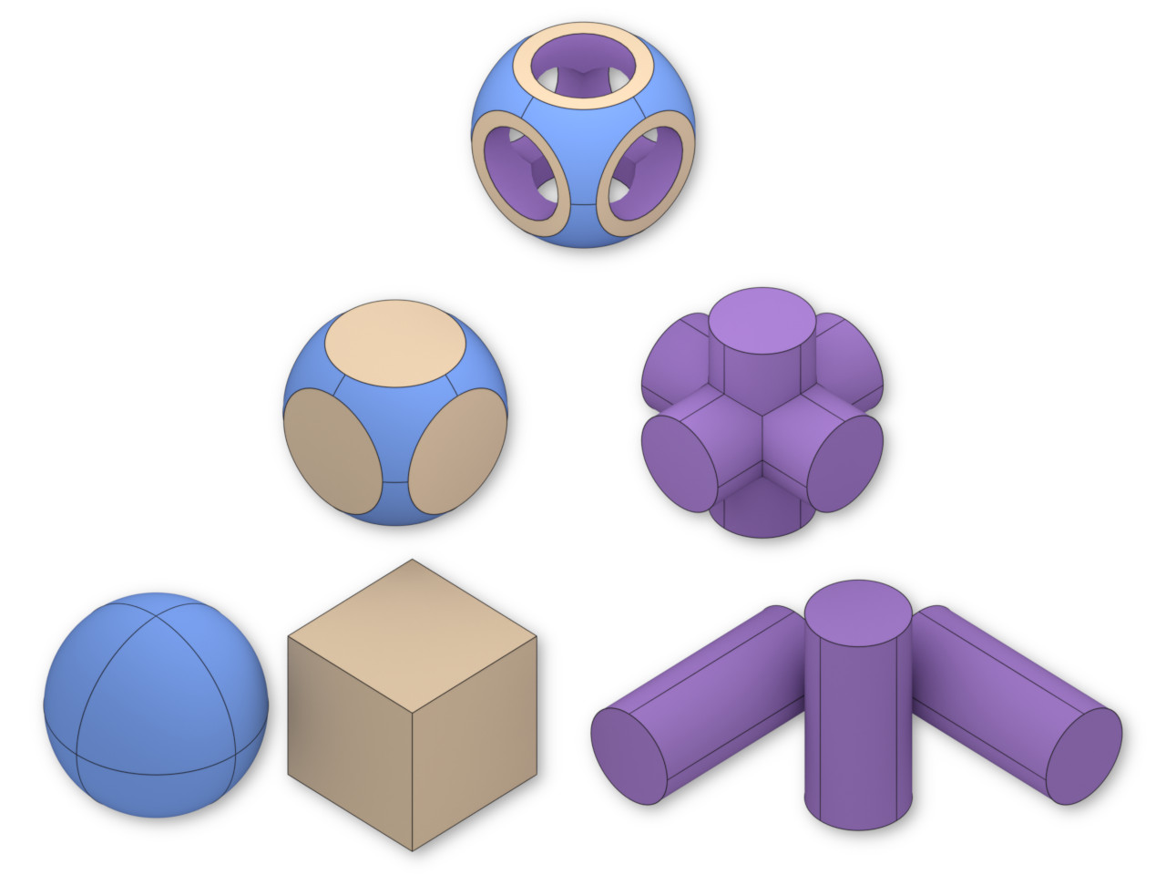
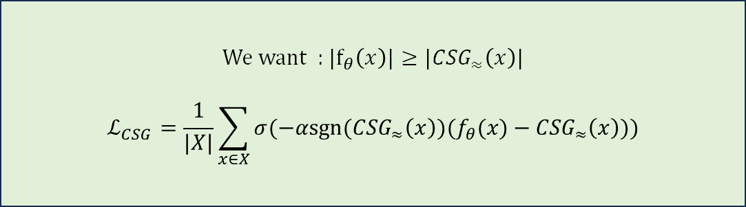
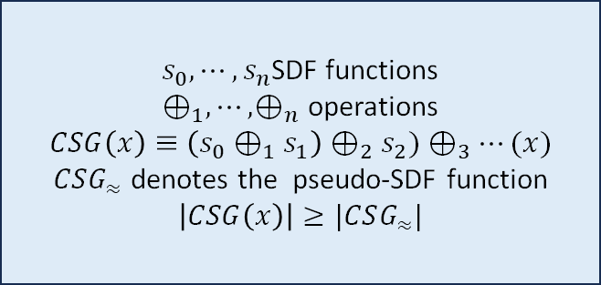
Paper’s applications: constructive solid geometry
Idea
Problem
$s_{0},⋯,s_{n}$SDF functions
$⊕_{1}, ⋯,⊕_{n}$ operations
$$CSG\left(x\right)≡\left(s_{0}⊕_{1}s_{1}\right)⊕_{2}s_{2})⊕_{3}⋯(x)$$
$CSG_{≈}$ denotes the pseudo-SDF function
$$\left|CSG\left(x\right)\right|≥|CSG_{≈}|$$
Construct complex object from simple building blocks
Solution
We want : $|f_{θ}\left(x\right)|≥|{CSG}_{≈}\left(x\right)|$
$$ℒ_{CSG}=\frac{1}{|X|}\sum_{x∈X}{σ(−αsgn⁡({CSG}_{≈}\left(x\right))(f_{θ}(x)−{CSG}_{≈}\left(x\right))})$$
Notes:
Under Union, substraction, addition, CSG keeps verifying the conservative distance property.

Slide 11
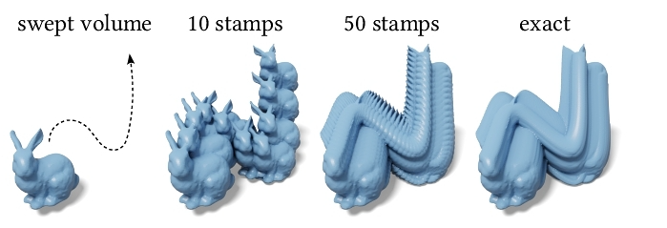

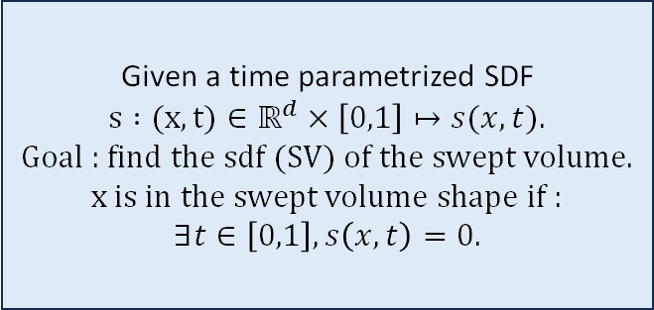
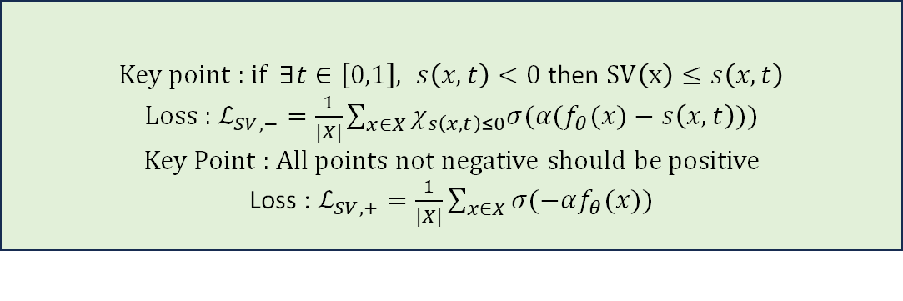
Paper’s applications: swept volumes
Idea
Problem
Given a time parametrized SDF
$s :(x,t)∈ℝ^{d}×\left[0,1\right]↦s(x,t)$.
Goal : find the sdf (SV) of the swept volume.
x is in the swept volume shape if :
$∃t∈\left[0,1\right], s\left(x,t\right)=0$.
Construct complex object from a single object and a path
Solution
Key point : if $∃t∈\left[0,1\right], s\left(x,t\right)<0$ then $SV\left(x\right)≤s\left(x,t\right)$
Loss : $ℒ_{SV,−}=\frac{1}{|X|}\sum_{x∈X}{χ_{s\left(x,t\right)≤0}σ(α(f_{θ}(x)−s\left(x,t\right))})$
Key Point : All points not negative should be positive
Loss : $ℒ_{SV,+}=\frac{1}{|X|}\sum_{x∈X}{σ(−αf_{θ}(x)})$
Notes:
Under Union, substraction, addition, CSG keeps verifying the conservative distance property.

Slide 12
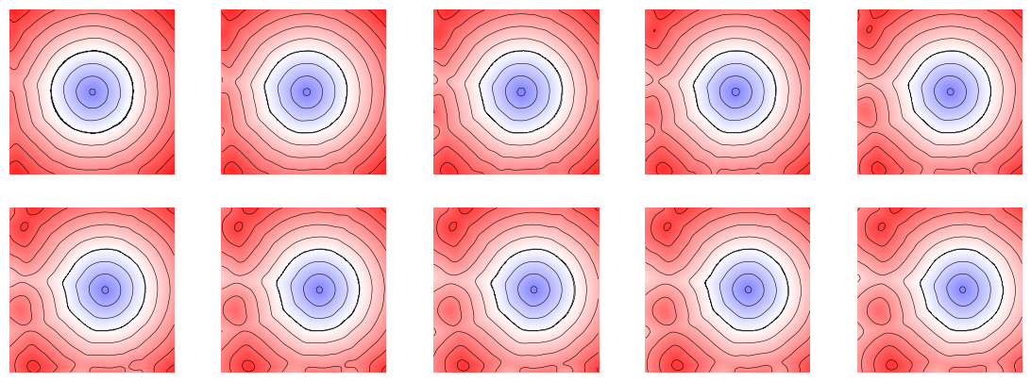
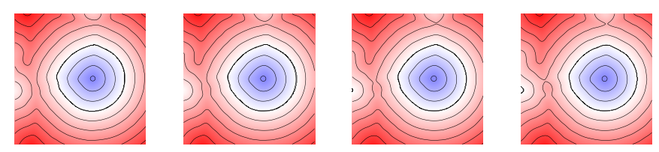
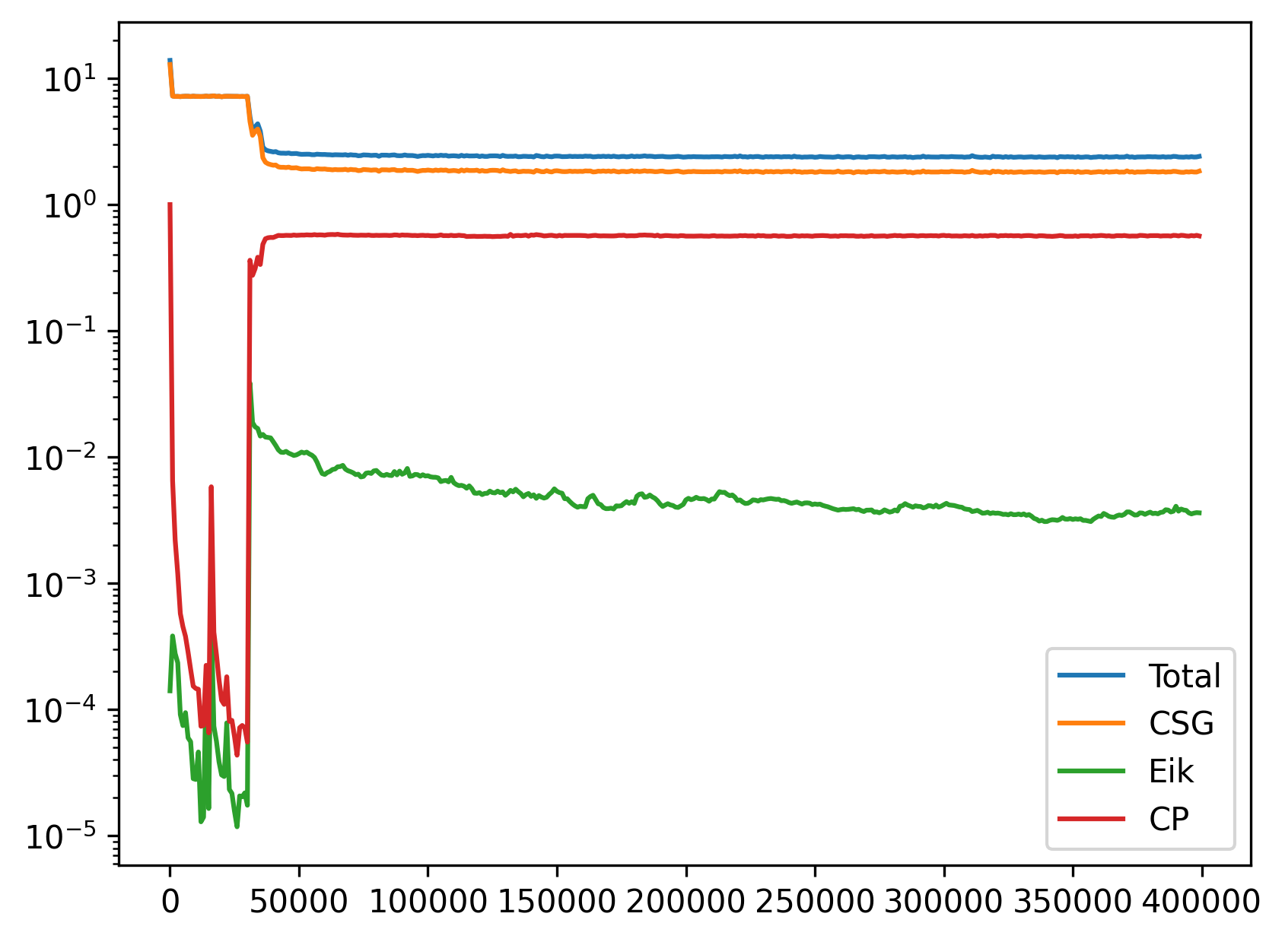
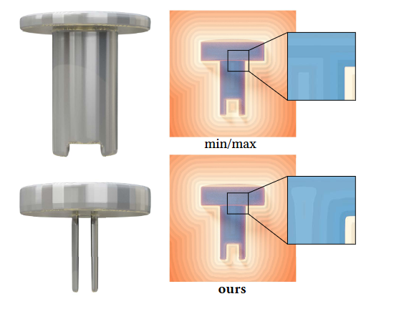
Results and limitation:
Result: It can correct easy shape
But we run ourselves the models:
Took 4 hours to regularize an easy shape on there repo. Much faster with some quick reimplementation from TP6
Needs some manual tuning
No additional loss
Adding the custom loss term
Profile of the loss
Notes:
Pierrick
Virer input output et sur les loss

Slide 13
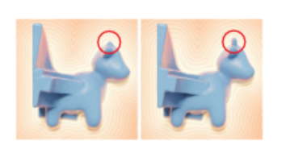
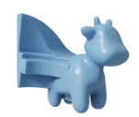

Going further : Importance sampling
Sample randomly and close to our points of interest
Usual random sampling
Importance sampling: sample points x near the zero level set
$$rand\left(0,1\right)≥N(s\left(x\right),{ \text{σ}}^{2})$$
input
Random sampling
Importance sampling
Notes:
Pierrick

Slide 14
Conclusions
Proposed a new loss to regularize the implicit output function
Can easily be added on a existing framework.
Notes:
Antoine
Voir follow up paper

Slide 15
For your final project, you will be asked to present a research paper related to our course. The main goals are:
Read and understand the article,
Understand the background (context in which the work is done),
Understand the presented solution,
Understand the strengths and weaknesses of this solution,
Possibly highlight future/follow-up work.
We will schedule slots of approximately 30 minutes, in which during the first 20 minutes we will ask you to give your presentation covering the article that you have chosen, and the remaining 10 minutes dedicated to the Q&A from our side. Please note that
You are not required to implement the paper.
If you do implement it (or run the publicly released code), you can, of course mention, this during your presentation and show the obtained results.
During the Q&A we might ask you questions from the course that might be related to the presented paper.
You can join in teams (of up to 2 members) to do this. Indeed we strongly encourage you to partner up with someone else for this final project.

