Slide 1
Elpi: the language you already know without knowing it
Enrico Tassi – Xmas 2023 / Nantes

Slide 2
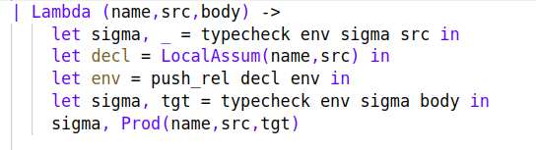
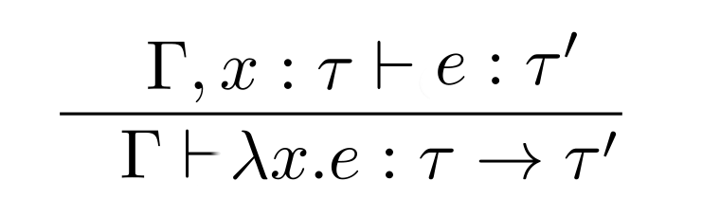
The workflow of a poor soul
Code, play, validate...
… and then communicate ...

Slide 3
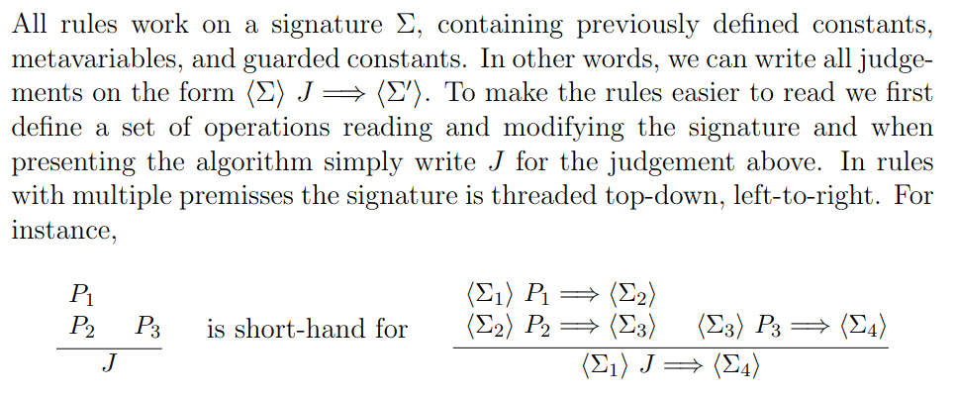
The workflow of a poor soul
… cheating ...

Slide 4
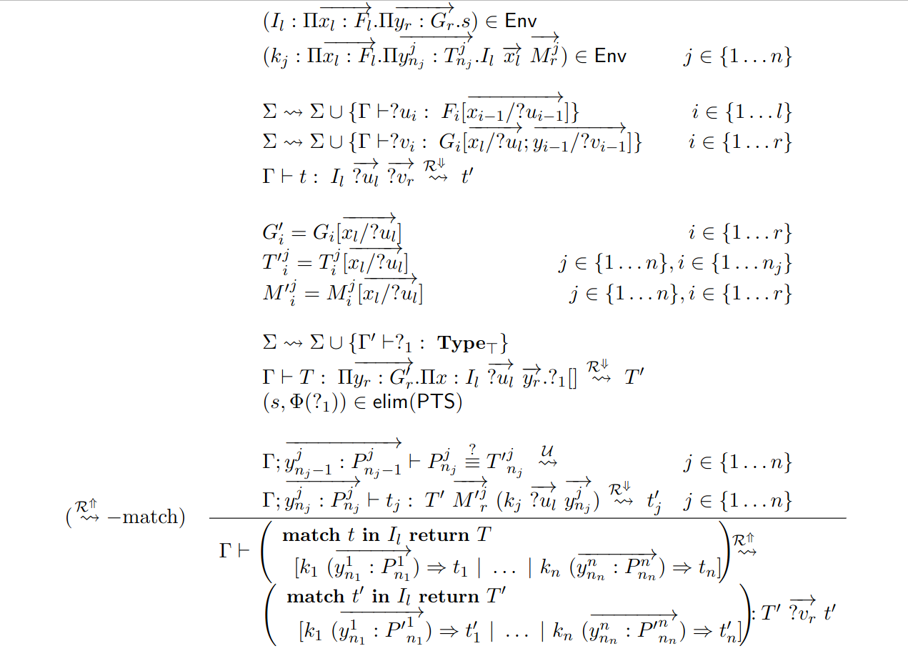
The workflow of a poor soul
… scaring

Slide 5
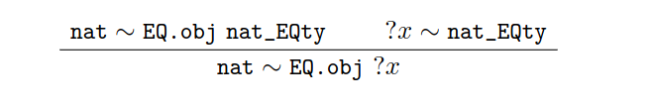
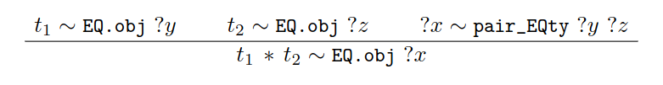
Inference rule(s)!
One key ingredient in the Odd Order Theorem is that we could program the elaborator by adding rules like:

Slide 6
Can we turn \frac into a programming language?
ADTs with binders and holes
A context (for the bound variables)
A sigma (for the hole’s metadata)
(obviously) rule-based

Slide 7
Elpi = λProlog + CHR
λProlog for …
  Context, substitution, assignment
  programming with binders, recursively
CHR for …
  State and metadata management
  manipulate unification variables
  non-local deductions

Slide 8
Outline
Elpi 101
  λProlog 101: type checker for λ→
  λProlog + CHR 101: even & odd
Demo: j.elpi / hm.elpi
  HM type inference + equality types
Coq-Elpi

Slide 9
λProlog 101
% HOAS of terms
type app term → term → term.
type lam (term → term) → term.
% HOAS of types
type arrow ty → ty → ty.
% Example: identity function
lam (x\ x)
% Example: fst
lam x\ lam y\ x

Slide 10
λProlog 101
pred of i:term, o:ty.
of (app H A) T :-
of H (arrow S T), of A S.
of (lam F) (arrow S T) :-
pi x\ of x S => of (F x) T.
% Convention
X % universally quantified around the rule
X_{i} % not quantified (existentially quantified, globally)

Slide 11
λProlog 101
Goal
Program
of (lam x\ lam y\ app x y) Q₀.
of (app H A) T :- of H (arrow S T), of A S.
of (lam F) (arrow S T) :-
pi x\ of x S => of (F x) T.
Assignments
Q₀ = ...

Slide 12
λProlog 101
Goal
Program
of ((x\ lam y\ app x y) c₁) T_{1.}
of (app H A) T :- of H (arrow S T), of A S.
of (lam F) (arrow S T) :-
pi x\ of x S => of (F x) T.
of c₁ S₁.
Assignments
Q₀ = arrow S₁ T₁
F₁ = (x\ lam y\ app x y)

Slide 13
λProlog 101
Goal
Program
of (lam y\ app c₁ y) T_{1.}
of (app H A) T :- of H (arrow S T), of A S.
of (lam F) (arrow S T) :-
pi x\ of x S => of (F x) T.
of c₁ S₁.
Assignments
Q₀ = arrow S₁ T₁
F₁ = (x\ lam y\ app x y)

Slide 14
λProlog 101
Goal
Program
of ((y\ app c₁ y) c₂) T_{2.}
of (app H A) T :- of H (arrow S T), of A S.
of (lam F) (arrow S T) :-
pi x\ of x S => of (F x) T.
of c₁ S₁.
of c₂ S₂.
Assignments
Q₀ = arrow S₁ (arrow S₂ T₂)
F₁ = (x\ lam y\ app x y)
F₂ = (y\ app c₁ y)

Slide 15
λProlog 101
Goal
Program
of (app c₁ c₂) T_{2.}
of (app H A) T :- of H (arrow S T), of A S.
of (lam F) (arrow S T) :-
pi x\ of x S => of (F x) T.
of c₁ S₁.
of c₂ S₂.
Assignments
Q₀ = arrow S₁ (arrow S₂ T₂)
F₁ = (x\ lam y\ app x y)
F₂ = (y\ app c₁ y)

Slide 16
λProlog 101
Goal
Program
of c₁ (arrow S₃ T₂).
of c₂ S₃.
of (app H A) T :- of H (arrow S T), of A S.
of (lam F) (arrow S T) :-
pi x\ of x S => of (F x) T.
of c₁ S₁.
of c₂ S₂.
Assignments
Q₀ = arrow S₁ (arrow S₂ T₂)
F₁ = (x\ lam y\ app x y)
F₂ = (y\ app c₁ y)
H₃ = c₁
A₃ = c₂

Slide 17
λProlog 101
Goal
Program
of c₂ S₃.
of (app H A) T :- of H (arrow S T), of A S.
of (lam F) (arrow S T) :-
pi x\ of x S => of (F x) T.
of c₁ (arrow S₃ T₂).
of c₂ S₂.
Assignments
Q₀ = arrow (arrow S₃ T₂) (arrow S₂ T₂)
F₁ = (x\ lam y\ app x y)
F₂ = (y\ app c₁ y)
H₃ = c₁ S₁ = (arrow S₃ T₂)
A₃ = c₂

Slide 18
λProlog 101
Goal
Program
of (app H A) T :- of H (arrow S T), of A S.
of (lam F) (arrow S T) :-
pi x\ of x S => of (F x) T.
of c₁ (arrow S₂ T₂).
of c₂ S₂.
Assignments
Q₀ = arrow (arrow S₂ T₂) (arrow S₂ T₂)
F₁ = (x\ lam y\ app x y)
F₂ = (y\ app c₁ y)
H₃ = c₁ S₁ = (arrow S₃ T₂)
A₃ = c₂ S₃ = S₂

Slide 19

λProlog + CHR 101
PL level
Goals
1
g
4
Rules
1
g :- g , ...
g :- new_constraint c [X]
… X = t …
CHR
2
rule “c” \ “d” | t <=> “g”.
3
3
4
“c”_{X}
“d”_{Y}
2
4
4
Constraints
d_{Y}
PL meta level

Slide 20
λProlog + CHR 101
type zero nat. type succ nat -> nat.
pred odd i:nat. pred even i:nat. pred double i:nat, o:nat.
even zero.
odd (succ X) :- even X.
even (succ X) :- odd X.
even X :- var X, new_constraint (even X) [X].
odd X :- var X, new_constraint (odd X) [X].
double zero zero.
double (succ X) (succ (succ Y)) :- double X Y.
double X Y :- var X, new_constraint (double X Y) [X].
constraint even odd double {
rule (even X) (odd X) <=> fail.
rule (double _ X) <=> (even X).
}

Slide 21
λProlog + CHR 101
even X, X = succ Y, not (double Z Y)
Goals
Program
even X
X = succ Y
not (double Z Y)
even zero.
odd (succ X) :- even X.
even (succ X) :- odd X.
even X :- var X, new_constraint (even X) [X].
odd X :- var X, new_constraint (odd X) [X].
double zero zero.
double (succ X) (succ (succ Y)) :- double X Y.
double X Y :- var X, new_constraint (double X Y) [X].
Constraint store
Rules
(even X) (odd X) <=> fail.
(double _ X) <=> (even X).

Slide 22
λProlog + CHR 101
even X, X = succ Y, not (double Z Y)
Goals
Program
X = succ Y
not (double Z Y)
even zero.
odd (succ X) :- even X.
even (succ X) :- odd X.
even X :- var X, new_constraint (even X) [X].
odd X :- var X, new_constraint (odd X) [X].
double zero zero.
double (succ X) (succ (succ Y)) :- double X Y.
double X Y :- var X, new_constraint (double X Y) [X].
Constraint store
even f_{X}
Rules
(even X) (odd X) <=> fail.
(double _ X) <=> (even X).

Slide 23
λProlog + CHR 101
even X, X = succ Y, not (double Z Y)
Goals
Program
even (succ Y)
not (double Z Y)
even zero.
odd (succ X) :- even X.
even (succ X) :- odd X.
even X :- var X, new_constraint (even X) [X].
odd X :- var X, new_constraint (odd X) [X].
double zero zero.
double (succ X) (succ (succ Y)) :- double X Y.
double X Y :- var X, new_constraint (double X Y) [X].
Constraint store
Rules
(even X) (odd X) <=> fail.
(double _ X) <=> (even X).

Slide 24
λProlog + CHR 101
even X, X = succ Y, not (double Z Y)
Goals
Program
odd Y
not (double Z Y)
even zero.
odd (succ X) :- even X.
even (succ X) :- odd X.
even X :- var X, new_constraint (even X) [X].
odd X :- var X, new_constraint (odd X) [X].
double zero zero.
double (succ X) (succ (succ Y)) :- double X Y.
double X Y :- var X, new_constraint (double X Y) [X].
Constraint store
Rules
(even X) (odd X) <=> fail.
(double _ X) <=> (even X).

Slide 25
λProlog + CHR 101
even X, X = succ Y, not (double Z Y)
Goals
Program
not (double Z Y)
even zero.
odd (succ X) :- even X.
even (succ X) :- odd X.
even X :- var X, new_constraint (even X) [X].
odd X :- var X, new_constraint (odd X) [X].
double zero zero.
double (succ X) (succ (succ Y)) :- double X Y.
double X Y :- var X, new_constraint (double X Y) [X].
Constraint store
odd f_{Y}
Rules
(even X) (odd X) <=> fail.
(double _ X) <=> (even X).

Slide 26
λProlog + CHR 101
even X, X = succ Y, not (double Z Y)
Goals
Program
not ( )
even zero.
odd (succ X) :- even X.
even (succ X) :- odd X.
even X :- var X, new_constraint (even X) [X].
odd X :- var X, new_constraint (odd X) [X].
double zero zero.
double (succ X) (succ (succ Y)) :- double X Y.
double X Y :- var X, new_constraint (double X Y) [X].
Constraint store
odd f_{Y}
double f_{Z} f_{Y}
Rules
(even X) (odd X) <=> fail.
(double _ X) <=> (even X).

Slide 27
λProlog + CHR 101
even X, X = succ Y, not (double Z Y)
Goals
Program
not (even Y)
even zero.
odd (succ X) :- even X.
even (succ X) :- odd X.
even X :- var X, new_constraint (even X) [X].
odd X :- var X, new_constraint (odd X) [X].
double zero zero.
double (succ X) (succ (succ Y)) :- double X Y.
double X Y :- var X, new_constraint (double X Y) [X].
Constraint store
odd f_{Y}
double f_{Z} f_{Y}
Rules
(even X) (odd X) <=> fail.
(double _ X) <=> (even X).

Slide 28
λProlog + CHR 101
even X, X = succ Y, not (double Z Y)
Goals
Program
not ( )
even zero.
odd (succ X) :- even X.
even (succ X) :- odd X.
even X :- var X, new_constraint (even X) [X].
odd X :- var X, new_constraint (odd X) [X].
double zero zero.
double (succ X) (succ (succ Y)) :- double X Y.
double X Y :- var X, new_constraint (double X Y) [X].
Constraint store
odd f_{Y}
double f_{Z} f_{Y}
even f_{Y}
Rules
(even X) (odd X) <=> fail.
(double _ X) <=> (even X).

Slide 29
λProlog + CHR 101
even X, X = succ Y, not (double Z Y)
Goals
Program
not ( fail )
even zero.
odd (succ X) :- even X.
even (succ X) :- odd X.
even X :- var X, new_constraint (even X) [X].
odd X :- var X, new_constraint (odd X) [X].
double zero zero.
double (succ X) (succ (succ Y)) :- double X Y.
double X Y :- var X, new_constraint (double X Y) [X].
Constraint store
odd f_{Y}
double f_{Z} f_{Y}
even f_{Y}
Rules
(even X) (odd X) <=> fail.
(double _ X) <=> (even X).

Slide 30
λProlog + CHR 101
even X, X = succ Y, not (double Z Y)
Goals
Program
even zero.
odd (succ X) :- even X.
even (succ X) :- odd X.
even X :- var X, new_constraint (even X) [X].
odd X :- var X, new_constraint (odd X) [X].
double zero zero.
double (succ X) (succ (succ Y)) :- double X Y.
double X Y :- var X, new_constraint (double X Y) [X].
Constraint store
odd f_{Y}
Rules
(even X) (odd X) <=> fail.
(double _ X) <=> (even X).

Slide 31
Elpi = λProlog + CHR
λProlog for …
  Context, substitution, assignment
  programming with binders, recursively
CHR for …
  State and metadata management
  manipulate unification variables
  non-local deductions

Slide 32
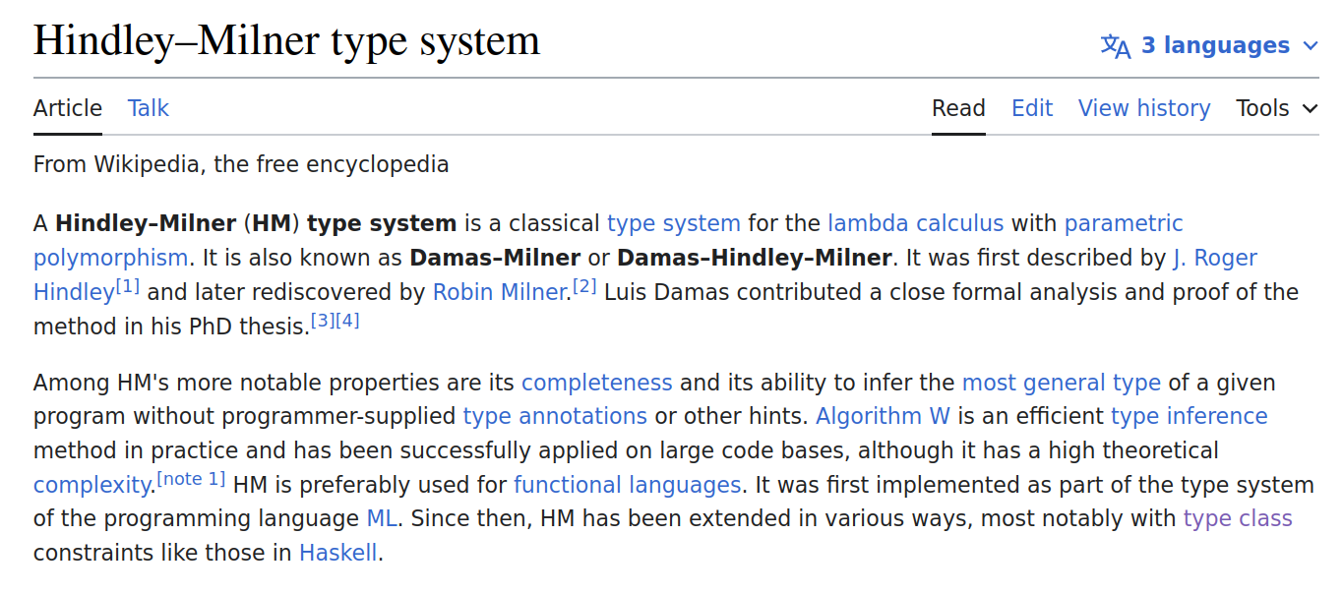
Demo: HM in Elpi

Slide 33

HM: syntax

Slide 34
Typing rules

Slide 35
Type schema: elimination

Slide 36
Type schema: introduction

Slide 37
Elpi → Coq-Elpi
Elpi is not a general purpose PL
  It is a DSL
Elpi finds his place inside a larger software, e.g. Coq
  Only used for tasks that fit well
  Needs (a lot of) glue code

Slide 38
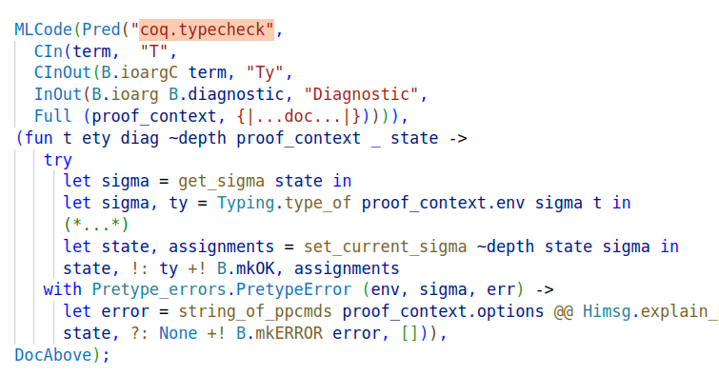
Coq-Elpi
Elpi is 12KLOC, Coq-Elpi is 12KLOC

Slide 39
Good, Bad and Ugly
Users!
Complete apps written in Coq-Elpi
Debugger
Constraints are hard to program with
Tutorials but no refman
No proper language-server
No (full) formal semantics / program logic

Slide 40
Future
Type Class solver / Elaborator
  HB hides the inference engine of MC2
Automation (eg Diaframe)
  Indexing techniques from ATP
  Memoization techniques from LP

Slide 41
Thanks for listening!

Slide 42

Elpi ! logic programming
high level with an operational meaning
  yummy!
Fact of life: 90% compute, 10% search
  wrong default (who needs backtracking?)
extensibility of programs (rule based)
  a miracle

