Slide 1
ELPI: an extension language with binders and unification variables

Slide 2
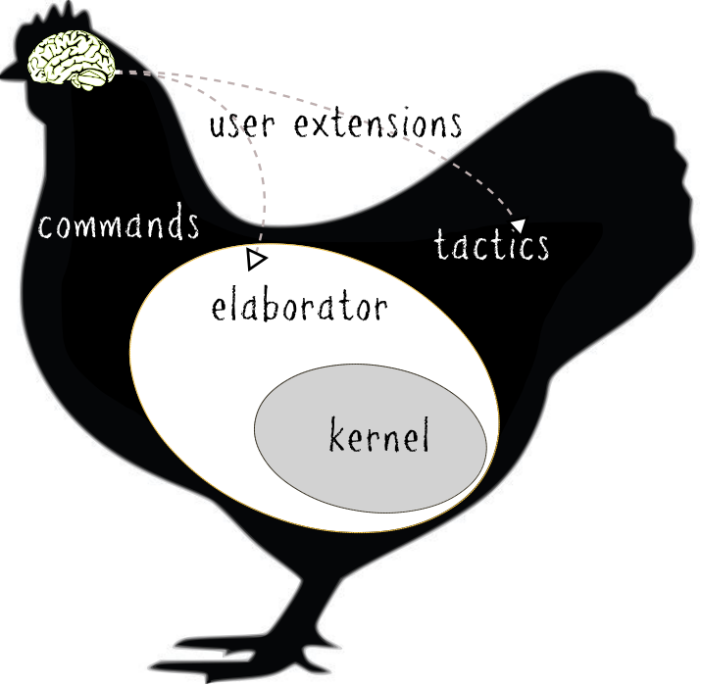
Context

Slide 3
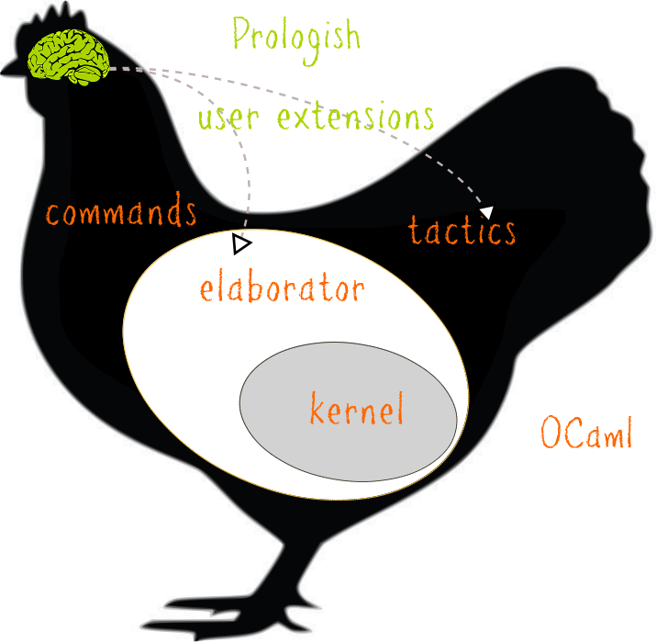

Slide 4
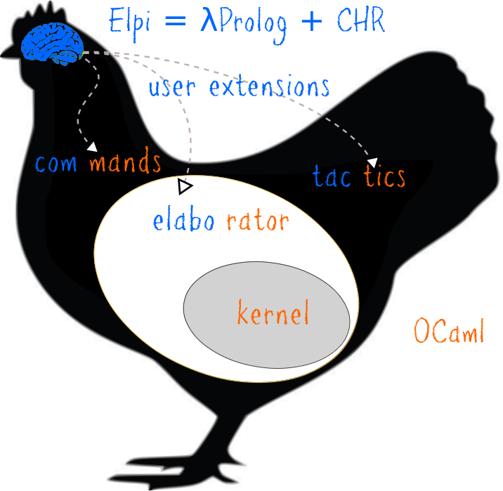

Slide 5
Elpi is...
Extension language
  a library
  FFI
Very high level
  binders
  unification variables
  constraints
A combination of λProlog + CHR

Slide 6
Outline
chi sono → coq + elaborator + extensions
Coq is ML , what works what does not
ELPI as an extension language
miniml.ml
W + eqtypes
Coq-elpi

Slide 7
λProlog 101
type app term → term → term.
type lam (term → term) → term.
type arrow ty → ty → ty..

Slide 8
λProlog 101
pred of i:term, o:ty.
of (app H A) T :- of H (arrow S T), of A S.
of (lam F) (arrow S T) :-
pi x\ of x S => of (F x) T.

Slide 9
λProlog 101
Goal
Program
of (lam x\ lam y\ app x y) Q.
of (app H A) T :- of H (arrow S T), of A S.
of (lam F) (arrow S T) :-
pi x\ of x S => of (F x) T.
Assignments
Q = ...

Slide 10
λProlog 101
Goal
Program
of ((x\ lam y\ app x y) c₁) T_{1.}
of (app H A) T :- of H (arrow S T), of A S.
of (lam F) (arrow S T) :-
pi x\ of x S => of (F x) T.
of c₁ S₁.
Assignments
Q = arrow S₁ T₁
F₁ = (x\ lam y\ app x y)

Slide 11
λProlog 101
Goal
Program
of (lam y\ app c₁ y) T_{1.}
of (app H A) T :- of H (arrow S T), of A S.
of (lam F) (arrow S T) :-
pi x\ of x S => of (F x) T.
of c₁ S₁.
Assignments
Q = arrow S₁ T₁
F₁ = (x\ lam y\ app x y)

Slide 12
λProlog 101
Goal
Program
of ((y\ app c₁ y) c₂) T_{2.}
of (app H A) T :- of H (arrow S T), of A S.
of (lam F) (arrow S T) :-
pi x\ of x S => of (F x) T.
of c₁ S₁.
of c₂ S₂.
Assignments
Q = arrow S₁ (arrow S₂ T₂)
F₁ = (x\ lam y\ app x y)
F₂ = (y\ app c1 y)

Slide 13
λProlog 101
Goal
Program
of (app c₁ c₂) T_{2.}
of (app H A) T :- of H (arrow S T), of A S.
of (lam F) (arrow S T) :-
pi x\ of x S => of (F x) T.
of c₁ S₁.
of c₂ S₂.
Assignments
Q = arrow S₁ (arrow S₂ T₂)
F₁ = (x\ lam y\ app x y)
F₂ = (y\ app c1 y)

Slide 14
λProlog 101
Goal
Program
of c₁ (arrow S₃ T₂).
of c₂ S3.
of (app H A) T :- of H (arrow S T), of A S.
of (lam F) (arrow S T) :-
pi x\ of x S => of (F x) T.
of c₁ S₁.
of c₂ S₂.
Assignments
Q = arrow S₁ (arrow S₂ T₂)
F₁ = (x\ lam y\ app x y)
F₂ = (y\ app c₁ y)
H₃ = c₁
A₃ = c₂

Slide 15
λProlog 101
Goal
Program
of c₂ S₃.
of (app H A) T :- of H (arrow S T), of A S.
of (lam F) (arrow S T) :-
pi x\ of x S => of (F x) T.
of c₁ (arrow S₃ T₂).
of c₂ S₂.
Assignments
Q = arrow (arrow S₃ T₂) (arrow S₂ T₂)
F₁ = (x\ lam y\ app x y)
F₂ = (y\ app c₁ y)
H₃ = c₁ S₁ = (arrow S₃ T₂)
A₃ = c₂

Slide 16
λProlog 101
Goal
Program
of (app H A) T :- of H (arrow S T), of A S.
of (lam F) (arrow S T) :-
pi x\ of x S => of (F x) T.
of c₁ (arrow S₂ T₂).
of c₂ S₂.
Assignments
Q = arrow (arrow S₂ T₂) (arrow S₂ T₂)
F₁ = (x\ lam y\ app x y)
F₂ = (y\ app c₁ y)
H₃ = c₁ S₁ = (arrow S₃ T₂)
A₃ = c₂ S₃ = S₂

Slide 17

Toyml: syntax

Slide 18
Toyml: types

Slide 19
Demo
toyml.ml
w.elpi

Slide 20
What about
“Automatic” but not first class in λProlog

Slide 21
The meta level of
Syntactic Constraints
suspend on X: goal → constraint
resume: when X is assigned
language to rewrite the constraints (CHR)
constraints are frozen goals
rule to-match \ to-remove | condition <=> new-goal
[ w c (uvar s) ] ?- overbar (mono (pair (uvar t) integer)) (uvar pt)

Slide 22
Constraints: an example
Coq mixes terms and types: unification variables can occur inside terms
w X T :- var X, declare_constraint (w X T) X.
Uniqueness of typing:
  if t : T and t : T’ then T = T’
Can be used to keep the evar map duplicate free
  rule ...

Slide 23
Elpi: implementation
Binder mobility
Assignment
GADT

Slide 24
Binder mobility
lp locally nameless
  De Buijn indexes for bound variables
  De Bruijn “levels” for nominal constants
w (lam F) (arrow S T) :- pi c\ w c S => w (F c) T.
?- w (lam x\ app f x) T % w (lam _\ app f 1) T
F c involves a β₀ reduction
  (_\ app f 1) c → app f c

Slide 25
Binder mobility
In Elpi
  De Bruijn “levels” for everything
w (lam F) (arrow S T) :- pi c\ w c S => w (F c) T. % w (F 1) T
?- w (lam x\ app f x) T % w (lam _\ app f 1) T
F 1 involves no substitution
  (_\ app f 1) 1 → app f 1

Slide 26
Assignment
The first prototype of Elpi was pure, and slow
Elpi uses ML’s references (mutable)
  closer to standard Prolog technology (stack, heap, trail)
  easy to align with the GC of the host application
  uncommonly, not a source of bugs

Slide 27
FFI
OCaml’s GADTs to describe the type of the ML code
  no type conversion/checking boilerplate
  mixes FFI call and projection of the result
MLCode(Pred("coq.env.const",
In(gref, "GR",
Out(term, "Bo", Out(term, "Ty",
Easy ("reads the type Ty and the body Bo of GR. ")))),
(fun gr bo ty ~depth ->
let t = if ty = Discard then None else Some (embed ... gr) in
let b = ... in
?: b +? t)),
DocAbove);
main :- coq.locate “nat” GR, coq.env.const GR TY _, ...

Slide 28

Elpi ! logic programming
high level with a procedural meaning
fact: 90% compute, 10% search
extensibility of programs: clauses

