Slide 1
Hemanth’s Algo trading contest submission
Analysing trading strategies on the ETH-USD pair for maximum returns

Slide 2
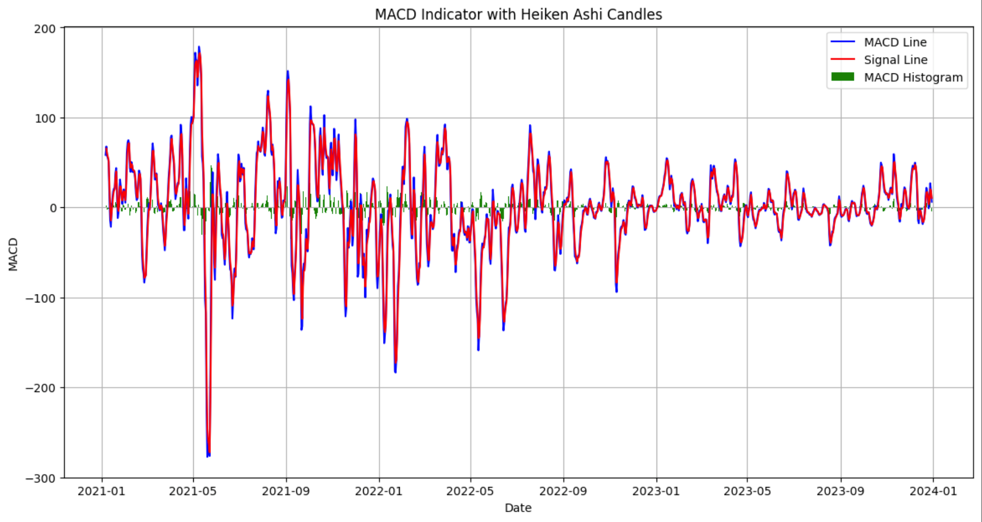
Indicators used
I will be using Heiken Ashi + Modified MACD
I have tightened the MACD ranges from 26, 12 and 9 to 6, 3 and 2 due to higher volatility of cryptocurrencies. Bigger averages don’t tend to work well on cryptocurrencies.
Heiken-Ashi candles are used to filter out noise and identify trends better as it’s a cryptocurrency and cryptocurrencies tend to have high volatility.

Slide 3
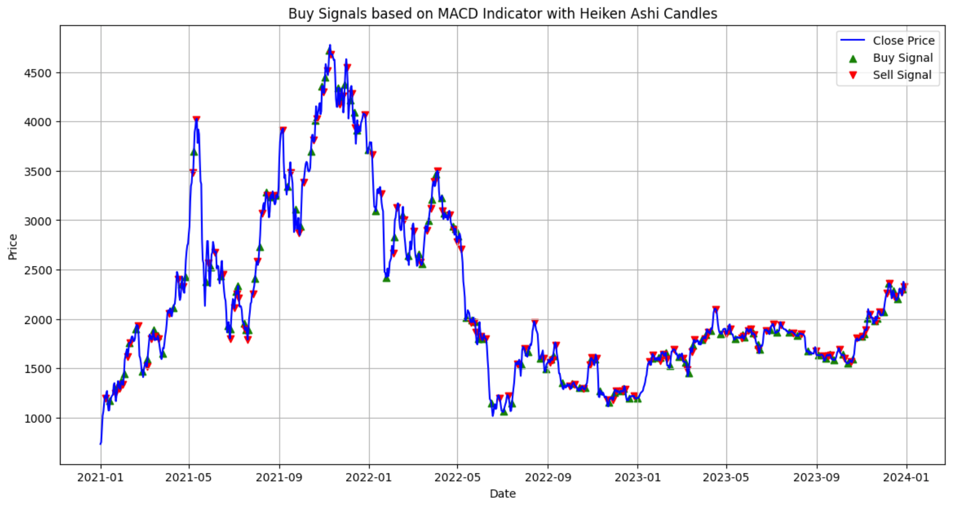
strategy used – All in
Now for returns I used a strategy where I put in all my money at a buy signal to buy how much I can and sell all my stocks at a sell signal.
Putting all your money is not risky due to small range of MACD lines. When the price drops even a little, you exit the trade ensuring your investments don’t go at a heavy loss. This is important for cryptocurrencies as they can undergo sharp drops in price.
Since you exit early and the trades execute at small price differences, it is best to invest maximum capital to make the most profit out of little price differences.

Slide 4
Ratios and returns
Returns over full period = 5329%
Annualized returns = 1776%
Maximum Drawdown = 22%
Win ratio = 59%
Sharpe = 0.41 This trading strategy has a high sensitivity to price movements. As a result, some downward trends also trigger the buy signal. Hence there are plenty of loss trades, leading to high deviation and low Sharpe ratio, but the profit trades are much bigger than the loss trades. The strategy hence gets good returns regardless of the low Sharpe ratio.

Slide 5
Thank you!

