Slide 1

How A Linux Desktop Works

Slide 2
Linux Uses X (X Windowing System)

Slide 3
What is X?
The X Window System (commonly X or X11) is a computer software system and network protocol that provides a graphical user interface (GUI) for networked computers, and was initially developed as part of Project Athena.
X features network transparency: the machine where an application program (the client application) runs can differ from the user's local machine (the display server).
X originated at MIT in 1984. The current protocol version, X11, appeared in September 1987. The X.Org Foundation leads the X project, with the current reference implementation, X.Org Server, available as free and open source software under the MIT License and similar permissive licenses.
More: http://en.wikipedia.org/wiki/X_Window_System

Slide 4
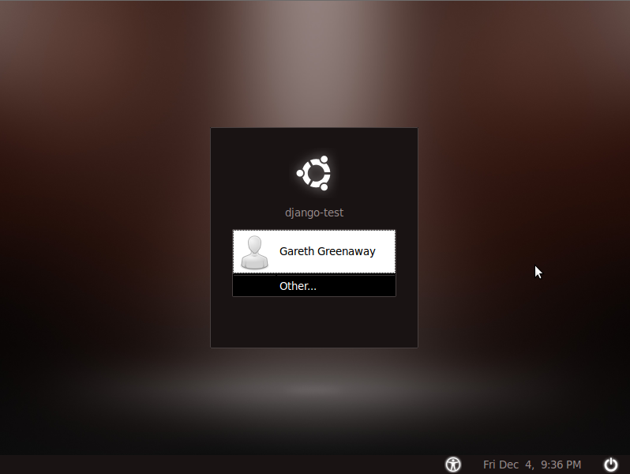
Familiar Site

Slide 5
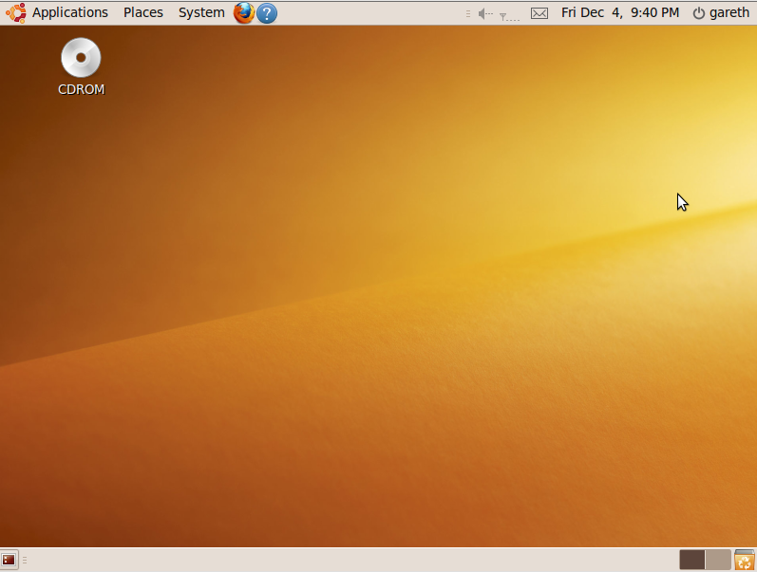
GNOME

Slide 6
How It Fits Together

Slide 7
Typical Layers of X
Evilwm
X Server receives input from a local keyboard and mouse and displays to a local screen.
A window manager controls the placement and appearance of windows within a windowing system.
A desktop environment is a collection of icons, toolbars, applications and desktop widgets.
Fluxbox
Applications
GNOME
Web Browser
Desktop Environment
Mouse
Linux
Xorg
Metacity
KDE
Office Suite
Window Manager
Keyboard
Solaris
Xi Graphics*
Kwin
X Server
XFCE
Etc.
OS Kernel
Monitor
OS X*
Star Net*
xfcewm
LXDE
Hardware
Video Card
*BSD
Enlightenment
Windows*
Many, Many More...

Slide 8
Using A Login Manager
Login Manager
Authentication
Xsession
Window Manager and/or Desktop Environment

Slide 9
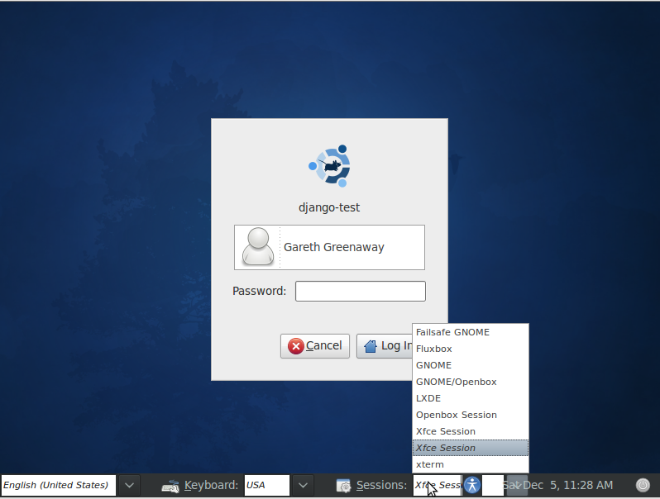
Choosing Session

Slide 10
.xsession
xterm &
startxfce4

Slide 11
Using “startx”
Console Login
Authentication
startx
xinit
.xinitrc
.xsession
Window Manager and/or Desktop Environment

Slide 12
How Xsession works
Xsession
.xsession exists
Yes
No
Yes
.xsession file from Home Directory
Default Xsession

Slide 13
Exciting Stuff
Remote Applications
Remote Desktop Access

