Slide 1

fossevents.org
Helping the Little Guy

Slide 2

Current State and Purpose
Easily search-able listing of Free and Open Source Software events taking place across the globe.

Slide 3

What kind of FOSS Events?
Conferences
User Group Meetings
Meet Ups
Community Events
Live & Virtual
Global

Slide 4
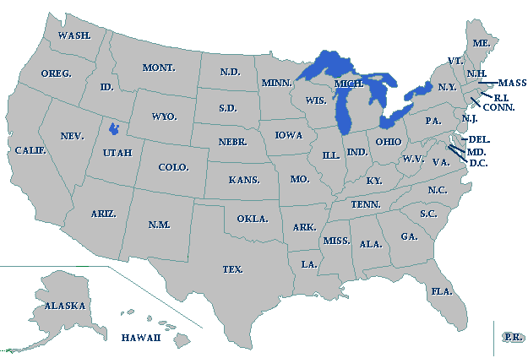

Flourish
PenguiCon
Linux Fest North West
Ohio Linux Fest
Open Source Bridge
Utah Open Source
Conference
Libreplanet
Libreplanet
Drupal
San Francisco
FOSSCon
FOSSCon
South East Linux Fest
Southern California
Linux Expo
Florida Linux Show
Florida Linux Show
Texas Linux Fest
Atlanta Linux Fest

Slide 5



Location, Location, Location

Slide 6

The Future

Slide 7
The dream....
...NOT World War 3

Slide 8
Too Many Events?

Slide 9
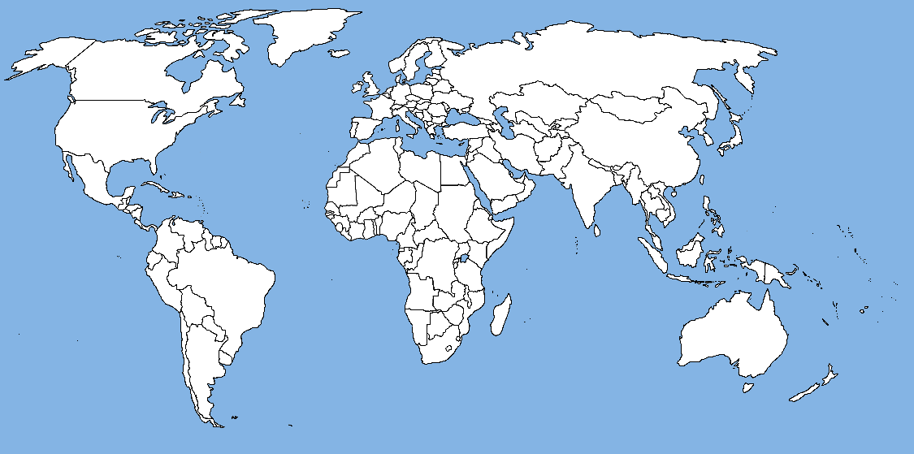
The World is Never Enough

Slide 10
How FOSSEvents wants to help?
Getting Started
Sponsors
Speakers
Promotion

Slide 11

Getting Started.
Deciding on a goal.
Learning from others.
Sharing Information.
Avoid “Sky is Falling” feeling.
Getting started
FOSS Events Wiki
Free & Open Event Planning

Slide 12
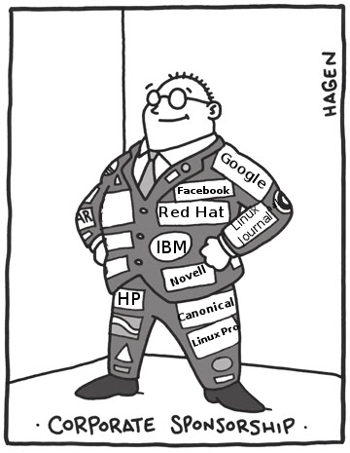
Sponsors
Why?
Who to talk to?
What should be sponsored?
How to handle sponsorship?
Sponsor Registration System
Events Find Sponsors
Sponsors Find Events
Speakers Find Sponsors
Umbrella organization

Slide 13
Speakers
Who wants to speak?
What do they want to speak about?
When can they speak?
What do they need to speak?
Central Speaker Registration System
Speakers register talks once
Submit to Event CFP
Events pull information

Slide 14
Promotion
What events are near me?
Finding others?
Event & User Registration
Register events with location information
A “G.L.U.E.” like system.
Promote to local groups

Slide 15

What's next?
Add events to fossevents.org
Build the new features
Build the community
Get Involved!
Volunteer: gareth@wiked.org

