Slide 1
EEG Probe Project
Grant G. Connell

Slide 2
EEG Probe Project
Design Objectives
  Investigate BCI for severely handicapped individuals
  Use time, frequency, and phase displays
  Use DSP techniques for near real time responses
  Use only the mono input to the sound card of a PC for multiple channel displays (start with two channels)

Slide 3
EEG Probe Project
Design requirements
  Some compatibility with Modular EEG H/W
    Can use analog section with modulator section, +/- 5V operation
  Single input (mono to sound card)
  Two channel prototype, expandable to 32 channels
    Reference leg for both channels
  Select either SSB, AM, or FM modulation technique
    Selected AM for frequency stability, better spectrum management than FM
  Displays
    Stripline, Vertical FFT, Vertical Phase, Waterfall
    Application screen size = 1024 by 768

Slide 4
EEG Probe Project
System Design (AM Modulation)
Amplitude
12 kHz
14 kHz
16 kHz
18 kHz
(Carriers)
500 Hz
Freq (Hz)
Chan1
Chan2
Chan3
Chan4

Slide 5
EEG Probe Project
AM System Design, Processing Chain
Stripchart
Channel 1
Bandpass
Filter, 16 kHz
Channel 1
AM Demod
and LP Filter
Decimate (8x)
Prog. Filter,
DC Removal
Channel 1
1024 Byte
Buffer & FFT
Vertical
FFT,
Phase
Sound Card
Input
(Mono)
Mic.
Channel 2
Bandpass
Filter, 18 kHz
Channel 2
AM Demod
and LP Filter
Decimate (8x)
Prog Filter,
DC Removal
Channel 2
1024 Byte
Buffer & FFT
Vertical
FFT,
Phase
11025 Hz
Sampling Rate
1024 Byte Blocks
1024 Byte
Convolutional
Filter, 500 Hz BW
1024 Bytes
Envelope
Detection
128 Bytes
1024 Bytes
Stripchart

Slide 6
EEG Probe Project
System Design: Displays
  Vertical FFT
  Vertical Phase
  Strip Chart
  Waterfall

Slide 7
EEG Probe Project
Development Environment
  Use C,C++ Builder IDE (from Borland)
  Third party components (knobs, switches)
  Low level sound card drivers
  All software developed internally
    Could use Intel DSP library for open source development

Slide 8
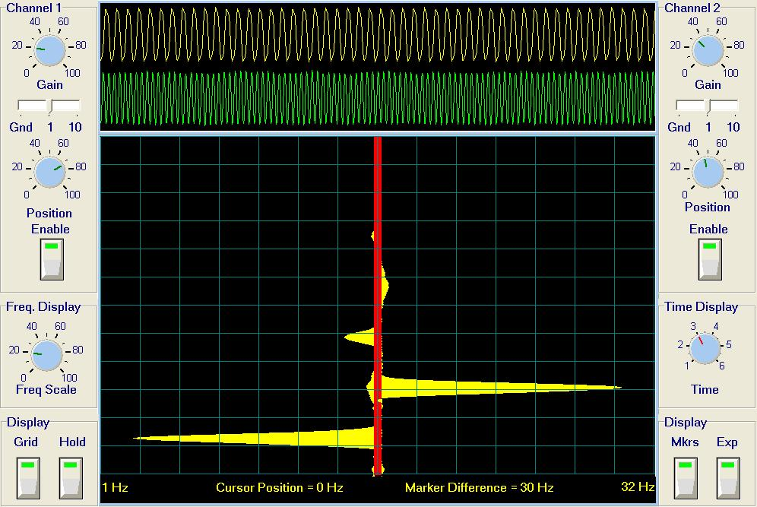
Vertical FFT Display, 6 Hz and 12 Hz inputs

Slide 9
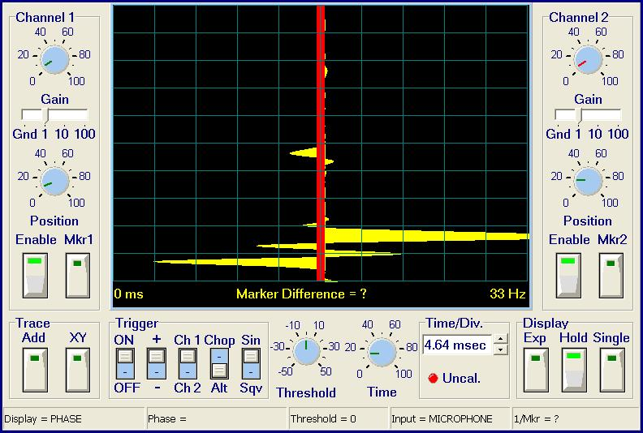
EEG Probe Project
Vertical Phase Display, 2 Hz and 5 Hz

Slide 10
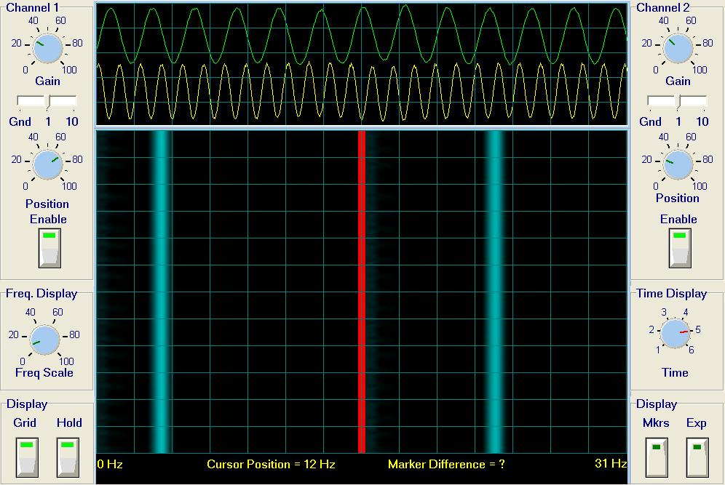
Waterfall Display, 6 Hz and 12 Hz inputs

Slide 11
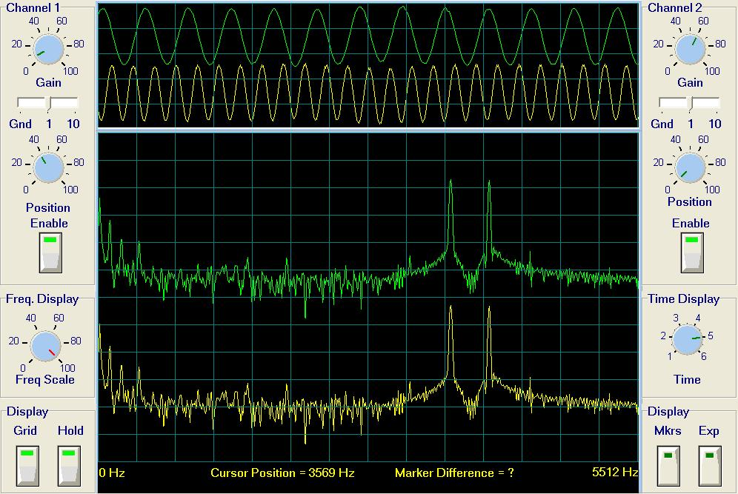
RAW FFT Spectrum 3.5 kHz and 4.0 kHz carriers

Slide 12
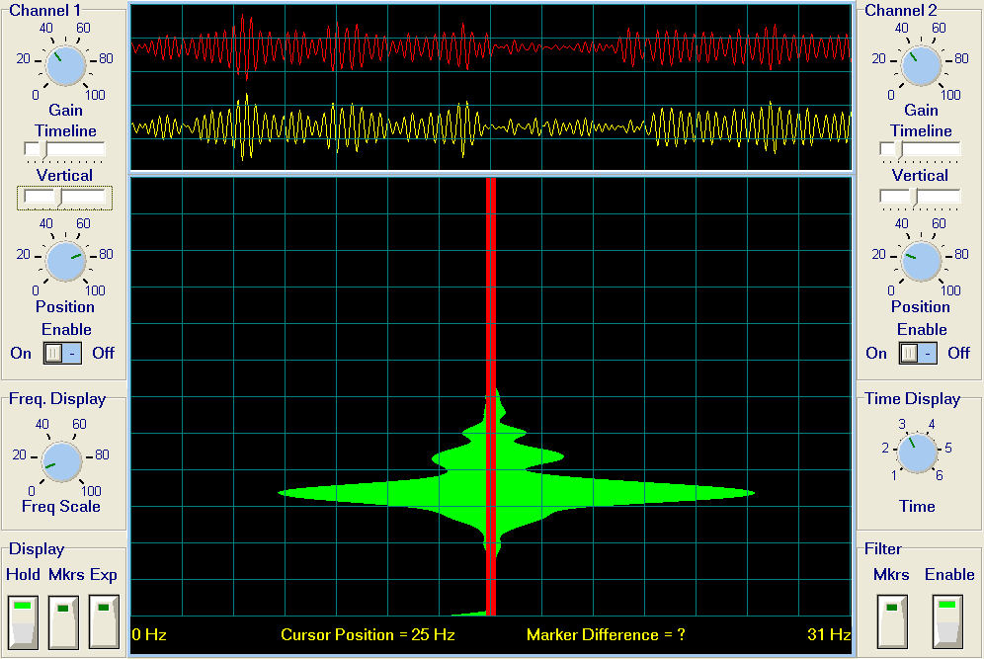
Alpha Bursts, 9 Hz

Slide 13
EEG Probe Project
First Hardware Protype
  Two PC boards
    Dual channel analog design similar to Modular EEG
    Dual channel modulator board using low cost ICs , output transformer coupled for isolation from the PC
    Single supply input (+12 volt) from isolation transformer, converted to +/- 5 volts.
  Front panel gain control for each channel
  Power supply LEDs

Slide 14
EEG Probe Project
Hardware Block Diagram
Lo1
Chan 1
AM Mod
Gain
XFMR
Sum
To
PC
Chan 1
Gain
AM Mod
Ref
DRL
Lo2
Gnd
Dual Channel
Low Noise Amplifier
Board
Dual Channel
AM Modulator
Board

Slide 15
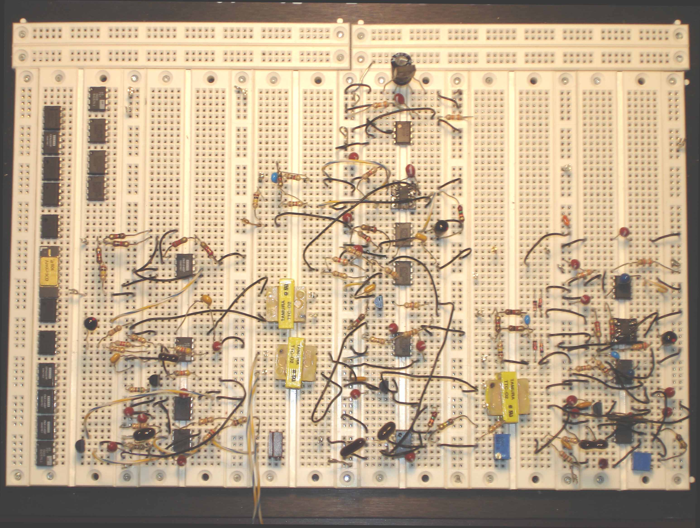
Breadboard Designs
AM
Design
New
Designs
FM
Design

Slide 16
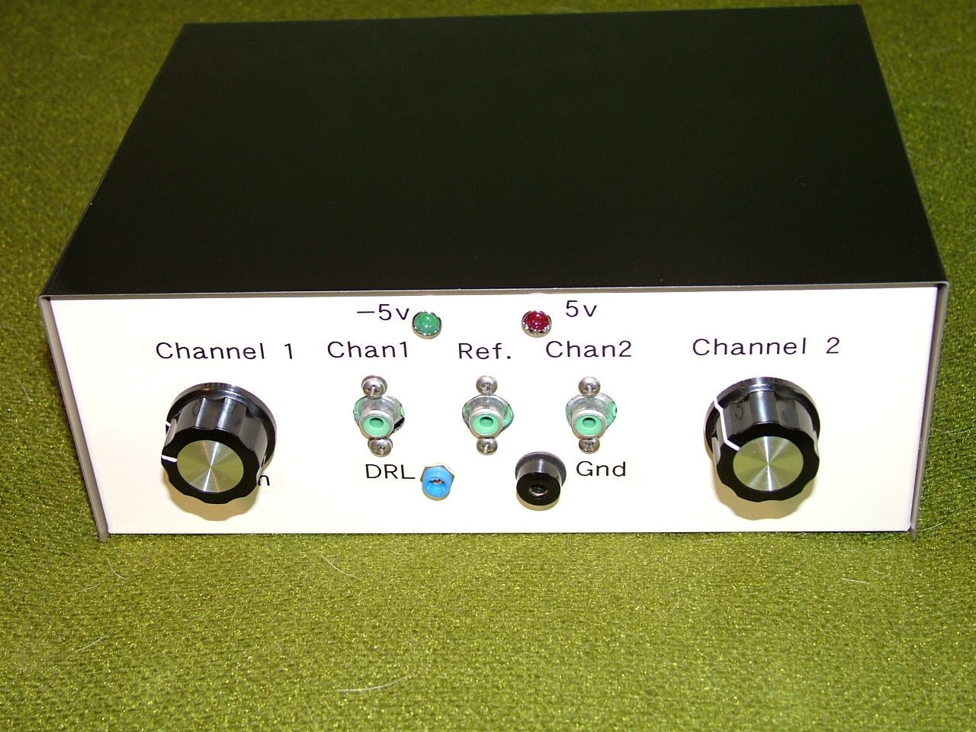
Prototype Unit

Slide 17
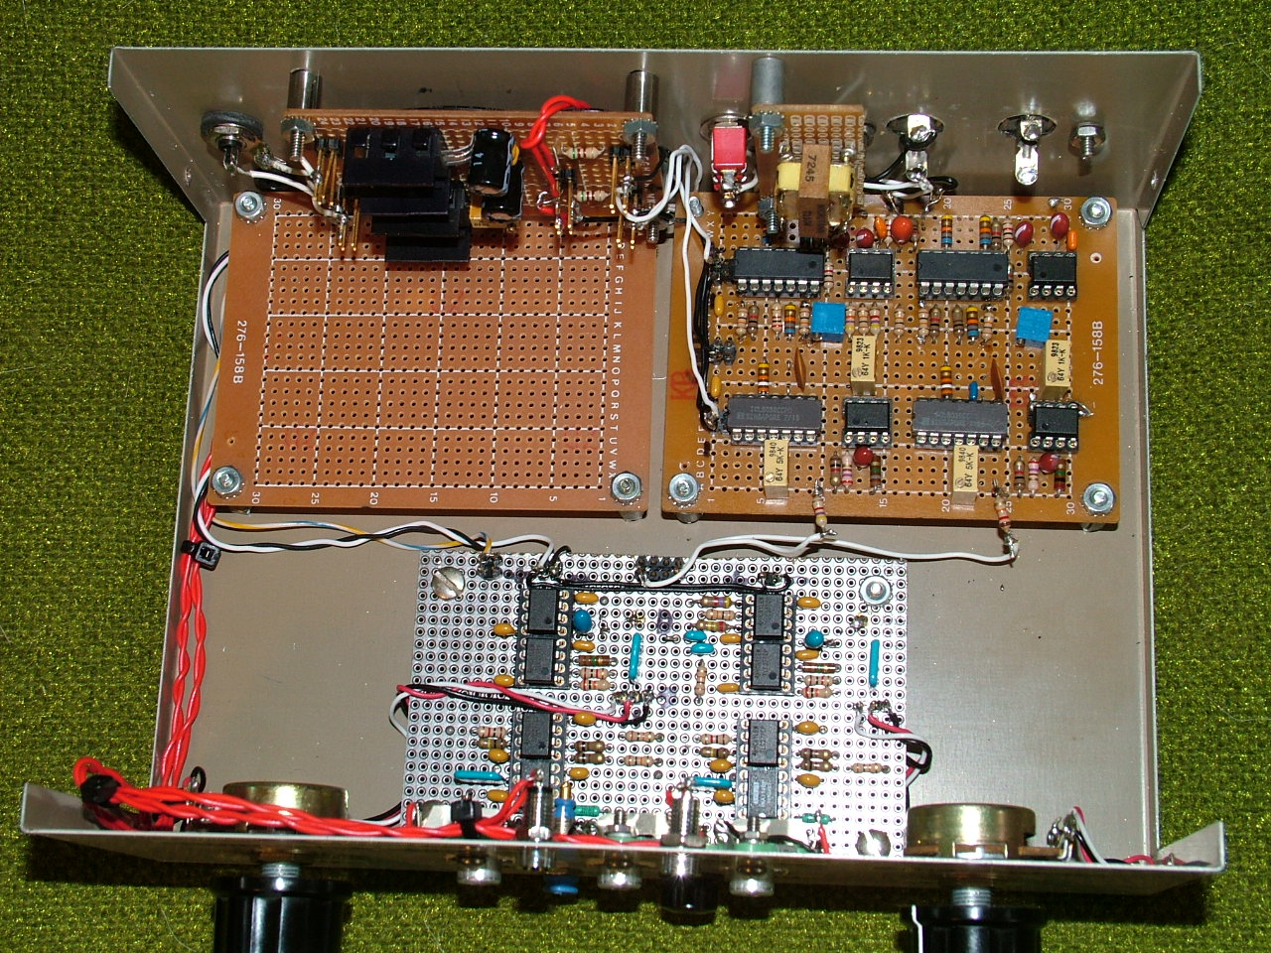
Chassis Layout
Power
Supply
Modulator
Board
Dual Amp
Board

Slide 18
EEG Probe Project
FM System Design, Processing Chain
Stripchart
Channel 1
Bandpass
Filter, 14 kHz
Channel 1
FM Demod
and LP Filter
Decimate (32x)
Prog. Filter,
DC Removal
Channel 1
1024 Byte
Buffer & FFT
Vertical
FFT,
Phase
Sound Card
Input
(Mono)
Channel 2
Bandpass
Filter, 19 kHz
Channel 2
FM Demod
and LP Filter
Decimate (32x)
Prog Filter,
DC Removal
Channel 2
1024 Byte
Buffer & FFT
Vertical
FFT,
Phase
44100 Hz
Sampling Rate
1024 Byte Blocks
4096 Byte
Convolutional
Filter, 500 Hz BW
4096 Bytes
Envelope
Detection
128 Bytes
1024 Bytes
Stripchart

Slide 19
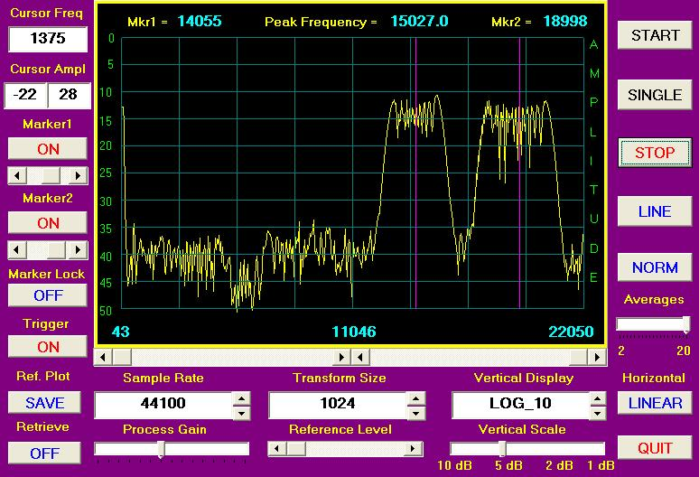
Dual Channel FM Spectrum

Slide 20
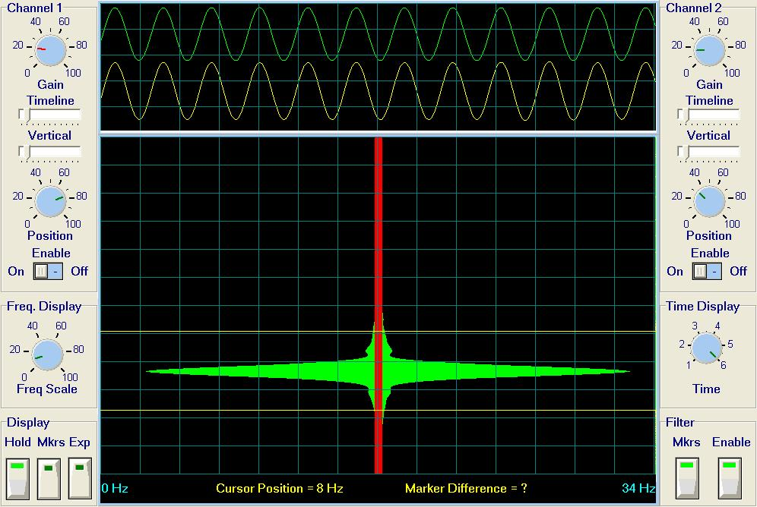
Dual Channel FM Waveforms

Slide 21
Modulation Scheme Comparison
AM Modulation
  Good spectrum management (1500 Hz per channel)
  80 dB dynamic range (2.0 mv to 0.20 uv)
  Requires only 3 IC’s plus a transistor per channel (most recent design)
  Gain calibration procedure with sound card required
  60 dB cross-talk isolation between channels
FM Modulation
  Limited spectrum management (4 kHz per channel)
  80 dB dynamic range (1.5 mv to 0.15 uv)
  Requires only 3 IC’s per channel
  Gain calibration built-in via H/W and S/W design
  60 dB cross-talk isolation between channels

Slide 22
EEG Probe Project
Prototyped single channel AM modulation unit
  Current drain approximately 6.5 ma. @ 9 volts
Prototype dual channel FM modulation unit
  Current drain approximately 5.75 ma. @ 9 volts
  Switched to CMOS version of NE555 IC
Prototype dual channel AM modulation unit
  Current drain approximately 7.0 ma. @ 9 volts
  Switched to simpler AM modulator with better noise performance
  Used CMOS version of NE555 IC (ICM7555)
All prototypes completed and operational

Slide 23
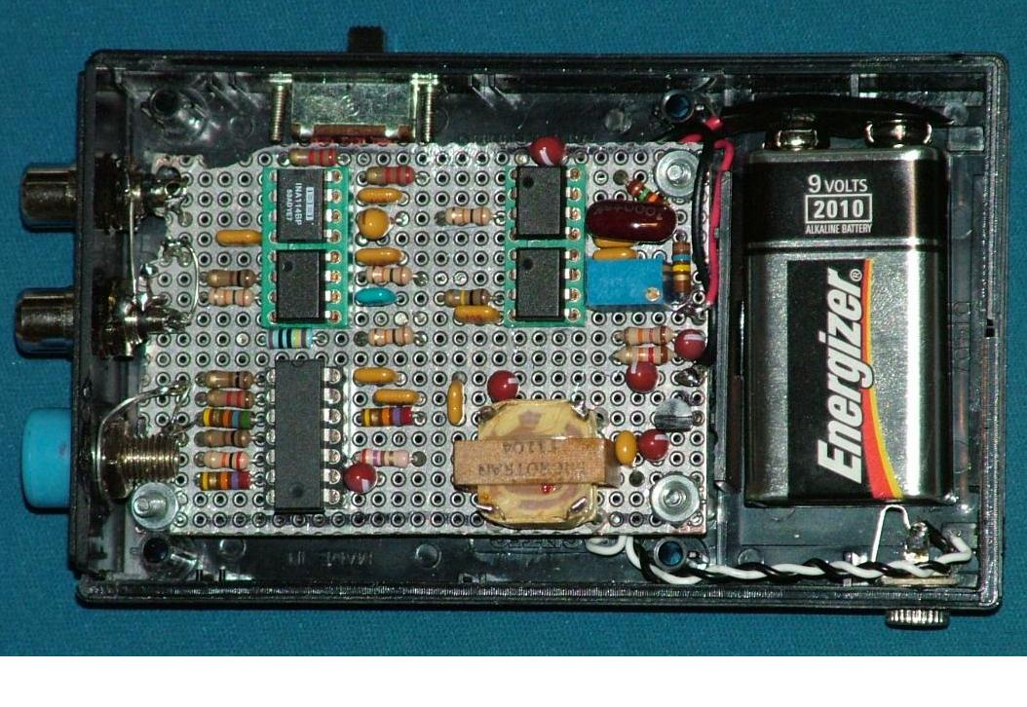
Single Channel AM Unit

Slide 24
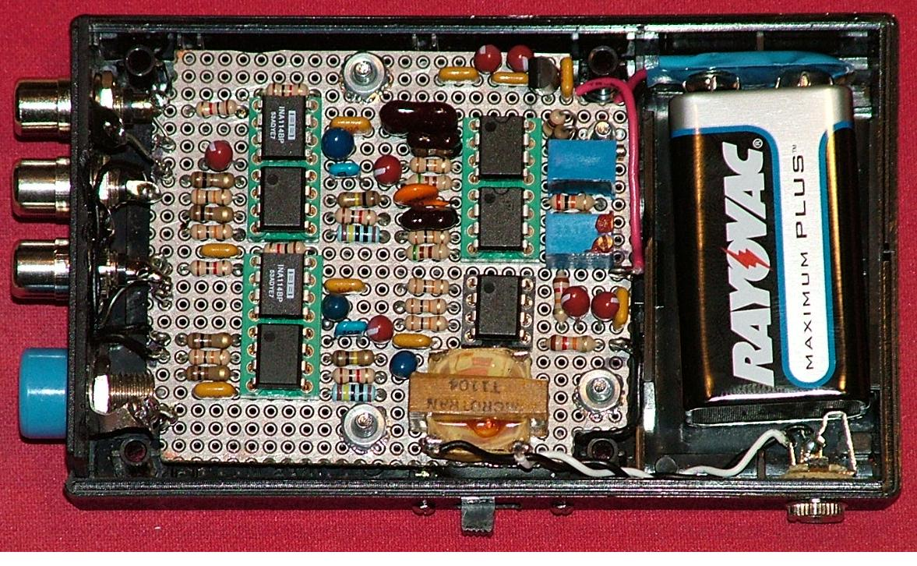
Dual Channel FM Unit

Slide 25
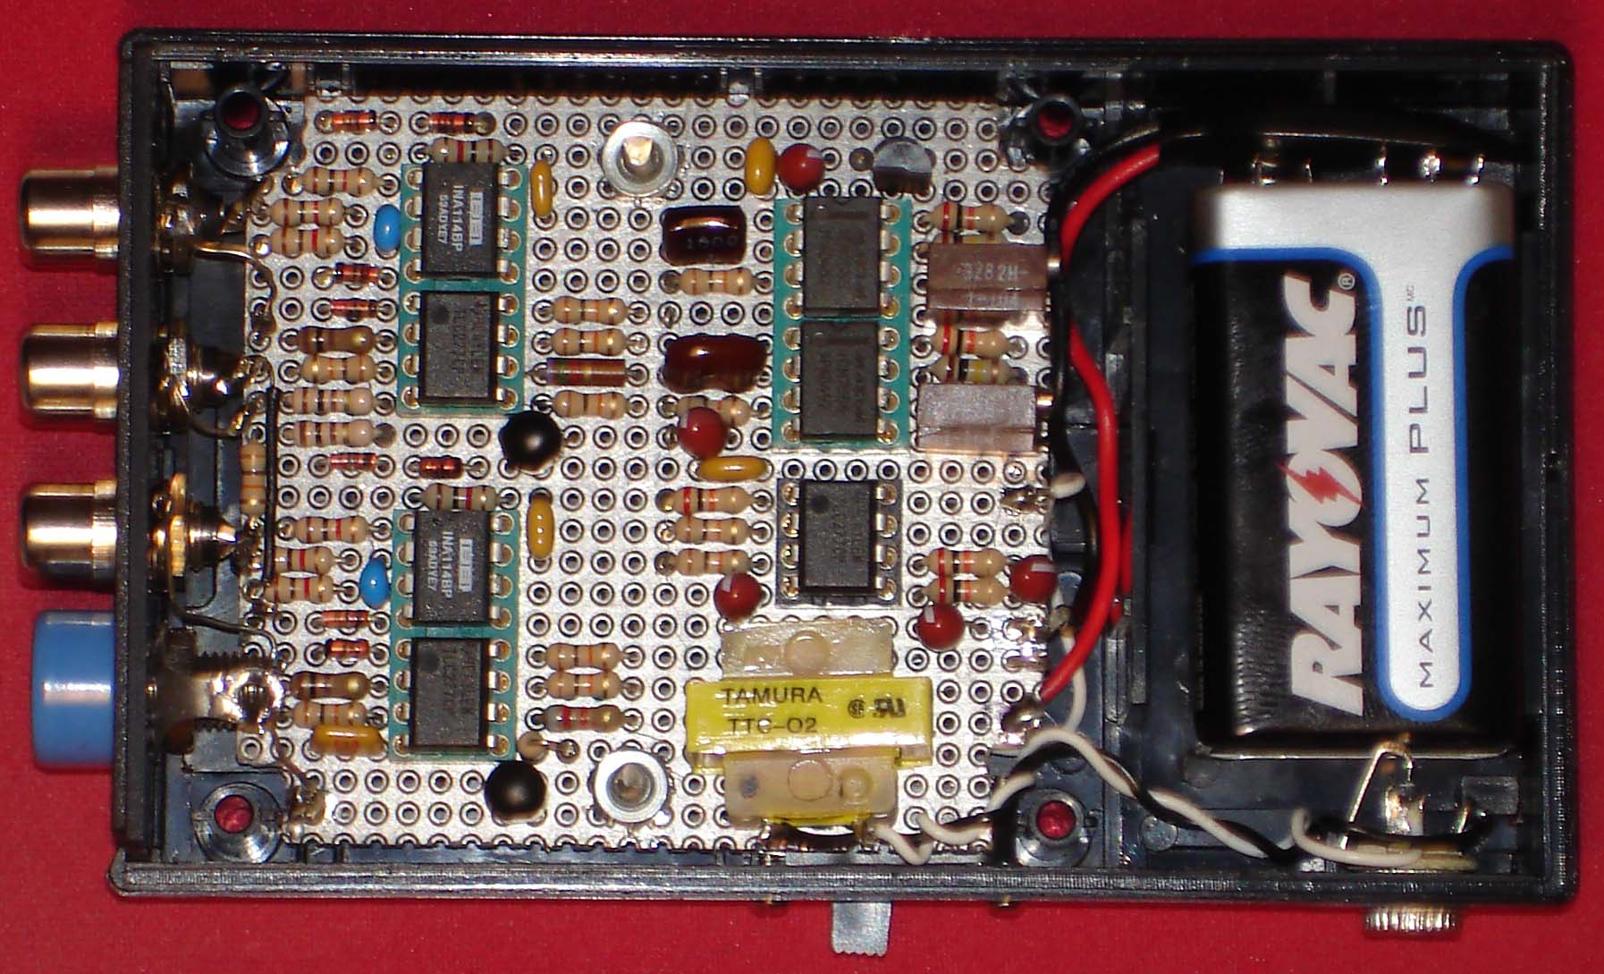
Dual Channel AM Unit

Slide 26
EEG Probe Project
Current Status
  Completing final S/W application
    AM demodulation design complete
    FM demodulation design complete
    Added adjustable LP and BP filters (S/W)
  Switched to digital LO (for a two channel system only), used cheaper ICs to generate the local oscillator
  Dual channel AM and FM designs completed and prototypes built

Slide 27
Software Update
EEG Probe software
  Added record and playback capability
  Near real-time response with IIR digital filters
Sound Card Interface to NeuroServer
  Converts sound card data to EDF format and interfaces to the NeuroServer
  Also converts sound card data to ModEEG format for RS-232 interfaces, requires Eltima virtual RS-232 driver
Both software packages available at the SourceForge web site:
  http://openeeg.sourceforge.net/doc/hw/sceeg/

