Slide 1
ImageModule
Caches
ImageLoader
ImageCache
ImageDecoder
IconLoader
FileCache
Loader
BitmapPool
AbsImageLoader
Pools
LoadTasks
Parameters
Executor

Slide 2
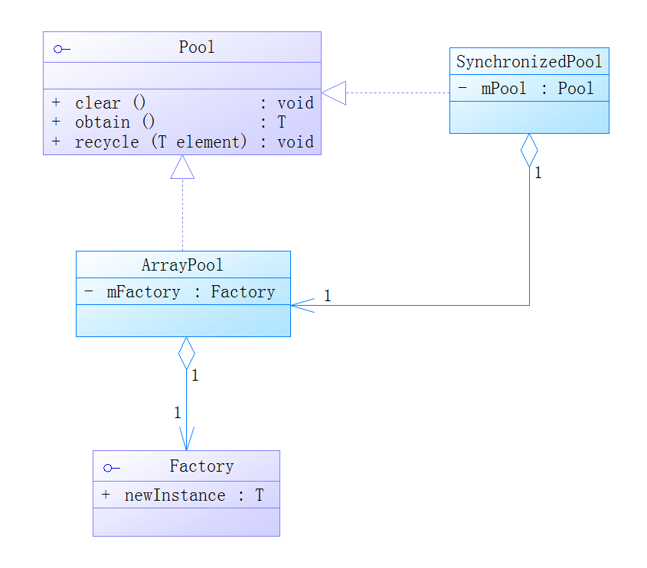

Slide 3
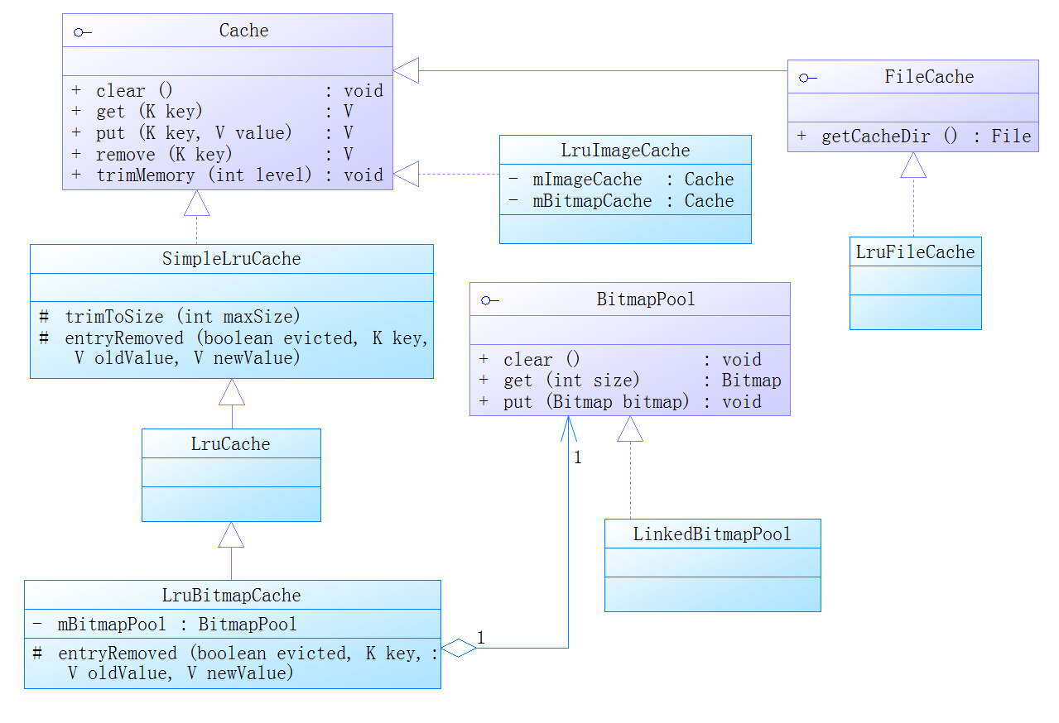

Slide 4
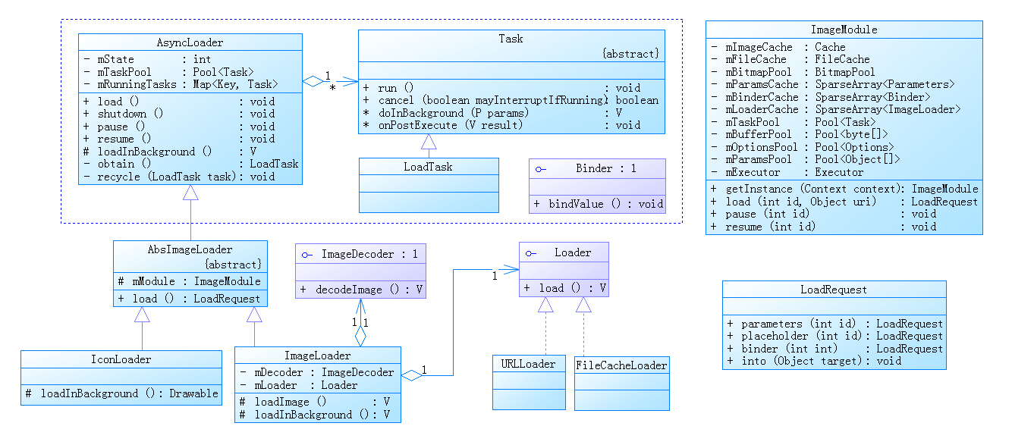

Slide 5
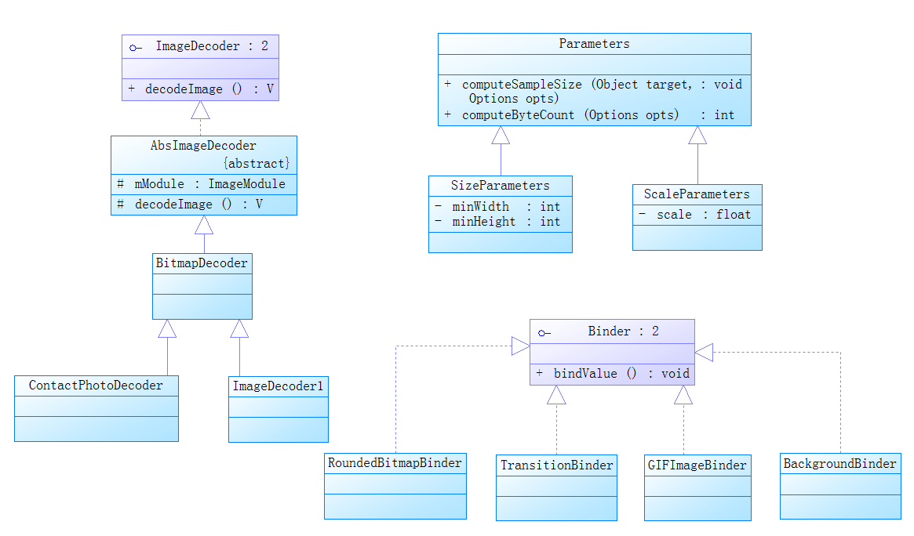

Slide 6
