Slide 1
0.0
Genome
Neat
Nodes
Connections
From
To
Weight
Clients/Population
Innovation Number
Species
Genome
Score
Species
Calculator
Clients/Population
Representative
Mutation
Evolve

Slide 2
1.0
Genome
Clients/Population
Species
Neat (CNS)
Nodes
Innovation Number
Connections
From
To
Weight
Representative
Score
Calculator
Mutation
Evolve

Slide 3
1.0b
Genome
Clients/Population
Species
Neat (CNS)
Nodes
Innovation Number
Connections
From
To
Weight
Representative
Score
Calculator
Mutation
Evolve
SPECIE

Slide 4
1.1
Genome
Clients/Population
Species
Neat (CNS)
Nodes
Innovation Number
Connections
From
To
Weight
Representative
Score
Calculator
Crossover
Evolve
Mutation
Connections
Nodes

Slide 5
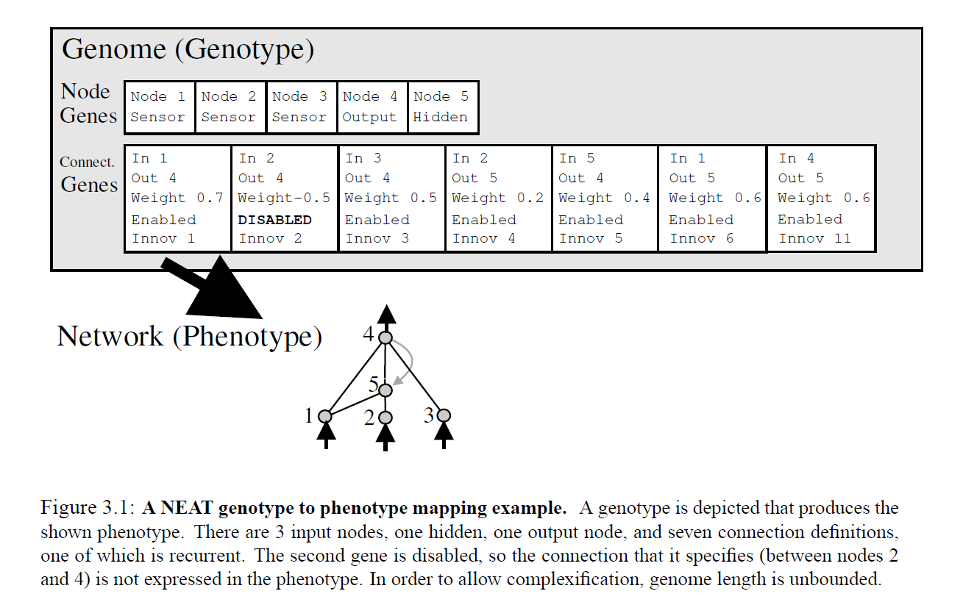

Slide 6
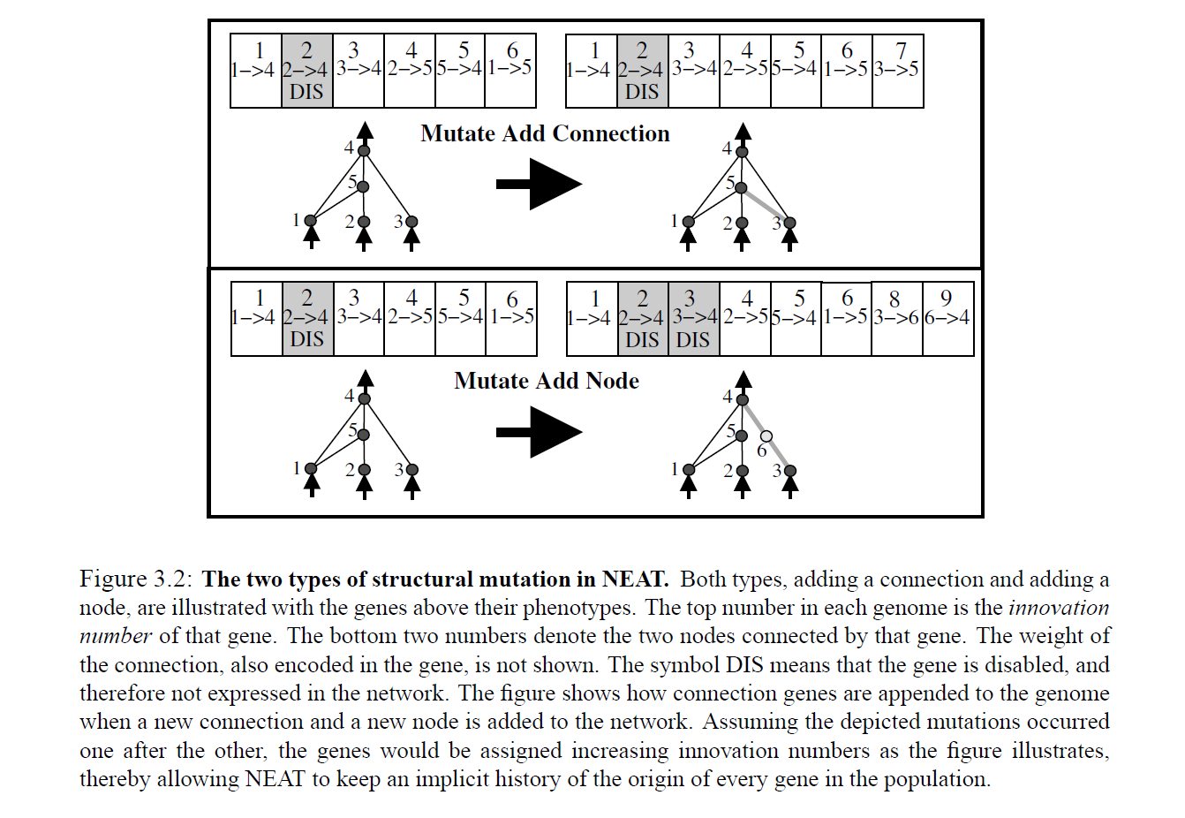

Slide 7
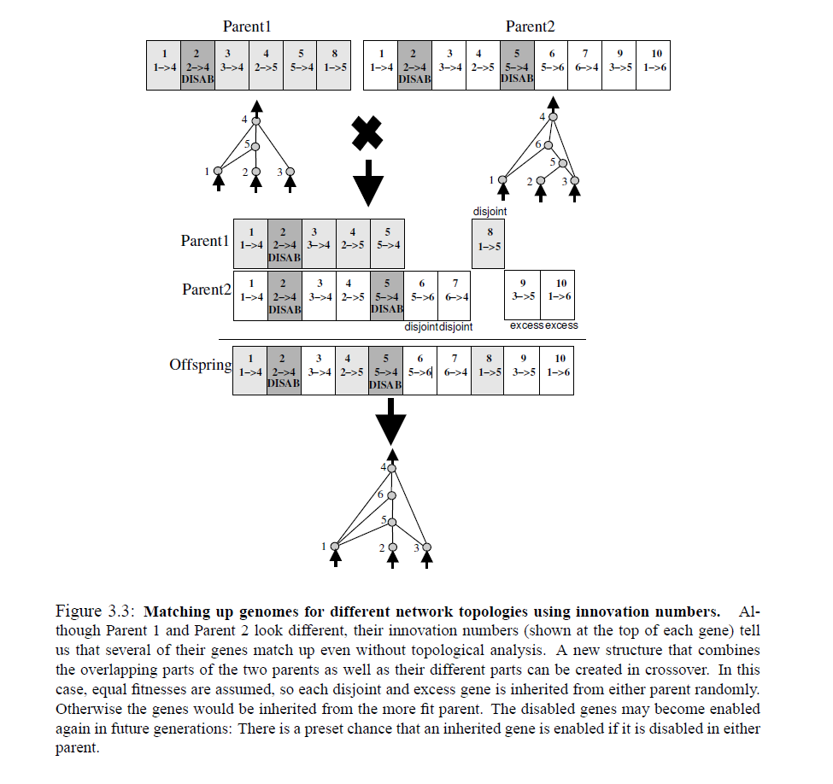

Slide 8
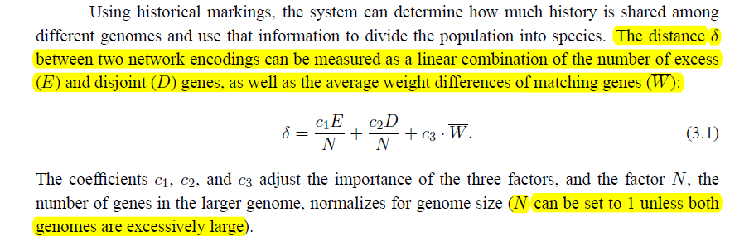

Slide 9
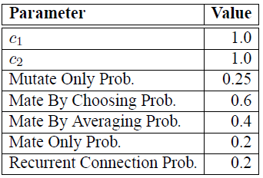

Slide 10
