Slide 1

FULL STACK-II PROJECT
COVID-19 TRACKER
DEPARTMENT OF COMPUTER SCIENCE ENGINEERING AND APPLICATIONS
Institute Of Engineering And Technology

Slide 2
Submitted By:
Megha Kansal
(181500382)
And
Deepanshi Garg
(181500206)
Supervised By:
Mr. Pankaj Kapoor
Asst. Professor
Department of Computer Science & Applications

Slide 3
OBJECTIVE
We all have been affected by the current COVID-19 pandemic. However, the impact of the pandemic and its consequences are felt differently depending on our status as individuals and as members of society. Our different social identities and the social groups we belong to determine our inclusion within society and, by extension, our vulnerability to epidemics.
By analyzing the data of a deadly pandemic that has created a mess in this wonderful world and caused a lot of deaths is a need of this hour such that we can easily take preventive measures and hold this pandemic growth and eradicate it with certain measures. Therefore, we made a COVID-19 tracking application.

Slide 4
INTRODUCTION
When disease can travel so quickly, information has to move even faster. This is where map-based dashboards become crucial.
It helps analyzing real time situation or virus by providing us updates about number of corona virus cases in our surroundings so that conclusions could be made how to protect us from its widespread.
Communication through map-based dashboards offers accessible information to people around the world eager to protect themselves and their communities.
COVID-19 tracking tools are getting developed at a rapid pace by different governments in their respective countries.

Slide 5
FEATURES OF COVID-19 TRACKER
It displays a country-wise breakdown of corona virus cases under three categories: corona virus cases, recovered, deaths.
It offers a simple, dual-colored, interactive world map visualizing the impact of corona virus across territories.
It offers to the users from no page reloads to all corona virus related data under a single web page.
It covers all scenarios to achieve the requirements of any user searching for worldwide or country wise details regarding corona virus.
The data is collected by asynchronous API calls to disease.sh that provides dynamic data depending on the endpoint used during the call. It gives JSON data in response.
It helps citizens to stay up to date with the latest on the pandemic.

Slide 6
TECHNOLOGIES USED
React JS and CSS library like Material UI has been used and making API calls to collect worldwide data related to Corona virus.
React is a JavaScript library created for building fast and interactive user interfaces for web and mobile applications. It is an open-source, component-based, front-end library responsible only for the application’s view layer.
Features of React
JSX - JavaScript Syntax Extension, Virtual DOM, Performance, Extensions, One-way Data Binding, Debugging.
React Hooks allows you to use state and other React features without writing a class. Hooks are the functions which "hook into" React state and lifecycle features from function components.

Slide 7
CSS (Cascading Style Sheets) is a simply designed language intended to simplify the process of making web pages presentable. Cascading Style Sheets is a style sheet language used for describing the presentation of a document written in a markup language such as HTML.
Material UI is a component library for React teeming with powerful components, can provide you with solid pre-styled components that will get the job done. Material-UI components work without any additional setup, and don't pollute the global scope.
API Calls- The data is collected by asynchronous API calls to disease.sh that provides dynamic data depending on the endpoint used during the call. It gives JSON data in response.
https://disease.sh/v3/covid-19/all
https://disease.sh/v3/covid-19/countries

Slide 8
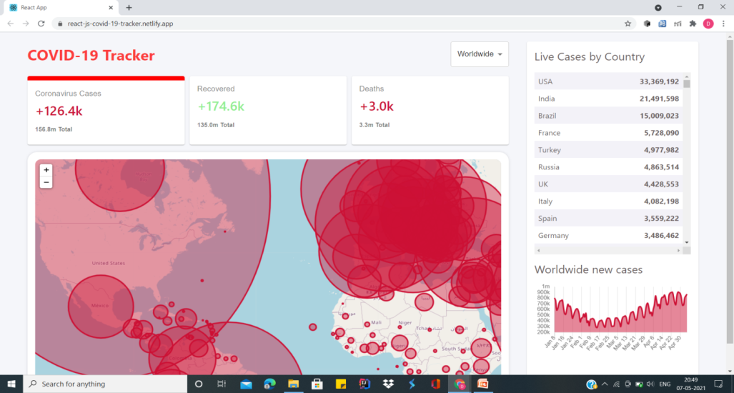
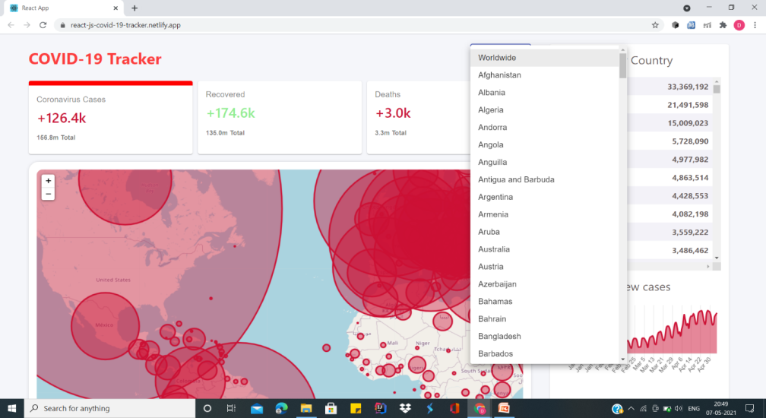
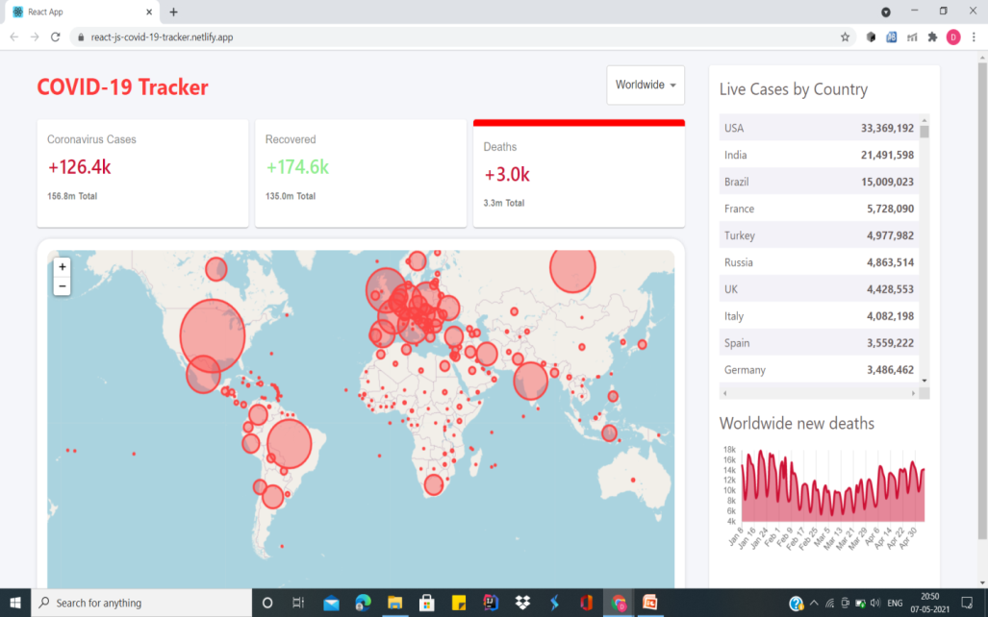
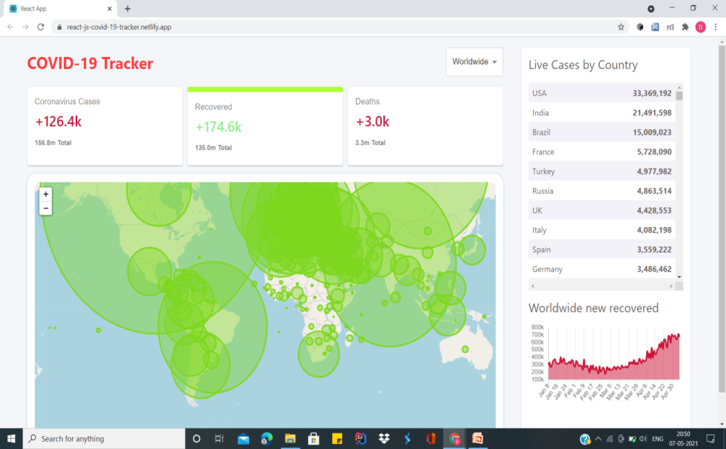
OUTPUT SCREENSHOTS

Slide 9

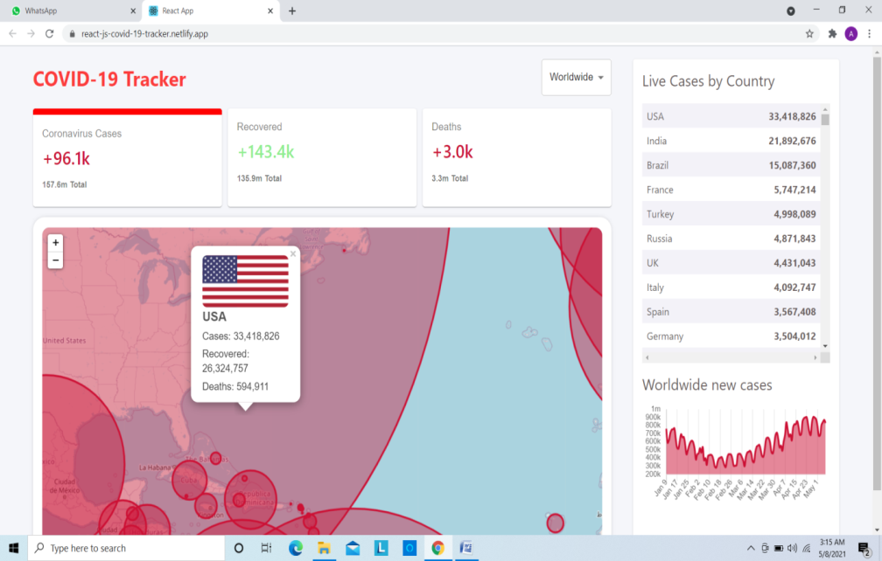
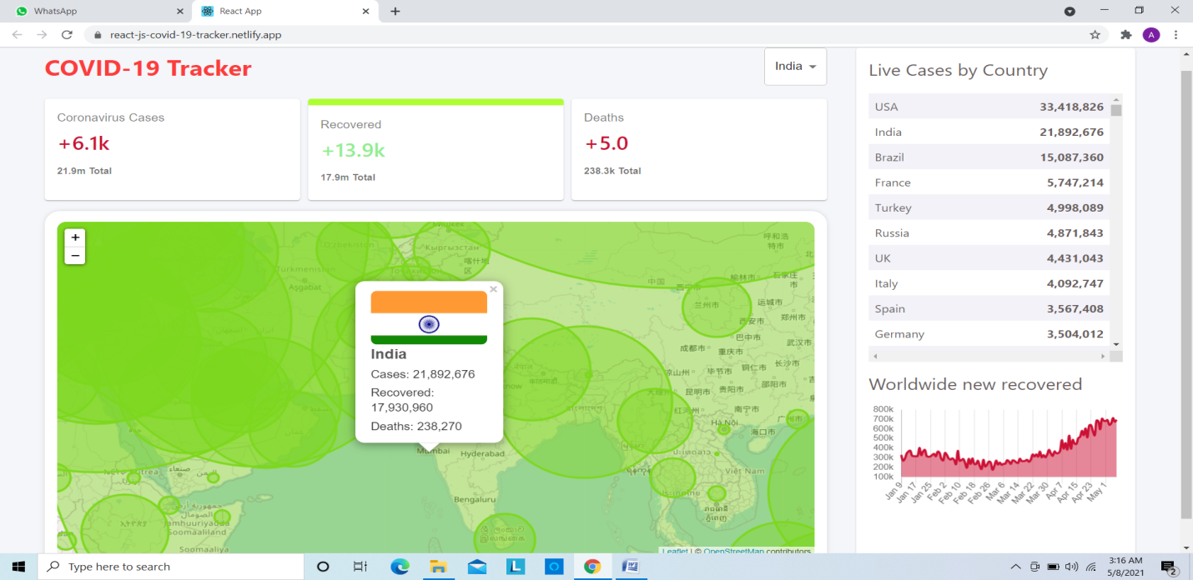
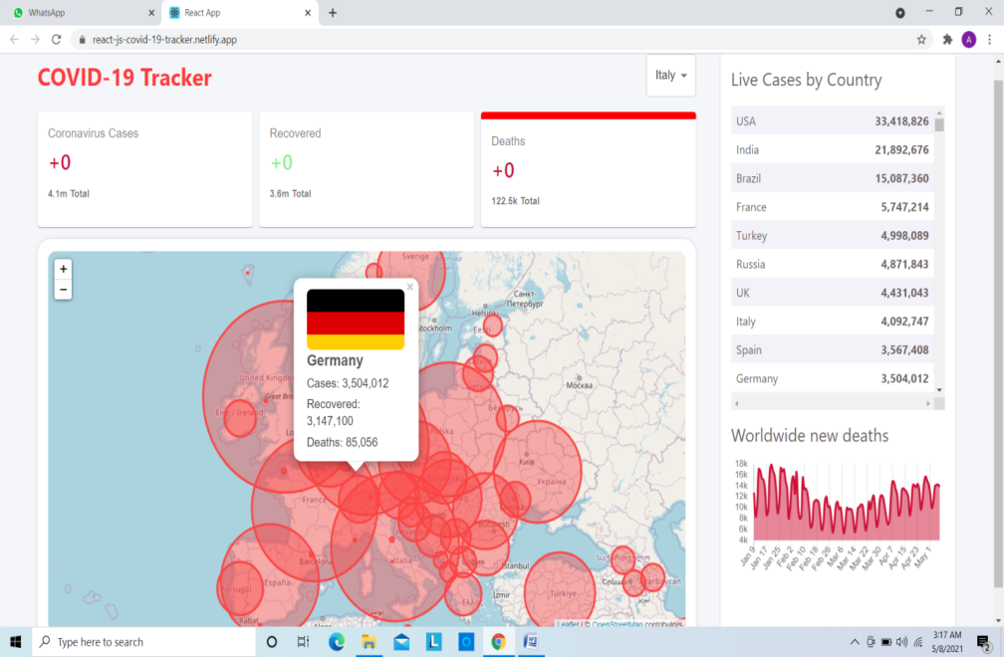

Slide 10
FUTURE SCOPE
Further implementation of some exciting features like disease prediction on the basis of symptoms and direction of further steps such as finding an appropriate doctor nearby user area would add wonders to this application.
These will be helpful in understanding and developing new algorithms for finding doctor’s for users according to their area. This is a booming project topic which is still going on for surveillance of large crowds in real time applications.

Slide 11
CONCLUSION
From this application, we conclude that how React JS and some basic concepts of frontend development can lead to such an exciting web application with a bunch of features.
Though the application is a pretty basic for now but it has a great scope for further implementation of some advanced topics and some more technologies and for now the application is serving its aim to the fullest for which it is developed.

Slide 12
THANKING YOU

