Slide 1
CHURN ANALYSIS
Priya Garg 169108106
Priyanka Batra 169105135

Slide 2
WHAT IS CHURNING
For a business in a stipulated period of time, customers can come under 3 major categories
Newly Acquired Customers
Existing Customers
Churned Customers
Churned Customers are those who have decided to end their relationship with their existing company. It can happen because of variety of reasons like bad behavior, bad customer services, bad onboarding or lack of ongoing customer success.
Churned Customers means a direct loss of Marketing Acquisition Cost and possible revenue which could be capitalized post sale. Hence, predicting possible customers who can churn beforehand can help us save this loss.

Slide 3
BANK CUSTOMER CHURN MODELLING DATASET
The data set includes information about:
Customers who left within the last month — the column is called Exited.
Services that each customer has signed up for —credit cards, no. of products etc.
Customer account information — Balance, credit score, tenure, estimated salary, is active member etc.
Demographic info about customers — gender, age, place etc.
Link: https://www.kaggle.com/barelydedicated/bank-customer-churn-modeling

Slide 4
ANALYSIS
OBJECTIVE : Predicting and thus reducing customer churn through pro-active actions.
DATA COLLECTION AND CLEANING : The predicting model is only as good as the data source. Thus it needs to be wholesome and clean for accurate predictions.
FEATURE SELECTION: Using Pearson correlation with threshold value 0.02, we select the important features among all those residing in the dataset.
MODELLING : The models used predict the churn value as 1(Churn) or 0(No Churn) by employing K-Fold cross validation.
    Artificial Neural Networks
    Logistic Regression
INSIGHTS AND ACTIONS : This is the part where we actually suggest actions to be taken in order to prevent the churning of these predicted customers.

Slide 5
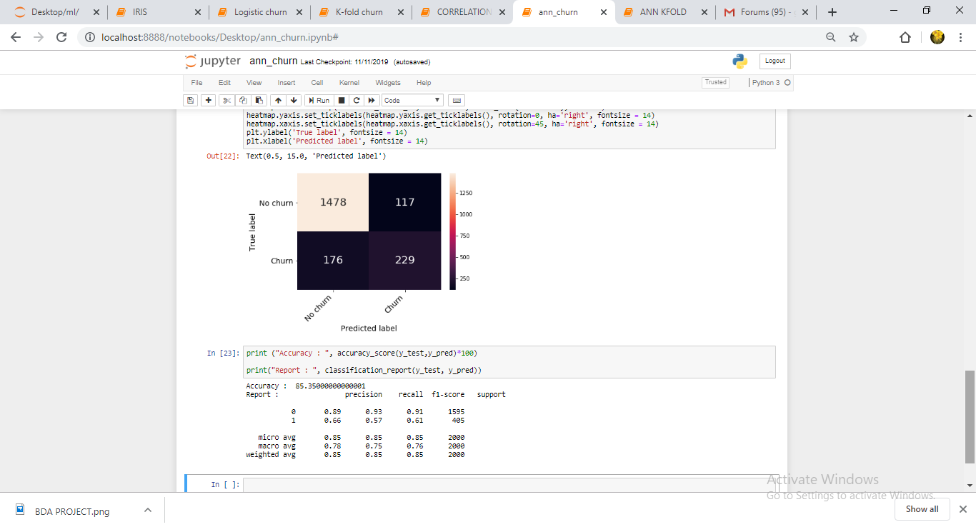
ARTIFICIAL NEURAL NETWORK
Accuracy after K-Fold : 81.86%

Slide 6
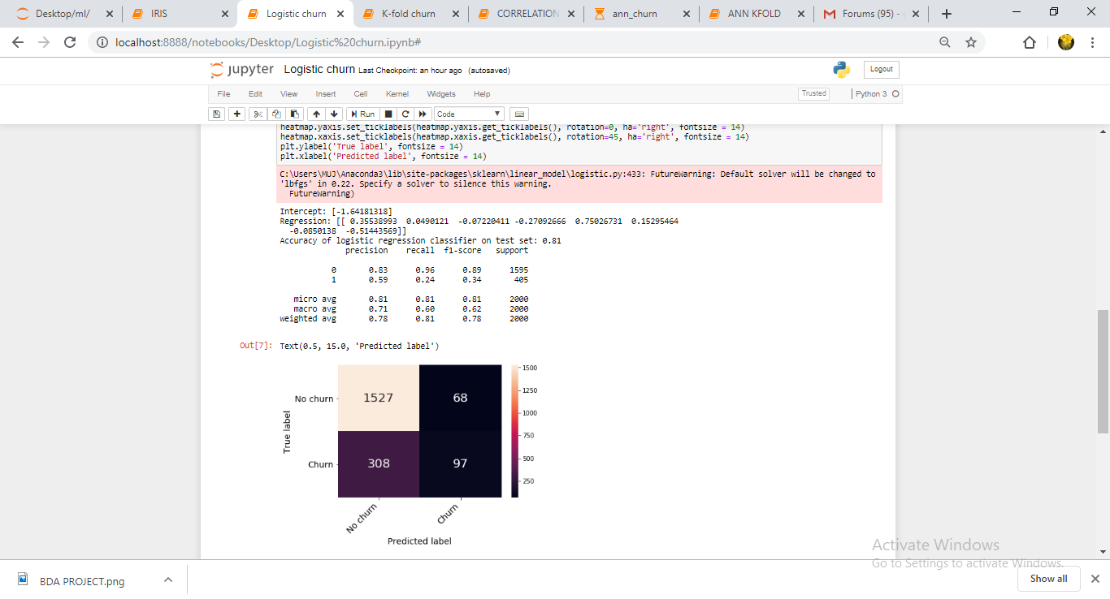
LOGISTIC REGRESSION
Accuracy after K-Fold : 50.25 %

Slide 7
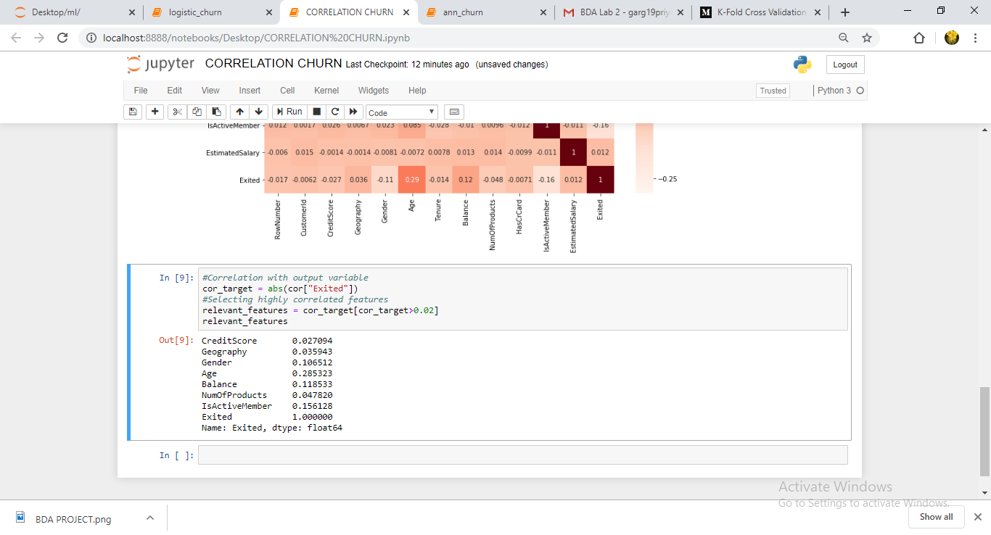
CORRELATION
PEARSON CORRELATION

Slide 8
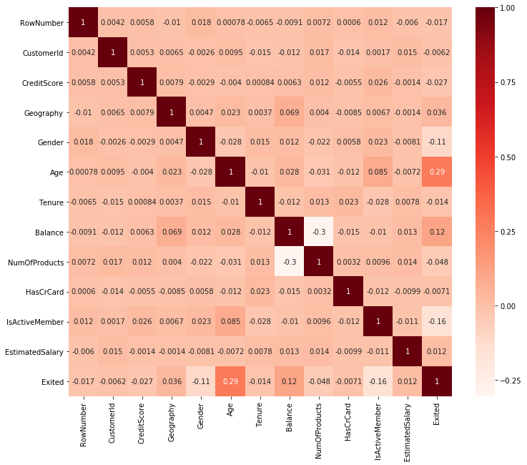
CORRELATION

Slide 9
FUTURE WORK
Suggesting actions to be taken in order to prevent churning would define the scope of future work in this project. Some of those are listed below:
1. Offer Incentives
2. Pay Attention to Complaints
3. Offer long term benefits
4. Prioritize certain services according to your best customers.

