Slide 1


Day 10: Managing Data with CRUD Operations
Building Your First Complete Web Application
FULL STACK BOOTCAMP · DAY 10 OF 13

Slide 2

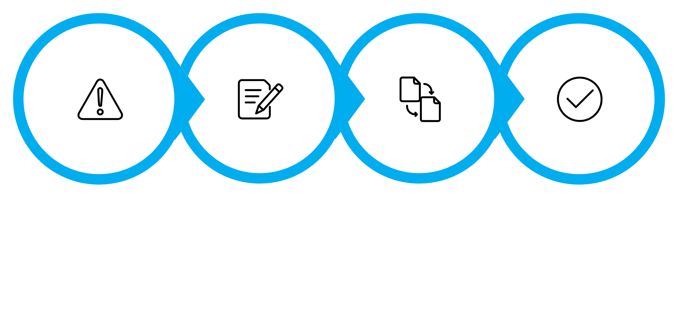
🤔 Opening Question
Imagine you just submitted a student record — but the CGPA is wrong. Can you fix it? Can you delete it entirely?
Every real-world application needs more than just inserting data. Users make mistakes. Records become outdated. Data needs to be corrected, removed, and searched. Today, you'll build exactly that — a system that gives you full control over your data.
Record Saved
Wrong Data
Edit Clicked
Run Update

Slide 3


🎯 Today's Mission
By the end of this session, you will have built and deployed a fully functional Student Management System — complete with every core CRUD operation and a polished Bootstrap UI.
View
Delete
Display all student records in a clean table
Remove records safely with a confirmation step
Edit & Update
Search
Modify existing student data via a pre-filled form
Filter records by name, branch, or email

Slide 4





📋 Session Roadmap
Every module follows the same proven four-step rhythm — so you always know what's coming next. No more than 10 minutes will pass without you writing code.
💡 Concept
👨‍💻 Live Coding
Understand the "why" in 3 minutes
Watch the instructor build it live
🎯 Mission
🏆 Challenge
You implement it yourself
Extend it with a bonus feature
This session has 4 modules: Update · Delete · Search · Better UX — followed by a Bug Hunt, Build Sprint, and Demo Day.

Slide 5
⚡ Rapid Fire Recap
Turn to the person next to you. You have 3 minutes to discuss these questions together. Be ready to share your answers with the class.
1. Purpose of MySQL
2. INSERT vs. SELECT
3. Primary Key
What role does MySQL play in a web application? What does it store?
What is the key difference? When do you use each one?
What is it, and why is it absolutely required in every table?
4. Form Validation
5. PHP ↔ MySQL
Why validate on both client-side (JS) and server-side (PHP)?
Walk through the connection steps: credentials, connect, query, fetch.

Slide 6
MODULE 1
Updating Records
Edit. Fix. Save.
In this module you'll learn how to select a specific record, pre-populate a form with its data, and write an UPDATE SQL query to save the changes — all wired together through PHP.

Slide 7
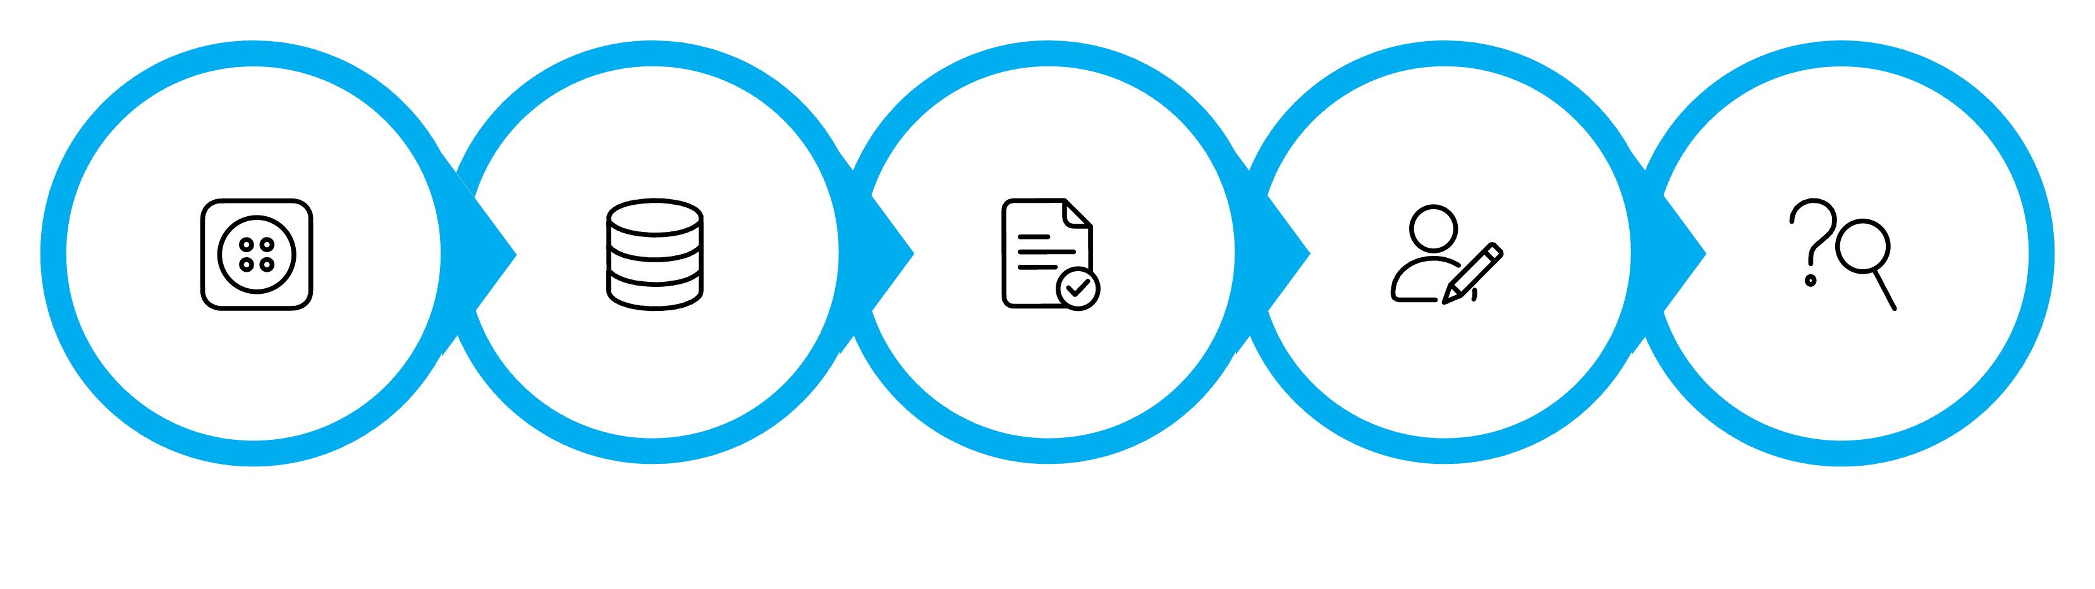
Module 1 · Concept: How UPDATE Works
Updating a record is a two-step process. First you read the record (SELECT by ID), then you write the changes back (UPDATE with a WHERE clause). The WHERE clause is critical — without it, every row in the table gets overwritten.
Edit
Fetch Record
Pre-fill Form
User Edits
Run UPDATE
The SQL Pattern
⚠️ Golden Rule
UPDATE students
SET name='John', cgpa=3.8
WHERE id=5;
Always include WHERE id = ? in your UPDATE statement. Omitting the WHERE clause will update every single row in your table — a mistake that is very difficult to undo.

Slide 8
Module 1 · Live Coding: Edit Student
Watch carefully. The instructor will build the full Edit flow — step by step — in VS Code. You'll see the result in the browser after each step.
01
02
03
Add Edit Button
Fetch the Record
Pre-fill the Form
Add an "Edit" button to each row in students.php that passes the student's id via the URL: edit.php?id=5
In edit.php, use $_GET['id'] to run a SELECT query and retrieve that student's current data.
Populate each input field's value attribute with the fetched data so the user sees the current values.
04
05
Run the UPDATE Query
Redirect with Message
On form submit, run the UPDATE students SET ... WHERE id=? query using prepared statements.
Redirect to students.php and display a Bootstrap success alert: "Record updated successfully."

Slide 9
Module 1 · 🎯 Your Mission + 🏆 Challenge
🎯 Mission — Implement Edit Student
🏆 Challenge
Build the complete edit flow for your Student Management System. Your edit form must allow changes to all four fields:
Display a Bootstrap alert-success green banner immediately after a successful update. The message should auto-dismiss after 3 seconds using JavaScript.
Student Name
Email Address
Branch / Department
CGPA (validate: 0.0 – 10.0)
⭐ Bonus
Add a updated_at TIMESTAMP column to your table and display "Last Updated: [time]" next to each student row.

Slide 10
MODULE 2
Deleting Records
Confirm. Then Delete.
Deleting is permanent. In this module you'll build a safe delete flow with a JavaScript confirmation dialog — because a good developer always asks "Are you sure?" before destroying data.

Slide 11
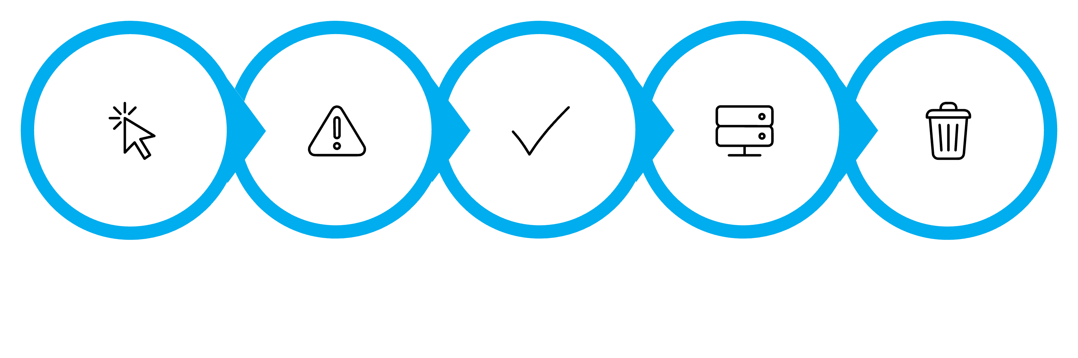
Module 2 · Concept: How DELETE Works
A delete operation is simple but dangerous. One unprotected DELETE without a WHERE clause wipes an entire table. The safest pattern: confirm in JavaScript first, then execute in PHP only if confirmed.
User clicks Delete
JS confirm dialog
User clicks OK
PHP runs DELETE
Record removed
The SQL Pattern
Why the Confirmation Dialog Matters
DELETE FROM students
WHERE id = 5;
Accidental clicks happen. A single window.confirm() call costs 1 line of JavaScript and prevents irreversible data loss. In production systems, a soft-delete approach (marking records as deleted rather than removing them) is even safer.

Slide 12
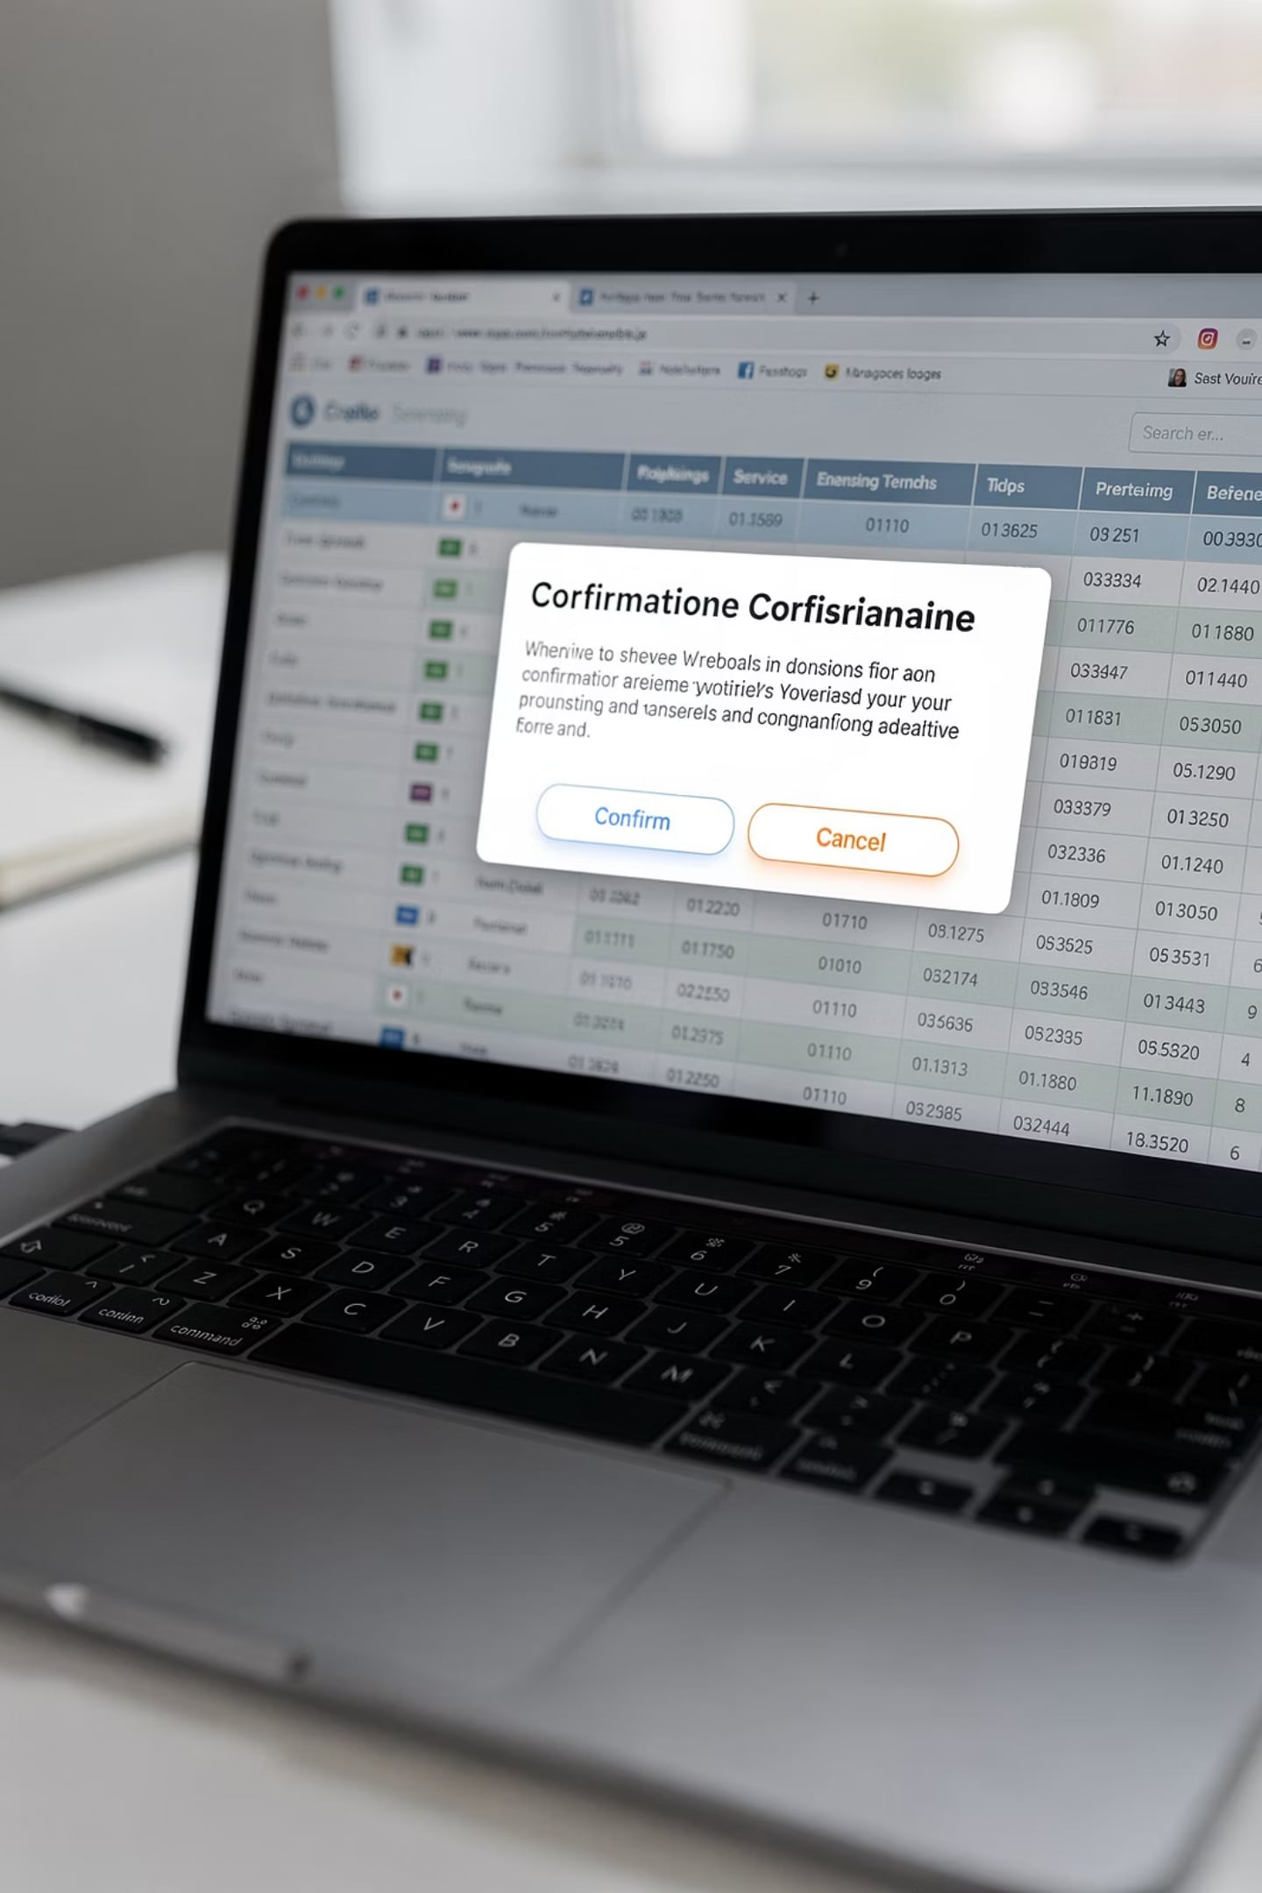
Module 2 · 🎯 Your Mission + 🏆 Challenge
🎯 Mission
🏆 Challenge
Add a Delete button to each row in your student table. Clicking it should pass the student's ID to delete.php, run a DELETE FROM students WHERE id=? query, and redirect back to the table.
Before the delete request is sent, show a JavaScript confirm() dialog: "Are you sure you want to delete this record? This action cannot be undone." Only proceed if the user clicks OK.
⭐ Bonus
After deletion, display a Bootstrap alert-danger red banner: "Record deleted successfully." Include the student's name in the message for extra clarity.

Slide 13
MODULE 3
Searching Records
Find. Filter. Fast.
When your table has hundreds of students, scrolling is not a solution. In this module you'll build a live search feature that filters results by name, branch, or email using PHP and SQL LIKE queries.

Slide 14
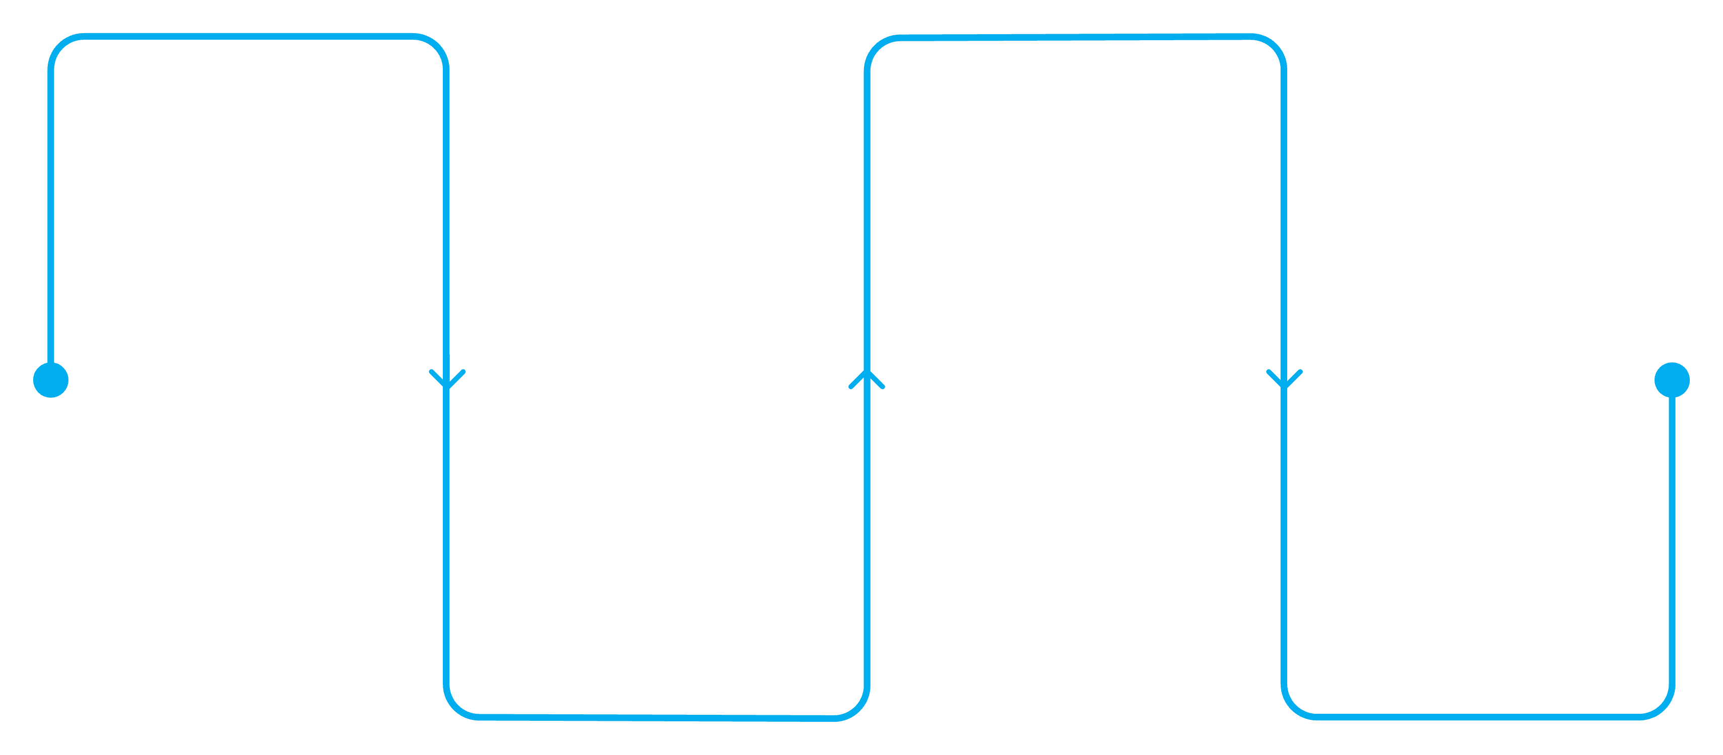
Module 3 · Concept: How Search Works
Search uses the SQL LIKE operator with wildcard characters. The % symbol matches any number of characters before or after your search term, making it flexible for partial-word matches.
User Search
SQL LIKE Query
Type query into search box
Run SELECT ... WHERE field LIKE '%term%'
Display Results
PHP Capture
Receive and sanitize input
Show filtered rows in table
The SQL Pattern
Search Best Practices
SELECT * FROM students
WHERE name LIKE '%john%'
OR email LIKE '%john%'
OR branch LIKE '%john%';
Always sanitize the search input before using it in a query
Use prepared statements to prevent SQL injection
Show a "No results found" message for empty result sets
Preserve the search term in the input box after submission

Slide 15
Module 3 · 🎯 Your Mission + 🏆 Challenge
Time to wire up search in your Student Management System. Your goal is a functional search bar that filters the student table in real time on form submit.
1
2
3
🎯 Mission Requirements
🏆 Challenge
⭐ Bonus
Add a Bootstrap search input above the student table
Search by student name using a LIKE query
Display only matching records in the table
Show a "No students found" row if no matches exist
Extend your search to also filter by Branch. Use an OR clause so a single search term matches name or branch.
Use PHP's str_replace() or JavaScript to highlight the matching keyword in yellow inside the search results — just like Google does.

Slide 16
MODULE 4
Better User Experience
Polish Matters.
Features without good UX feel broken. In this final module you'll add Bootstrap alerts, empty states, hover effects, and a professional table layout — turning your working app into a great app.

Slide 17
Module 4 · Concept: UX That Users Notice
The difference between a student project and a professional application often comes down to the small things: feedback messages, empty states, and visual polish. These take minutes to add but make a world of difference.
Success Alerts
Empty State
Bootstrap alert-success and alert-danger confirm to the user that their action worked — or failed. Never leave the user guessing.
When no records exist or no search matches, show a friendly "No students found" message. A blank table looks broken; an empty state looks intentional.
Professional Table
Record Count
Use Bootstrap's table-hover, table-striped, and table-bordered classes. Add action buttons with icons using Bootstrap Icons for a polished, modern look.
Display the total number of students with a Bootstrap badge: "Showing 12 students." Small details like this build trust in the application.

Slide 18
Module 4 · 🎯 Your Mission + 🏆 Challenge
🎯 Mission — Polish the UI
🏆 Challenge
Apply all four UX improvements to your Student Management System:
Add alternating row colors using Bootstrap's table-striped class and customize the stripe color with a small CSS override to match your app's theme.
Bootstrap alert-success after insert/update
Bootstrap alert-danger after delete
Empty state message when no records found
Bootstrap Icons on action buttons (✏️ Edit, 🗑 Delete)
⭐ Bonus
Display a dynamic counter badge at the top of the table: "Total Students: 12" — pulled live from a SELECT COUNT(*) query in PHP.

Slide 19
🐛 Bug Hunt — Guess the Result
Bug #1 — Wrong SQL Keyword
Bug #2 — Missing WHERE Clause
A student used INSERT instead of UPDATE in the edit form handler. What happens when they save?
The UPDATE query runs without WHERE id = ?. Every student's data is now identical. How do you prevent this?
Bug #3 — Delete Without ID
Bug #4 — No Primary Key
The delete link passes no ID. DELETE FROM students runs without a WHERE clause. The entire table is wiped.
The table was created without a primary key. Edit and Delete have no reliable way to target a single row. Always define id INT AUTO_INCREMENT PRIMARY KEY.

Slide 20
🚀 Build Sprint — 30 Minutes
This is your final boss. Build a complete, production-ready Student Management Portal from scratch — or extend your existing project. Timer starts now.
✅ Create
📋 Read
Add new student with form validation
Display all students in a Bootstrap table
✏️ Update
🗑 Delete
Pre-filled edit form with success alert
Confirm dialog + success message
🔍 Search
⭐ Bonus
Filter by name and branch
Responsive layout + professional icons + record count

Slide 21
🎤 Demo Day — Student Showcase
Each team gets exactly 2 minutes to present their Student Management System to the class. The instructor will ask one technical question per team — so be ready to explain your code, not just show it.
01
02
Show Your App Live
Walk Through CRUD
Demo the running application in the browser — add, edit, delete, and search a student record live.
Briefly point to the code for each operation and explain what each block does in plain English.
03
04
Biggest Challenge
One Future Improvement
What was the hardest part to implement? What error did you hit, and how did you solve it?
If you had 30 more minutes, what feature would you add next — and why?

Slide 22
🧠 Interview Quiz — Think Fast
These are real interview questions asked by tech companies. Answer out loud. No Googling. Go.
1
2
3
INSERT vs. UPDATE
The WHERE Clause
No Primary Key
What is the exact difference? When would you use each one in a Student Management System?
What is the purpose of WHERE in a DELETE or UPDATE query? What happens if you omit it?
If a table has no primary key, how do you uniquely identify a student to edit or delete? What problems arise?
4
5
Confirm Before Delete
Predict the Output
Why is a confirmation dialog best practice? What alternative pattern do production apps use instead of hard-deleting records?
What does SELECT * FROM students WHERE cgpa > 8.0 ORDER BY name ASC return? Describe the result set.

Slide 23
📋 Assignment — Push It Further
Tonight's assignment extends your Student Management System into a more complete, real-world application. Push your final code to GitHub before the start of tomorrow's session.
Profile Photo Upload
Multi-Field Search
Add a file input to the student form. Store the filename in MySQL and display the photo in the student table using an <img> tag.
Extend search to cover name, email, branch, and CGPA range simultaneously using combined WHERE conditions.
Student Status
Better Dashboard
Add an Active / Inactive status dropdown. Filter the table to show only active students by default, with an option to view all.
Add a stats row at the top: Total Students · Average CGPA · Students per Branch — pulled from SQL aggregate queries.
Course Filter
Add a dropdown filter above the table to show students by department or course. Use a WHERE branch = ? query.

