Slide 1
Watsi App
Fund healthcare for people around the world.

Slide 2
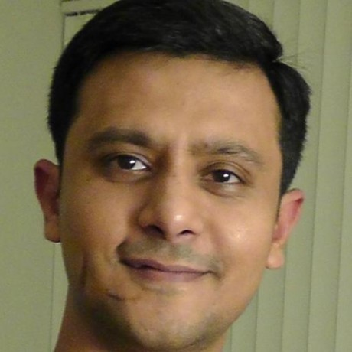
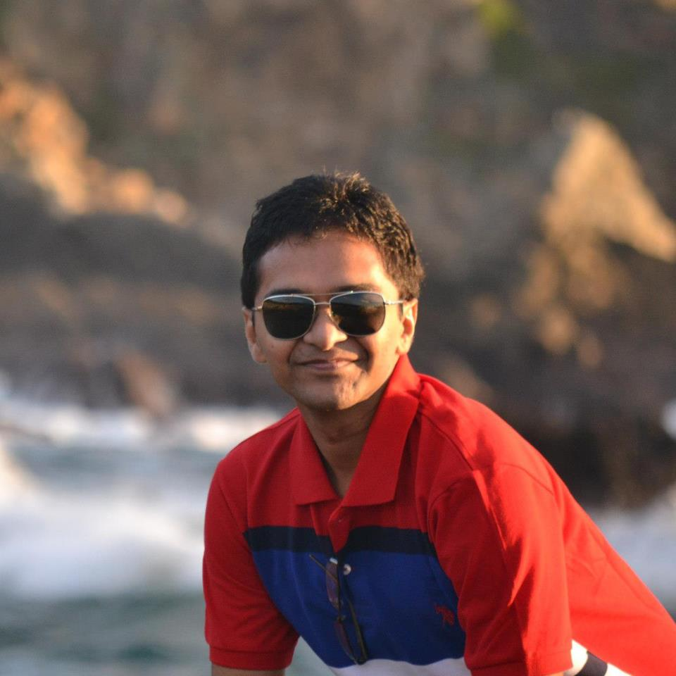
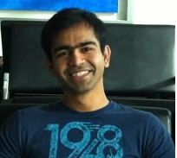
Team
Rutvij
Ankit
Ganesh

Slide 3
Inspiration
Medical care is never cheap.
Big burden in developing countries.
Watsi harnesses the crowd to change that.

Slide 4
Why Watsi App
100% of donation funds life-changing healthcare.
Spread awareness about watis patients.
Social network engagement.
Help running donation campaigns.

Slide 5
Demo

Slide 6
Technical challenges
No API from watis.org
Watsi.org under renovation

Slide 7
Future work
Tablet UI
Location aware notifications.
Periodic data updates from watsi.org

