Slide 1
Watsi
Fund healthcare for people around the world.

Slide 2
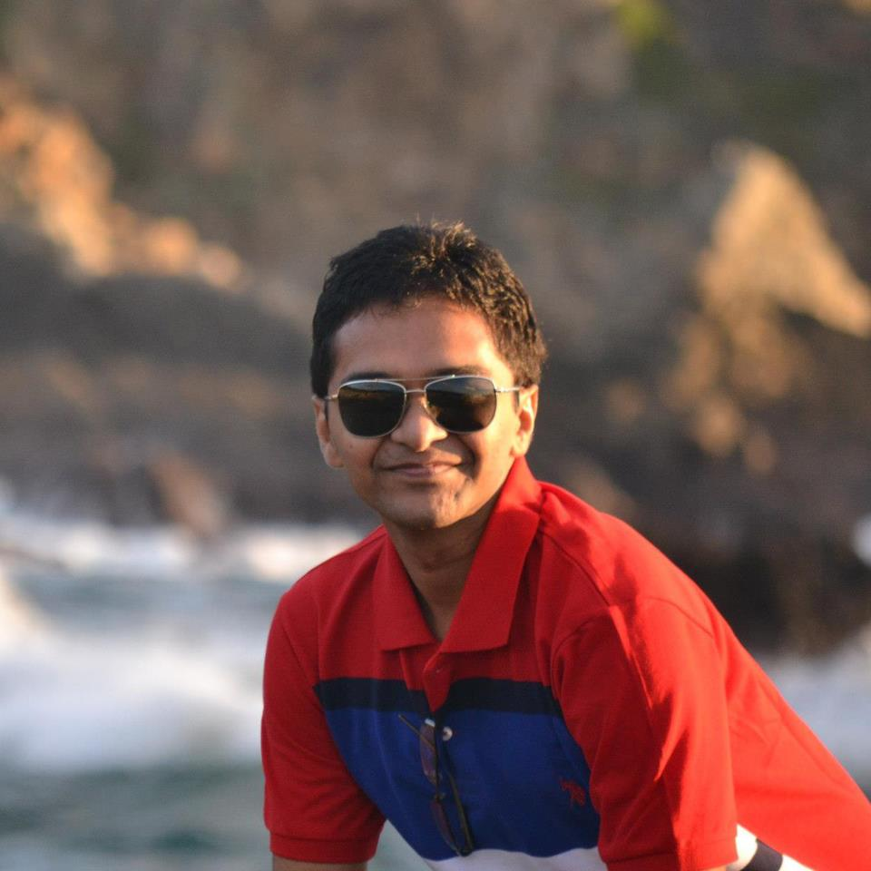
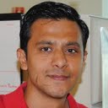
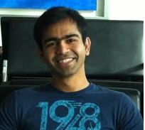
Team
Ankit
Rutvij
Ganesh
Notes:
Our team was a perfect blend of Front end, backend and work experience.
Sprint planning was done in such a manner to pick up stories that were feasible in time limit and we made sure that we are planning to keep time to think about design and polish.
Our application focused on simple usable design. Application is made keeping UX in mind.

Slide 3
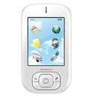

Inspiration
Non-Profit problems
Smart Phone Revolution
Slow
Fast
Bureaucratic
Free and Open
Difficult to enroll huge sections of society
Power of Social Networks
Feel better, really.
Notes:
Medical care is never cheap.
Big burden in developing countries.
Watsi harnesses the crowd to change that.

Slide 4




Watsi App
Browse Patients in need
Make it easy to donate
Make it easy to Share
Make it fun, while keeping it serious
Notes:
What can a user do in using our application. User stories
Browse list of patients see progress of each patient, their medical need.
Either donate or share on social networking site so as to spread awareness about the people in need.
In activity feed user can know about which patients got funded special campaign messages and new patients that have joined the portal.
Spread awareness about Watsi patients.
Social network engagement.
Helps running donation campaigns.
100% of donation funds life-changing healthcare.

Slide 5
Demo

Slide 6



Challenges
Getting Data from watsi.org
Presenting Profile Images with Donation Details
User Login and Facebook Integration
Minimal, polished and lively UI

Slide 7





Future work
Integration with watsi.org
Make it FUN !
Code Improvements and Tablet Compatibility
Notes:
Tablet UI
Location aware notifications.
Auto pay start of every month
Integration with Watsi Api
Heat map based on donation data.

Slide 8
Thanks. Do good, do well. Donate for Watsi.
Notes:
Tablet UI
Location aware notifications.
Auto pay start of every month
Integration with Watsi Api
Heat map based on donation data.

