Slide 1

Watsi
Fund healthcare for people in need.
Notes:
Introduction to Watsi : Watsi is nonprofit crowd funding platform, Watsi is like a kickstarter for healthcare on the world.

Slide 2
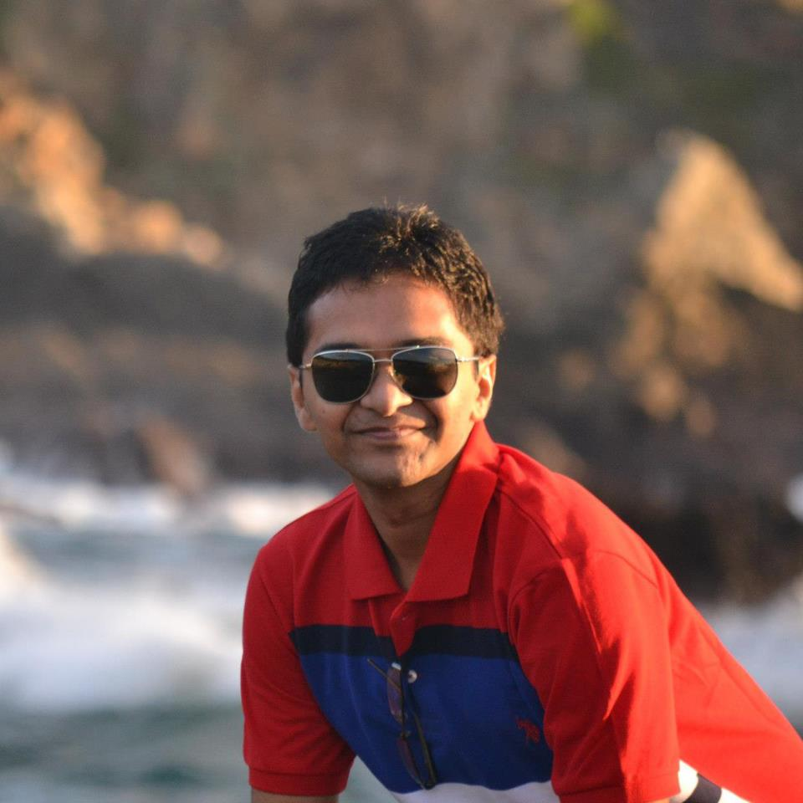
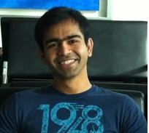
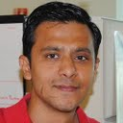
Team
Ankit
Ganesh
Rutvij
Notes:
Our team was a perfect blend of Front end, backend and work experience.
Sprint planning was done in such a manner to pick up stories that were feasible in time limit and we made sure that we are planning to keep time to think about design and polish.
Our application focused on simple usable design. Application is made keeping UX in mind.

Slide 3
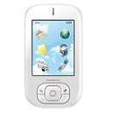

Inspiration
Non-Profit problems
Watsi App
Awareness
Feed, Notification
Help
Single click Donate/Share
Engagement & Reach
Social Networks
Making Positive Change
Notes:
Watsi is solving a good problem, BUT
- > Currently its has everything on website, people rarely regularly visit website to know who are new patients who need help etc.
We think we can help watsi
- > To extend their reach and awareness with our mobile app.
Pyramid structure of problem and inspiration

Slide 4




Watsi App
Browse Patients in need
Easy to donate
Easy to Share
Make it fun, while keeping it serious
Notes:
3 pillars of this app.
Create Awareness : Patient list.
Help needy : By funding patient or Sharing their need on social media.
Motivate social circle: By campaign messages, Push notifications.

Slide 5
Demo
Notes:
Show time :
Gist of everything we show and tell is
App is designed to have simple usable UX.
Well focused on Three things ( Fund, Share, Encourage )

Slide 6
Challenges
Getting Data from watsi.org
Third Party Libraries
Paypal Integration
Minimal, polished and lively UI

Slide 7


Future work
Integration with Watsi API & Payment gateway
Automated testing on various devices
Official approval from Watsi release to play store
Notes:
Tablet UI
Location aware notifications.
Auto pay start of every month
Integration with Watsi Api
Heat map based on donation data.

Slide 8
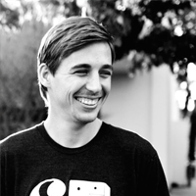
"We were really excited that Rutvij and his team decided to help out Watsi by building us an awesome Android app. Thanks guys!"
Chase Adam
Co-founder Watsi.org
Notes:
This slide will be removed if we don’t get testimonial from Chase.
Testimonial text will be replaced with the one we get from Chase if we get one.
-------------------------------------------------------------------------------------------------
Note: We kept Watsi in loop since our proposal to build this app for watsi. Watsi (Chase) surprised by what we have achieved without any help from watsi team.

Slide 9

Questions
Notes:
Take questions but don’t forget to go to next slide for Thanks ☺

Slide 10
Do good, do well. Donate for Watsi.
Thanks
Nathan and Codepath Jesus
Yahoo !

