Slide 1
Watsi
Fund healthcare for people around the world.

Slide 2
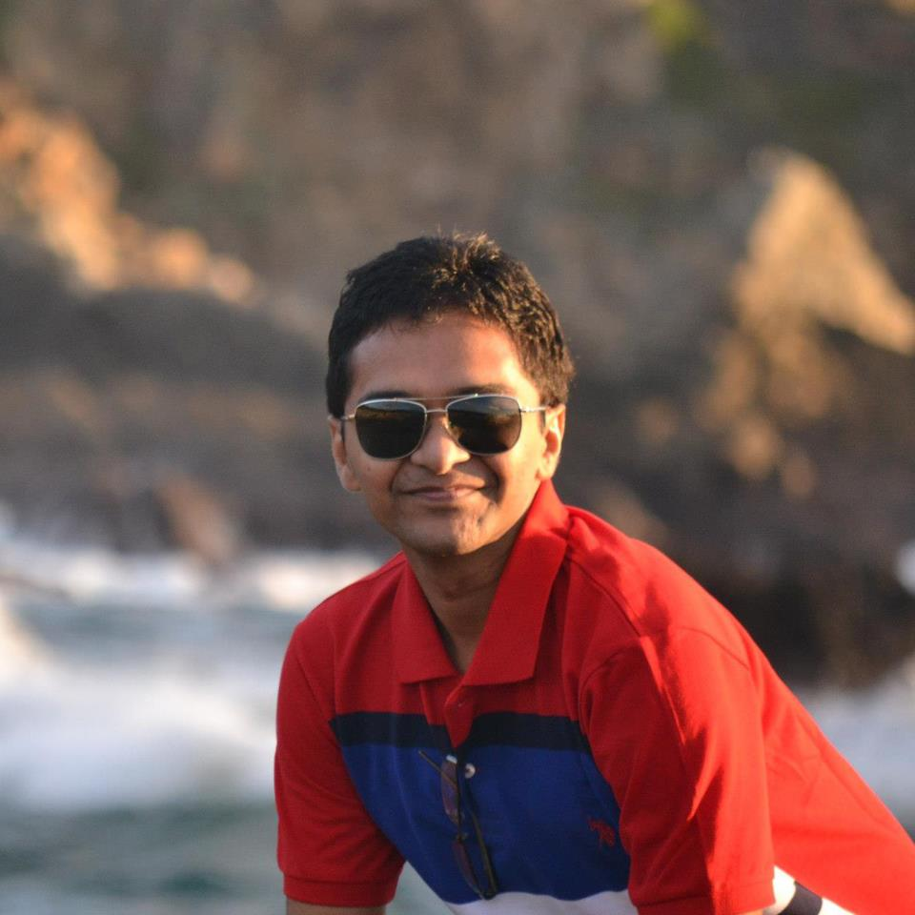
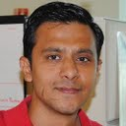
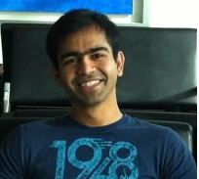
Team
Rutvij
Ankit
Ganesh

Slide 3
Inspiration
Medical care is never cheap.
Big burden in developing countries.
Watsi harnesses the crowd to change that.

Slide 4
Why Watsi App
Spread awareness about Watsi patients.
Social network engagement.
Helps running donation campaigns.
100% of donation funds life-changing healthcare.

Slide 5
Demo

Slide 6
Technical challenges
No API from watsi.org
Watsi.org under renovation

Slide 7
Future work
Tablet UI
Location aware notifications.
Payment Module
Auto pay start of every month
Integration with Watsi Api
Generate graph on map base on donation data.
Periodic data updates from watsi.org

