Slide 1
Watsi
Fund healthcare for people around the world.
Notes:
Introduction to Watsi : Watsi is nonprofit crowd funding platform, Watsi is like a kickstarter for healthcare on the world.

Slide 2
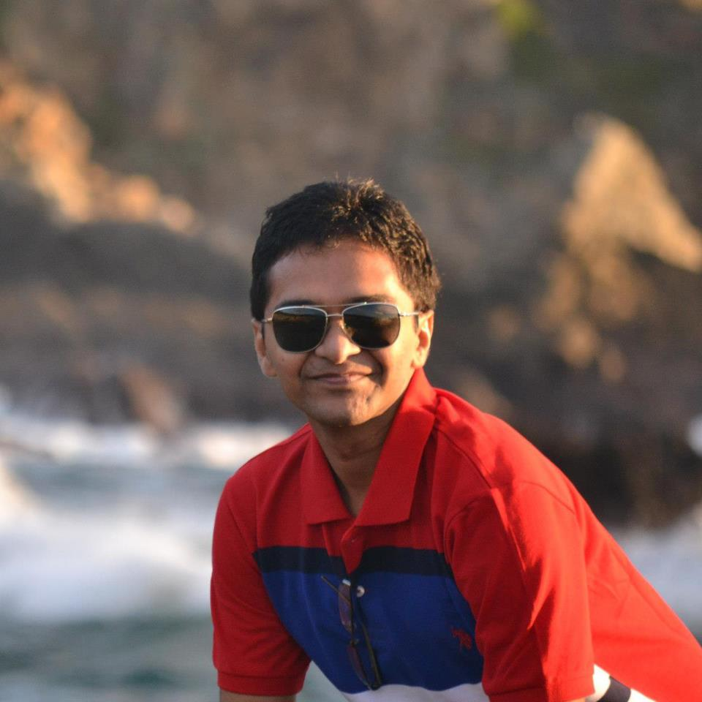
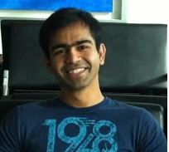
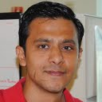
Team
Ankit
Ganesh
Rutvij
Notes:
Our team was a perfect blend of Front end, backend and work experience.
Sprint planning was done in such a manner to pick up stories that were feasible in time limit and we made sure that we are planning to keep time to think about design and polish.
Our application focused on simple usable design. Application is made keeping UX in mind.

Slide 3
Inspiration
Medical care is never cheap.
Watsi harnesses the crowd to change that.
No mobile app available for Watsi.
Mobile and social media helps to extend reach.
Notes:
Watsi is solving a good problem, BUT
- > Currently its has everything on website, people rarely regularly visit website to know who are new patients who need help etc.
We think we can help watsi
- > To extend their reach and awareness with our mobile app.

Slide 4
Watsi App
Awareness
Help
Motivate
Notes:
3 pillars of this app.
Create Awareness : Patient list.
Help needy : By funding patient or Sharing their need on social media.
Motivate social circle: By campaign messages, Push notifications.

Slide 5
Demo
Notes:
Show time :
Gist of everything we show and tell is
App is designed to have simple usable UX.
Well focused on Three things ( Fund, Share, Encourage )

Slide 6
Challenges
No API available from Watsi.org
Patient images
Payment Integration for donation
Third party libraries

Slide 7
Future work
Code improvements.
Official approval from Watsi.
Integration with Watsi API & Payment gateway.
App testing on various devices ( AppThwack).
Release to play store.
Notes:
High level roadmap from “Now” to “Playstore”

Slide 8
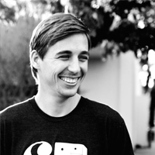
“At first glance, it looks amazing. Thanks again for picking us as your project!”
Chase Adam
Cofounder Watsi.org
Notes:
This slide will be removed if we don’t get testimonial from Chase.
Testimonial text will be replaced with the one we get from Chase if we get one.
-------------------------------------------------------------------------------------------------
Note: We kept Watsi in loop since our proposal to build this app for watsi. Watsi (Chase) surprised by what we have achieved without any help from watsi team.

Slide 9
Questions ?
Notes:
Take questions but don’t forget to go to next slide for Thanks ☺

Slide 10
Nathan and Codepath Jesus ( Mentor ) Yahoo ! Do good, do well. Donate for Watsi.
Thanks

