Slide 1
Watsi
Fund healthcare for people around the world.

Slide 2
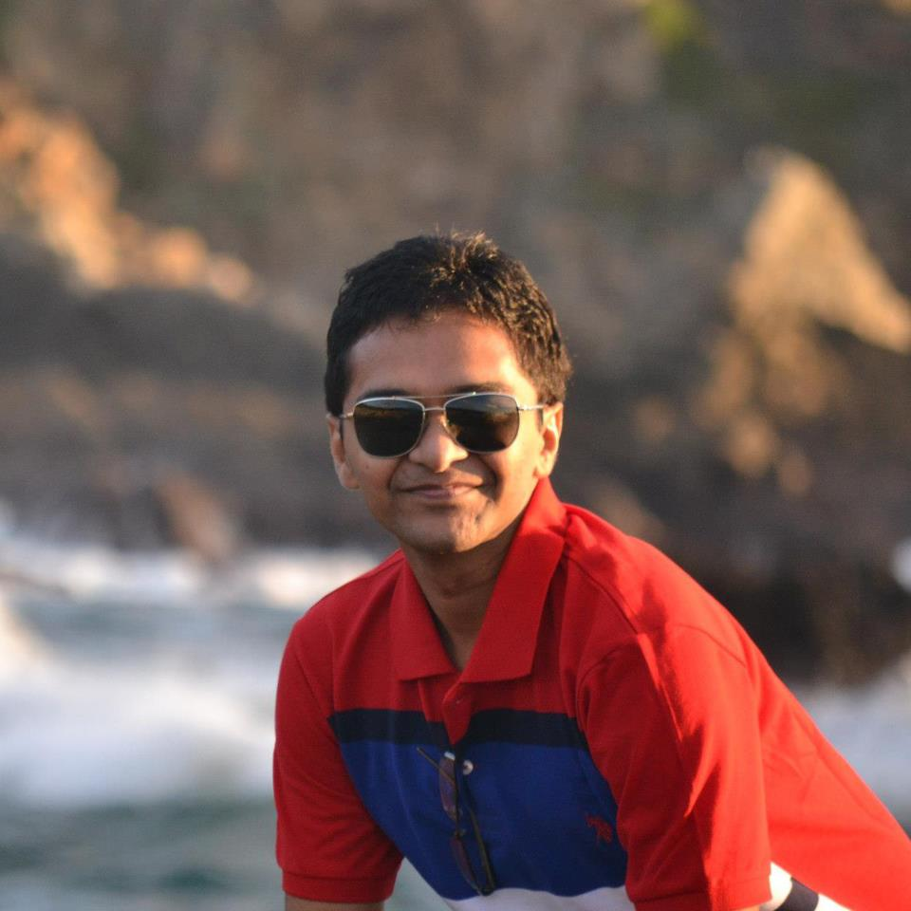
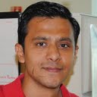
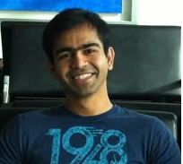
Team
Rutvij
Ankit
Ganesh
Notes:
Our team was a perfect blend of Front end, backend and work experience.
Sprint planning was done in such a manner to pick up stories that were feasible in time limit and we made sure that we are planning to keep time to think about design and polish.
Our application focused on simple usable design. Application is made keeping UX in mind.

Slide 3
Inspiration
Medical care is never cheap.
Big burden in developing countries.
Watsi harnesses the crowd to change that.

Slide 4
Why Watsi App
Spread awareness about Watsi patients.
Social network engagement.
Helps running donation campaigns.
100% of donation funds life-changing healthcare.
Notes:
What can a user do in using our application. User stories
Browse list of patients see progress of each patient, their medical need.
Either donate or share on social networking site so as to spread awareness about the people in need.
In activity feed user can know about which patients got funded special campaign messages and new patients that have joined the portal.

Slide 5
Demo

Slide 6
Technical challenges
No API from watsi.org
Watsi.org under renovation

Slide 7
Future work
Tablet UI
Location aware notifications.
Payment Module
Auto pay start of every month
Integration with Watsi Api
Generate graph on map base on donation data.
Periodic data updates from watsi.org

