Slide 1
REAL TIME CHAT SYSTEM USING FULLSTACK.

Slide 2

Contents
Introduction
Objective
About Web Development
Technology used
Tools required
Hardware requiements
Software requirements
Hardware Interface
Conclusion
Snapshots

Slide 3
CHAT WEBSITE
Submitted By:
Ashita Vijay Seth
181500145
Ishika Dubey
181500283
Aryan Saxena
181500136
Aryan Garg
181500135
Khush Sharma
181500343
Supervised By:
Mr. Pankaj Kapoor
Ass. Professor
Department of Computer Engineering & applications
GLA UNIVERSITY
MATHURA

Slide 4
Introduction
Messaging apps are surging in popularity nowadays, there are literally thousands of chat based apps and they are also very popular among the users as they provide a person .Real-time chat system using JavaScript, Node Js and socket.io. For the frontend, we have used HTML, CSS, Bootstrap, and JavaScript. And for the backend, we have used Node Js, ExpressJs and MongoDB for Database. We have used socket.io web socket library for real time data.

Slide 5
Objective
The Objective of this project is to develop a front-end part of a chat website. It will allow the user to chat with each others in real time. Our main objective is developing a simple chat application; therefore for simplicity we have avoided the authentication part. The messages must be updated without refreshing the page.
It is a real time web application which means user does not have to refresh the page to see their chat. As soon as user presses the send button the message will be visible to everyone.

Slide 6
ABOUT WEB DEVELOPMENT
Web development is a broad term for the work involved in developing a website for the Internet (World Wide Web). Web development commonly includes web engineering, web design, web content development, client-side/server-side scripting, web server and network security configuration, and e-commerce development.
Among web professionals, “web development” usually refers to the main non-design aspects of building web sites: writing markup and coding. Websites are typically dedicated to a particular topic or purpose, ranging from entertainment and social networking to providing news and education.

Slide 7
Technology used
HTML5
HTML is the standard markup language for documents designed to be displayed in a web browser.
HTML describes the structure of a web page semantically and originally included cues for the appearance of the document.
HTML provides a means to create structured documents by denoting structural semantics for text such as headings, paragraphs, lists, links, quotes and other items.

Slide 8
Technology used
JAVASCRIPT
JavaScript enables interactive web pages and is an essential part of web applications.
The vast majority of websites use it for client-side page behavior, and all major web browsers have a dedicated JavaScript engine to execute it.
As a multi-paradigm language, JavaScript supports event-driven, functional, and imperative programming styles.

Slide 9
Technology used
CSS3
CSS is designed to enable the separation of presentation and content, including layout, colors, margins and also fonts.
This separation can improve content accessibility, provide more flexibility and control in the specification of presentation characteristics.
CSS enables multiple web pages to share formatting by specifying the relevant CSS in a separate .css file which reduces complexity and repetition in the structural content.

Slide 10
Technology used
NODE JS
Node.js is an open-source, cross-platform, back-end JavaScript runtime environment that runs on the V8 engine and executes JavaScript code outside a web browser.
Node.js lets developers use JavaScript to write command line tools and for server-side scripting—running scripts server-side to produce dynamic web page content before the page is sent to the user's web browser.

Slide 11
Technology used
EXPRESS JS
Express is a minimal and flexible Node.js web application framework that provides a robust set of features for web and mobile applications. It is an open source framework developed and maintained by the Node.js foundation.
Express provides a minimal interface to build our applications. It provides us the tools that are required to build our app. It is flexible as there are numerous modules available on npm, which can be directly plugged into Express.

Slide 12
Technology used
MONGODB
MongoDB is a source-available cross-platform document-oriented database program. Classified as a No SQL database program, MongoDB uses JSON-like documents with optional schemas. MongoDB is developed by Mongo DB Inc.
MongoDB supports field, range query, and regular-expression searches. Queries can return specific fields of documents and also include user-defined JavaScript functions.

Slide 13
Tools Required
Software Requirements :
Operating system: Windows 7 or above
Coding Language: HTML-5, CSS-3, JavaScript, Bootstrap-4, Node Js, Express Js, Mongo DB
Visual Studio Code
Web browser

Slide 14
Hardware Interface
Laptop/Desktop
1.8 GHz or faster processor. Quad-core or better recommended
4 GB of RAM
Hard disk space: Minimum of 800MB up to 210GB of available space
Video card that supports a minimum display resolution of 720p (1280 by 720)

Slide 15

Conclusion
So, in this web application we have built a real time chat system in which user has enter his/her name first in order to access the webpage. One can chat with anyone who is online by typing a messaging and pressing sent. It is a real time web application so user does not have to bother about refreshing the page again and again. The messages will be stored in the database with sender’s name, time and date.

Slide 16
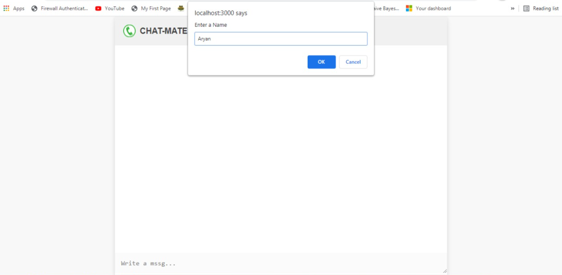
SNAPSHOTS

Slide 17
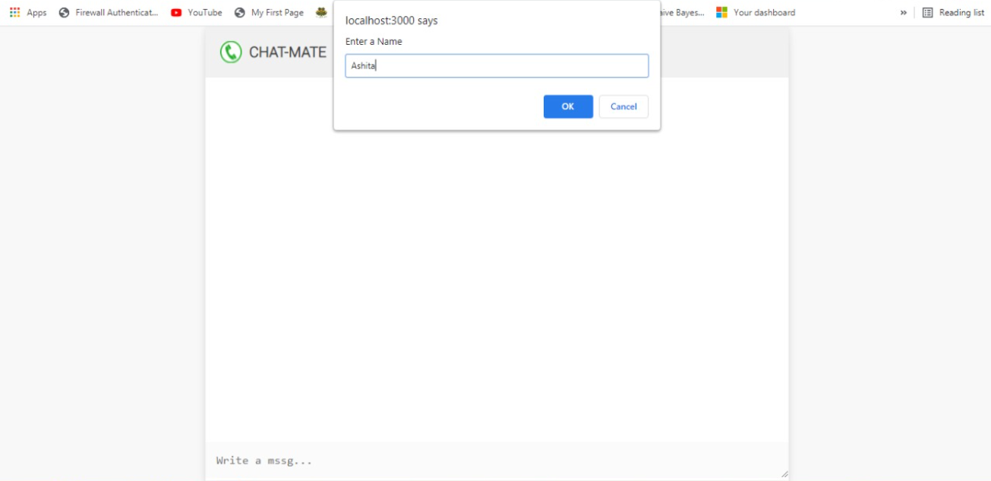
SNAPSHOTS

Slide 18
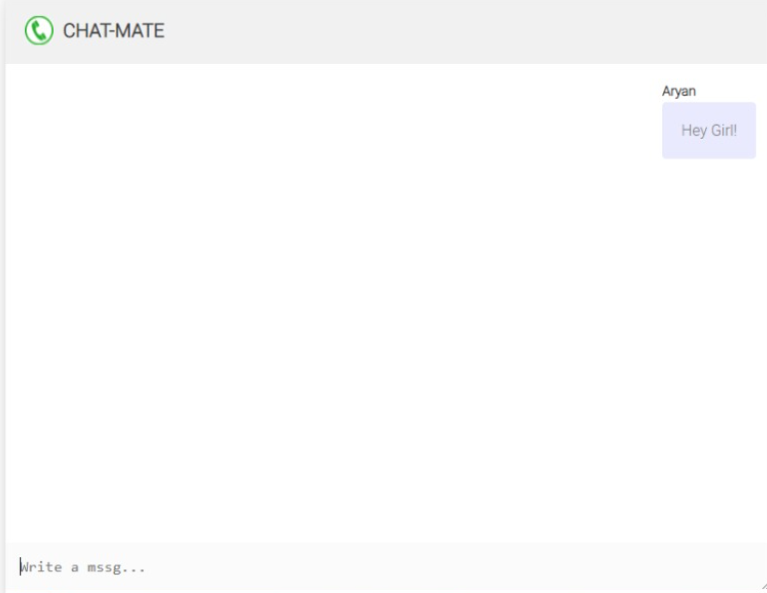
SNAPSHOTS

Slide 19
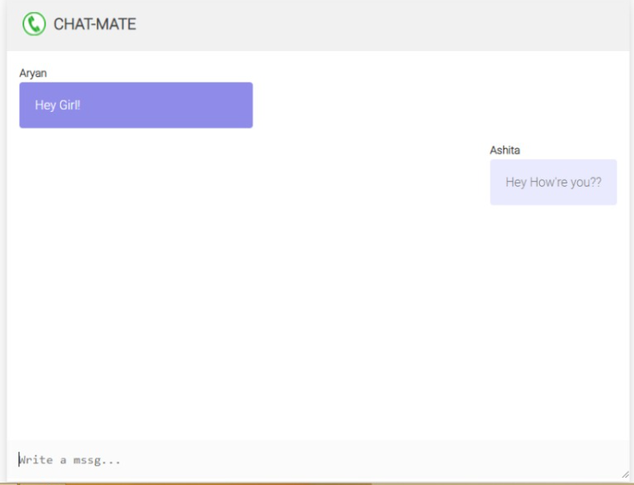
SNAPSHOTS

Slide 20
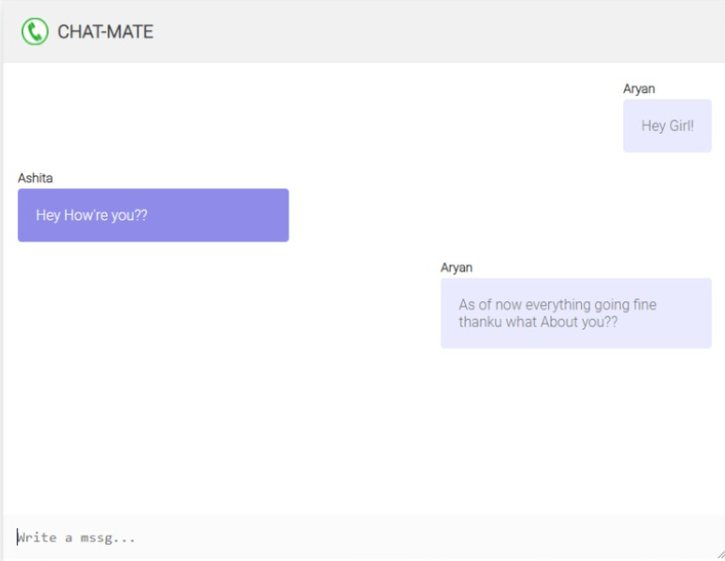
SNAPSHOTS

Slide 21
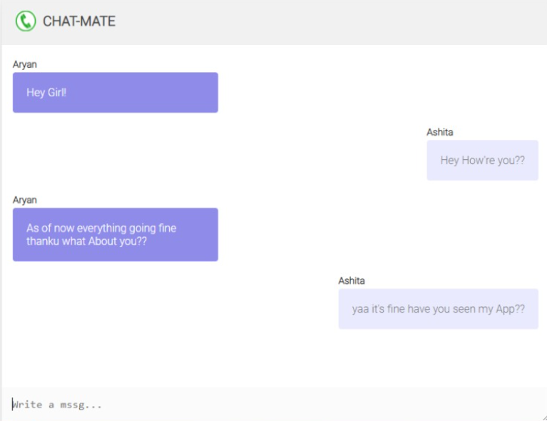

Slide 22
Thanks!

