Slide 1
The Champion Strategy
Proprietary Alpha in Unpopular Sectors
Identifying Hidden Strength Where Others See Noise

Slide 2
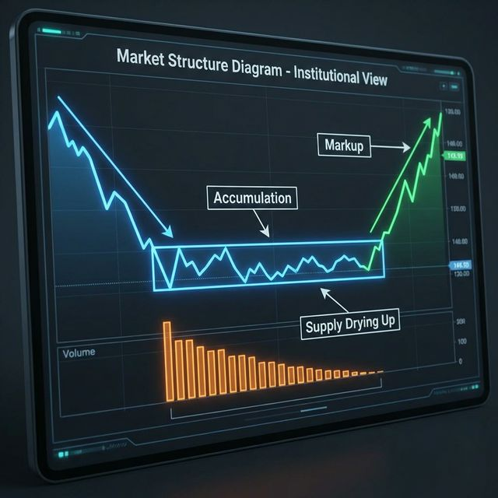
The Core Philosophy
Identifying Strength Where Others See Noise
The Contrarian Edge: Most participants chase 'hot' themes, creating overcrowding risk
Our Advantage: Focus on unpopular, neglected sectors where value is mispriced
The Precision: Proprietary models identify isolated pockets of hidden strength

Slide 3
The Alpha Source
Capturing Structural Imbalances
The Logic: Prices move due to Supply/Demand imbalances
The Signal: Our model detects subtle shifts: • Supply Exhaustion: Selling pressure dries up • Smart Accumulation: Demand stabilizes
The Result: Entry at inflection point for high-probability moves

Slide 4

The Selection Process
A Rigorous, Multi-Layered Funnel
Step 1: Proprietary Sector Scan Identifying sectors with 'Accumulation Signatures'
Step 2: Strength Confirmation Verifying broad sector strength to minimize risk
Step 3: Momentum Ranking Buying the leaders of the new trend (RSNP Rank)

Slide 5
Fundamentally Sound
Strength with Safety
Safety First: Strict Liquidity and Volatility filters. No junk.
Structural Integrity: Price strength backed by valid market structure
Disciplined Allocation: • Max 15 Stocks (Concentrated) • Max 3 per Industry (Diversified)

Slide 6
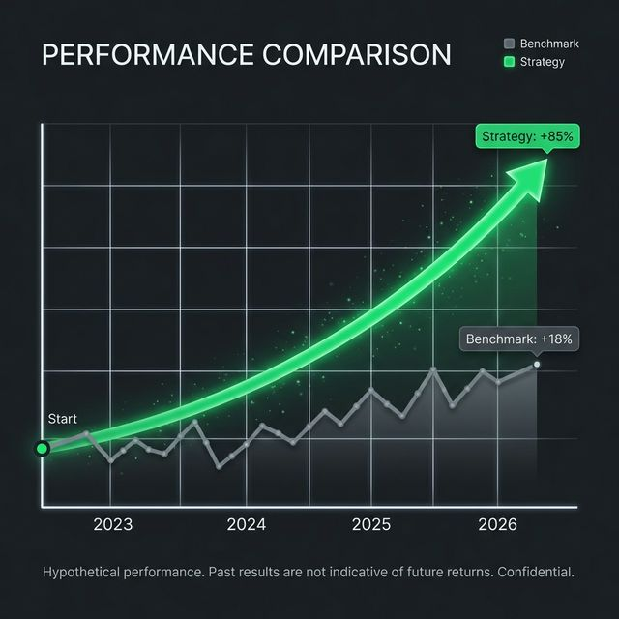
Validated by Results
Delivering Alpha (2023-2026)
CAGR: 28.87% Consistent outperformance vs Benchmark (~15%)
Sharpe Ratio: 1.17 Superior risk-adjusted returns
Drawdown: -21.85% Contrarian approach protects capital during corrections

Slide 7
The Dynamic Edge
Intelligent Holding Periods
Beyond Fixed Timeframes
We hold winners as long as our Proprietary Signal remains valid
Potential Return Boost: >31% CAGR

