Slide 1
The Contrarian Strength
Proprietary Alpha in Unpopular Sectors
Finding Strength Where Others Look Away

Slide 2
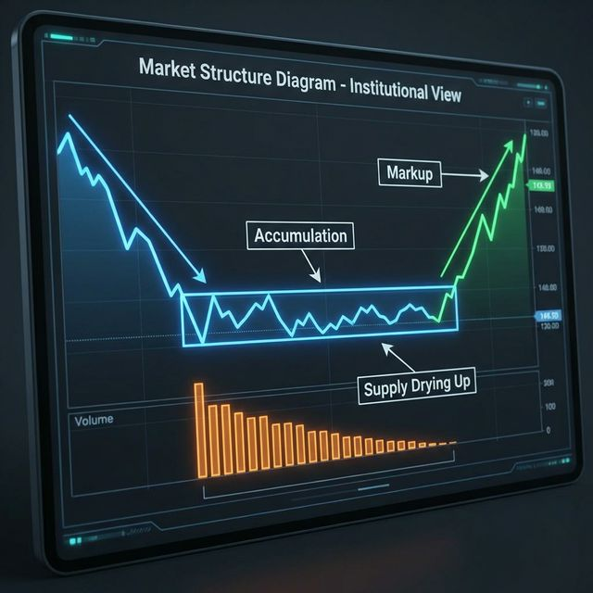
THE CORE PHILOSOPHY
Identifying Strength Where Others See Noise
The Contrarian Edge: Most participants chase 'hot' themes, creating overcrowding risk.
Our Advantage: Focus on ignored, neglected sectors where new momentum is emerging.
The Precision: We select only the strongest stocks in these 'ignored' industries.
CONFIDENTIAL | The Contrarian Strength Strategy
2

Slide 3
THE ALPHA SOURCE
Capturing Structural Imbalances
The Logic: Prices move due to Supply/Demand imbalances.
The Signal: Our model detects subtle shifts in ignored sectors:
• Supply Exhaustion: Selling pressure dries up
• Smart Accumulation: Demand stabilizes
The Result: Entry at inflection point for high-probability moves.
CONFIDENTIAL | The Contrarian Strength Strategy
3

Slide 4
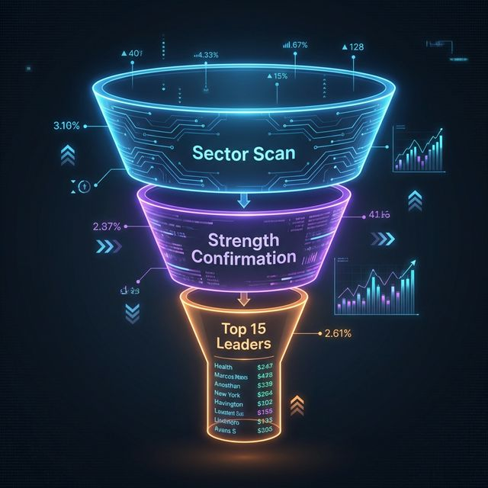
THE SELECTION PROCESS
A Rigorous, Multi-Layered Funnel
Step 1: Proprietary Sector Scan Identifying sectors with 'Accumulation Signatures'
Step 2: Strength Confirmation Verifying broad sector strength to minimize risk
Step 3: Momentum Ranking Buying the leaders of the new trend (RSNP Rank)
CONFIDENTIAL | The Contrarian Strength Strategy
4

Slide 5
FUNDAMENTALLY SOUND
Strength with Safety
Safety First: Strict Liquidity and Volatility filters. No junk.
Structural Integrity: Price strength backed by valid market structure.
Disciplined Allocation:
• Max 15 Stocks (Concentrated)
• Max 3 per Industry (Diversified)
CONFIDENTIAL | The Contrarian Strength Strategy
5

Slide 6
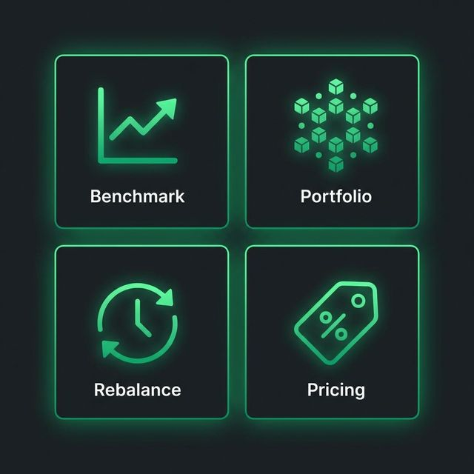
STRATEGY AT A GLANCE
Configuration & Structure
Benchmark: Nifty 500 / Top 1000 Universe
Structure: Concentrated Portfolio (10-15 Stocks)
Turnover: High Active Rotation (~7-10 stocks replaced/qtr)
Pricing: 2% Fixed / 20% Profit Share (Above Hurdle)
CONFIDENTIAL | The Contrarian Strength Strategy
6

Slide 7
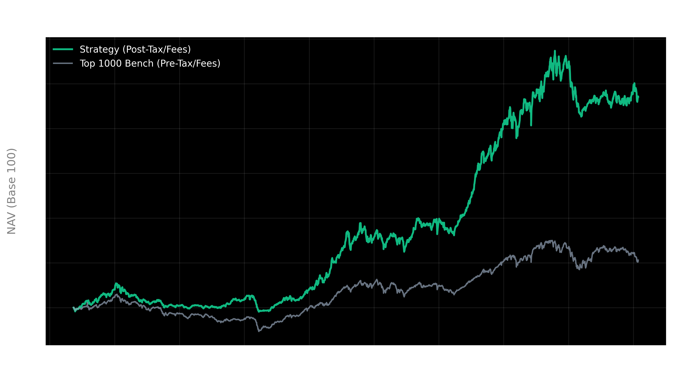
LONG-TERM VALIDATION
Full Cycle Backtest (2017-2026)
CAGR: 22.5% (vs 8.8% Bench)
Sharpe (Rf=6%): 0.83 (vs 0.23 Bench)
Max Drawdown: -41.1% (vs -64.0%)
Total Return: 470% (vs 106%)
Note: We have back-tested the quantitative part of this strategy to give you an idea on how this thought process has performed in the past. Actual implementation includes qualitative fundamental checks.
CONFIDENTIAL | The Contrarian Strength Strategy
7

Slide 8
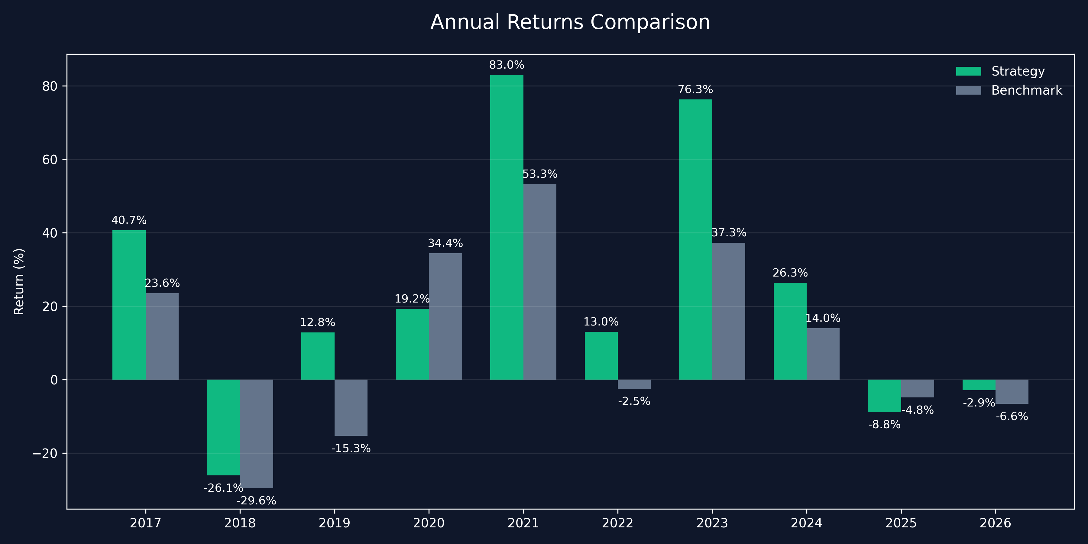
ANNUAL RETURNS BREAKDOWN
Consistent Outperformance Across Cycles
Yearly Outperformance: 80%
CONFIDENTIAL | The Contrarian Strength Strategy
8

Slide 9
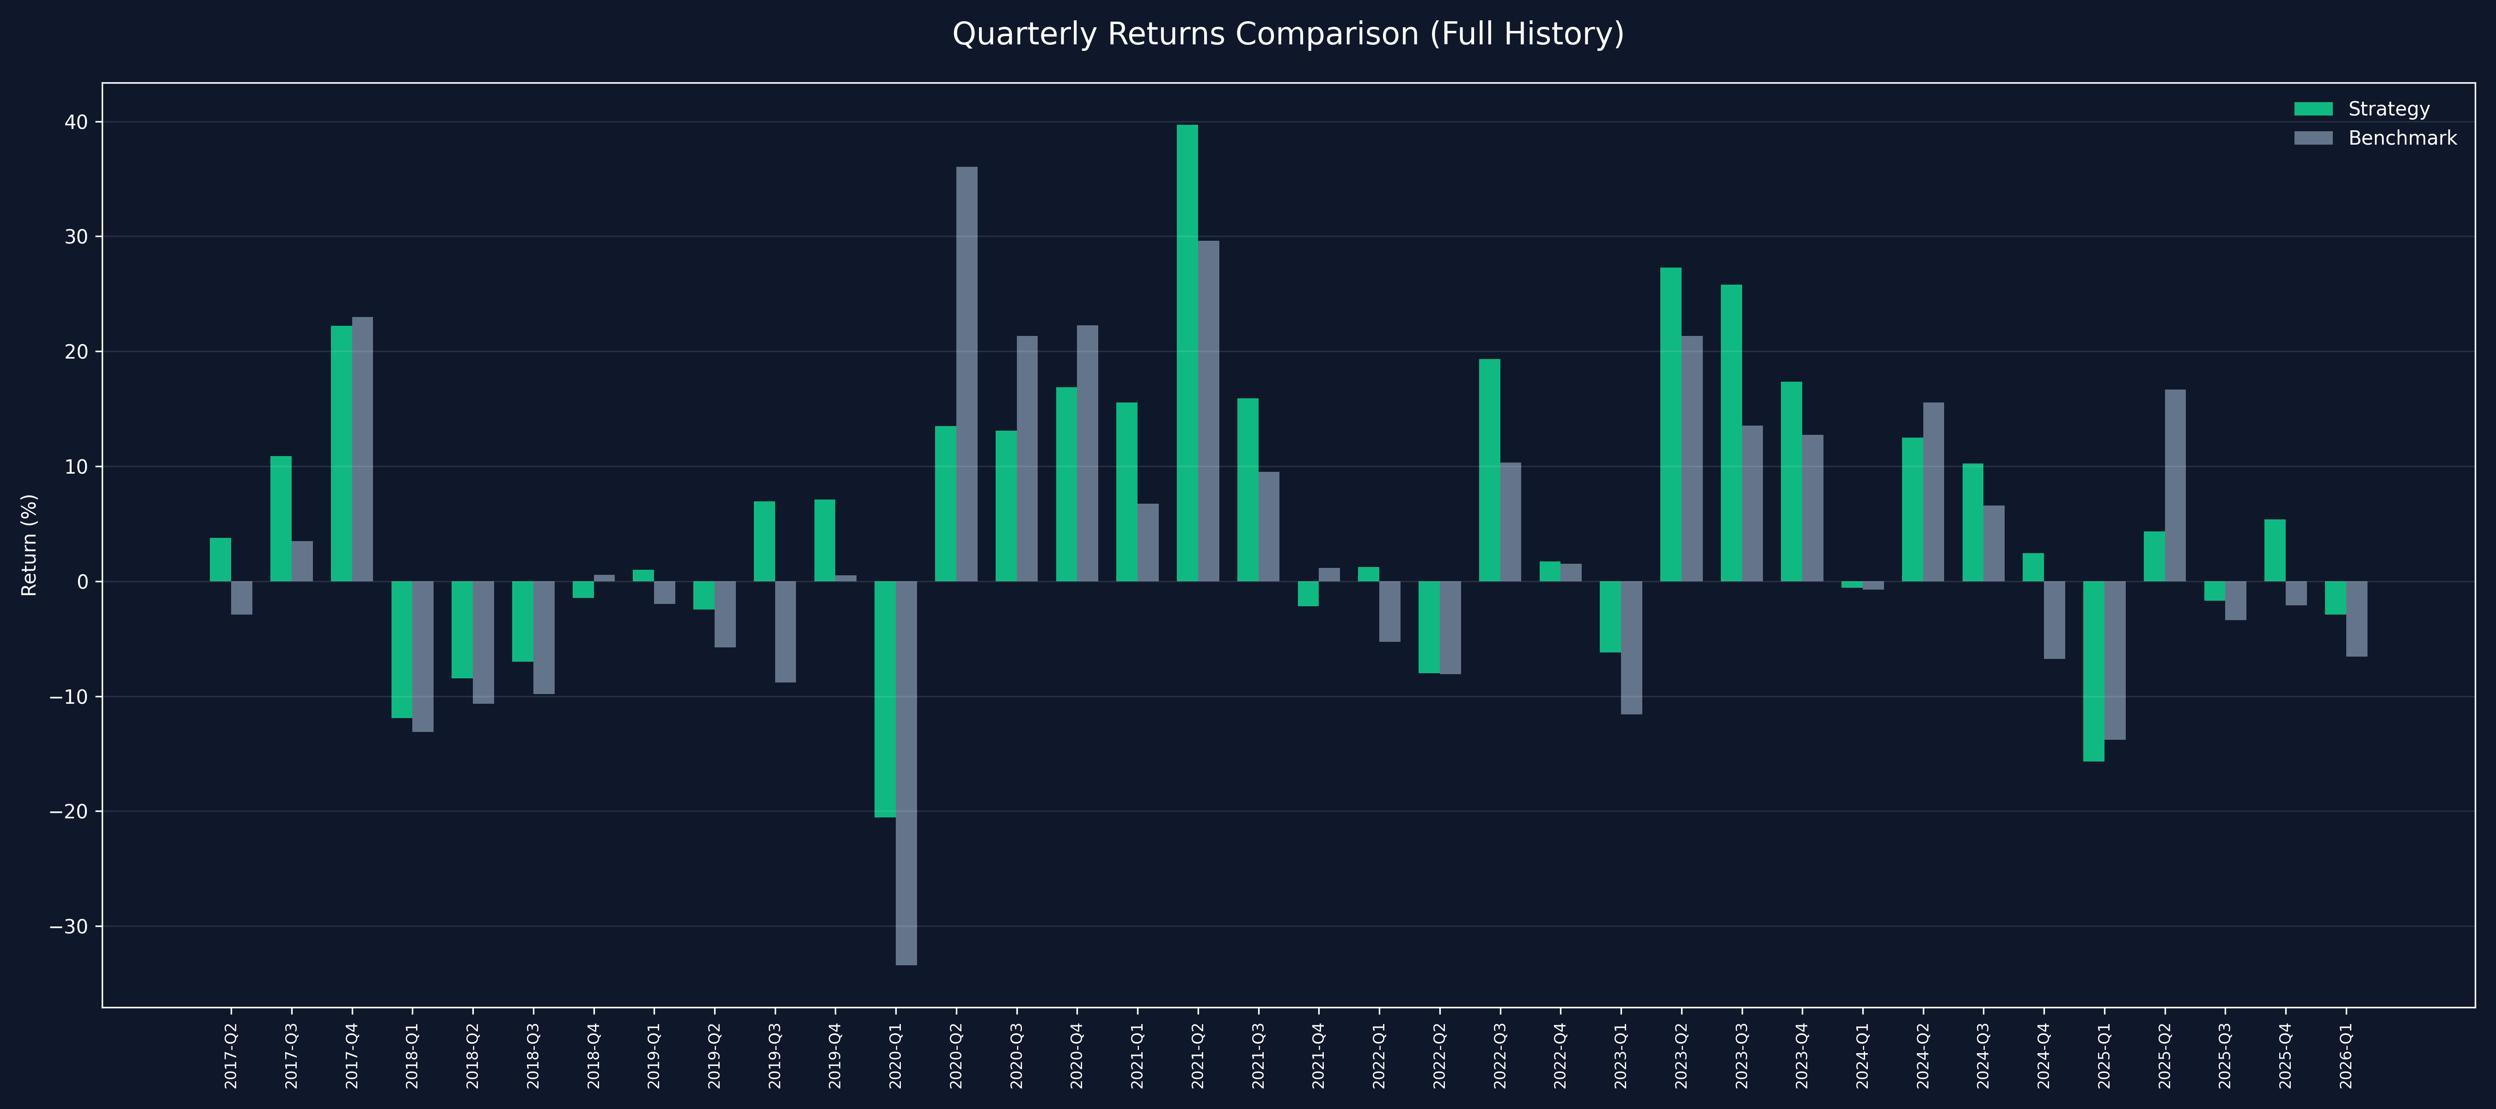
QUARTERLY PERFORMANCE
Granular View of Alpha Generation
Quarterly Outperformance: 75%
CONFIDENTIAL | The Contrarian Strength Strategy
9

Slide 10
THE DYNAMIC EDGE
We hold winners as long as our Proprietary Signal remains valid.
Potential Return Boost: >31% CAGR
CONFIDENTIAL | The Contrarian Strength Strategy
10

