Slide 1
Openstack India Meetup
May 5
Deepak Garg
Citrix R&D
Openstack India Meetup by Deepak Garg is licensed under a Creative Commons Attribution-NonCommercial-NoDerivs 3.0 Unported LicenseBased on a work at github.com.

Slide 2
Contents
History and Motivation
My DC !
How it looks to the User !
Components
Simple WorkFlow
History and Motivation
Partners
Openness and Culture
Community in India
Meetups/Events
Some of the pics in this slide is taken from Ken Pepple's website http://ken.pepple.info

Slide 3
What does it do !
A Software to create IaaS clouds
Infrastructure → Physical Servers, Physical Storage, Network Switches etc..
Pool your Compute ( Servers ), Storage ( FS, SAN, Filers etc.. ), Control your network devices
100 Servers each with 32 GiB RAM ~= a Black box with 3200 GiB RAM
On demand !
SeamLess

Slide 4
My DC !
DB VMs
Web VMs
Switch 1
Switch 2
Physical Hosts
S1
S16
S2
S3
S4
S5

Slide 5
How it looks to the User !
Compute
Pooling the compute. To the user, it can serve scalable and infinite compute on demand
Pooling the storage. To the user, it can serve scalable and infinite storage on demand

Slide 6
Components
Nova – Openstack Compute
Swift – Openstack Object Storage
Glance – Openstack Image Service
Keystone – Openstack Identity Service
Horizon – Openstack Dashboard
Quantum – Openstack Networking Service
Others:
Atlaas – Load Balancing as a Service

Slide 7
Nova
VM lifecycle → provisioning, maintaining
~ Amazon EC2, RAX Cloud Servers, VPS
Also provides volume service ~ EBS
Further divided into logical components: nova-api, nova-compute, nova-network,
- nova-schedule:- decides which physical host the VM should run. Scheduling algos can be very simple or very complex
- nova-api:- provides endpoint for OS/EC2 API, initiates req.
- nova-compute:- lifecycle of VMs
- nova-volume:- creates, attaches, detaches persistent vols
- nova-network:- provisioning vifs, firing iptable rules

Slide 8
Swift
Object Blob Store
~ Amazon S3 or RAX Cloud Files
Distributed architecture -- no SPOF, scale horizontally
- Proxy Server:- provides API endpoint
- Account Server:- manage accounts
- Container Server:- maps containers (folders)
- Object Server:- manage actual files/objects

Slide 9
Keystone
Users and Tenants management
AuthN and AuthZ services
~ Amazon IAM
All components talk to Keystone
Give your username/password and get a token
- Pass token to other services for the API calls you make
- Services verify that token with Keystone for AuthN / AuthZ
- Pluggable backend → LDAP, SQL, Key-Value stores

Slide 10
Glance
Discover, Storage and Retrieval of VM images for Nova
Can use Swift or any other filesystem for backend storage
Optional component but recommended
- glance-api:- provides api endpoint
- glance-registry:- metadata about images
- image-store:- could be swift / S3 etc.

Slide 11
Horizon and Quantum
GUI for admins, tenants and users
Uses keystone API for commands
Quantum:
- plays with switches → physical and virtual
- pluggable architeture → drivers available for OVS, Nicira, Cisco etc., write your own proprietary driver

Slide 12
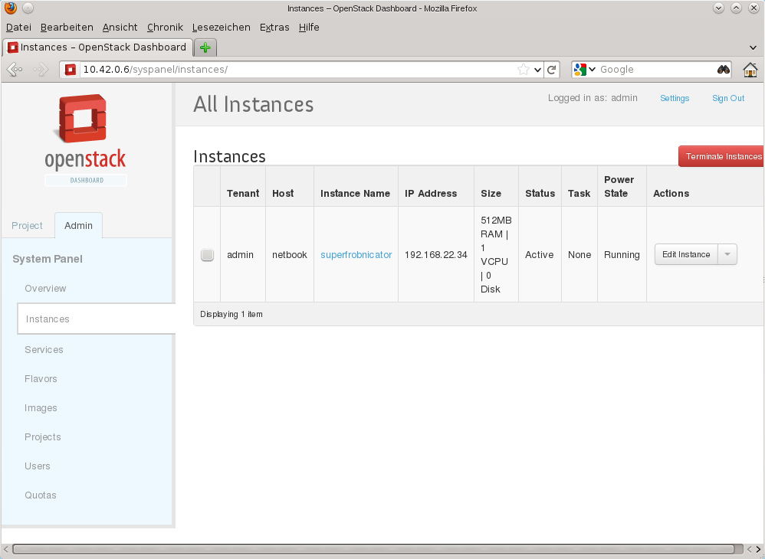

Slide 13
The Others
Queuing Service → RabbitMQ or any AMQP
DB → MySql, Postgres, Sqlite
Apache with mod_wsgi → Dashboard

Slide 14
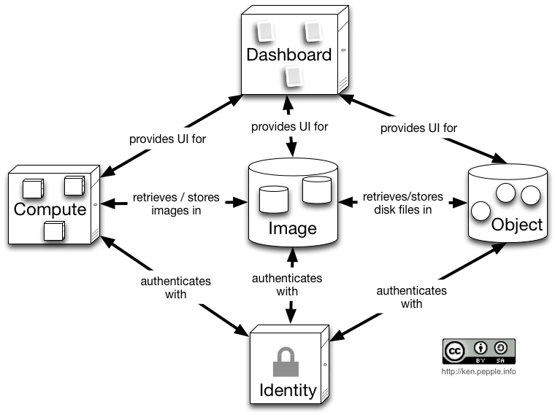
Simple Workflow

Slide 15
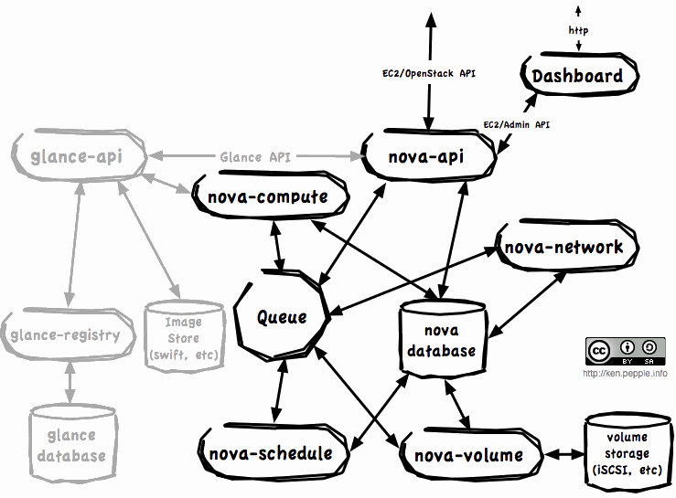
Simple WorkFlow 2.0

Slide 16
History and Motivation
July 2010,
RAX and NASA
RAX to compete in IaaS industry
RAX Cloud – 2009 Cloud Files rewrite
    2010 cloud Servers rewrite/ open source
NASA launch VMs and launch satellites
    Nebula – not happy with Eucalyptus
    Writing their own (in Python)

Slide 17
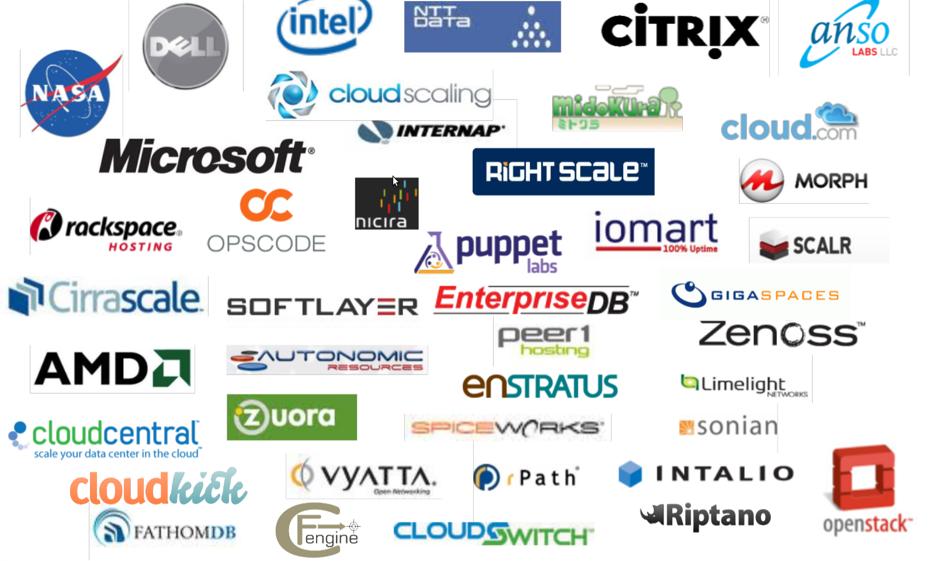
Partners

Slide 18
Openness and culture
Open Source → Apache 2.0
Open Design → Design Summit and Dev conf for every release
Open Dev → github, Launchpad and gerrit
Open Community → PTLs and PB members elected by the community

Slide 19
Community in India
ML: openstackindia@librelist.com
Meetup Page: http://www.meetup.com/Indian-OpenStack-User-Group/
LinkedIn: Openstack India community http://www.linkedin.com/groups/OpenStack-India-4005742
FB: Openstack India User Grp http://www.facebook.com/groups/328814400511881/
Python Developers Meetup page:
http://www.meetup.com/Bangalore-Python-Developers-Group/

Slide 20
Meetups/Events
Bug Squashing Day / Release Hack Ins
User grp and Knowledge transfer

Slide 21
deepakgarg.iitg@gmail.com
@donji
Q ?

