Slide 1
BangPypers April Meetup
Fabric and App Deployment
Deepak Garg
Citrix R&D
Openstack India Meetup by Deepak Garg is licensed under a Creative Commons Attribution-NonCommercial-NoDerivs 3.0 Unported LicenseBased on a work at github.com.

Slide 2
Contents
Fabric ?
Example Code
App Deployment
Fab cmds
Fab decorators
Fabric for Django App Deployment
Why Fabric ?
Issues and Alternatives
Q & A

Slide 3

Fabric ?
Automated deployments for lazy people
A command fab
and a py file fabfile.py
Get it: http://fabfile.org
$ sudo pip install fabric

Slide 4
Example Code
def clean(site=None):
"""Remove .pyc files from a site."""
from os import path
if not site:
site = prompt('Please specify which site(s) to clean (a comma delimited list): ', validate=r'^[\w-.,]+$')
site_list = site.split(',')
for item in site_list:
env.hosts = [ item ]
path = path.join('/var/www', item)
sudo("find %s -name '*.pyc' -depth -exec rm {} \;" % path)
$ fab clean:site=xenstack.org
[172.16.12.6] sudo: find /var/www/xenstack.com -name
'*.pyc' -depth -exec rm {} \;
Password for testuser@192.168.56.3:
Done.
Disconnecting from 172.16.12.6... done.
$

Slide 5
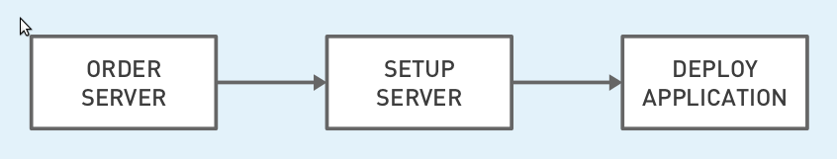
App Deployment
Order Server: Provision VMs
Setup Server: Create users, groups, Customize config files, Install base packages
Deploy App: install app specific packages, deploy application, start services

Slide 6
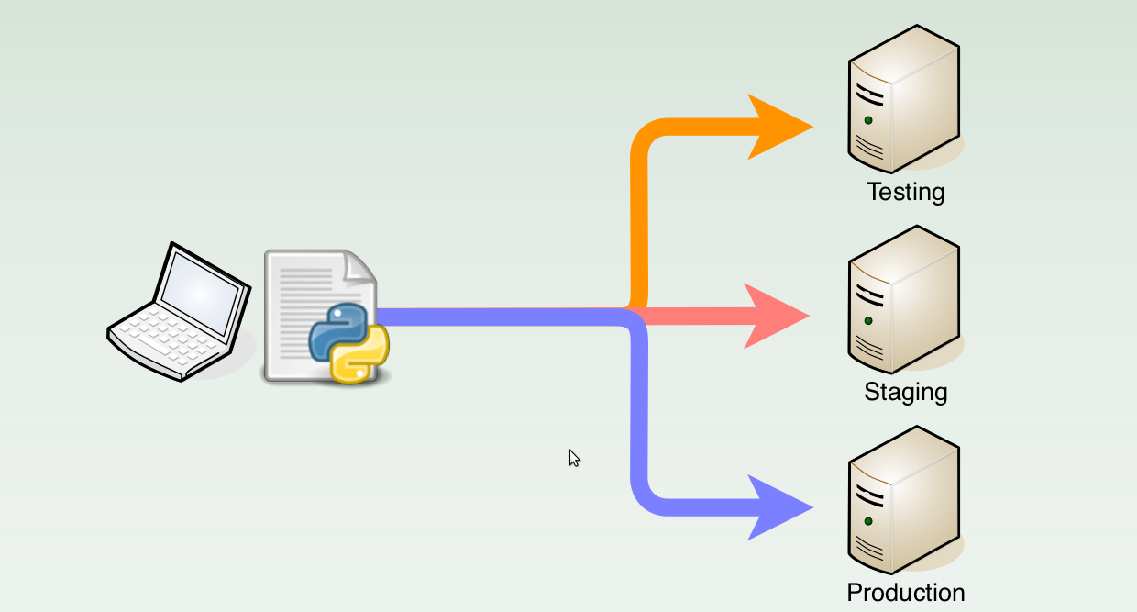
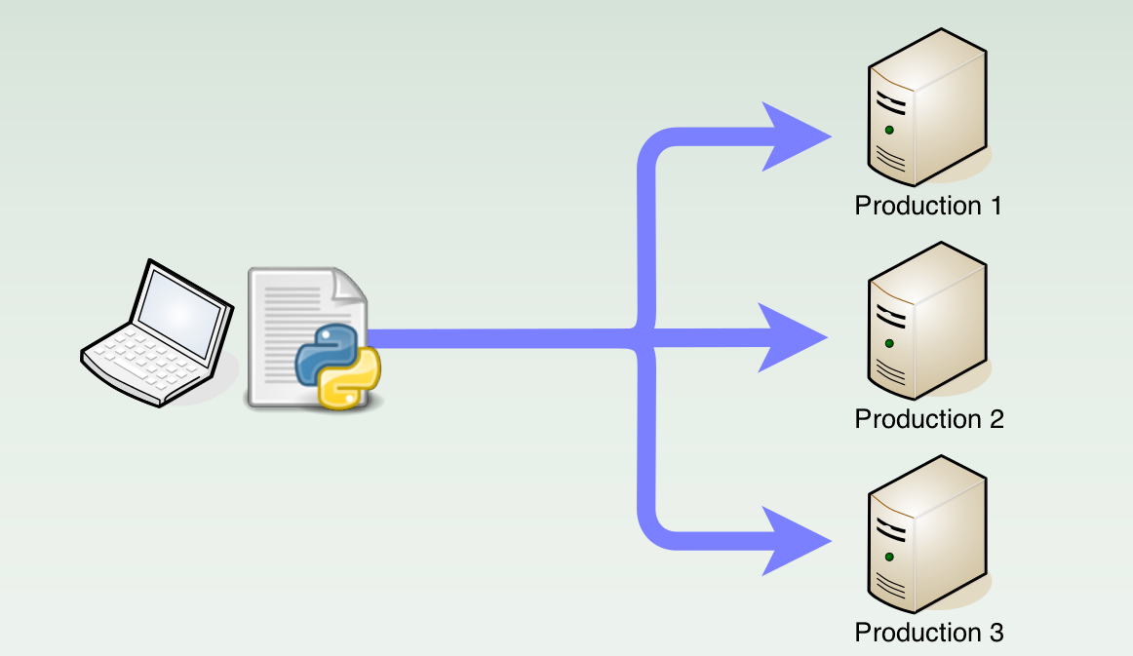
App Deployment
Deploy on multiple servers – scale out
Deploy on multiple environments
Make this process AUTOMATED, Simple and fast

Slide 7
Sample snippet 1
def provision_vm():
# Use boto to provision server in AWS
..........
def install_baseline():
local("git add -p && git commit")
...........
def install_app_specific_packages():
......
def install_db(db_name=None):
.............
with-settings(warn_only=True)
def safe_merge():
...........
@roles('production_web')
def production_server():
provision_vm()
install_baseline()
install_app_specific_packages()
install_db(db_name='mysql')
configure_production()
@roles('testvm')
def testenv_server():
install_baseline()
install_app_specific_packages()
install_db(db_name='mysql')
configure_test()
$ fab testenv_server #Local Env
$ fab production_server # Prodn Env

Slide 8
Sample snippet 2
def basic_tests():
local("./manage.py test my_app")
..........
def commit():
local("git add -p && git commit")
...........
def local_deploy():
basic_tests()
Commit()
def grab_code():
# git fetch
.............
with-settings(warn_only=True)
def safe_merge():
# git merge
...........
@hosts('user1@host1', 'host2', 'user3@host3')
def stage_deploy():
grab_code()
basic_tests()
stage_tests()
safe_merge()
$ fab local_deploy #Local Env
$ fab stage_deploy # Staging Env
$ fab production_deploy # Prodn Env

Slide 9
Why Fabric ?
Testing: Deploy some vms
execute some api/cmds
collect the results, logs back, analyse etc...
Deploy and Scale your App: All the servers should have exactly the same configurations and same code
Systems Administration
  Clean .pyc files
  Check out new revision from a SCM repository
  Install packages, Apply patches
  Available fabric recipes !!
Crux: Interact with Systems !
Make admin and deployment tasks Pythonic !!

Slide 10
Fab Cmds
prompt: Display a prompt to the user and store the input in the given variable. Validation is optional.
put: Upload files to the remote host(s).
get: Download a file from a remote host.
run: Run a shell command on the remote host(s).
sudo: Run a root privileged shell command command on the remote host(s).
local: Run a command locally.
upload_template: Render and upload a template text file to a remote host.
rsync_project: Synchronize a remote directory with the current project directory via rsync
append: Append string (or list of strings) text to filename.

Slide 11
Fab Decorators
@hosts: Defines on which host or hosts to execute the wrapped function.
@parallel: Forces the wrapped function to run in parallel
@with_settings: Forces fab settings on that task
e.g: @with_settings(warn_only=True) -> turn aborts into warnings
@runs_once: Prevents wrapped function from running more than once.
@serial, @roles etc...
    @hosts('user1@host1', 'host2', 'user2@host3')
    @runs_once
    def my_func():
    pass
    @roles('web')
    def my_other_func():
    pass

Slide 12
Lets look at a sample fabfile .....

Slide 13
Issues and Alternatives
Roll back not easy
State Management
Alternatives: Puppet, Chef
  Not easy to write
  Need to maintain Master and Slave nodes

Slide 14
THANK YOU !
Presentation at: https://github.com/gargdeepak/Presentations
Happy to help !
deepakgarg.iitg[at]gmail.com
@donji

