Slide 1
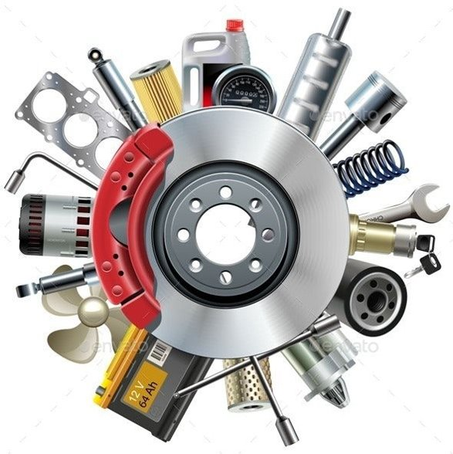
Motorex
Motor Part Shop Software
Inventory Management
Software Engineering Laboratory

Slide 2
Problem Statement
2

Slide 3

A small auto-mobile spare parts shop sells the spare parts for a vehicles of several makes and models.
To streamline the sales and supply ordering, the shop owner has asked us to develop the following motor part shop software.
The shop owner maintains different parts in wall mounted and numbered racks. The shop owner maintains as few inventory for each item as reasonable, to reduce inventory overheads after being inspired by the just-in-time (JIT) philosophy.
Calculate the threshold value for each item, the software must be able to calculate the average number of parts sales for one week for each part.
At the end of each day, the shop owner would request the computer to generate the items to be ordered. The computer should print out the part number, the amount required and the address of the vendor supplying the part.
The computer should also generate the revenue for each day.
At the end of day, the software should plot a graph.
3

Slide 4
Why This Software ?
4

Slide 5
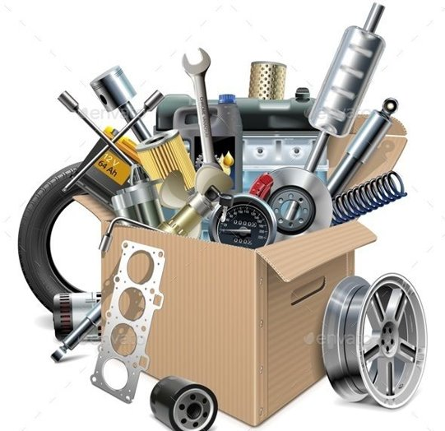
It is very a difficult task to handle large database of items manually by a Spare Part shopkeeper.​
The shop owner faces difficulties in maintaining the shop inventory.​
The shop owner never want to a loss due to lack of stock in his shop. While maintaining the inventory of the shop, he often had troublesome experiences.​
The shop owner faces difficulty in calculating and maintaining the revenue on a daily basis.​
The shop owner often forgets where a particular item is kept.
5

Slide 6
Motorex Key Features
6

Slide 7

Motorex is very easy to use and has a very user-friendly interface.
It is OS independent and has minimum number of dependencies. So, one do not have to do troublesome work before using the software. The software can be very easily installed in the system.
It will provide a hassle-free experience to the owner for maintaining the stock inventory.
Motorex gives importance to the security features as well. Only the user with valid username and password can access Motorex.
Motorex keeps track of all the information of the items of the shop like price, item's manufacturers, rack and vehicle type.
7

Slide 8
It also stores the details of manufacturer as well. This also reduces the burden of remembering and maintaining the records of all the manufacturers.
Motorex automatically generates the order list of items which should be ordered in order to maintain the inventory of the shop to last for one week. So, the owner never has to worry about stock after using Motorex.
It also calculates the revenue of the sales of the shop on a daily basis. This helps in keeping track of the revenues and profits of the shop.
8

Slide 9
Implementation
And
Design Choices
9

Slide 10

Why Java ?​
Java is an object-oriented programming language.
Easy to install and maintain.
Easy to design GUI Framework
Easy integration with MySQL database.
10

Slide 11
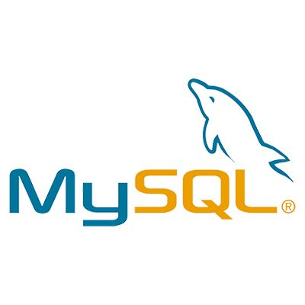
Why MySQL ?​
MySQL is easy to use, fast, secure, flexible and free to use database management system.
Easy integration with Java make it an ideal choice.
MySQL is highly secure.
11

Slide 12
Challenges Faced
12

Slide 13
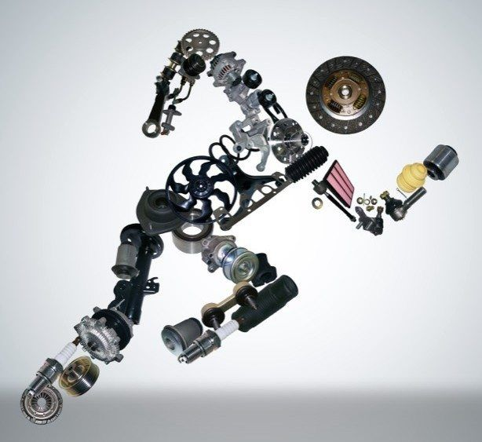
Developing the frontend
Database management
Making the software functional along with exception handling in a limited amount of time.
Other Challenges
13

Slide 14
Short Demo
14

Slide 15
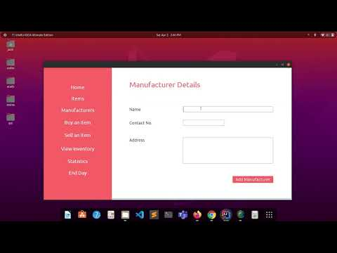
15

Slide 16
Future Improvements
16

Slide 17

Adding utility functions.
Sell feature can be improved to add multiple items in an order.
We can add the option to generate a printed invoice of sales.
A cloud-based database can be used to improve the database handling and to use the software in multiple devices.
Multiple user handling
Security enhancements
17

Slide 18



Our Team
Jatin Gupta
(20CS10087)
Gopal
(20CS30021)
Jay Kumar Thakur
(20CS30024)
18

Slide 19
Thank You

