Slide 1
Water

Slide 2
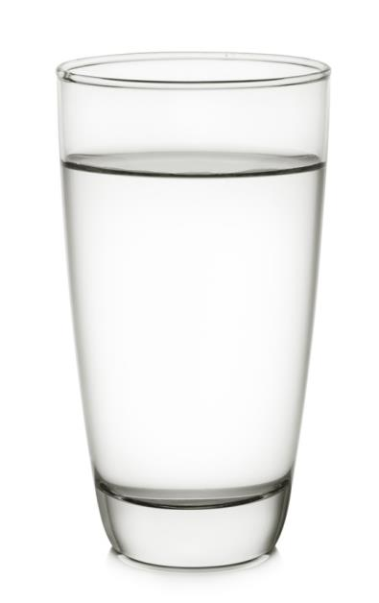
Water
Water is essential for life. It is the major component of body fluids and helps to maintain normal physical and cognitive functions, as well as the normal regulation of the body’s temperature. Water also helps to get rid of waste substances in the body.
The body is nearly two-thirds water, so it is important to consume enough fluid to stay hydrated. If we do not consume enough water, we become dehydrated.

Slide 3
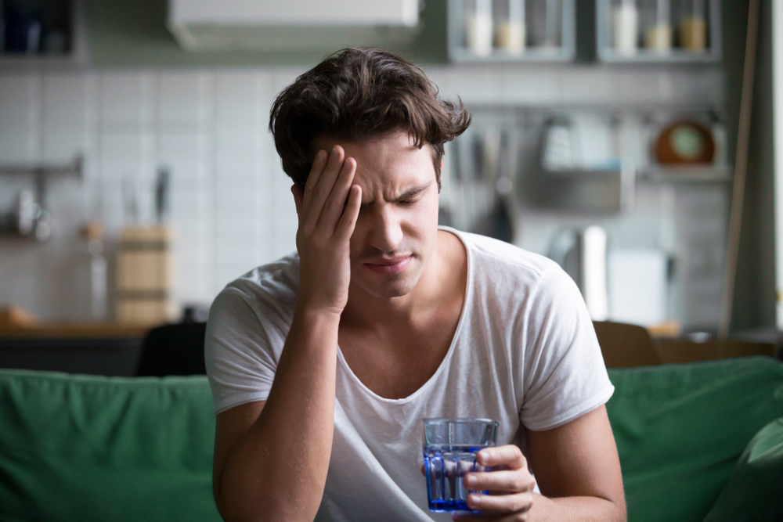
Water
Our bodies lose water all the time, when we go to the toilet, from sweat and also through respiration. We need to replace this water by drinking regularly to prevent dehydration.
Even mild dehydration can lead to headaches, irritability and loss of concentration.
Did you know?
Humans can survive for a few weeks without food, but they can only survive for a much shorter time without fluids.

Slide 4
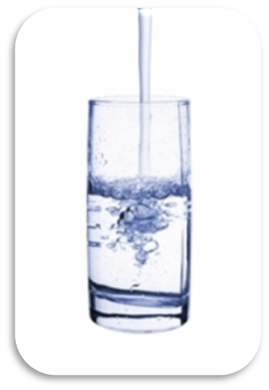
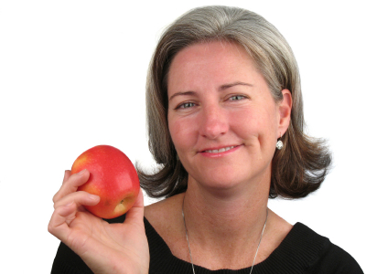
Sources of water
20% of water is provided by food such as soups, yogurts, fruit and vegetables. The other 80% is provided by drinks such as water, milk and juice.
Water is a good choice of drink because it hydrates without providing energy.

Slide 5
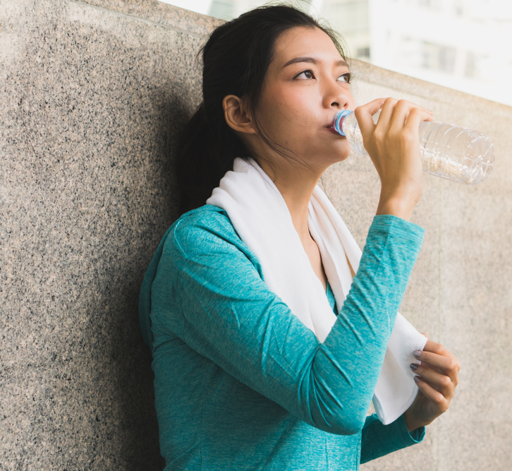
How much water do we need?
The amount of water and other fluids that we need to drink each day varies from person to person.
The recommendation is to drink about 6 to 8 glasses of fluids a day to prevent dehydration. This is in addition to the fluid we get from food.
We need to drink more when the weather is hot or when we are active.

Slide 6
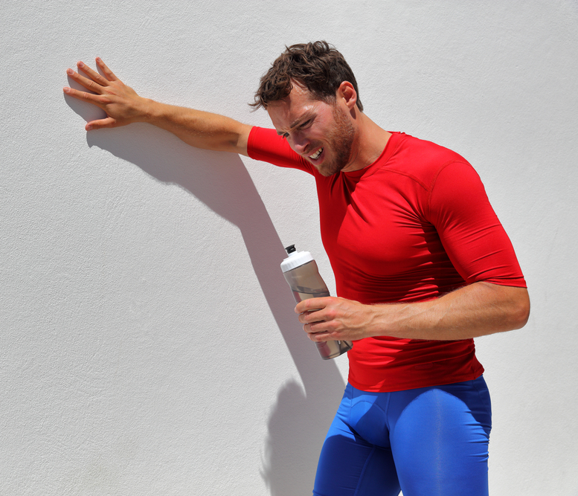
What is thirst?
The body’s first response when dehydration is detected is to signal the kidneys to conserve water.
The thirst response is initiated when 1-2% of body mass is lost due to dehydration so it is important to drink if we are thirsty. Dehydration can be very serious and a loss of as little as 2% can result headache and fatigue.
The easiest way to spot that you might not be getting enough water is if your urine is a dark yellow colour during the day. If you are getting enough water your urine should be a pale straw colour.

Slide 7
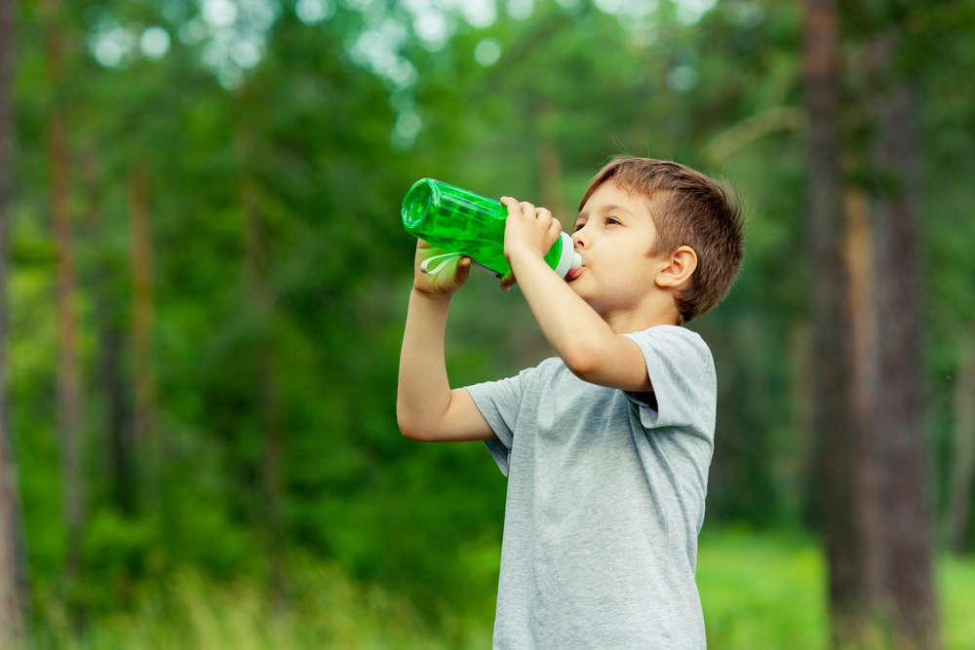
Which population groups may be at risk of dehydration?
Older adults may have a weaker sense of thirst. If necessary they should be helped and encouraged to drink regularly.
Children need plenty of fluid and they should be encouraged to drink regularly, especially if they are very active.
People who are very physically active should drink enough fluid to replace the water loss through sweating.

Slide 8
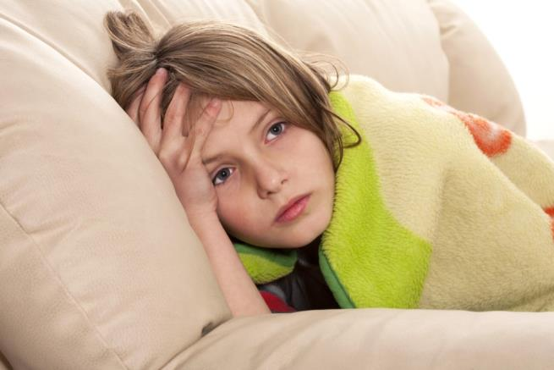
What happens if we drink too much water?
Drinking too much water can lead to ‘water intoxication’ with potentially life threatening hyponatraemia.
This is caused when the concentration of sodium in the blood gets too low.
Symptoms of hyponatremia include nausea, vomiting and headache.

Slide 9
Quiz- Kahoot
Open the link below on the main screen and get students to log onto kahoot.it on their tablets or smartphones. They can then enter the code (that will come up on the main screen when you start the game) and their own nickname. They can then play along with the quiz choosing the multiple choice answers that correspond with the questions on the main screen. There will then be a leaderboard of the scores after each question and at the end.
https://play.kahoot.it/#/?quizId=3d2b6762-4413-459b-a4da-89e822913e33

Slide 10
Water
For further information, go to:
www.foodafactoflife.org.uk

