Slide 1
BIRD IDENTIFICATION
Akrum Hamdy

Slide 2
Table of Contents
Introduction
Bird Anatomy
Classifying Birds
Bird Species

Slide 3
Introduction
There are many groups of wild birds, including waterfowl, shorebirds, raptors, and pest and nuisance birds.
Many fall into another group called inland birds.
These are species that do not prefer a wetland habitat.

Slide 4
Some are game birds and some are songbirds.
This lesson will provide a basis for identifying and naming birds, a system of taxonomy.

Slide 5
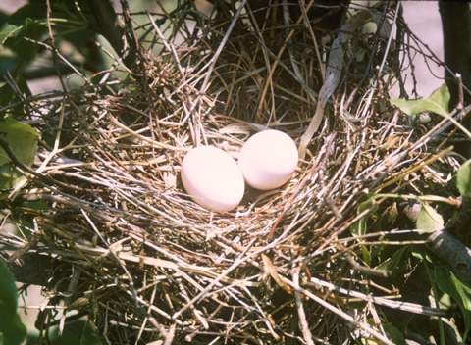
Bird Anatomy
Birds are warm-blooded and can regulate body temperature; that is, they are homiothermous.
They give birth by laying eggs and care for their young after hatching.
Photo by Erwin Cole courtesy of USDA Online Photography Center.

Slide 6
Birds are able to fly for the following reasons:
No teeth or heavy jaws;
Reduced skeleton – fewer bones;
Hollow bones;
Shorter intestine;
No urinary bladder;

Slide 7
Air spaces in the bones and body cavity; and
Positioning of major muscles and body organs toward the center of the body.

Slide 8
Ornithology is the study of birds, which is largely based on form and structure of birds.
Field guides aid in identification, which relies on an understanding of feather arrangement and color.
Birds have different shapes of wings, tails, bills, and feet.

Slide 9
Birds can belong to pure communities, which have birds that are almost all of the same species.
Birds can also be part of an ecotone, which is a place where two or more ecosystems meet.

Slide 10
Some species will not leave a pure community.
Others adapt well to the more diverse habitat of an ecotone.

Slide 11
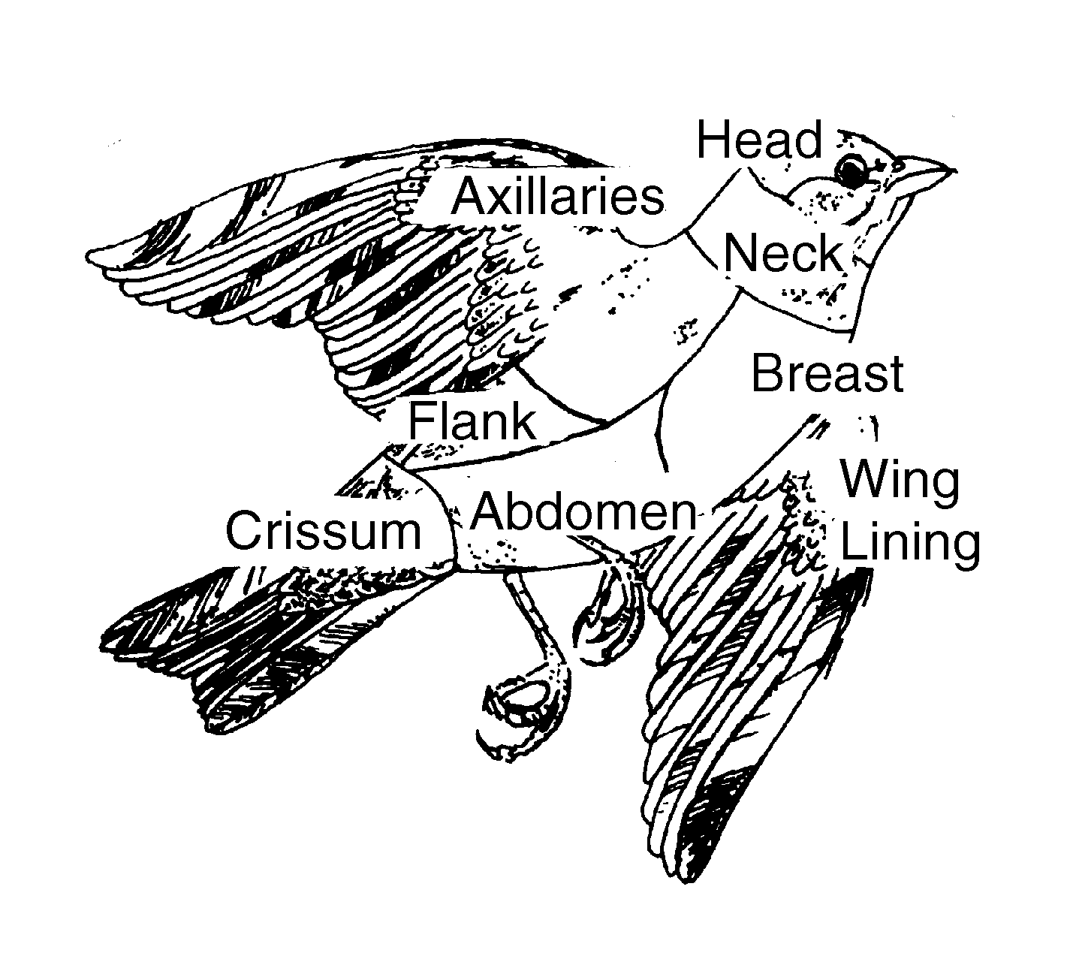
The parts of a bird’s exterior are mapped out as topography.
The areas are keys to identifying the different species.

Slide 12
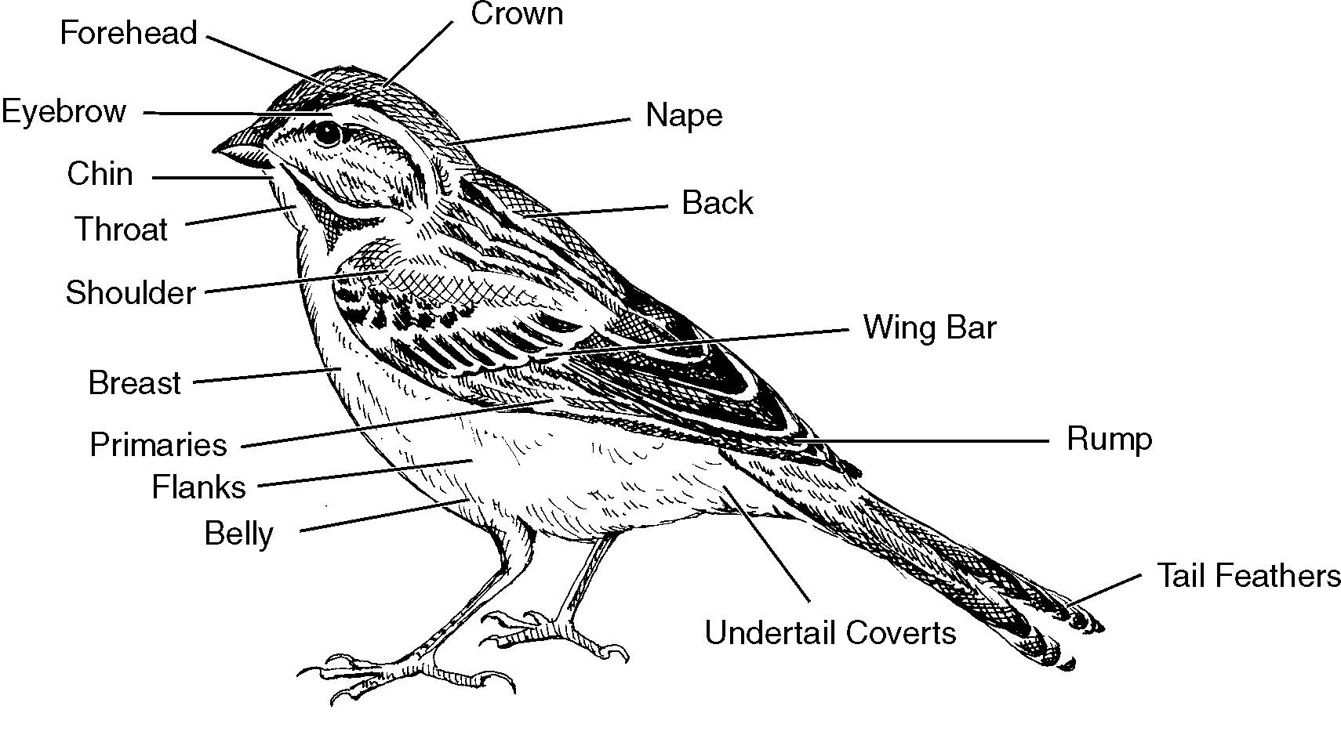

Slide 13
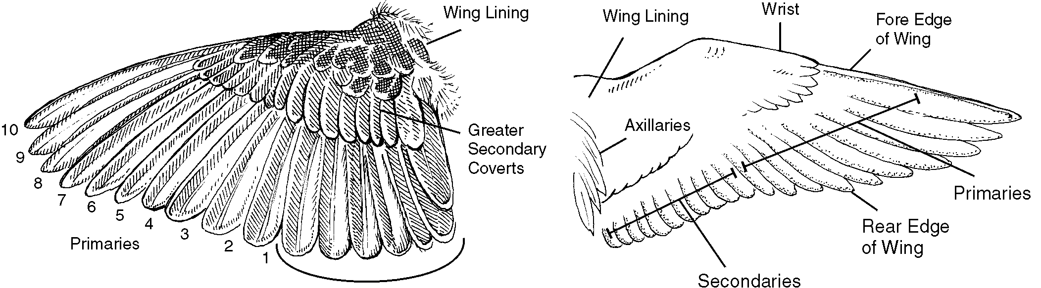
Surface of Wing
Upper Under

Slide 14
Pigment can be a result from the food the bird eats.
Physical properties and feather structure also create colors.
Light reflecting off feathers creates an iridescent color.

Slide 15
Birders look for filed marks such as streaking on a bird’s side, head color, or bill shape.

Slide 16
Classifying Birds
Birds are alike in many ways, yet very different in other ways.
Birds are grouped into orders by their features.
Carolus Linnaeus published a book in 1735 that had a system of classifying plants and animals.

Slide 17
Linnaeus’ system is known as binomial nomenclature (two names).
This system developed into taxonomy, which is the science of classifying organisms.
Linnaeus developed larger categories including kingdom, phylum, class, order, and family, to go with the two names.

Slide 18
The final two names of genus and species follow the family. Therefore, a taxonomy hierarchy looks like this:
Kingdom Phylum Class Order Family Genus Species

Slide 19
Birds fit into the following categories:
Kingdom – Animalia
Phylum – Chordata
Class – Aves

Slide 20
Bird Species
The orders of birds all end in the suffix “iformes.”
The 10 orders of inland birds are:
Falconiforms – birds of prey;
Galliformes – grouse, pheasant, quail, and turkey;
Columbioformes – pigeon, doves;

Slide 21
Cuculiformes – cuckoos, roadrunners;
Strigiformes – owls;
Caprimulgiformes – goatsuckers, nighthawks;
Apodiformes – swifts, hummingbirds;
Coraciformes – kingfishers;
Piciformes – woodpeckers; and
Passeriformes – songbirds.

Slide 22
Galliformes
Galliformes include the upland game birds of turkey, quail, grouse, and pheasant.
These birds have a chicken-like appearance and a high reproductive potential.
These birds are called gallinaceous, which means heavy-bodied, mostly ground-feeding birds.

Slide 23
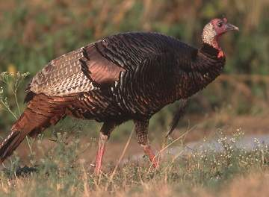
Turkey
Two main species of turkey populations are found in Texas, the Rio Grande turkey and the Eastern turkey.
They are similar in appearance.
Photo courtesy of USDA Natural Resources Conservation Service.

Slide 24
Decline in populations are due to clearing of forests, wasteful hunting, poultry diseases, and interbreeding with domestic turkeys.
The Eastern turkey population has also been affected by feral hogs, which would eat any eggs or poults they found.

Slide 25
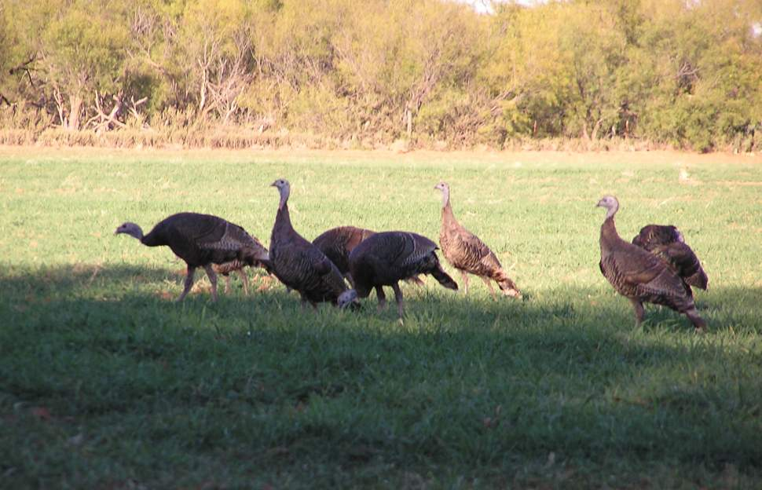
Photo by Tim Knezek.

Slide 26
Rio Grande Turkey
The male turkey is a black-barred, iridescent, greenish-bronze color.
The head is naked and blue-colored with reddish wattles.
A bristly black beard hangs from the chest.

Slide 27
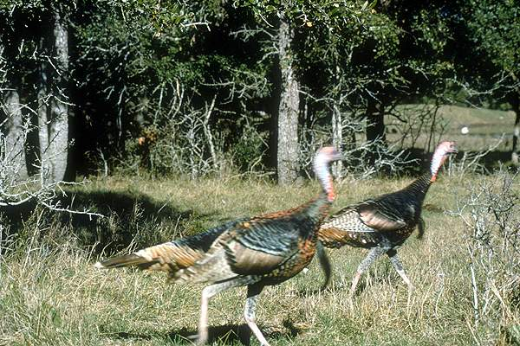
IMS Photo

Slide 28
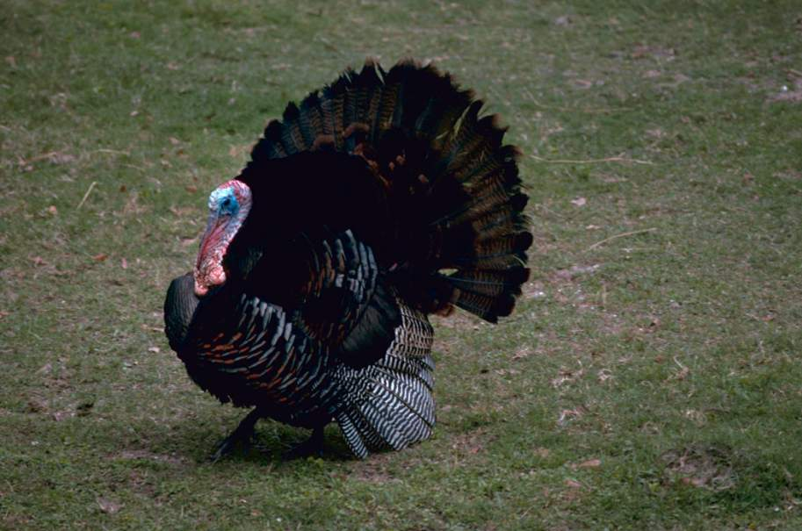
Eastern Turkey
Photo by Gary Stolz courtesy of U. S. Fish and Wildlife Service.

Slide 29
Grouse
Grouse include the lesser prairie chicken, the ruffed grouse, and others.
At first, agriculture benefited the grouse.
As agriculture became more intense, the grouse began to decline.

Slide 30
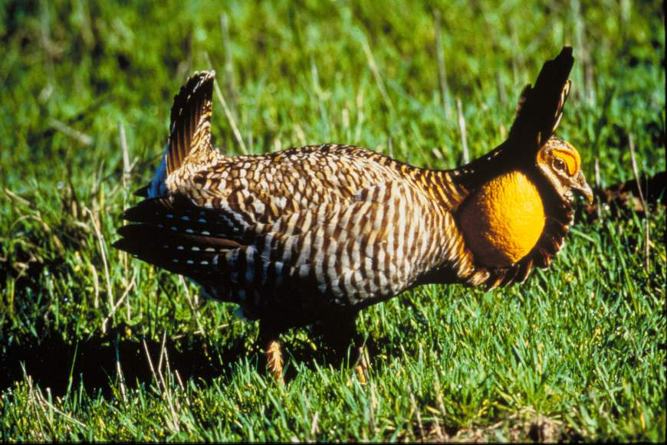
Greater Prairie Chicken Tympanuchus cupido attwateri
Photo by George Lavendowski courtesy of U. S. Fish and Wildlife Service.

Slide 31
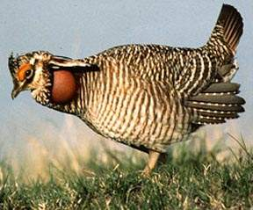
Lesser Prairie Chicken Tympanuchus pallidicinctus
Photo courtesy of U. S. Fish and Wildlife Services.

Slide 32
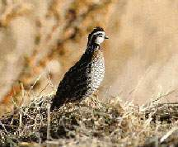
Quail
Two species of quail are common to Texas, the bobwhite quail and the scaled quail.
The scaled quail prefers desert areas of the south and western part of Texas.
The bobwhite prefers grassy areas next to shrubs.
Photo courtesy of U. S. Fish and Wildlife Service.

Slide 33
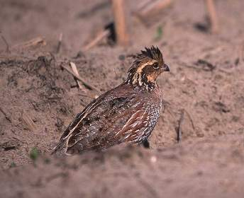
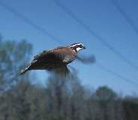
Quail are mainly terrestrial, preferring to walk around or under obstacles rather than fly over them.
Photos by Jeff Vanuga courtesy of USDA Natural Resources Conservation Service.

Slide 34
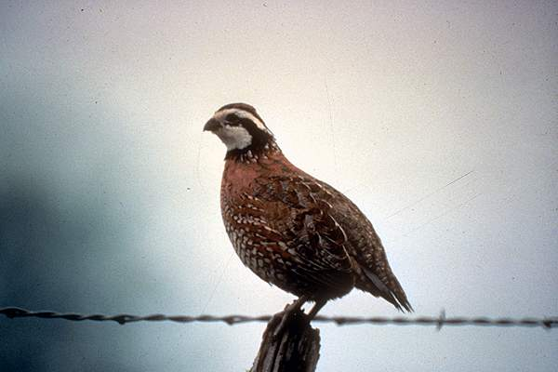
Bobwhite Quail Colinus virginianus
IMS Photo

Slide 35
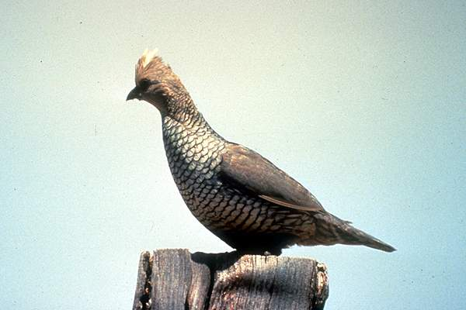
Scaled Quail (Blue Quail) Callipepla squamata
IMS Photo

Slide 36
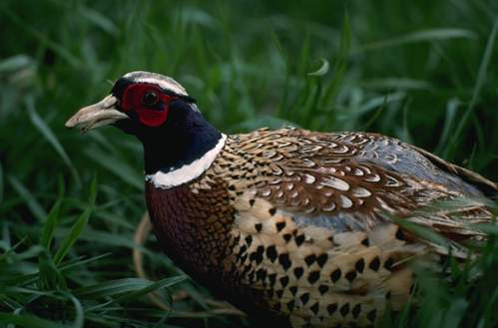
Pheasant Phasianus colchicus
Pheasants are Asiatic game birds that were imported for sport.
Their preferred habitat includes open grasslands and cropland areas with brushy cover nearby.
Photo by Ron Nichols courtesy of USDA Online Photography Center.

Slide 37
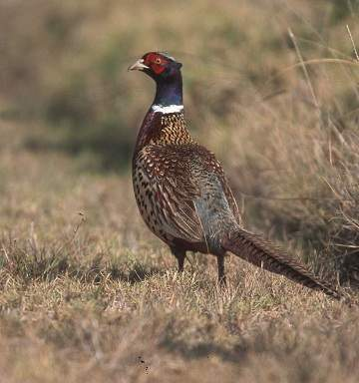
Photo courtesy of USDA Natural Resources Conservation Service.

Slide 38
Columbiformes
Columbiformes are pigeons and doves.
They are plump birds with small heads.
Columbiforms are fast flyers.

Slide 39
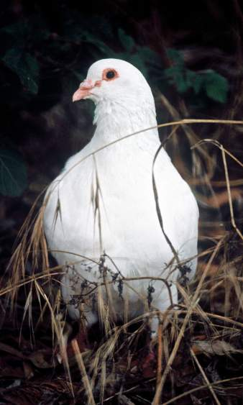
Pigeons (Rock Doves) Columba livia
Pigeons, or rock doves, are an exotic to North America, arriving in the early 1600s.
They originated in Africa, Asia, Europe, and the Middle East.
They are a feral species.
Photo by Lee Karney courtesy of U. S. Fish and Wildlife Service.

Slide 40
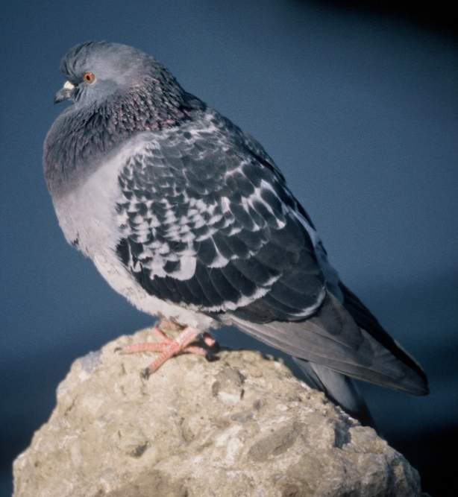
Photo by Lee Karney courtesy of U. S. Fish and Wildlife Service.

Slide 41
Doves
Two species of doves are classified as game birds, the mourning dove and the white-winged dove.

Slide 42
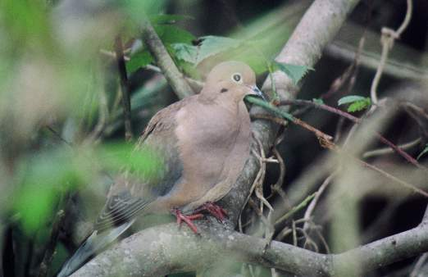
Mourning Dove Zenaidura macroura
The mourning dove has adapted to human activity, but prefers open woodlands or edges between forests and prairies.
Photo by Lee Karney courtesy of U. S. Fish and Wildlife Service.

Slide 43
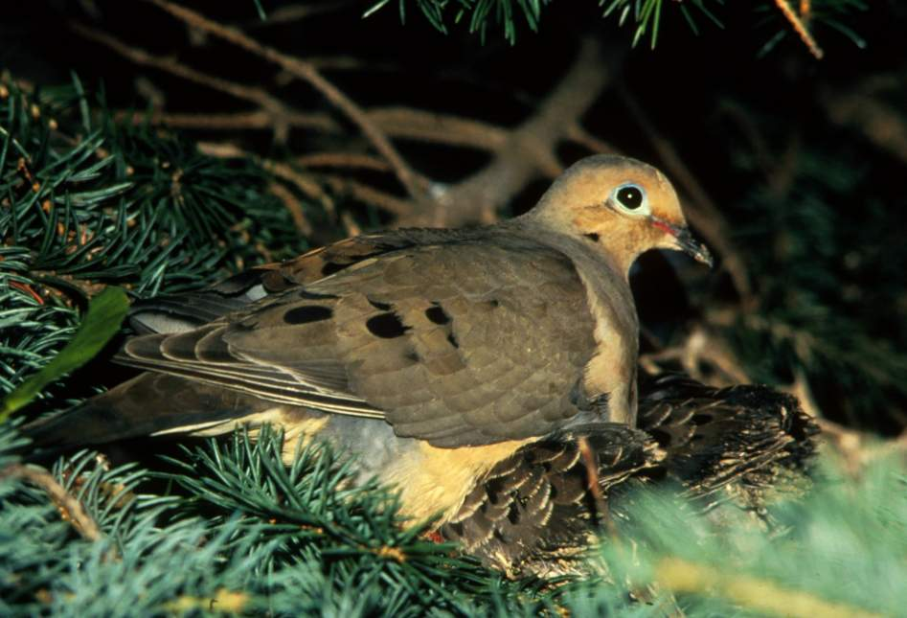
Photo by James Leupold courtesy of U. S. Fish and Wildlife Service.

Slide 44
White-winged Dove Zenaida asiatica
The white-winged dove ranges from the southwestern United States through Mexico and South America.
It prefers tall mesquite and prickly-pear cactus near the Rio Grande.

Slide 45
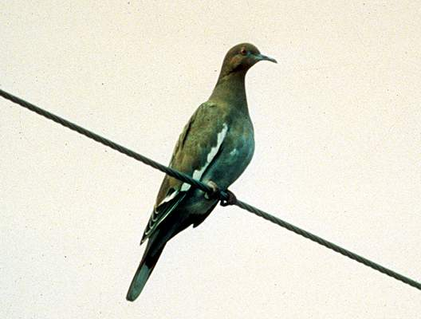
IMS Photo

Slide 46
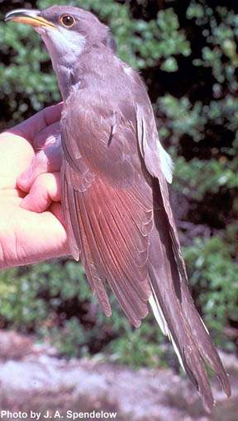
Cuculiformes
Cuculiformes are cuckoos and roadrunners.
Birds in this family are slender-bodied and have a long tail.
Their feet have two toes that are forward and two toes that are backward.
Yellow-billed cuckoo
Photo courtesy of U. S. Fish and Wildlife Service.

Slide 47
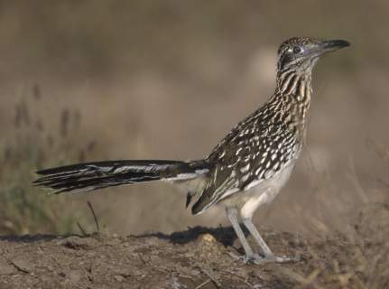
Roadrunner Geococcyx californianus
The greater roadrunner is a terrestrial cuckoo that runs quite well.
Roadrunners occur in the open country with scattered cover or dry brush in the arid southwest.
Photo by Gary Kramer courtesy of U. S. Fish and Wildlife Service.

Slide 48
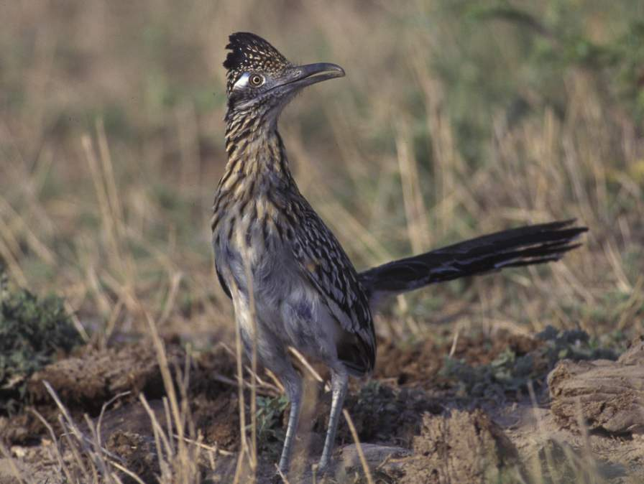
Photo by Gary Kramer courtesy of U. S. Fish and Wildlife Service.

Slide 49
Passeriformes
Songbirds or perching birds belong to the order Passerformes.
There are numerous birds in this order. Included in this presentation are the:
mockingbird,
blue jay,
cardinal, and
American robin.

Slide 50
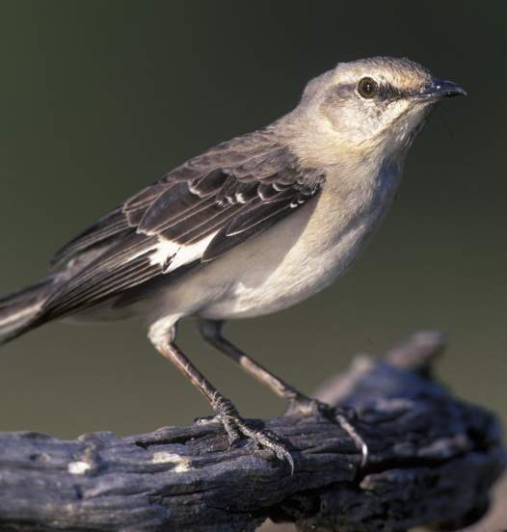
Mockingbird Mimus polyglottos
The mockingbird is an excellent mimic and is the official state bird of Texas.
Photo by Gary Kramer courtesy of U. S. Fish and Wildlife Service.

Slide 51
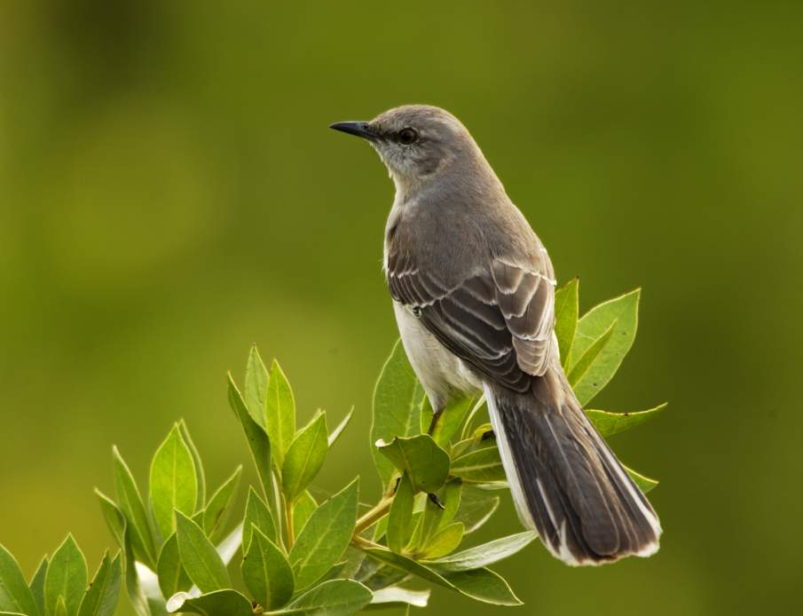
Photo by Ryan Hagerty courtesy of U. S. Fish and Wildlife Service.

Slide 52
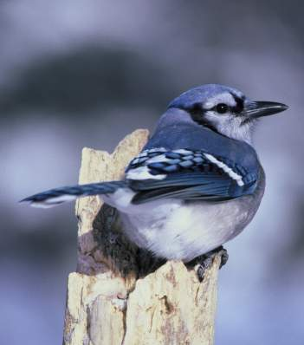
Blue Jay Cyanocitta stelleri
The blue jay is the most common jay found in the eastern oaks and piney woods.
They are among the most striking species in yards and parks in the eastern and central parts of Texas.
Photo by Dave Menke courtesy of U. S. Fish and Wildlife Service.

Slide 53
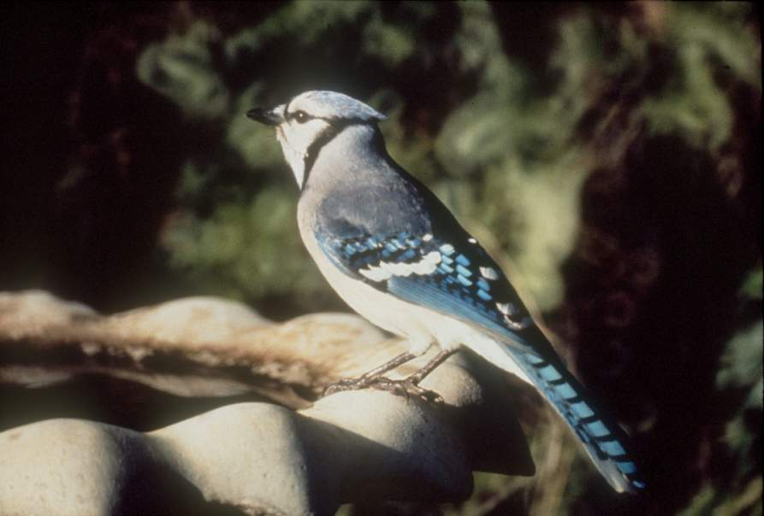
IMS Photo

Slide 54
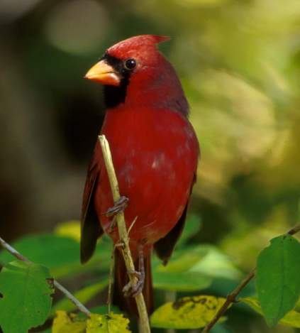
Cardinal Richmondena cardinalis
The cardinal is bright red with a red, conical beak.
They are common throughout Texas, except in the Panhandle.
Photo by John & Karen Hollingsworth courtesy of U. S. Fish and Wildlife Service.

Slide 55
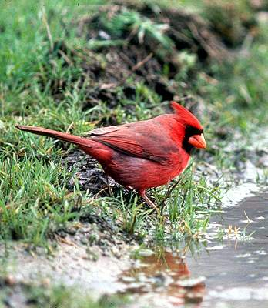
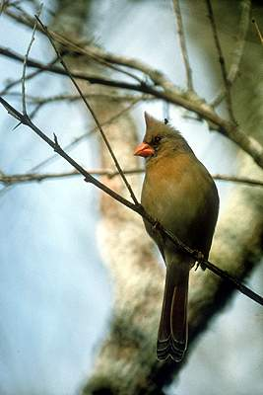
IMS Photo
IMS Photo

Slide 56
American Robin Turdus migratorius
Its red breast easily identifies the American robin.
This is a familiar winter bird of Texas.
When on the ground, it can hop, walk, or run in search of earthworms.

Slide 57
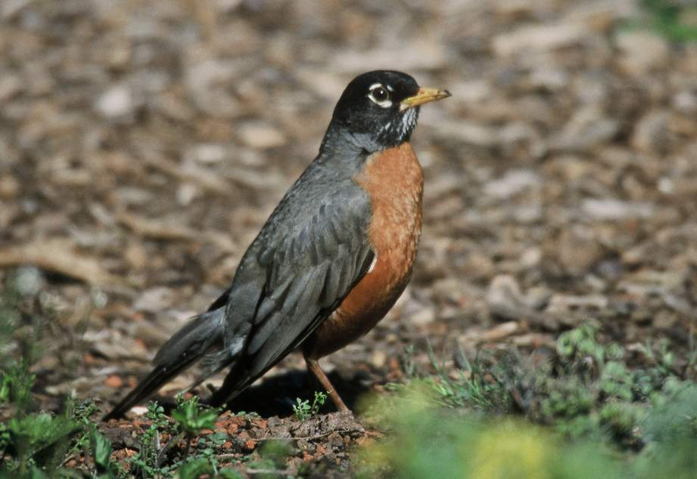
Photo by Lee Karney courtesy of U. S. Fish and Wildlife Service.

Slide 58
Thank you

