Slide 1

Introduction to ML
Content:
- Machine Learning (ML) is a subset of artificial intelligence that focuses on developing algorithms and statistical models to enable computers to learn from and make predictions or decisions without explicit programming.
- ML uses data to train and improve algorithms, allowing computers to automatically learn patterns, make predictions, and perform tasks.
- ML is used in various fields such as finance, healthcare, marketing, and cybersecurity, to solve complex problems and improve decision-making.

Slide 2

History of ML
Content:
- The concept of ML dates back to the 1950s when early pioneers proposed the idea of computers learning from data.
- In the 1960s and 1970s, researchers developed statistical models for ML, such as linear regression and decision trees.
- The 1980s and 1990s saw advancements in neural networks and the rise of ML algorithms like support vector machines.
- In recent years, with the availability of big data and advancements in computing power, ML has witnessed significant growth and applications in various industries.

Slide 3
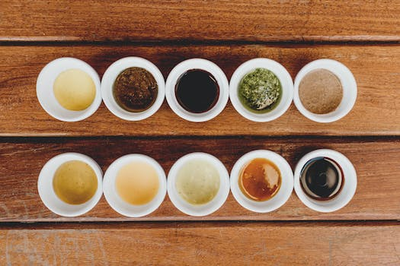
Types of ML
Content:
- Supervised Learning: In this type, the system is provided with labeled training data and learns to predict or classify new data.
- Unsupervised Learning: Here, the system learns to find patterns or structures in data without any predefined labels.
- Reinforcement Learning: It involves training an agent to take actions in an environment to maximize rewards or minimize penalties.
- Deep Learning: A subset of ML, it uses neural networks with multiple layers to learn and extract features from complex data.

Slide 4

Real-life Examples
Content:
- Recommendation Systems: ML is used to personalize content recommendations on platforms like Netflix and Amazon.
- Fraud Detection: ML algorithms automatically detect fraudulent activities in banking and finance industries.
- Medical Diagnosis: ML models assist in diagnosing diseases and predicting treatment outcomes based on patient data.
- Autonomous Vehicles: ML enables self-driving cars to learn and make real-time decisions based on sensor inputs.

Slide 5

Benefits of ML
Content:
- Automation: ML automates repetitive tasks, freeing up time for employees to focus on higher-value activities.
- Improved Decision Making: ML provides insights from large amounts of data, helping businesses make informed decisions.
- Enhanced Personalization: ML allows for personalized recommendations, advertisements, and user experiences.
- Increased Efficiency: ML algorithms optimize processes, reducing time and cost involved in tasks.

Slide 6

Advantages of ML
Content:
- Ability to Handle Complex and Big Data: ML algorithms can efficiently process and analyze large datasets with high dimensionality.
- Adaptability and Flexibility: ML models can adapt to new data and changing circumstances, making them suitable for dynamic environments.
- Scalability: ML algorithms can scale to handle large amounts of data without a significant loss in performance.
- Continual Learning: ML models can improve over time by learning from new data, enabling continuous improvement.

Slide 7

Disadvantages of ML
Content:
- Data Dependence: ML models heavily rely on quality and quantity of data, which can be challenging to obtain.
- Lack of Transparency: Some ML models, like deep neural networks, can be black boxes, making it difficult to interpret their decision-making process.
- Ethical Concerns: ML can perpetuate biases or unfair practices if the training data itself reflects such biases.
- Overfitting and Underfitting: ML models may generalize poorly if they are too complex or simplistic, respectively.

Slide 8

Future of ML
Content:
- ML is expected to continue advancing and be integrated into more industries and aspects of our daily lives.
- Increased automation through ML can lead to significant efficiency gains and reduce human error.
- ML may enable the development of more sophisticated AI systems with capabilities for reasoning, planning, and natural language understanding.
- Ethical considerations, regulation, and responsible use of ML will be crucial in shaping the future of this technology.

Slide 9
Credits
Images provided by Pexels: https://www.pexels.com

