Slide 1
Kaggle Competition House Prices: Advanced Regression Techniques
Team Members
Karthik Karunanithi (802827527)
Bharath Krishnan (893429449)
Shankar Tiwari (803012350)
Gargi Mrunal Kulkarni (893210922)

Slide 2

Overview
Introduction
Dataset
Python SKLearn
Data preprocessing
Code Implementaion
Conclusion
References

Slide 3

Introduction
Kaggle Competition - “House Prices: Advanced Regression Techniques”
Dataset: Provided by Kaggle : Ames Housing Dataset
Data Mining Tool: Python scikit library.
Analysis & Prediction: Prediction of the sale price of the houses
Algorithms: LASSO, Ridge, Random forest, XgBoost
Notes:
Our idea is around someone who doesn’t know what specific pc configuration they want but knows what they want to use the computer for.
3 different types of uses: Gaming, home and office
We would prompt the user with certain questions (which are the rules!) and based on the input, we would create a new set of facts. Based on the new facts it would new rules would be fired and eventually we would come up with a configuration for the user. This configuration is based on our own knowledge of computers and what we think would best fit their needs.

Slide 4

Python SKLearn
Scikit-learn is known as Machine Learning in Python with following features:
Simple and efficient tools for data mining and data analysis
Accessible to everybody, and reusable in various contexts
Built on NumPy, SciPy, and matplotlib
Open source, commercially usable - BSD license

Slide 5
Data Pre-Processing
Handling Categorical Features
df = pd.get_dummies(all_df)
Handling Missing Values
df.isnull().sum().sort_values(ascending=False)
df = df.fillna( df.mean())

Slide 6
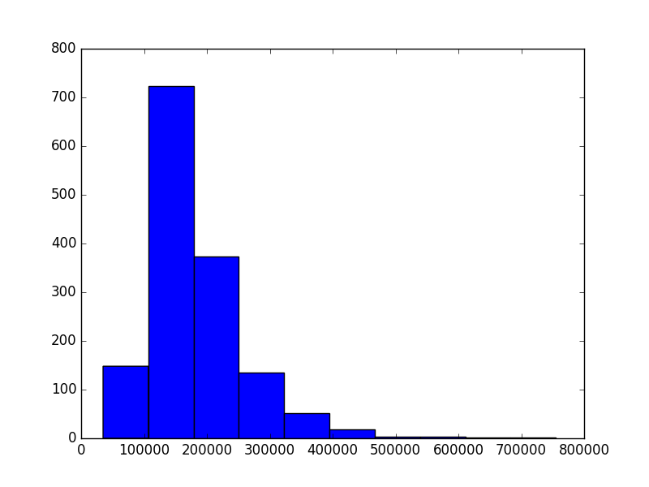
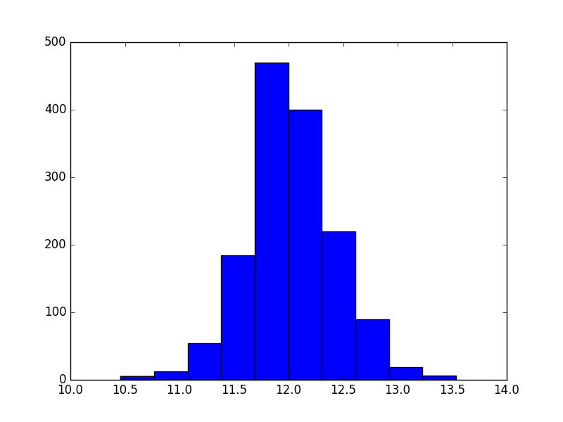
Handle Skewed distribution and Normalization

Slide 7


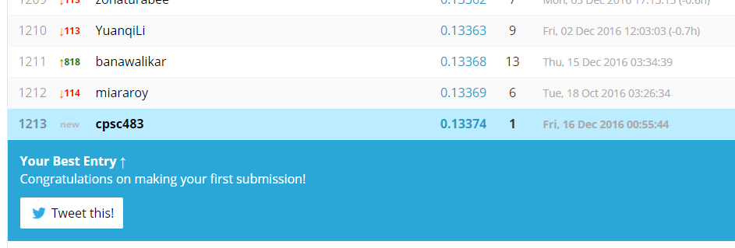
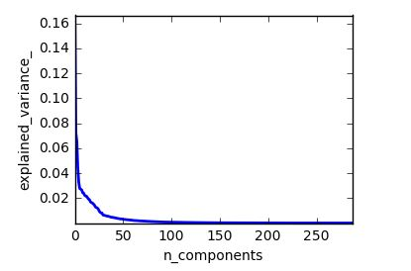



PCA+ Lasso

Slide 8
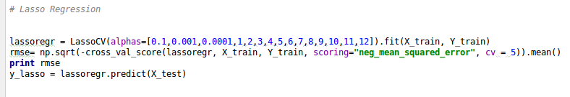
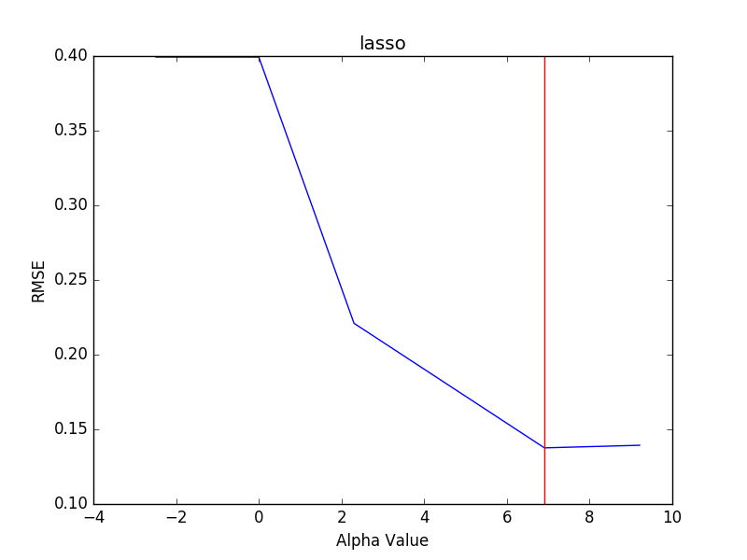
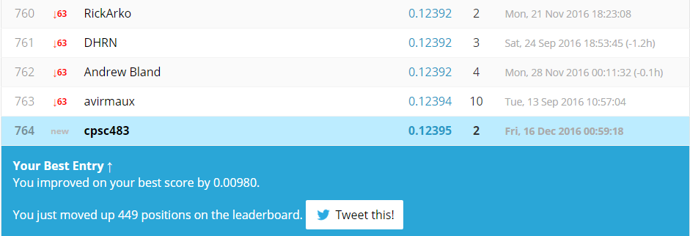
LASSO Regression
least absolute shrinkage and selection operator
variable selection and regularization
enhance the prediction accuracy and interpretability

Slide 9
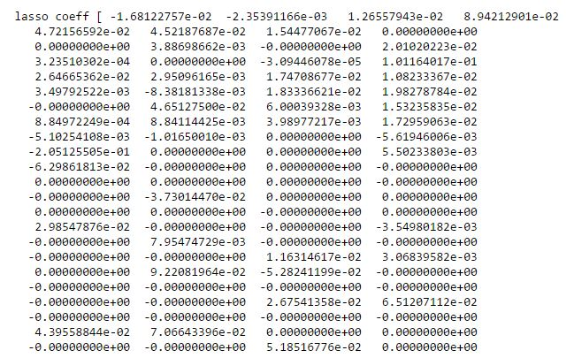
LASSO Coefficients
RMSE- 0.13753644007

Slide 10
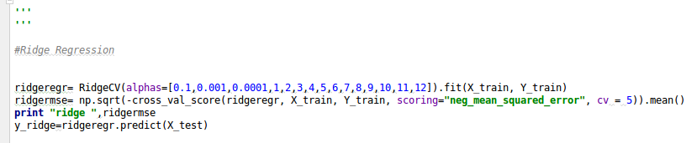
Ridge Regression
Similar to LASSO
Variable selection and regularization
RMSE - 0.139439225524

Slide 11
Xgboost
open-source software library
Scalable, Portable and Distributed Gradient Boosting (GBM, GBRT, GBDT) Library
highly efficient, flexible and portable
provides a parallel tree boosting

Slide 12
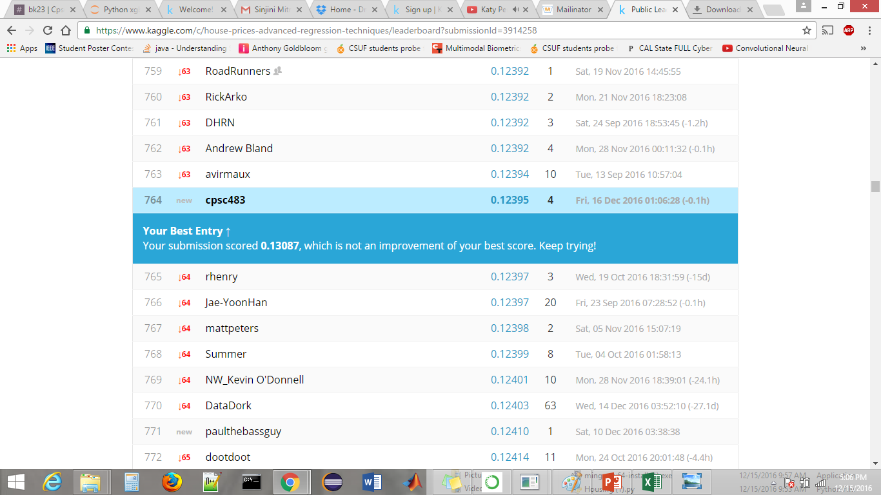
Random Forest Regression
ensemble learning method
classification, regression and other tasks, that operate by constructing a multitude of decision trees
Random decision forests correct for decision trees' habit of overfitting to their training set.

Slide 13
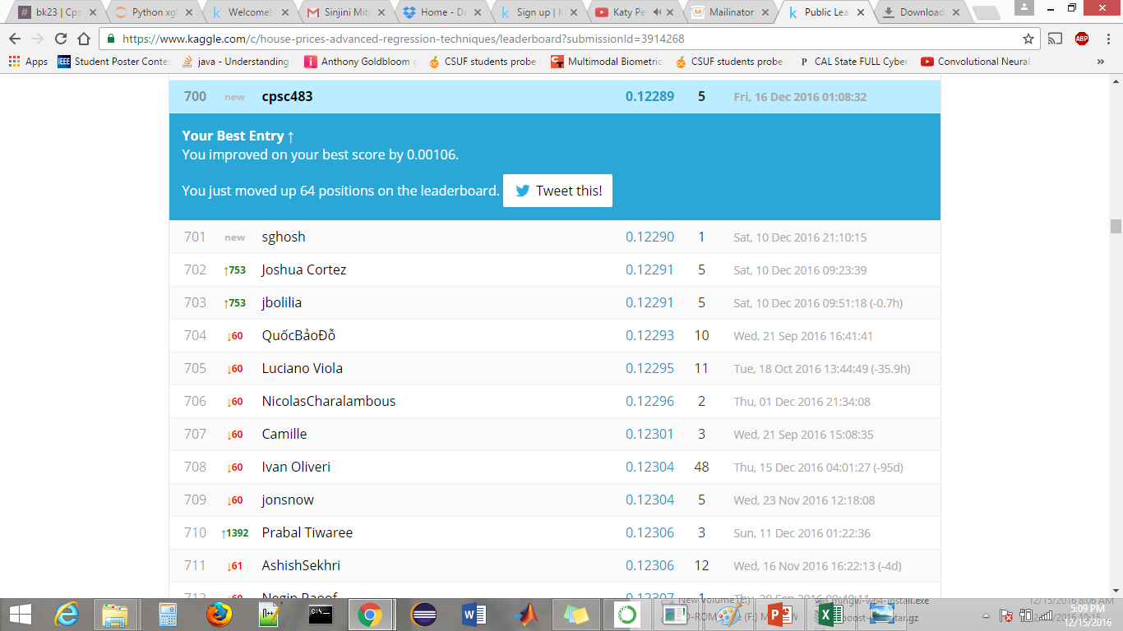
XGB + LASSO

Slide 14
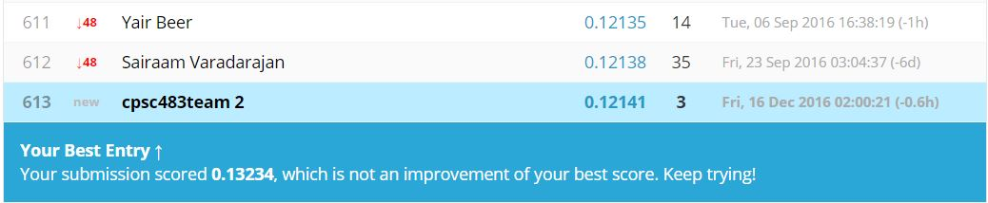
XGB + lasso + ridge

Slide 15
CODE
https://drive.google.com/drive/folders/0B0IPQ7Vp-_rwVmZRcTJhVGY1WmM

Slide 16

LASSO it is…
Lasso contributed much to the ranking
And so did XGBOOST + Lasso + Ridge Combination

Slide 17
References
Python SKLearn: http://scikit-learn.org/stable/index.html
Wikipedia: https://www.wikipedia.org/
Kaggle: https://www.kaggle.com/c/house-prices-advanced-regression-techniques
http://xgboost.readthedocs.io/en/latest/parameter.html
https://www.kaggle.com/forums/f/15/kaggle-forum

Slide 18
Thank you!
KAGGLE IS SUPER COOL

