Slide 1
Processing Lab 02: Tone
Download Lab02.Tone from OneNote (your choice)
BlueJ: Processing.Lab02.Tone.BlueJ.zip
Eclipse: Processing.Lab02.Tone.Eclipse.zip
Download HowTo from OneNote
Follow the steps to get Lab02.Tone running
Learning objectives:
Introduction to Minim
Detect when mouse clicks on an object

Slide 2

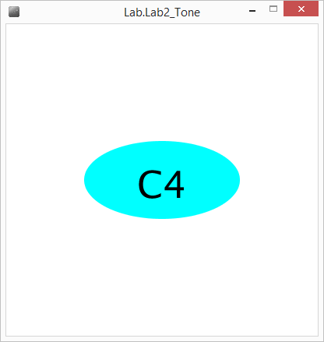
Minim
Audio Library for Java
http://code.compartmental.net/tools/minim/
Load & Play sound files (.WAV)
Generate notes
Press spacebar to play

Slide 3
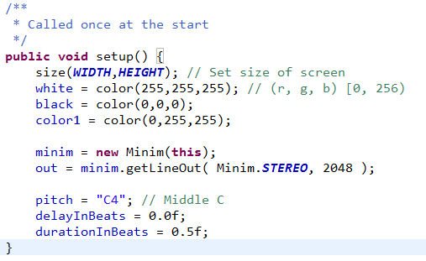
Code Overview: setup()
Minim object is created with a PApplet parameter.
Minim object then provides an AudioOutput object.
New Stuff

Slide 4
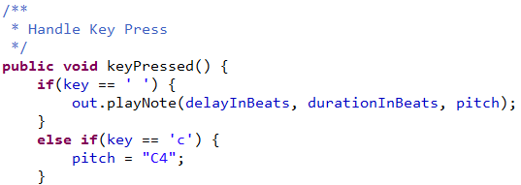
Code Overview: out.playNote(…)
out.playNote(float delay, float duration, String pitch)
Delay is the number of beats between when the playNote function is called and when the note begins playing. (Default is 0.0f) (Default beats per minute is 60)
Duration is the number of beats the note will be played. (Default is 1.0f)
Pitch is the note to play. Ex: "C4" Pitch ‘C’ and Register ‘4’

Slide 5
Lab02: Play Tone
Run the Lab02 application and press spacebar.
Open Tone.java
In keyPressed():
Allow a user to change the Pitch by pressing the ‘d’ key.
Allow users to modify the duration of the Note.
Allow users to modify the delay before playing the Note.
Notes:
Lab Time! 20min

