Slide 1
Lecture-11
Introduction to HTML

Slide 2
Content
HTML Drag and Drop API

Slide 3
In HTML, any element can be dragged and dropped.

Slide 4
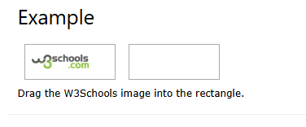
In HTML, any element can be dragged and dropped.

Slide 5
Drag and Drop
Drag and drop is a very common feature. It is when you "grab" an object and drag it to a different location.

Slide 6
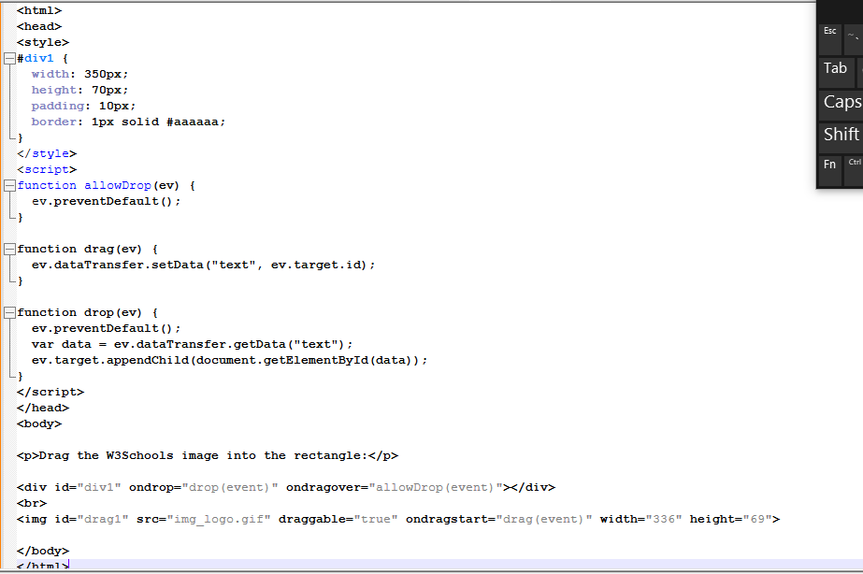

Slide 7
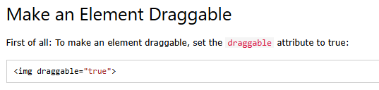

Slide 8
What to Drag - ondragstart and setData()
Then, specify what should happen when the element is dragged.
In the example above, the ondragstart attribute calls a function, drag(event), that specifies what data to be dragged.
The dataTransfer.setData() method sets the data type and the value of the dragged data:

Slide 9


Slide 10
Where to Drop - ondragover
The ondragover event specifies where the dragged data can be dropped.
By default, data/elements cannot be dropped in other elements. To allow a drop, we must prevent the default handling of the element.
This is done by calling the event.preventDefault() method for the ondragover event:

Slide 11


Slide 12
Do the Drop - ondrop
When the dragged data is dropped, a drop event occurs.
In the example above, the ondrop attribute calls a function, drop(event):

Slide 13
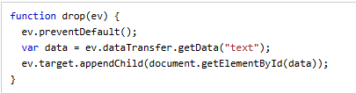

Slide 14
Code explained:
Call preventDefault() to prevent the browser default handling of the data (default is open as link on drop)
Get the dragged data with the dataTransfer.getData() method. This method will return any data that was set to the same type in the setData() method
The dragged data is the id of the dragged element ("drag1")
Append the dragged element into the drop element

Slide 15


