Slide 1
Lecture-12
Introduction to HTML

Slide 2
Content
HTML Geolocation API

Slide 3
Locate the User's Position
The HTML Geolocation API is used to get the geographical position of a user.
.

Slide 4
Using HTML Geolocation
The getCurrentPosition() method is used to return the user's position.
The example below returns the latitude and longitude of the user's position

Slide 5
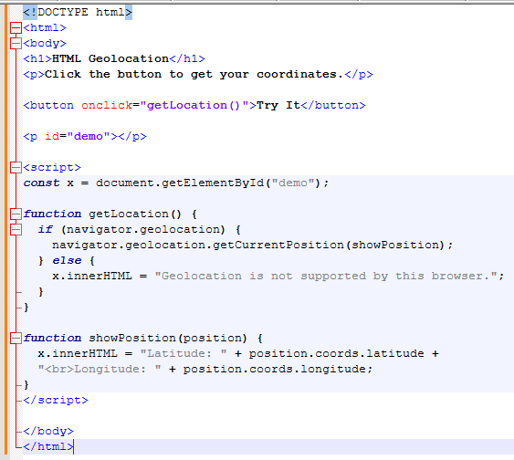

Slide 6


