Slide 1
Lecture-13
Introduction to HTML

Slide 2
Content
HTML Multimedia
Multimedia on the web is sound, music, videos, movies, and animations.

Slide 3
What is Multimedia?
Multimedia comes in many different formats. It can be almost anything you can hear or see, like images, music, sound, videos, records, films, animations, and more.
Web pages often contain multimedia elements of different types and formats.

Slide 4
HTML Audio
The HTML <audio> element is used to play an audio file on a web page.
The HTML <audio> Element
To play an audio file in HTML, use the <audio> element:

Slide 5
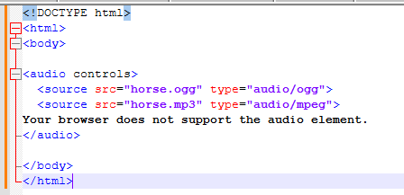

Slide 6
HTML <audio> Autoplay
To start an audio file automatically, use the autoplay attribute:

Slide 7
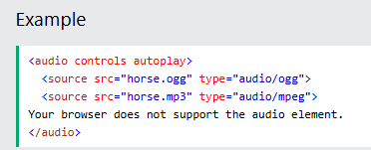

Slide 8


