Slide 1
Lecture-14
Introduction to HTML

Slide 2
Content
CSS Selectors
CSS id Selector
CSS class Selector

Slide 3
CSS Selectors
CSS selectors are used to "find" (or select) the HTML elements you want to style.

Slide 4
The CSS element Selector
The element selector selects HTML elements based on the element name.

Slide 5
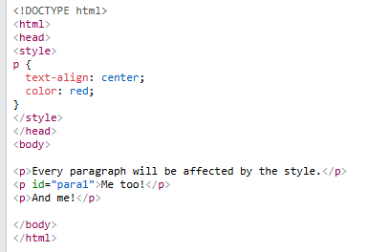

Slide 6
The CSS id Selector
The id selector uses the id attribute of an HTML element to select a specific element.
The id of an element is unique within a page, so the id selector is used to select one unique element!
To select an element with a specific id, write a hash (#) character, followed by the id of the element.

Slide 7
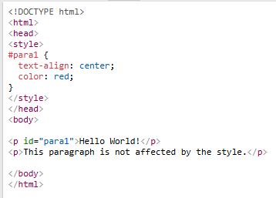


Slide 8
The CSS class Selector
The class selector selects HTML elements with a specific class attribute.
To select elements with a specific class, write a period (.) character, followed by the class name.

Slide 9
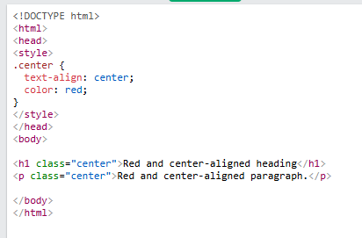

Slide 10
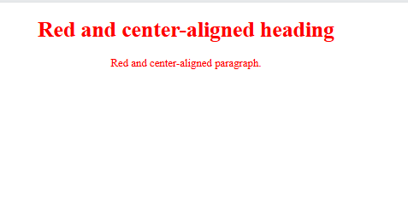

Slide 11
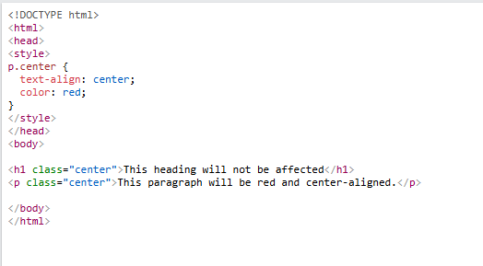
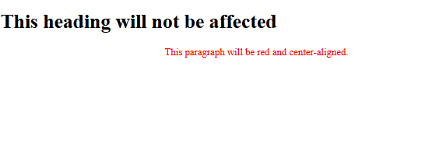
In this example only <p> elements with class="center" will be red and center-aligned:

Slide 12
The CSS Universal Selector
The universal selector (*) selects all HTML elements on the page.

Slide 13
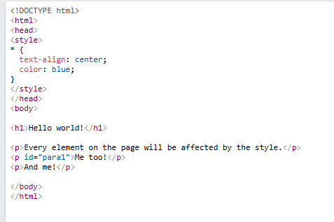

Slide 14
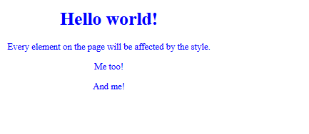

Slide 15
The CSS Grouping Selector
The grouping selector selects all the HTML elements with the same style definitions.
Look at the following CSS code (the h1, h2, and p elements have the same style definitions):

Slide 16
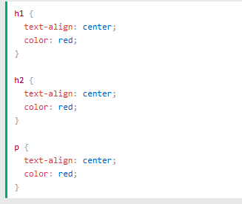

Slide 17


Slide 18


