Slide 1
Lecture-15
Introduction to HTML

Slide 2
Content
CSS Lists

Slide 3
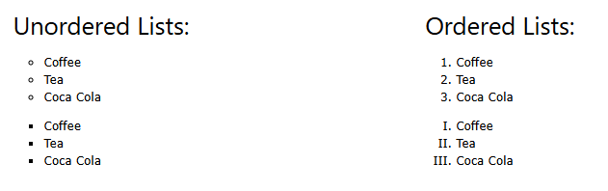

Slide 4
HTML Lists and CSS List Properties
In HTML, there are two main types of lists:
unordered lists (<ul>) - the list items are marked with bullets
ordered lists (<ol>) - the list items are marked with numbers or letters

Slide 5
The CSS list properties allow you to:
Set different list item markers for ordered lists
Set different list item markers for unordered lists
Set an image as the list item marker
Add background colors to lists and list items

Slide 6
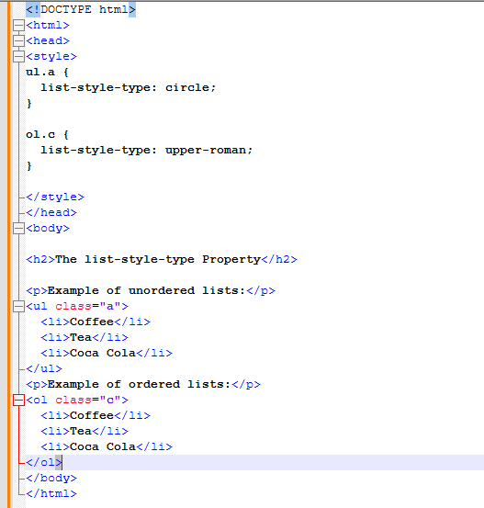

Slide 7
An Image as The List Item Marker
The list-style-image property specifies an image as the list item marker:

Slide 8
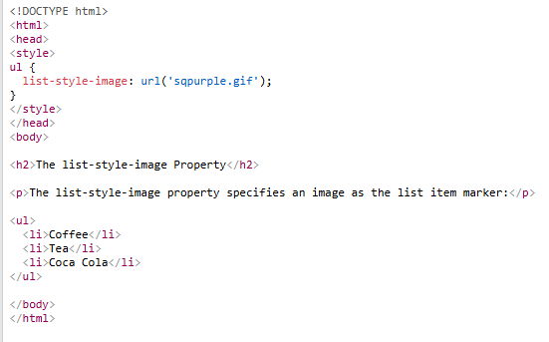
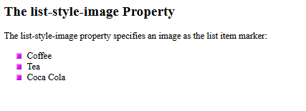

Slide 9
Styling List With Colors
We can also style lists with colors, to make them look a little more interesting.
Anything added to the <ol> or <ul> tag, affects the entire list, while properties added to the <li> tag will affect the individual list items:

Slide 10
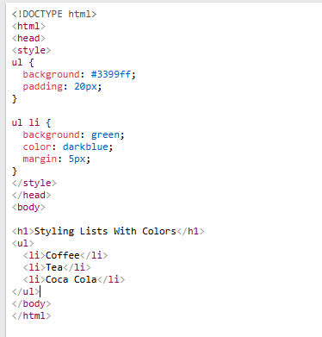

Slide 11
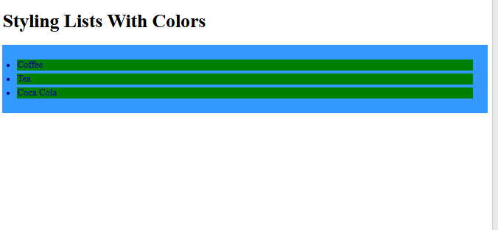

Slide 12


