Slide 1
Lecture-17
Introduction to HTML

Slide 2
Content
What is HTML Web Storage?
window.localStorage
window.sessionStorage

Slide 3
What is HTML Web Storage?
With web storage, web applications can store data locally within the user's browser.
Before HTML5, application data had to be stored in cookies, included in every server request. Web storage is more secure, and large amounts of data can be stored locally, without affecting website performance.
Unlike cookies, the storage limit is far larger (at least 5MB) and information is never transferred to the server.
Web storage is per origin (per domain and protocol). All pages, from one origin, can store and access the same data.

Slide 4
HTML Web Storage Objects
HTML web storage provides two objects for storing data on the client:
window.localStorage - stores data with no expiration date
window.sessionStorage - stores data for one session (data is lost when the browser tab is closed)

Slide 5
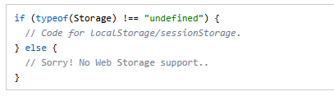

Slide 6
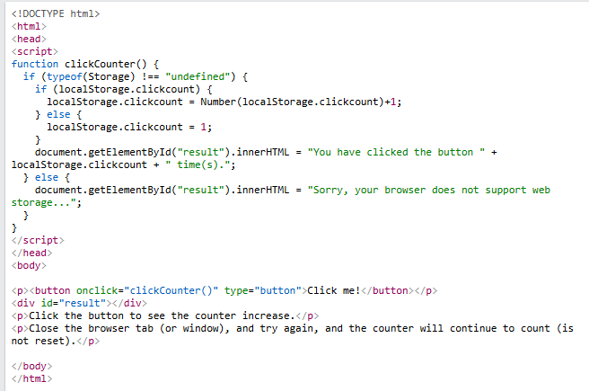

Slide 7
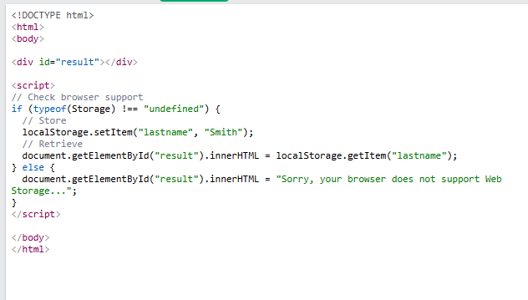

Slide 8
The sessionStorage Object
The sessionStorage object is equal to the localStorage object, except that it stores the data for only one session.
The data is deleted when the user closes the specific browser tab.
The following example counts the number of times a user has clicked a button, in the current session:

Slide 9
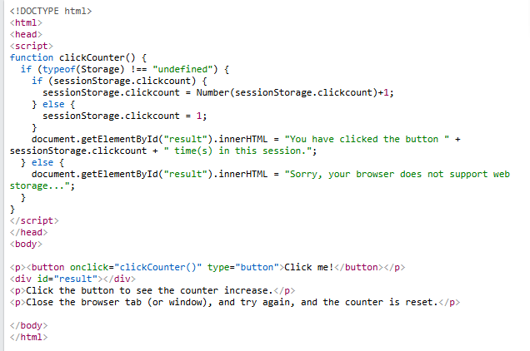

Slide 10


