Slide 1
Lecture-18
Introduction to HTML

Slide 2
Content
HTML Web Workers API

Slide 3
What is HTML Web Storage?
With web storage, web applications can store data locally within the user's browser.
A web worker is a JavaScript running in the background, without affecting the performance of the page.

Slide 4
What is a Web Worker?
When executing scripts in an HTML page, the page becomes unresponsive until the script is finished.
A web worker is a JavaScript that runs in the background, independently of other scripts, without affecting the performance of the page.
You can continue to do whatever you want: clicking, selecting things, etc., while the web worker runs in the background.

Slide 5
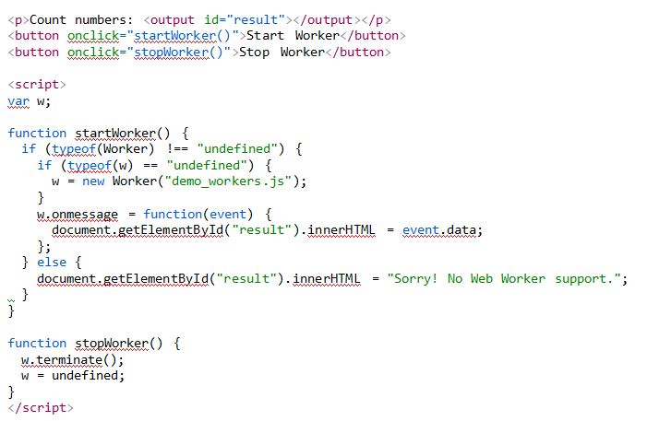

Slide 6
Create a Web Worker Object
Now that we have the web worker file, we need to call it from an HTML page.
The following lines checks if the worker already exists, if not - it creates a new web worker object and runs the code in "demo_workers.js":

Slide 7
Create a Web Worker File
Now, let's create our web worker in an external JavaScript.
Here, we create a script that counts. The script is stored in the "demo_workers.js" file:

Slide 8
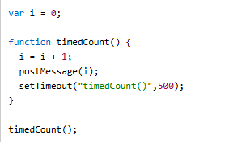
The important part of the code above is the postMessage() method - which is used to post a message back to the HTML page.

Slide 9


Slide 10
Then we can send and receive messages from the web worker.
Add an "onmessage" event listener to the web worker.

Slide 11


Slide 12
Terminate a Web Worker
When a web worker object is created, it will continue to listen for messages (even after the external script is finished) until it is terminated.
To terminate a web worker, and free browser/computer resources, use the terminate() method:
w.terminate();

Slide 13
Reuse the Web Worker
If you set the worker variable to undefined, after it has been terminated, you can reuse the code:
w = undefined;

Slide 14
HTML Plug-ins
Plug-ins are computer programs that extend the standard functionality of the browser.
Plug-ins
Plug-ins were designed to be used for many different purposes:
To run Java applets
To run Microsoft ActiveX controls
To display Flash movies
To display maps
To scan for viruses
To verify a bank id

Slide 15
The <object> Element
The <object> element is supported by all browsers.
The <object> element defines an embedded object within an HTML document.
It was designed to embed plug-ins (like Java applets, PDF readers, and Flash Players) in web pages, but can also be used to include HTML in HTML:

Slide 17


