Slide 1
Lecture-20
Introduction to HTML

Slide 2
Content
CSS Layout – float
Align

Slide 3
CSS Layout - float
The CSS float property specifies how an element should float.
The CSS clear property specifies what elements can float beside the cleared element and on which side.

Slide 4
The float Property
The float property is used for positioning and formatting content e.g. let an image float left to the text in a container.
The float property can have one of the following values:
left - The element floats to the left of its container
right - The element floats to the right of its container
none - The element does not float (will be displayed just where it occurs in the text). This is default
inherit - The element inherits the float value of its parent
In its simplest use, the float property can be used to wrap text around images.

Slide 5
Example - float: right;
The following example specifies that an image should float to the right in a text:

Slide 6
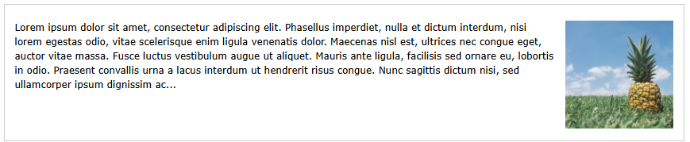

Slide 7
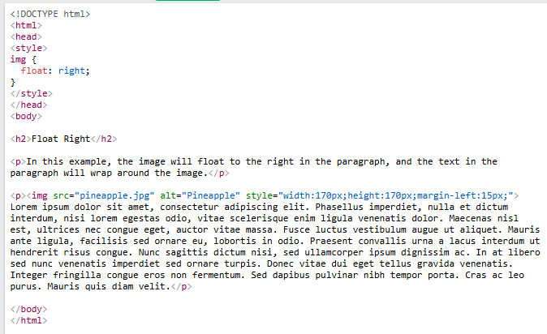

Slide 8
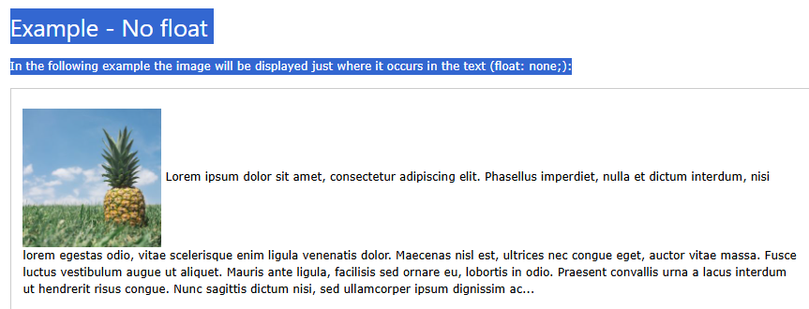

Slide 9
Float Next To Each Other
Normally div elements will be displayed on top of each other. However, if we use float: left we can let elements float next to each other:

Slide 10
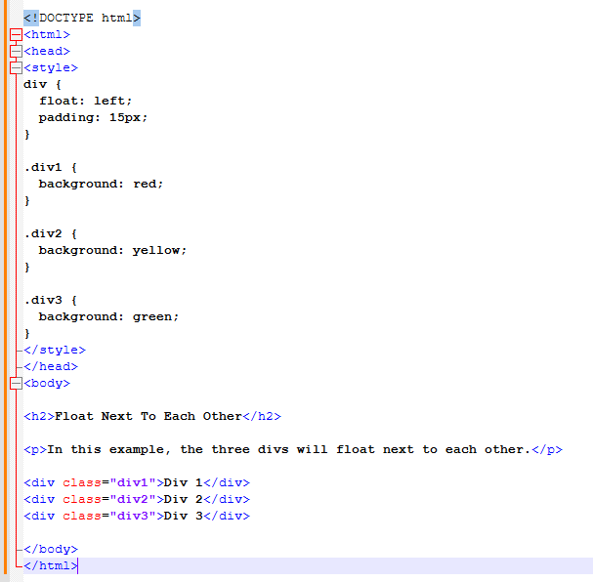

Slide 11
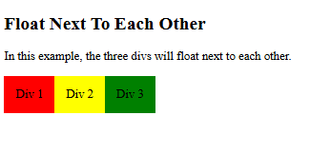

Slide 12
CSS Layout - Horizontal & Vertical Align
Center Align Elements
To horizontally center a block element (like <div>), use margin: auto;
Setting the width of the element will prevent it from stretching out to the edges of its container.

Slide 13
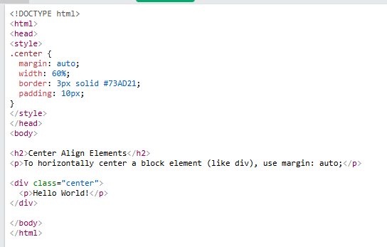

Slide 14
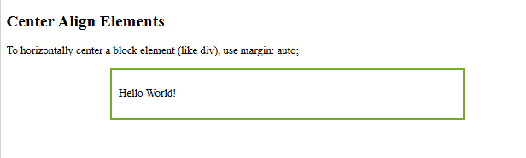

Slide 15
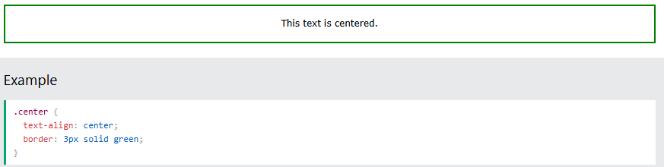
Center Align Text To just center the text inside an element, use text-align: center;

Slide 16
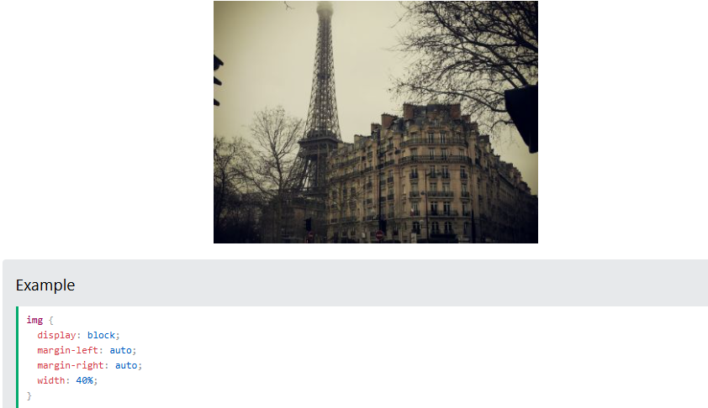
Center an Image To center an image, set left and right margin to auto and make it into a block element:

Slide 17
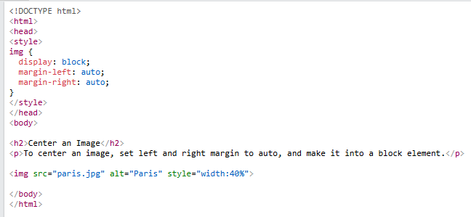

Slide 18


